Slide 1
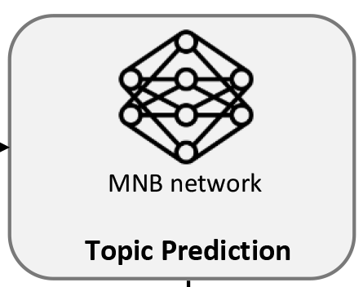
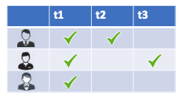

Featured topics recommended by MNBN
Topics recommended by TopFilter
TopFilter
MNB Network
GitHub repository
Combined topics

