Slide 1
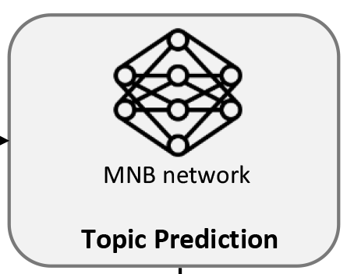
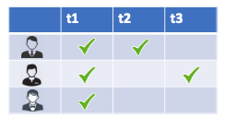

Featured topics
TopFilter-α
TopFilter-α topics
MNB network
GitHub repository
Mixed topics

