Slide 1
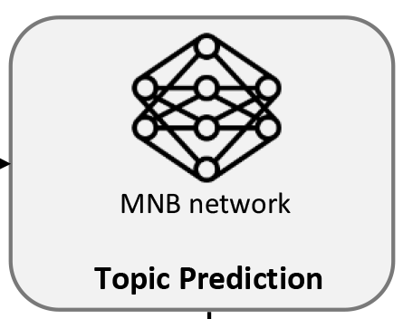
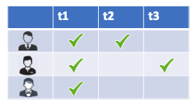

Featured topics
CTop
CTop topics
MNB network
GitHub repository
Mixed topics

