Slide 1
IEEE 1471-2000
A Metamodel Example
Albin Jossic (albin.jossic@gmail.com)
ATLAS group (INRIA & LINA), University of Nantes, France
http://www.sciences.univ-nantes.fr/lina/atl/

Slide 2
Generalities about IEEE 1471-2000
It is a standard define bye IEEE commitee, 21 september 2000.
It precises the recommended practice for the design and the analysis of Architecture of Software Intensive Systems.
This metamodel is an interpretation in km3 of class diagrams give in official papers.

Slide 3
Concepts in IEEE 1471-2000 (1/2)
A System is a set of components organized to do some specific functions. A system has an architecture in real world.
An Architectural Description is a set of documents that describing an architecture in particular models.
A Stakeholder defines a user class like owners, developers or maintainers of a system. It can be a single person, a team or an organization.

Slide 4
Concepts in IEEE 1471-2000 (2/2)
A Concern represents the interest of a stakeholder about a part of a system lifecycle like the development and the operation or about a property like distribution or security of a system.
View is a representation of a whole system from the perspective of a related set of concerns. A view conforms to one and only one viewpoint.
Viewpoint is a specification to define a view about an architecture.

Slide 5
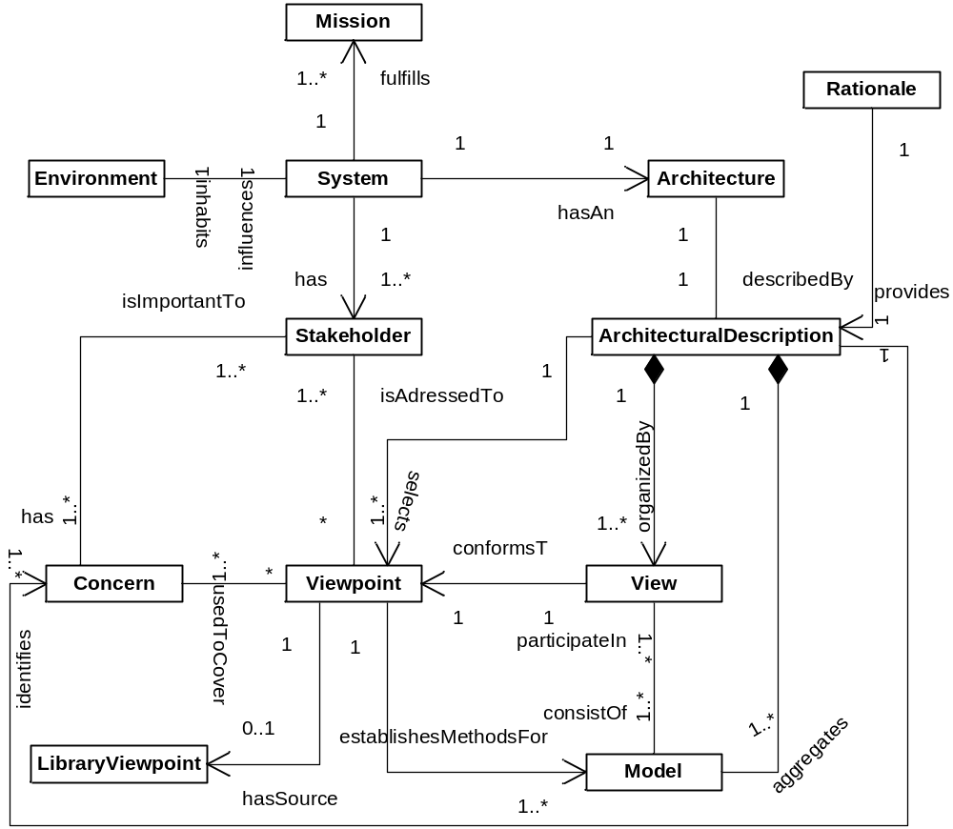
A Simplified Metamodel: Conceptual Model

Slide 6
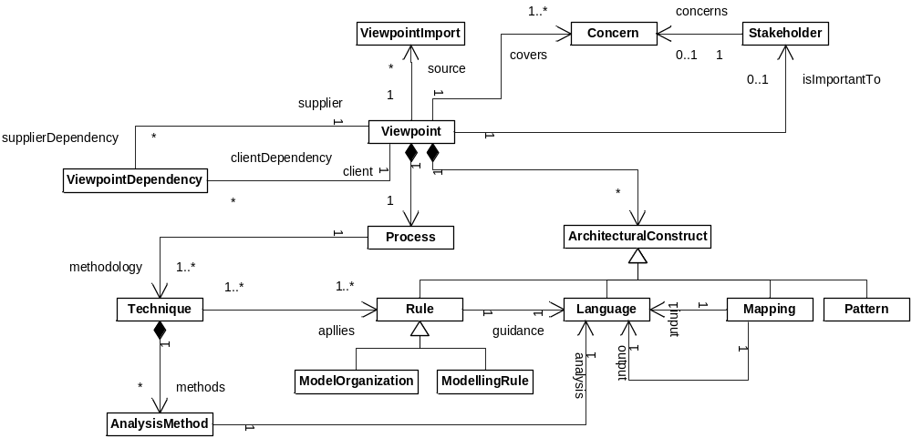
A Simplified Metamodel: Based Viewpoint Metamodel

Slide 7
End of the presentation
Sources
  IEEE Std 1471-2000, Recommended Practice for Architectural Description of Software-Intensive Systems, IEEE Computer Society, 21 September 2000.
  http://www.item.ntnu.no/fag/ttm4160/Artikler/ieee1471.pdf
  KM3 Manual: http://www.eclipse.org/gmt/atl/doc/KernelMetaMetaModel%5Bv00.06%5D.pdf
AMMA@lina.univ-nantes.fr
ATLAS group, INRIA & LINA, Nantes

