Slide 1
MoDAF AV
A Metamodel Example
Albin Jossic (albin.jossic@gmail.com)
ATLAS group (INRIA & LINA), University of Nantes, France
http://www.sciences.univ-nantes.fr/lina/atl/

Slide 2
Generalities about MoDAF
Ministry of Defense Architecture Framework
It used to describe an enterprise architecture.
It based on the DoDAF (US Department of Defense Architecture Framework). This framework has its origins in the C4ISR.
MoDAF use IEEE 1471-2000 terminology about Architectural Description.
This metamodel is an interpretation in km3 of class diagrams give in official papers.

Slide 3
Concepts in MoDAF (1/2)
A Enterprise is the same concept that System in the IEEE 1471 terminology. A Enterprise inhabits in a contextual Environment and fulfills Missions. A Enterprise has an architecture in real world
An Architectural Description is a set of documents that describing an architecture in particular models.
A Stakeholder defines a user class like owners, developers or maintainers of a system. It can be a single person, a team or an organization.

Slide 4
Concepts in MoDAF (2/2)
A Concern represents the interest of a stakeholder about a part of a system lifecycle like the development and the operation or about a property like distribution or security of a system.
Architectural Product (AP) is the same concept that View in IEEE 1471. AP is a representation of a whole system from the perspective of a related set of concerns. A AP conforms to one and only one View in MoDAF.
View is the same concept that Viewpoint in IEEE 1471. View is a specification to define a AP about an architecture.

Slide 5
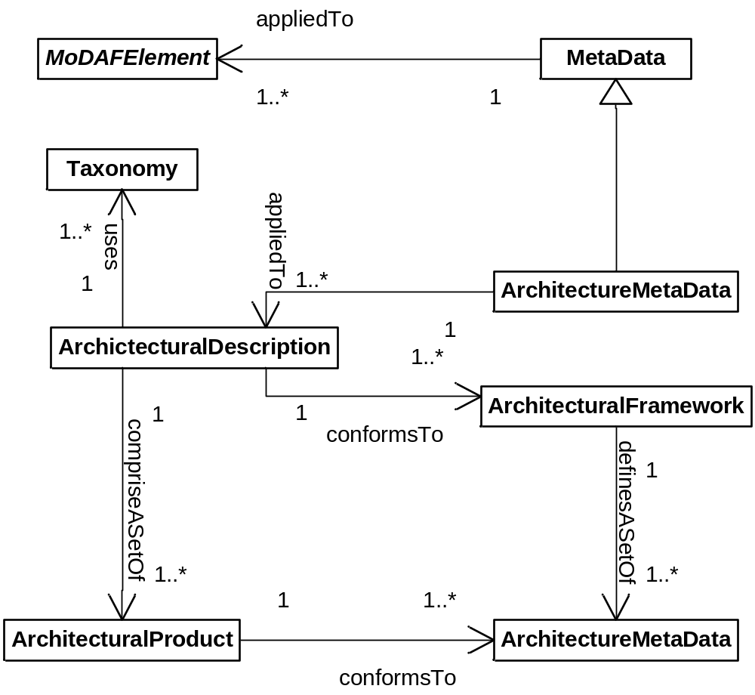
A Simplified Metamodel: MoDAF Overview

Slide 6
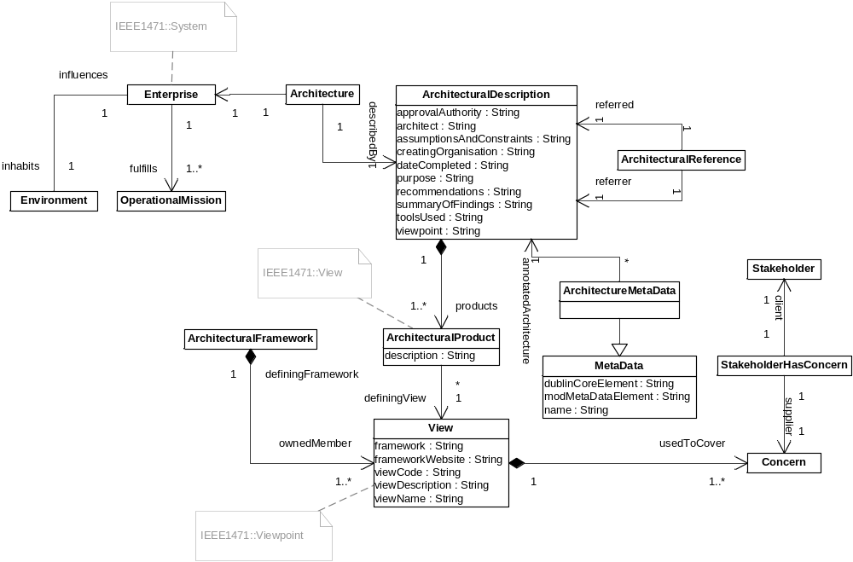
A Simplified Metamodel: MoDAF Architecture View

Slide 7
End of the presentation
Sources
  MoDAF official site:
  http://modaf.modelfutures.com/
  IEEE Std 1471-2000, Recommended Practice for Architectural Description of Software-Intensive Systems, IEEE Computer Society, 21 September 2000.
  http://www.item.ntnu.no/fag/ttm4160/Artikler/ieee1471.pdf
  KM3 Manual: http://www.eclipse.org/gmt/atl/doc/KernelMetaMetaModel%5Bv00.06%5D.pdf
AMMA@lina.univ-nantes.fr
ATLAS group, INRIA & LINA, Nantes

