Slide 1

Taps, Dies and Threads
Mater Dei Robotics

Slide 2
Agenda
Mater Dei Robotics
Thread Types
Taps and Dies
How to Use

Slide 3
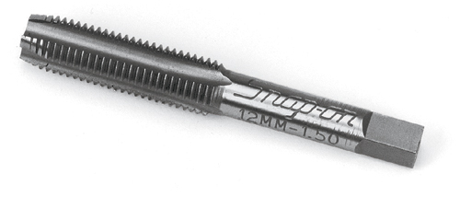
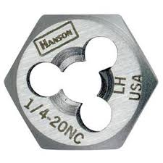

Thread Types
ISO Metric Screw Threads
Maa x bb
aa = Diameter in mm
bb = Thread Pitch in mm
Unified Screw Threads
Coarse or Fine
Bolt Diameter and Threads per inch
¼-20 (UNC)
¼-28 (UNF)

Slide 4
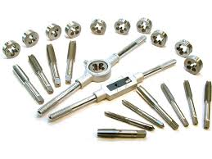
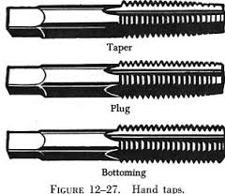
Taps and Dies
Taps used to thread holes.
Dies used to thread rods.

Slide 5
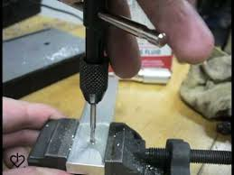
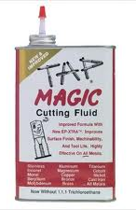
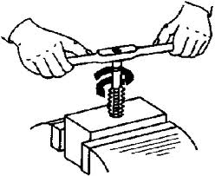
How to Use
Apply a few drops of cutting fluid on tap and hole.
Insert tap lightly into hole, perpendicular to part.
Lightly rotate tap in clockwise/counterclockwise direction.
Continue until desired depth is tapped.

