Slide 1
FIRST Robotics
Drive Trains
Dale Yocum
Robotics Program Director
Catlin Gabel School

Slide 2
Overview
Traction overview
Review popular drive trains
  2 wheel
  4 wheel
  6 wheel
  Mecanum
  Treads
Transmissions
  Innovation FIRST
  AndyMark
  BaneBots
Wheels
  Innovation FIRST
  AndyMark
  Skyway
Final Tips

Slide 3
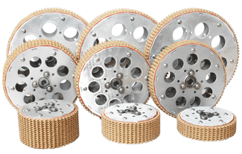
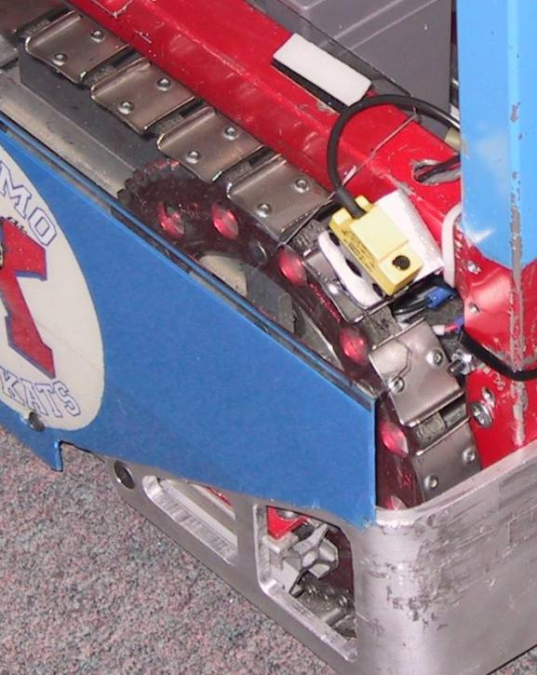
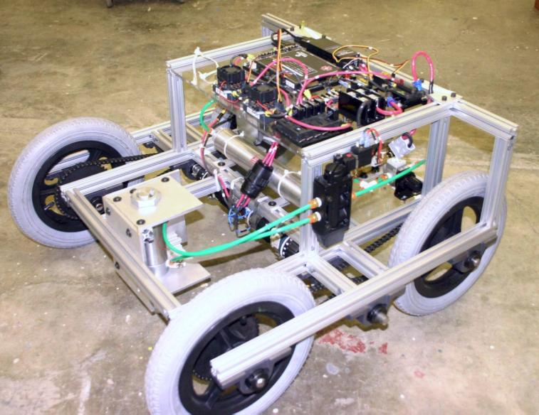
Coefficient of Friction
Material of robot wheels
    Soft “sticky” materials have higher COF
    Hard, smooth, shiny materials have lower COF
Shape of robot wheels
Want wheel to interlock with surface for high COF
Surface Material and condition
Always test on carpet
But not this way!

Slide 4
Traction Basics
Terminology
maximum
tractive
force
Coefficient
of friction
x
Normal Force
(Weight)
torque
turning the
wheel
=
weight
tractive
force
normal
force
The coefficient of friction for any given contact with the floor, multiplied by the normal force, equals the maximum tractive force can be applied at the contact area.
Source: Paul Copioli, Ford Motor Company, #217

Slide 5
Traction Fundamentals
“Normal Force”
weight
front
normal
force
(rear)
normal
force
(front)
The normal force is the force that the wheels exert on the floor, and is equal and opposite to the force the floor exerts on the wheels. In the simplest case, this is dependent on the weight of the robot. The normal force is divided among the robot features in contact with the ground.
Source: Paul Copioli, Ford Motor Company, #217

Slide 6
Traction Fundamentals
“Weight Distribution”
more weight in back
due to battery and
motors
less weight in front
due to fewer parts
in this area
EXAMPLE
ONLY
front
more
normal
force
less
normal
force
The weight of the robot is not equally distributed among all the contacts with the floor. Weight distribution is dependent on where the parts are in the robot. This affects the normal force at each wheel.
Source: Paul Copioli, Ford Motor Company, #217

Slide 7
Weight Distribution is Not Constant
arm position in
rear makes the weight
shift to the rear
arm position in front
makes the weight
shift to the front
EXAMPLE
ONLY
front
normal
force
(rear)
normal
force (front)
Source: Paul Copioli, Ford Motor Company, #217

Slide 8
How Fast?
Under 4 ft/s – Slow. Great pushing power if enough traction.
  No need to go slower than the point that the wheels loose traction
5-7 ft/s – Medium speed and power. Typical of a single speed FRC robot
8-12 ft/s – Fast. Low pushing force
Over 13ft/sec – Crazy. Hard to control, blazingly fast, no pushing power.
Remember, many motors draw 60A+ at stall but our breakers trip at 40A!

Slide 9

Base Choices
Everything is a compromise

Slide 10
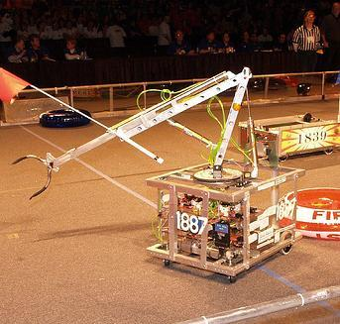
Two Wheels - Casters
Pros:
  Simple
  Light
  Turns easily
  Cheap
Cons:
  Easily pushed
  Driving less predictable
  Limited traction
    Some weight will always be over non-drive wheels
    If robot is lifted or tipped even less dive wheel surface makes contact.

Slide 11
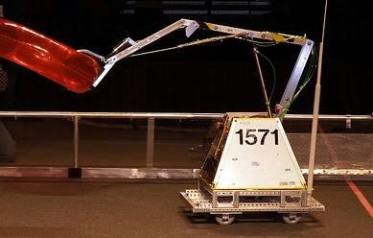
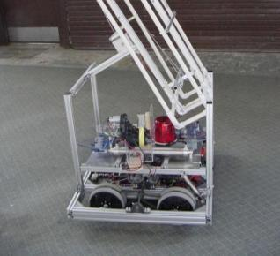
4 Standard Wheels
Pros:
  Simpler than 6 wheel
  Lighter than 6 wheels
  Cheaper than 6 wheels
  All weight supported by drive wheels
  Resistant to being pushed
Cons
  Turning! (keep wheel base short)
  Can high center during climbs
    Bigger wheels = higher COG

Slide 12
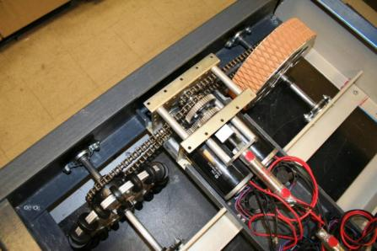
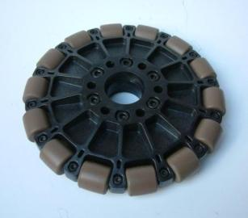
4 Wheels With Omni Wheels
Pros:
  Same as basic four wheel
  Turns like a dream but not around the robot center
Cons:
  Vulnerable to being pushed on the side
  Traction may not be as high as 4 standard wheels
  Can still high center = bigger wheels

Slide 13
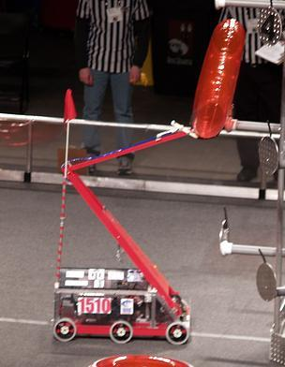
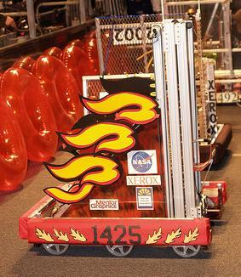
6 Wheels
Pros:
  Great traction under most circumstances
  Smaller wheels
    Smaller sprockets = weight savings
  Turns around robot center
  Can’t be easily high centered
  Resistant to being pushed
Cons:
  Weight
  More complex chain paths
    Chain tensioning can be fun
  More expensive
Note: Center wheel often lowered about 3/16”

Slide 14
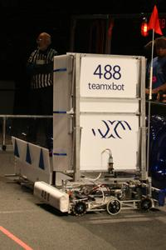
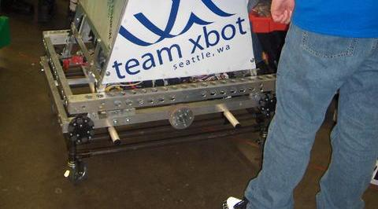
Xbot’s Six Wheel Variants

Slide 15
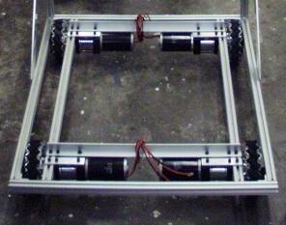
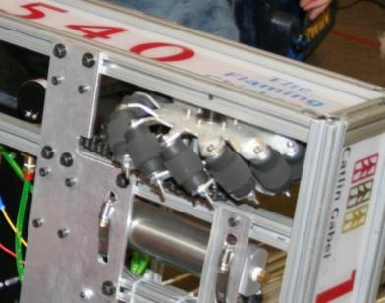
Mecanum
Pros:
  Highly maneuverable
    Might reduce complexity elsewhere in robot
  Simple Chain Paths (or no chain)
  Redundancy
  Turns around robot center
Cons:
  Lower traction
  Can high center
  Not great for climbing or pushing
  Software complexity
  Drift dependant on weight distribution
  Shifting transmissions impractical
  Autonomous challenging
  More driver practice necessary
  Expensive

Slide 16
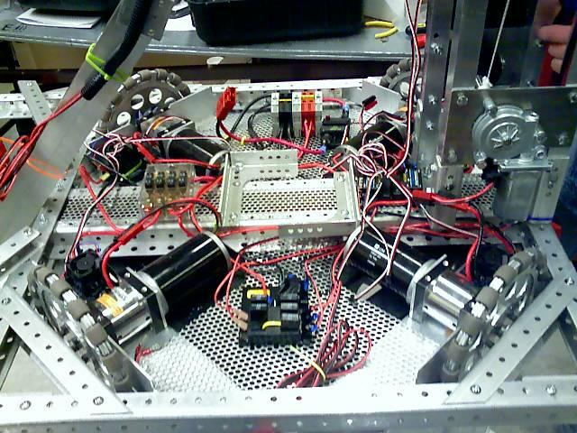
Holonomic Drive
2047’s 2007 Robot

Slide 17
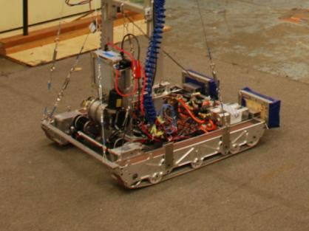
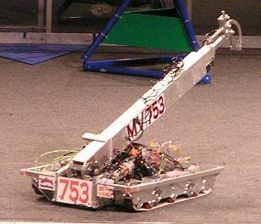
Treads
Pros:
  Great traction
  Turns around robot center
  Super at climbing
  Resistant to being pushed
  Looks awesome!
Cons
  Not as energy efficient
  High mechanical complexity
  Difficult for student-built teams to make
    Needs a machine shop or buy them
  Turns can tear the tread off and/or stall motors
997

Slide 18
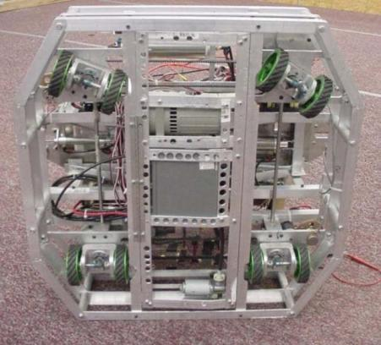
Swerve/Crab
Wheels steer independently or as a set
More traction than Mecanum
Mechanically Complex!
Adds weight
  Don’t try this at home!

Slide 19
Transmissions

Slide 20
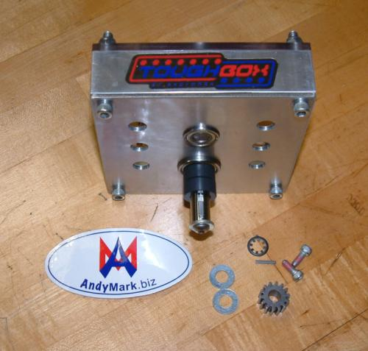
AndyMark Toughbox
Came in last year’s kit
12.75:1 Ratio
Options for 6:1 and 8.5:1
Long shaft option
2.5 lbs
One or two CIMs
$98

Slide 21
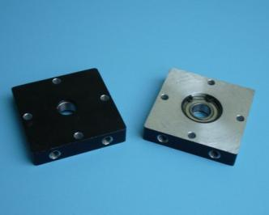
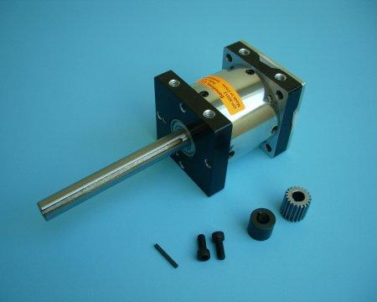
BaneBots
Many gear ratios 3:1- 256:1
Long shaft options
$107
2.5 lbs
Don’t drive to the limit!
Avoid dual CIMs
Order Early!

Slide 22
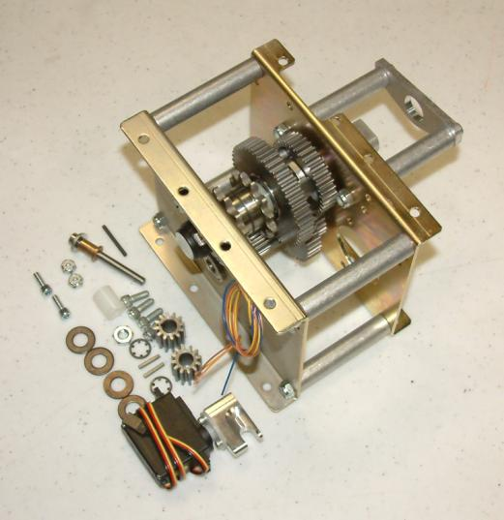
AndyMark Gen 2 Shifter
11:1 & 4:1 Ratios
3.6 lbs
One or two CIMs
Servo or pneumatic shifting
Two chain paths
Encoder included
$350

Slide 23
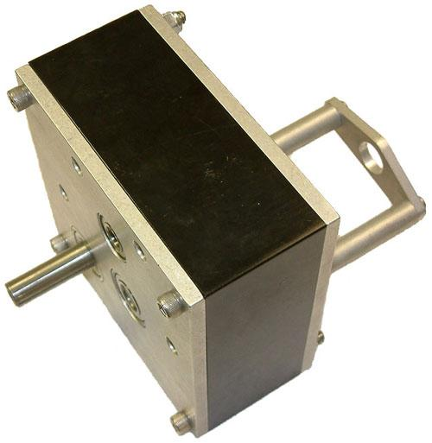
AndyMark SuperShifter
24:1 & 9:1 standard ratios + options
Made for direct drive of wheels
4.6 lbs
One or two CIMs
Servo or pneumatic shifting
Direct Drive Shaft
Includes encoder
$360

Slide 24
Wheels

Slide 25
Wheels are a Compromise
(Like everything else)
Coefficient of friction
  You can have too much traction!
Weight
Diameter
  Bigger equals better climbing and grip but also potentially higher center of gravity, weight, and larger sprockets.
Forward vs lateral friction

Slide 26
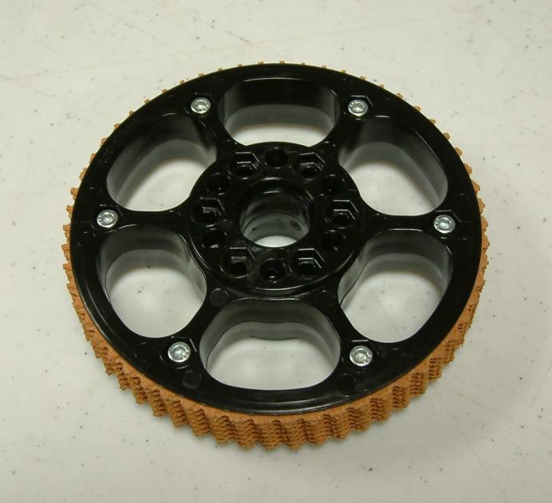
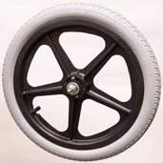
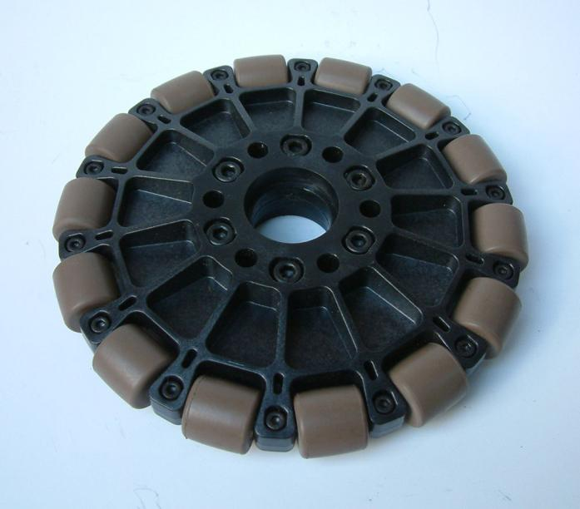
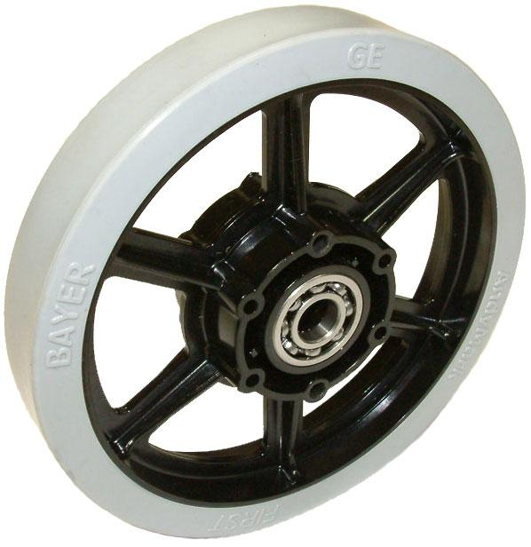
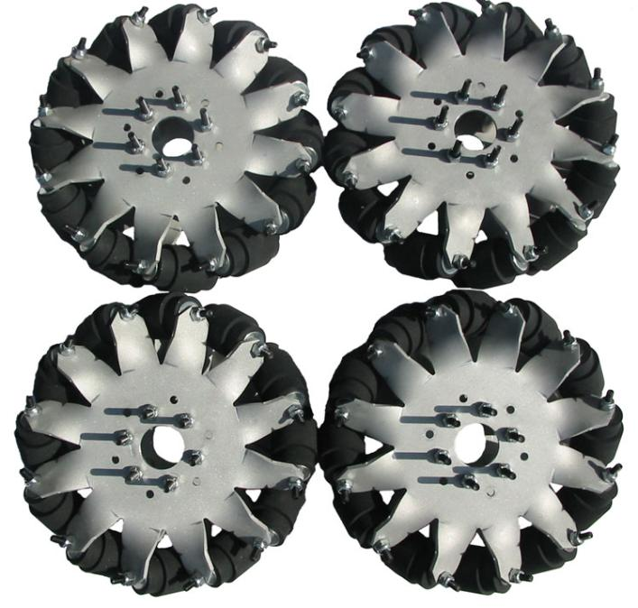
Wheel Types
Conveyer belt covered
Solid Plastic
Pneumatic
Omniwheels
Mechanum

Slide 27
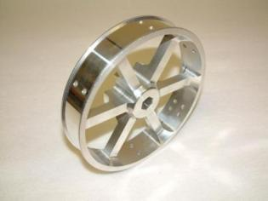
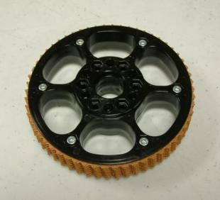
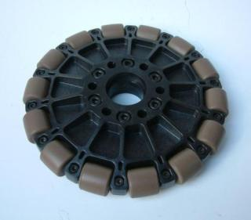

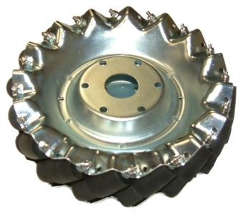
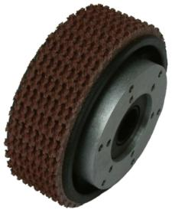
AndyMark.biz

Slide 28
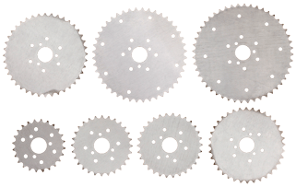
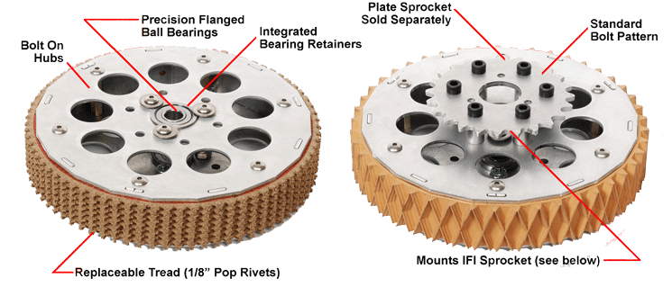
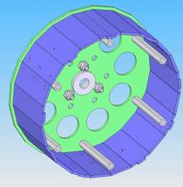
Innovation FIRST

Slide 29

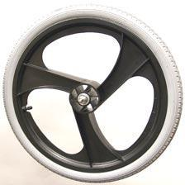
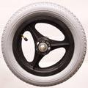
Skyway

Slide 30
Tips and Good Practices
From Team 488
Three most important parts of a robot are drive train, drive train and drive train.
Good practices:
  Support shafts in two places. No more, no less.
  Avoid long cantilevered loads
  Avoid press fits and friction belts
  Alignment, alignment, alignment!
  Reduce or remove friction everywhere you can
  Use lock washers, Nylock nuts or Loctite EVERYWHERE

Slide 31
Tips and Good Practices: Reparability (also from 488)
You will fail at achieving 100% reliability
  Design failure points into drive train and know where they are
  Accessibility is paramount. You can’t fix what you can’t touch
  Bring spare parts; especially for unique items such as gears, sprockets, transmissions, mounting hardware, etc.
  Aim for maintenance and repair times of <10 min.

Slide 32
So Which is “Best”
Depends on the challenge
2008 Championship Division Winners and Finalists
  14 Six Wheel drive
  2 Six Wheel with omnis
  2 Four wheel with omnis
  2 Mecanum
  2 Serve/Crab drive
  1 Four wheel rack and pinion!

Slide 33
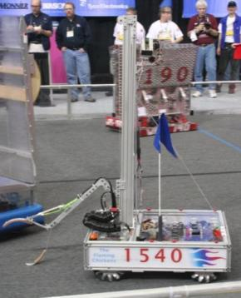
Questions

