Slide 1
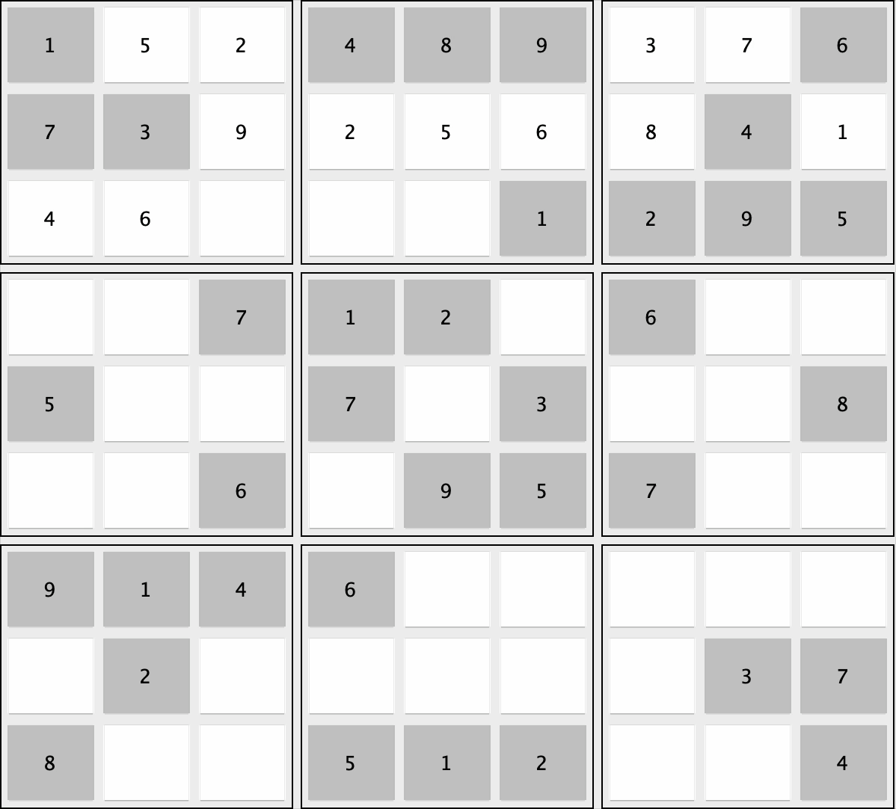
Sudoku Solver Visualizer
Mohamed Ijas 12221580

Slide 2
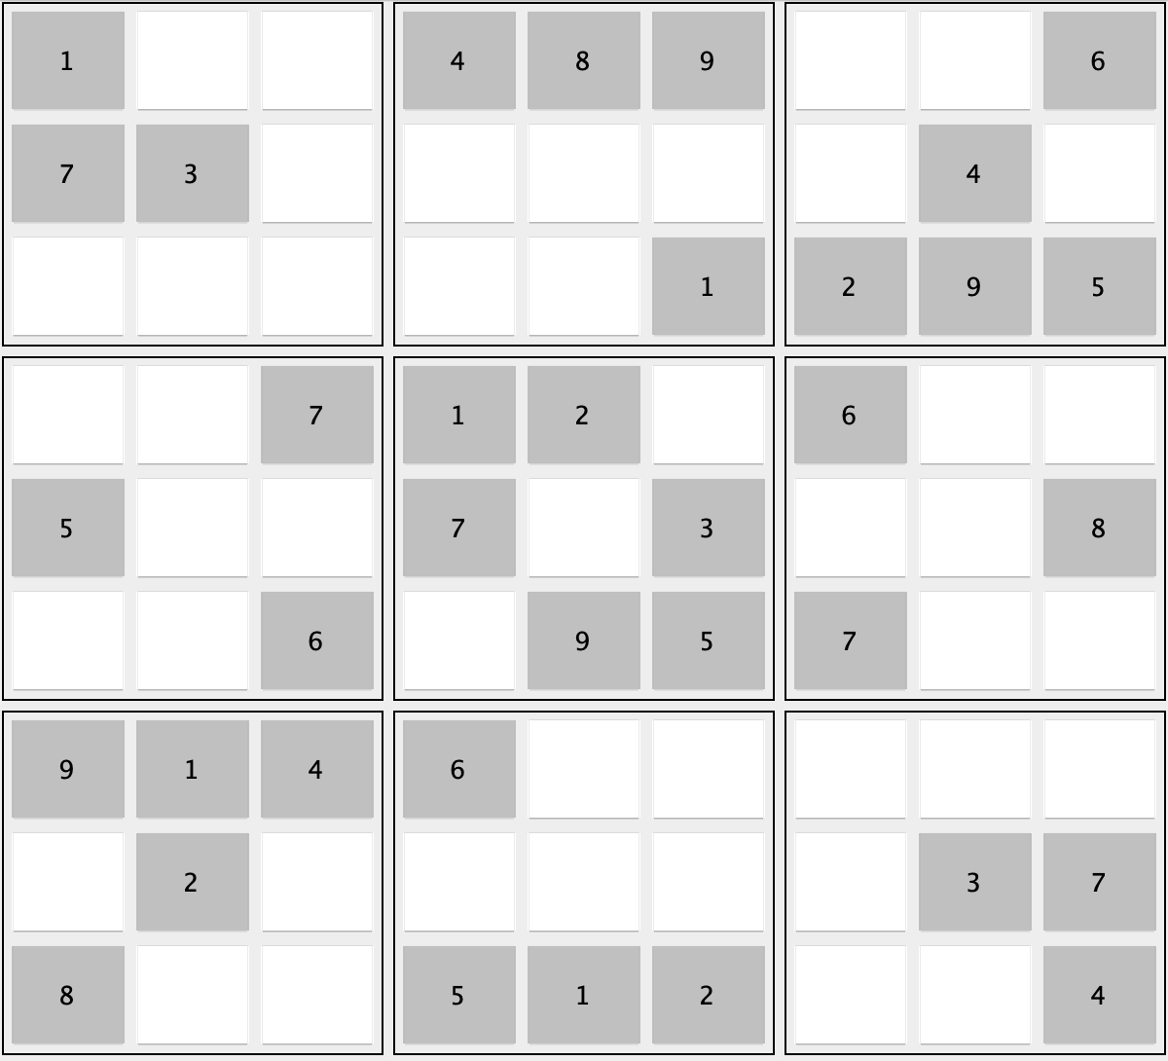
The Sudoku Grid
9x9 Grid
The Sudoku puzzle consists of a 9x9 grid, divided into 9 smaller 3x3 sub-grids.
1
Unique Numbers (1-9)
Each row, column and 3x3 sub-grid must contain the digits from 1 to 9 without repeating any digits.
2
Empty Cells
The puzzle starts with some cells filled, and the goal is to fill the remaining empty cells.
3
Sudoku Grid

Slide 3
Algorithm
Backtracking Algorithm
Backtracking is an algorithmic technique for solving problems recursively by trying to build a solution incrementally, one piece at a time. It explores all possible solutions by making choices at each step. If a choice leads to a dead end, the algorithm backtracks to the previous choice point and tries a different option. Methods used: isValid() Method
solveSudoku() Method

Slide 4
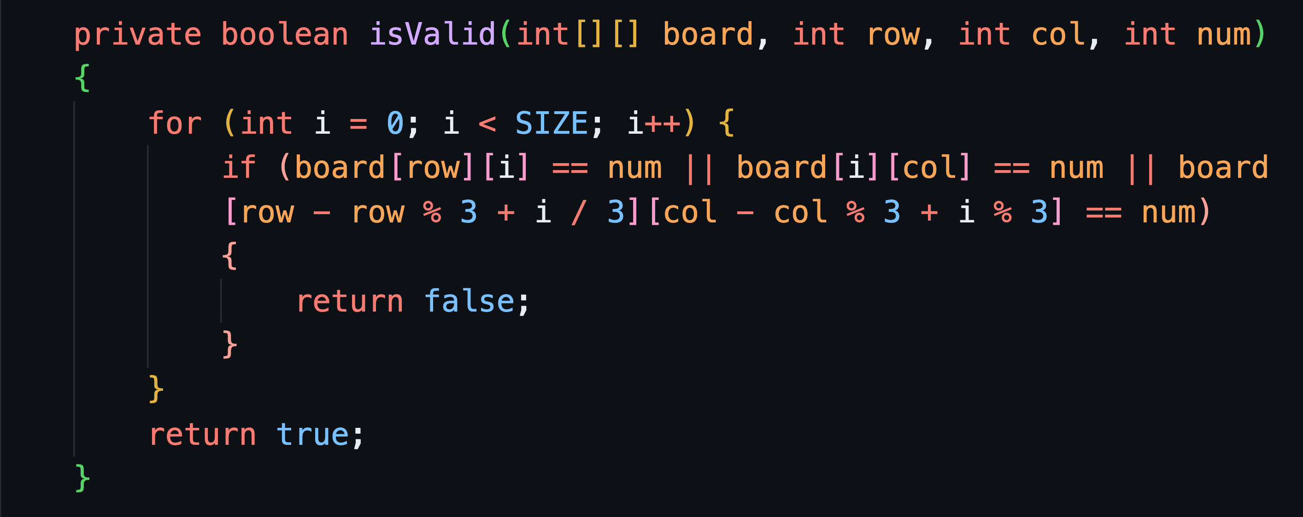
isValid() Method

Slide 5
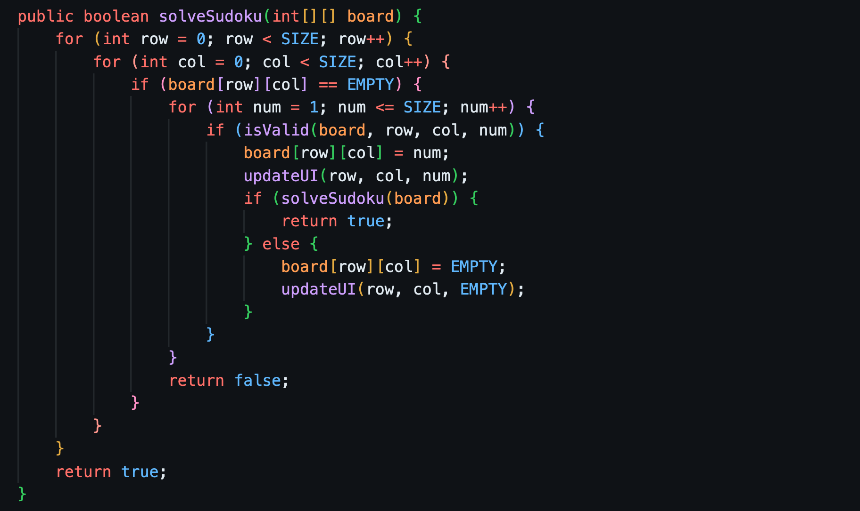
solveSudoku() Method

Slide 6
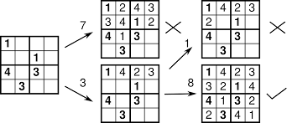
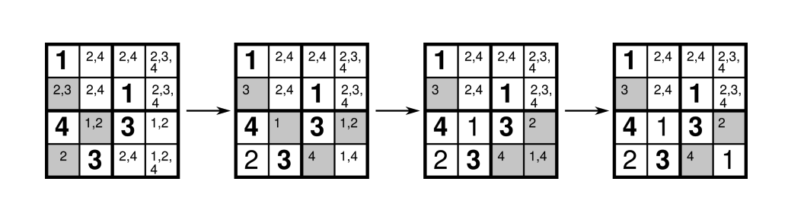
DEMONTRATION

Slide 7
Any Questions ?
Thank you

