Slide 1
Template files for various adapters
Segger JLink
Arm Virtual Hardware
CMSIS-DAP using pyOCD and GDB server
./vscode/launch.json Debug Setup
Build Information Output
My+target. cbuild-run.yml Run and Debug Configuration
CMSIS Solution Extension
./vscode/tasks.json Command Line Tool Setup

Slide 2

Each processor core is assigned to one GDB Server Port
SoC
GDB Server (i.e. pyOCD)
GDB Server Port Processor core #1
Debug Adapter CMSIS-DAP JLink
Etc.
Cortex Processor core #1
JTAG SWD
GDB Server Port Processor core #2
Cortex Processor core #2

Slide 3
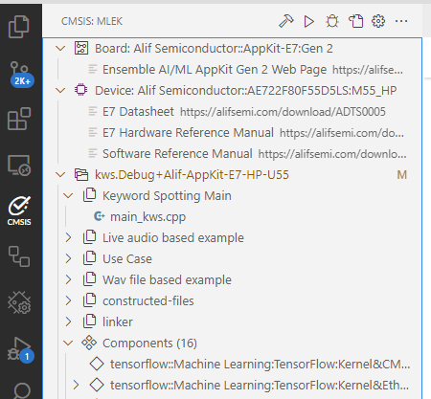
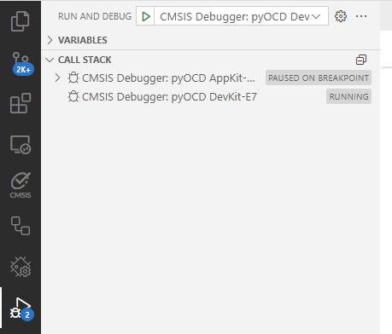
VS Code & multi-processor GDB connections with pyOCD
Load & Run
Microsoft C/C++ VS Code Extension
SoC
Load & Debug
Cortex-A running Linux
Manage Solution
GDB Port: Linux Cortex-A
GDB Server
Linux Application
Each processor has one GDB Server Port
Bare Metal
pyOCD
Classic MCU Development
GDB Port: Processor #1
Cortex-M Processor #1
Adapter CMSIS-DAP JLink
Etc.
Select Core & Attach Debug
GDB Port: Processor #2
JTAG SWD
Cortex-M Processor #2
Interact with Cores
Trace Port
Trace Streams
Trace output (SWO) is connected via separate server port and streamed to data files. Viewers (such as System Analyser) shows the content.
Beta Release: May 25

