Slide 1
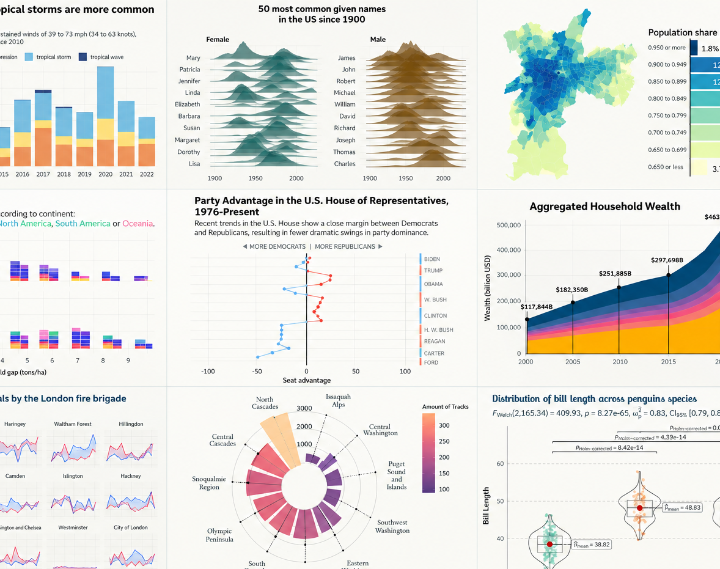
Introduction to ggplot2
By Nadia Muhe
Map & Data Library
University of Toronto

Slide 2
datatools.utoronto.ca github.com/MDLutoronto/r-ggplot2/

Slide 3
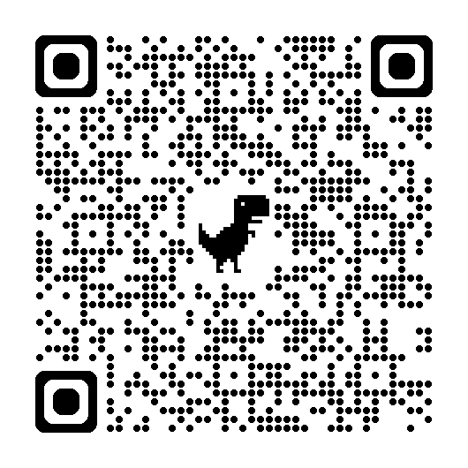
Thank you!
Please scan the QR code or click here to provide feedback.

Slide 4
Contact Information
Nadia Muhe
Statistical Support Specialist
Email: nadia.muhe@utoronto.ca
Phone: 416-978-7689

