Slide 1

ROOMSENSE
Mario Caudevilla Ruiz
Marcos Galán Carrillo
Víctor Martínez Páramo

Slide 2
Table Of Contents
1. Project Overview
2. High-Level System Architecture
3. Technical Implementation Details

Slide 3
1. PROJECT OVERVIEW

Slide 4


What is RoomSense?
RoomSense is an IoT system designed to monitor study rooms in real time.
Each room is equipped with temperature, humidity, and light sensors that continuously collect environmental data.
Goal: to improve the student experience by allowing users to choose the most comfortable study space before entering.

Slide 5

The RoomSense Application
Users can select their preferred temperature level.
Each room displays:
Temperature (ºC) and humidity (%)
Total capacity and current occupancy
Availability (no ambient light → unavailable)
Last 7 temperature measurements
Recommends rooms based on users temperature preferences.
AI recommendation engine suggests the most suitable room based on advanced criteria.

Slide 6



Who can use RoomSense?
Potential Clients
Public and university libraries.
Study centers and collaborative spaces.
Educational institutions.
Institutions aiming to improve user comfort and space management.

Slide 7
2. HIGH-LEVEL SYSTEM ARCH.

Slide 8

Hardware & Communication
Hardware Components
Arduino Uno (data acquisition)
CNT5 sensor (temperature & humidity)
LDR + potentiometer (light sensing through a voltage divider)
Breadboard prototype
Communication
Arduino sends data through Serial.
Bridge application forwards data to the cloud.

Slide 9


Cloud Backend & RoomSense App
Cloud Backend (DigitalOcean)
Node.js server processing incoming sensor data.
Updates each rooms digital twin.
Stores all data in a PostgreSQL database.
Provides a real-time API for external clients.
RoomSense Application
Displays temperature, humidity, light, occupancy and availability.
Recommends the best study room based on user preferences.
Developed in Kotlin.

Slide 10
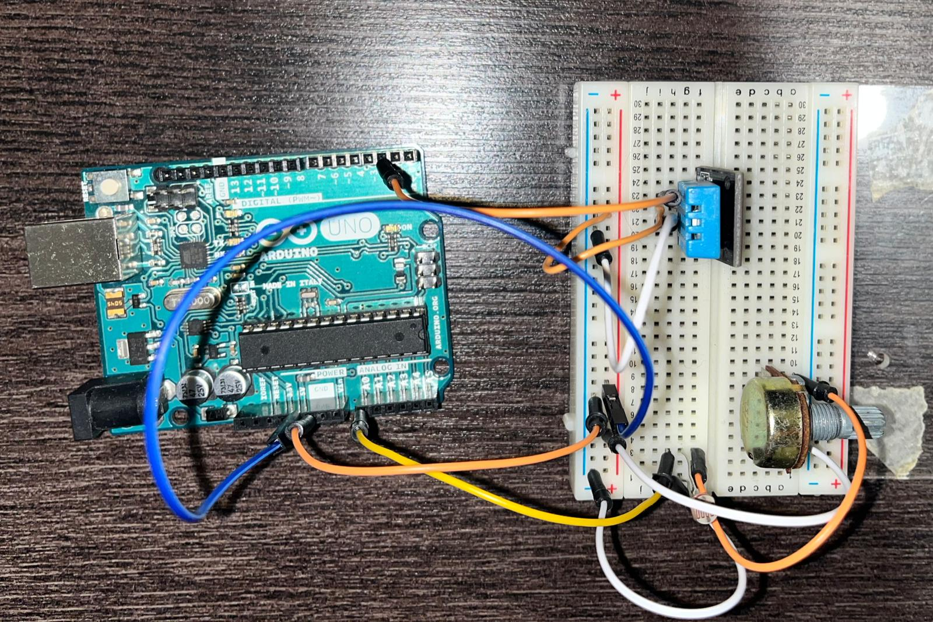
Circuit Implementation
CNT5
Arduino Uno
Breadboard
Potentiometer
LDR

Slide 11
3. TECH. IMPLEMENTATION DETAILS

Slide 12
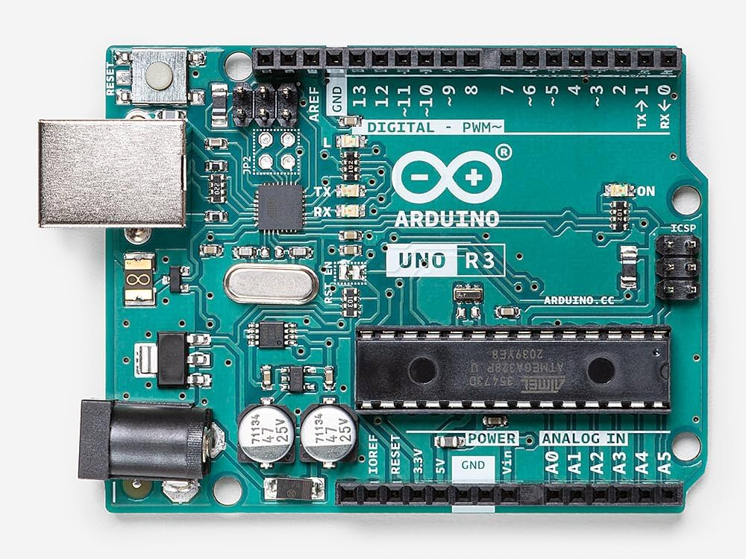
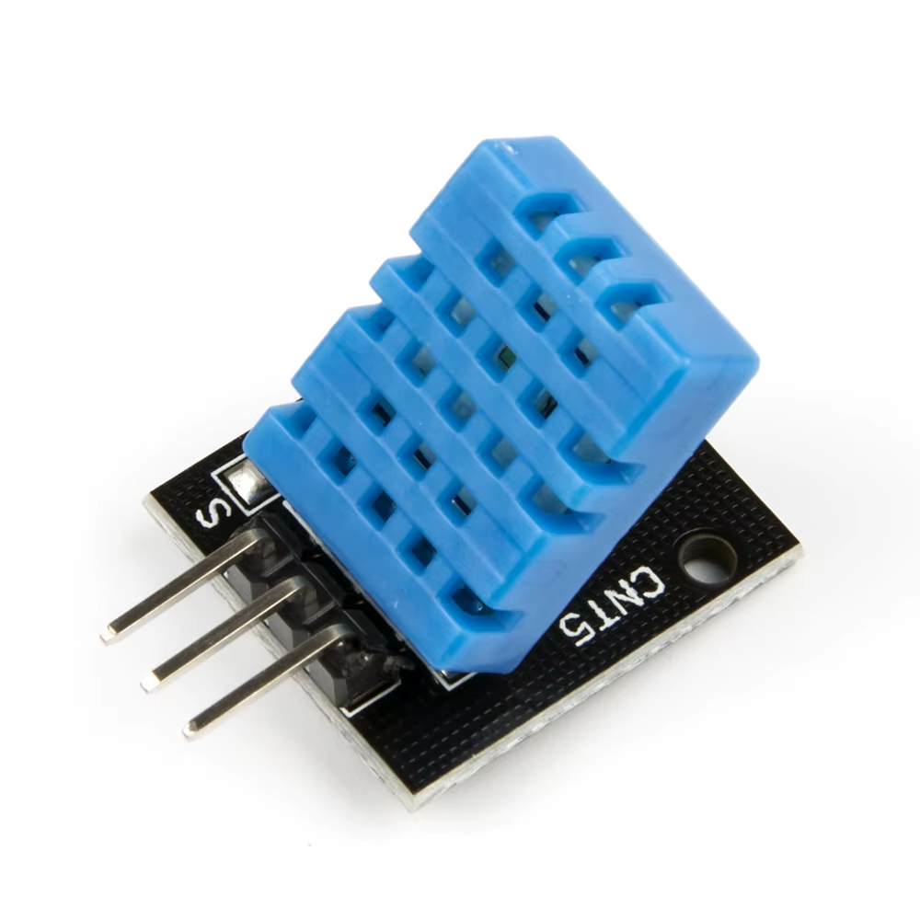
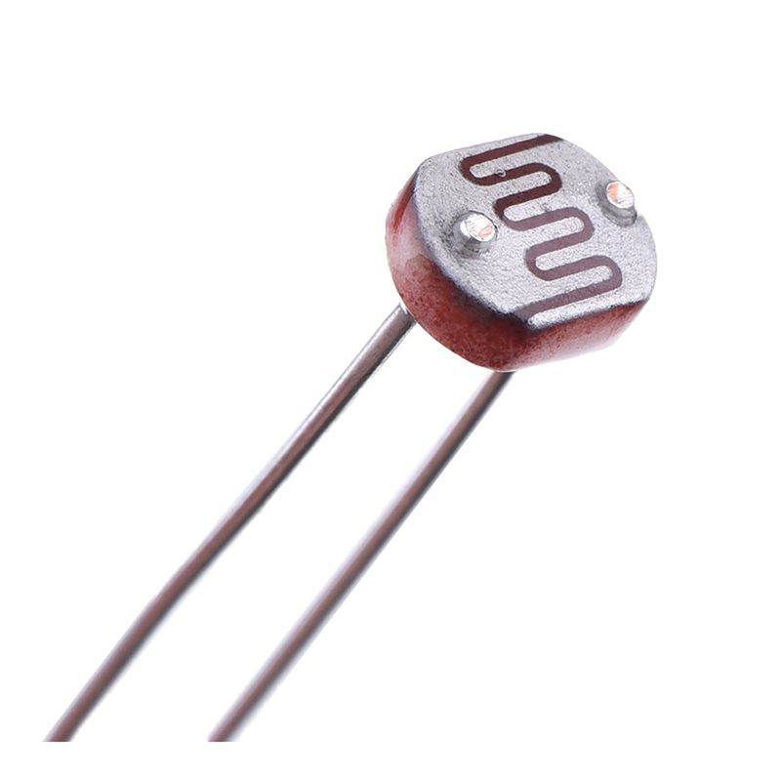
Hardware Architecture (I)
Arduino Uno
Microcontroller that captures all sensor readings.
Sends prepared data to the next system stage
CNT5
Provides temperature (°C) and relative humidity (%)
Data line connected to pin D2
Uses DHT.h to interpret the digital protocol
LDR
With potentiometer forms a voltage divider to measure ambient light
LDR resistance ↑ when light ↓ (and vice versa)

Slide 13
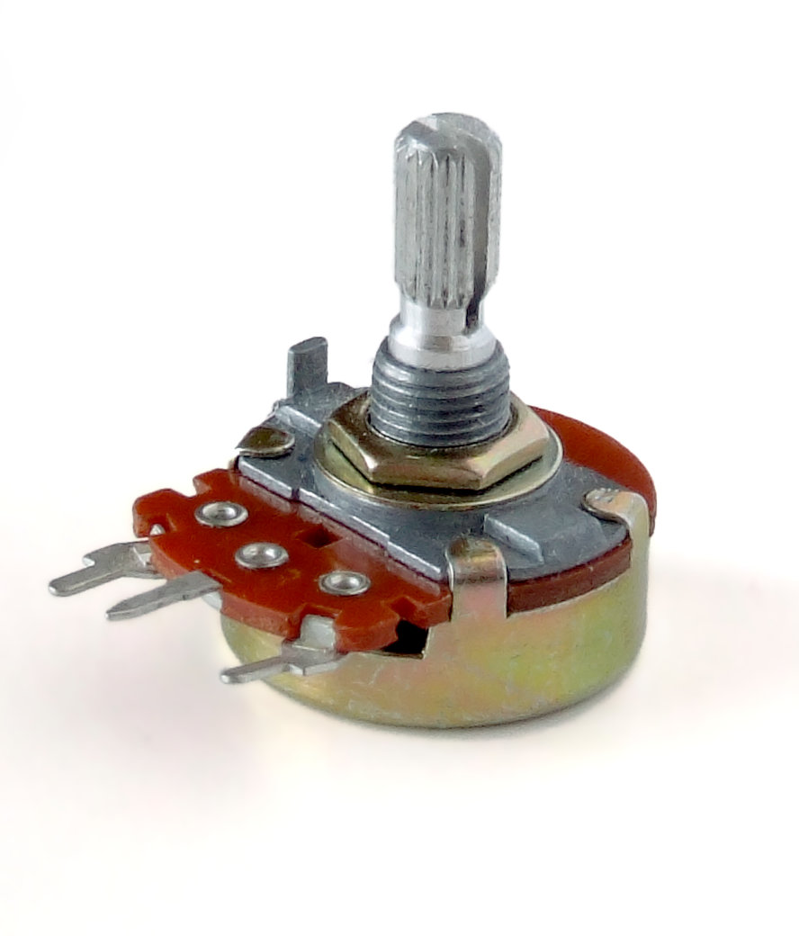
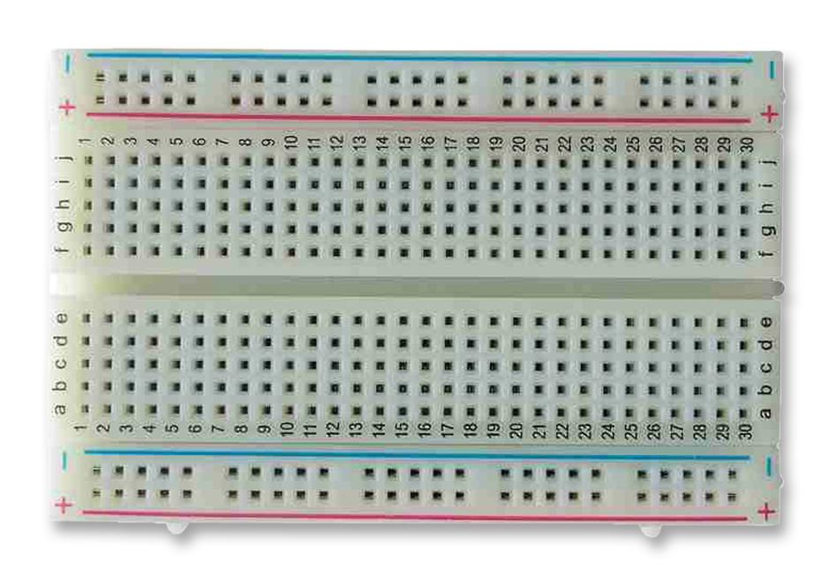
Hardware Architecture (II)
Voltage Divider
5V Potentiometer LDR GND
A0
Potentiometer
Allows manual calibration of the circuit’s sensitivity and adjustment of the threshold at which a room is considered illuminated
Breadboard
Enables easy prototyping and modifications

Slide 14

The Bridge: Connecting Hardware to the Cloud
The Arduino Uno cannot connect to the internet by itself, so the system needs a bridge running on a computer.
This bridge receives the sensor readings from the Arduino, interprets them, and forwards the data to the cloud backend.
It is the link that transforms the physical measurements into usable digital information for the RoomSense application.

Slide 15
Data Sent from the Arduino (UART + JSON)
The Arduino sends temperature, humidity, and light values through its serial port using the UART protocol.
Each reading cycle generates a JSON message, which the bridge reads line by line.
const port = new SerialPort({ path: COM, baudRate: BAUD });
const parser = port.pipe(new ReadlineParser({ delimiter: '\n' }));
parser.on('data', (line) => {
const data = JSON.parse(line.trim());
const temp = Number(data.temperatura);
const hum = Number(data.humedad);
const light = Number(data.luz);
});

Slide 16
Sending Data to the Cloud (HTTP POST)
Every time the bridge receives a valid JSON reading, it builds an HTTP POST request and sends it to our backend hosted on DigitalOcean.
const payload = { temp, hum, light, name: ROOM.toUpperCase() };
await fetch(`${BASE}/api/samples/${ROOM}`, {
method: 'POST',
headers: { 'Content-Type': 'application/json' },
body: JSON.stringify(payload),
});

Slide 17
Integration with the Backend, Database and App
Once the backend receives the POST request, it updates the room’s data and stores the new measurements in a PostgreSQL database.
The RoomSense mobile app use the backend API to fetch the latest conditions of each room and provide personalised recommendations to users.
Arduino → UART → Bridge → HTTP POST → Backend → Database → App

Slide 18
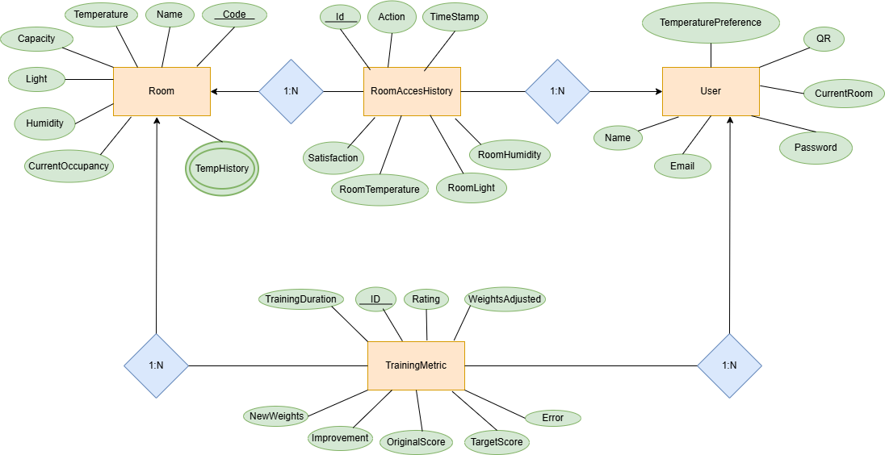
Database Model

Slide 19
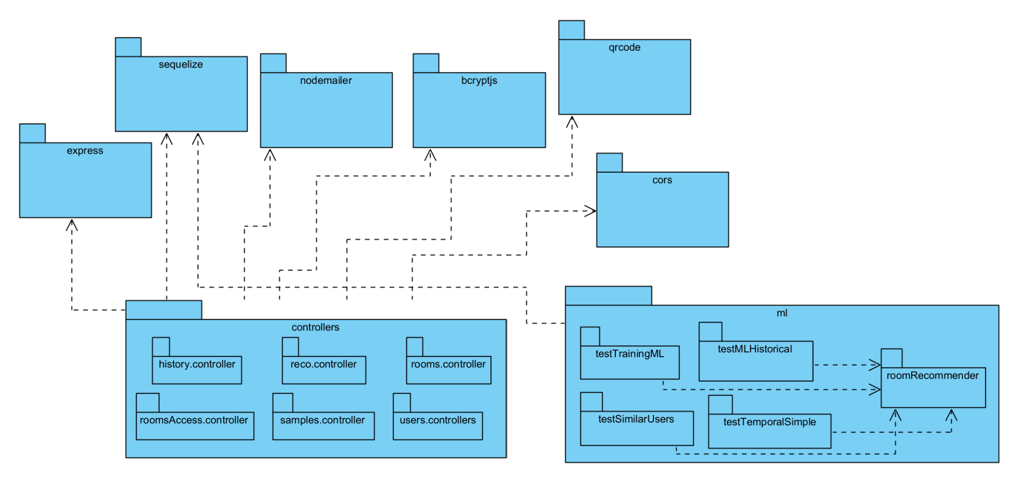
Module Backend View

Slide 20
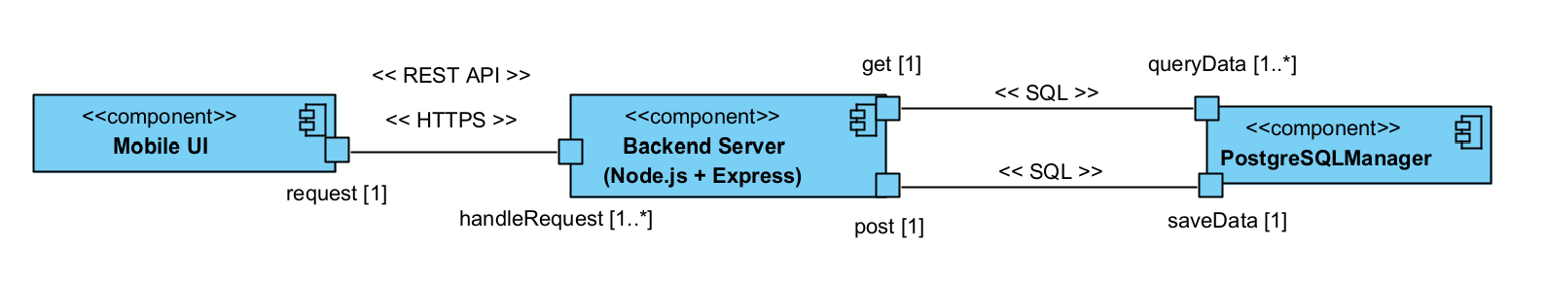
C&C General View

Slide 21
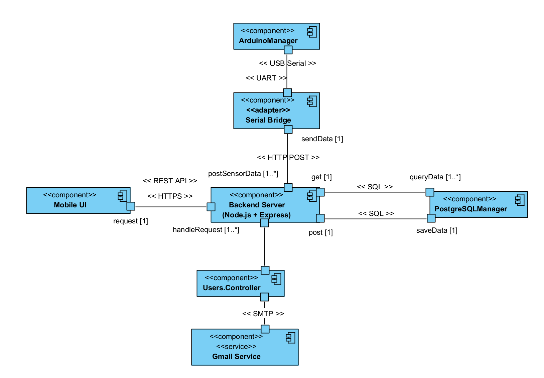
C&C Detailed View

Slide 22
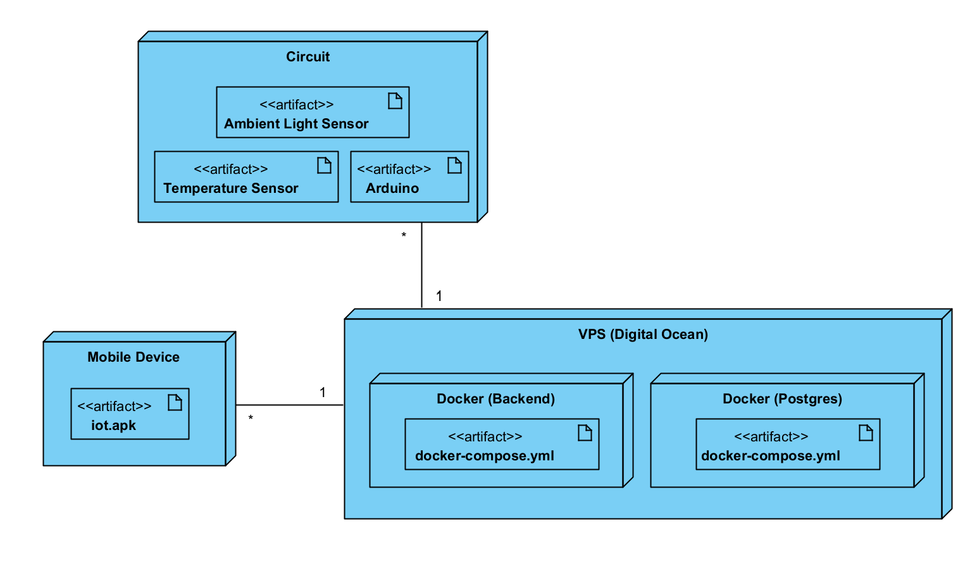
Deployment View

Slide 23


AI Module
Hybrid ML System based on:
Collaborative Filtering → learns from similar users
Content-Based Filtering → analyzes room characteristics
Temporal Analysis → detects usage patterns by time
Business Rules → availability, capacity, current occupancy
Learns from users feedback
Continuous improvement

Slide 24
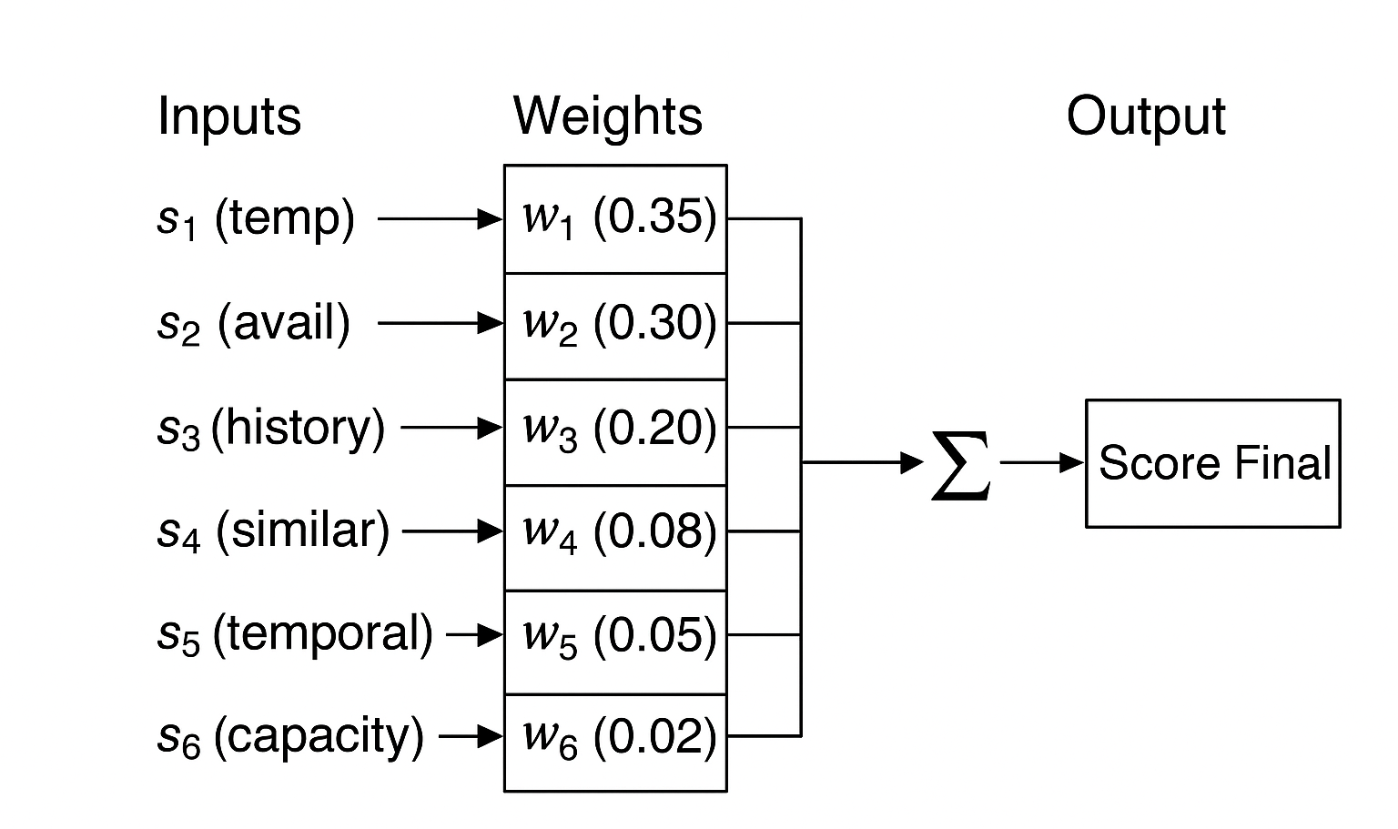
How the ML System works?
Two main phases:
Inference (Prediction Phase) → O(n x m)
Training (Learning Phase) → O(1)
Supervised Learning based on a Shallow Neural Network :
6 input neurons (factors)
Single output (compatibility score)
Trained via Gradient Descent
this.weights = {
roomFeatures: 0.35, // User Temperature (35%)
availability: 0.30, // Actual Availability (30%)
userHistory: 0.20, // User Historical (20%)
similarUsers: 0.08, // Similar Users (8%)
temporalPattern: 0.05, // Temporal Patterns (5%)
capacityMatch: 0.02 // Preferred Size (2%)
}; // Total: 100%

Slide 25
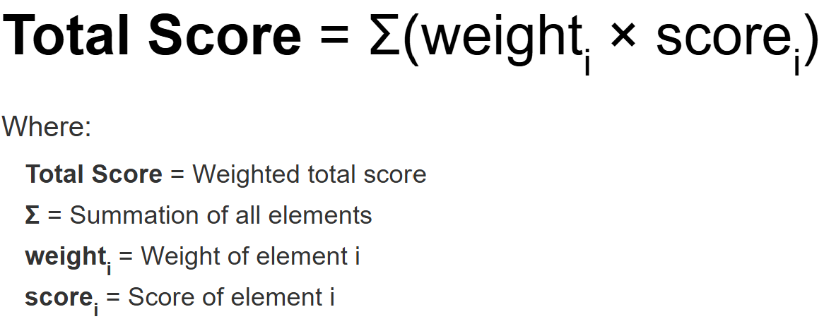
Inference Phase (I)
Goal: predict the best room for a user
Divided into 5 steps:
Request
Fetch
Each Score Calculation
Total Score Calculation
Recommendation
4
5
const reasons = [];
if (availabilityScore > 0.7) {
reasons.push(`High availability (${room.capacity - room.currentOccupancy} available spaces)`);
}
if (visitCount >= 50) {
reasons.push(`Very frequent visitor (${visitCount} visits) - Your favorite room!`);
} else if (visitCount >= 25) {
reasons.push(`Frequent visitor (${visitCount} visits) - You know this room well`);
}
if (similarUsersScore >= 0.75) {
reasons.push('Similar users prefer this room');
}
if (featuresScore > 0.9 && room.temp) { . . . }
if (hasTimePattern && timeSlot && visitsInTimeSlot >= 3) { . . . }
async getTopRecommendation(userId, preferences = {}) {
const rooms = await this.getRoomsData(); // 1.1 Retrieve all the available rooms
const userData = await this.getUserData(userId); // 1.2 Retrieve user data
// 1.3 Calculate all rooms scores
const scoredRooms = await this.calculateRoomScores(rooms,userData,preferences);
scoredRooms.sort((a, b) => b.score - a.score); // 1.4 Sort by descending score
return scoredRooms[0]; // 1.5 Return the top room la mejor sala
}
2

Slide 26
Inference Phase (II)
calculateRoomFeaturesScore(room, userData, preferences) {
if (!userData || !userData.preferenciaTemperatura) return 0.5;
let score = 0;
// Principal score: temperature
if (room.temp) {
const tempScore = this.matchTemperaturePreference(
room.temp,
userData.preferenciaTemperatura
);
score += tempScore * 0.7; // 70% weight is temperature
}
// Additional score: light (15%)
if (room.light) {
score += this.normalizeLightLevel(room.light) * 0.15;
}
// Additional score: humidity (15%)
if (room.hum) {
score += this.normalizeHumidityLevel(room.hum) * 0.15;
}
return Math.min(1.0, score);
}
score_features = 0.7 × temp_score + 0.15 × light_score + 0.15 × humidity_score
temp_score = f(|T_room - T_ideal.ideal|)
Where:
T_ideal = { COLD: { ideal: 18, comfort: 3, acceptable: 5}
{ WARM: { ideal: 22, comfort: 2, acceptable: 4}
{ HOT: { ideal: 26, comfort: 3, acceptable: 5}
f(diff) = { 1.00 si diff = 0°C (Perfect)
{ 0.98 si diff ≤ 0.5°C (Almost perfect)
{ 0.95 si diff ≤ 1°C (Excellent)
{ 0.85 si diff ≤ T_ideal.comfort (Very comfortable)
{ 0.70 si diff ≤ T_ideal.comfort + 1 (Comfortable)
{ 0.50 si diff ≤ T_ideal.acceptable (Acceptable)
{ 0.30 si diff ≤ T_ideal.acceptable + 2 (Tolerable)
{ 0.15 si diff ≤ T_ideal.acceptable + 4 (Bit comfortable)
{ 0.05 en otro caso (Very uncomfortable)
3
normalizeLightLevel(light) {
if (!light) return 0.5;
// Ideal light between 300-500
if (light >= 300 && light <= 500) return 1.0;
if (light >= 200 && light <= 600) return 0.8;
if (light >= 100 && light <= 700) return 0.6;
return 0.4;
}
normalizeHumidityLevel(humidity) {
if (!humidity) return 0.5;
// Ideal hum. between 40-60%
if (humidity >= 40 && humidity <= 60) return 1.0;
if (humidity >= 30 && humidity <= 70) return 0.8;
if (humidity >= 20 && humidity <= 80) return 0.6;
return 0.4;
}

Slide 27
Inference Phase (III)
async calculateUserHistoryScore(room, userData) {
if (!userData) return { score: 0.5, visitCount: 0 };
try {
const { RoomAccessHistory } = require('../models');
if (RoomAccessHistory) {
const visitCount = await RoomAccessHistory.count({
where: {
userId: userData.id,
roomId: room.id,
action: 'ENTER'
}
}); // Count user visits to THIS room
let score;
if (visitCount >= 50) {
score = 0.98; // Very Frequent User (50+ visits)
} else if (visitCount >= 25) {
score = 0.92; // Frequent User (25-49 visits)
} else if (visitCount >= 10) {
score = 0.85; // Regular User (10-24 visits)
} else if (visitCount >= 3) {
score = 0.70; // Occasional User (3-9 visits)
} else if (visitCount >= 1) {
score = 0.55; // Few visits (1-2 visits)
} else {
score = 0.3; // New User (0 visits)
}
return { score, visitCount };
}
// Table does not exist, use neutral score
return { score: 0.5, visitCount: 0 };
}
async calculateSimilarUsersScore(room, userData) {
. . .
try {
. . .
const similarUsers = await Users.findAll({
where: {
preferenciaTemperatura: userData.preferenciaTemperatura,
id: { [sequelize.Sequelize.Op.ne]: userData.id } // Without actual user
},
attributes: ['id'],
limit: 50
}); // Find users with similar preferences
if (similarUsers.length === 0) {
return 0.5; // Without similar users = neutral score
}
const similarUserIds = similarUsers.map(u => u.id);
const visitsFromSimilarUsers = await RoomAccessHistory.count({
where: {
userId: { [sequelize.Sequelize.Op.in]: similarUserIds },
roomId: room.id,
action: 'ENTER'
}
}); // Count how many users have visited THIS room
// Calculate score based on popularity among the similar users
const visitRateBySimiarUsers = visitsFromSimilarUsers / similarUsers.length;
if (visitRateBySimiarUsers >= 5) return 0.95; // Very popular (5+ visits per user)
if (visitRateBySimiarUsers >= 3) return 0.85; // Popular (3-4 visits per user)
if (visitRateBySimiarUsers >= 2) return 0.75; // Quite visited (2-3 visits)
if (visitRateBySimiarUsers >= 1) return 0.65; // Moderately visited (1-2 visits)
if (visitRateBySimiarUsers >= 0.5) return 0.55; // Somewhat visited (0.5-1 visits)
return visitsFromSimilarUsers > 0 ? 0.45 : 0.3; // No user have visited → low score
}
3

Slide 28
Inference Phase (IV)
async calculateTemporalScore(room, userData, preferences) {
const now = new Date(Date.now());
const currentHour = now.getHours();
const currentDay = now.getDay(); // 0 = Sunday, 6 = Saturday
let score = 0.1; // Give importance to the pattern
let hasTimePattern = false; let currentTimeSlot = null; let visitRateInSlot = 0; let visitsInTimeSlot = 0;
if (userData && userData.id) {
try {
const { RoomAccessHistory } = require('../models');
if (RoomAccessHistory) {
const visits = await RoomAccessHistory.findAll({
where: {
userId: userData.id,
roomId: room.id,
action: 'ENTER'
},
attributes: ['createdAt', 'timestamp'],
limit: 50
}); // Retrieve previous visits from this room
// Analyze at what times this room is visited
// Determine the current time slot of the day
// morning: 6-11, afternoon: 12-17, evening: 18-23, night: 0-5
. . .
// Count visits from the same part of the day (morning/afternoon/evening)
. . .
// Percentage calculation
const hourlyVisitRate = visitsInCurrentHour / visits.length;
visitRateInSlot = visitsInTimeSlot / visits.length;
. . .
if (visitsInCurrentHour > 0) { . . . } // Progressive scoring
. . .
return {
score: Math.min(1.0, score),
hasTimePattern,
timeSlot: currentTimeSlot,
visitRateInSlot,
visitsInTimeSlot // Number of visits in that slot time
};
}
. . .
}
calculateAvailabilityScore(room) {
if (room.currentOccupancy >= room.capacity) {
return 0; // Full room capacity
}
const occupancyRate = room.currentOccupancy / room.capacity;
// Want rooms with low capacity
if (occupancyRate < 0.3) return 1.0; // Very available
if (occupancyRate < 0.5) return 0.85; // High availability
if (occupancyRate < 0.7) return 0.6; // Media availability
if (occupancyRate < 0.9) return 0.3; // Low availability
return 0.1; // Almost full
}
3
calculateCapacityScore(room, preferences) {
const preferredCapacity = preferences.preferredCapacity;
if (!preferredCapacity) return 0.5;
const capacity = room.capacity;
if (preferredCapacity === 'small') {
if (capacity <= 15) return 1.0;
if (capacity <= 20) return 0.7;
if (capacity <= 30) return 0.4;
return 0.2;
}
. . . // Same with medium and large size rooms
return 0.5; // Neutral score
}

Slide 29
Training Phase (I)
Goal: adjust the model weights based on real user feedback
Divided into 6 steps:
Feedback Validation
Retrieve Original Prediction
Target Score Calculation
Prediction Error Calculation
Weight Adjustment → Gradient Descent
Save Metrics
console.log('[TRAINING] Calculating original prediction with current weights...');
const preferences = { preferredCapacity: 'medium' };
const originalScore = await this.calculateRoomScore(room, user, preferences);
const user = await this.getUserData(userId);
const room = await Rooms.findByPk(roomId);
if (!user || !room) {
return {
success: false,
message: 'User or room not found',
feedback
};
}
console.log(` - Predicted score:${(originalScore.totalScore * 100).toFixed(2)}%`);
console.log(' - Score breakdown:'); . . .
async trainModel(feedback) {
const { userId, roomId, rating, actualUsage, satisfaction } = feedback;
// Data Validation
if (!userId || !roomId || rating === undefined) {
return { success: false, message: 'Invalid feedback' };
}
if (rating < 1 || rating > 5) {
return { success: false, message: 'Rating must be between 1 and 5' };
} . . .
}
2
1

Slide 30
Training Phase (II)
// Normalize rating (1-5) to score (0-1)
const targetScore = rating / 5.0;
// If the person stayed a long time = good recommendation)
let adjustedTarget = targetScore;
if (actualUsage !== undefined && actualUsage !== null) {
if (actualUsage >= 60) {
adjustedTarget = Math.min(1.0, targetScore + 0.1); // Interested
} else if (actualUsage <= 10) {
adjustedTarget = Math.max(0.0, targetScore - 0.1); // Not interest.
}
}
// How the user felt
if (satisfaction) {
if (satisfaction === 'good') {
adjustedTarget = Math.min(1.0, adjustedTarget + 0.15); // Increase
} else if (satisfaction === 'poor') {
adjustedTarget = Math.max(0.0, adjustedTarget - 0.15); // Reduce
}
// 'neutral' no adjustment
}
console.log('[TRAINING] Target calculation:');
console.log(` - Base target (from rating): ${(targetScore * 100).toFixed(2)}%`);
if (actualUsage !== undefined && actualUsage !== null) {
console.log(` - After usage adjustment: ${(adjustedTarget * 100).toFixed(2)}%`);
}
if (satisfaction) {
console.log(` - After satisfaction adjustment (${satisfaction}): ${(adjustedTarget * 100).toFixed(2)}%`);
}
console.log(` - Final adjusted target: ${(adjustedTarget * 100).toFixed(2)}%`);
/* Decision:
* |Error| < 0.05 → No adjustment (excellent predict)
* |Error| ≥ 0.05 → Apply Gradient Descent
*/
const error =
adjustedTarget - originalScore.totalScore;
const errorPercentage = error * 100;
console.log(` - Prediction error: ${errorPercentage > 0 ? '+' : ''}${errorPercentage.toFixed(2)}%`);
if (Math.abs(error) < 0.05) {
console.log(' - Status: EXCELLENT (error < 5%) - No weight adjustment needed\n');
return {
success: true,
message: 'Prediction was already accurate. No training needed.',
metrics: {
originalScore: originalScore.totalScore,
targetScore: adjustedTarget,
error: error,
weightsAdjusted: false
}
};
}
console.log(` - Status: ${Math.abs(error) < 0.15 ? 'GOOD' : 'NEEDS IMPROVEMENT'} - Adjusting weights...\n`);
4
3

Slide 31
Training Phase (III)
console.log('[TRAINING] Applying gradient descent to adjust weights...');
const learningRate = 0.05; // Conservative learning rate
const oldWeights = { ...this.weights };
// Gradient = error × score_factor × learning_rate
const gradients = {
roomFeatures: error * originalScore.scoreBreakdown.features * learningRate,
availability: error * originalScore.scoreBreakdown.availability * learningRate,
userHistory: error * originalScore.scoreBreakdown.history * learningRate,
similarUsers: error * originalScore.scoreBreakdown.similarUsers * learningRate,
temporalPattern: error * originalScore.scoreBreakdown.temporal * learningRate,
capacityMatch: error * originalScore.scoreBreakdown.capacity * learningRate
};
this.weights.roomFeatures += gradients.roomFeatures; // Apply gradients
this.weights.availability += gradients.availability;
this.weights.userHistory += gradients.userHistory;
this.weights.similarUsers += gradients.similarUsers;
this.weights.temporalPattern += gradients.temporalPattern;
this.weights.capacityMatch += gradients.capacityMatch;
Object.keys(this.weights).forEach(key => {
this.weights[key] = Math.max(0.01, Math.min(0.99, this.weights[key]));
}); // Weights E [0, 1]
// Normalize (summation has to be 1.0)
const totalWeight = Object.values(this.weights).reduce((sum, w) => sum + w, 0);
Object.keys(this.weights).forEach(key => {
this.weights[key] = this.weights[key] / totalWeight;
});
const trainingMetrics = {
userId,
roomId,
rating,
actualUsage,
satisfaction,
originalScore: originalScore.totalScore,
scoreBreakdown: originalScore.scoreBreakdown,
targetScore: adjustedTarget,
error: error,
newScore: newScore.totalScore,
newError: newError,
improvement: Math.abs(error) - Math.abs(newError),
weightsAdjusted: true,
oldWeights,
newWeights: { ...this.weights },
learningRate: 0.05// Not high drastic changes
};
// Save in the metrics table
try {
const { TrainingMetrics } = require('../models');
if (TrainingMetrics) {
await TrainingMetrics.create(trainingMetrics);
console.log('[TRAINING] Training metrics saved to database ✓');
}
} catch (dbError) {
. . .
}
6
5

Slide 32
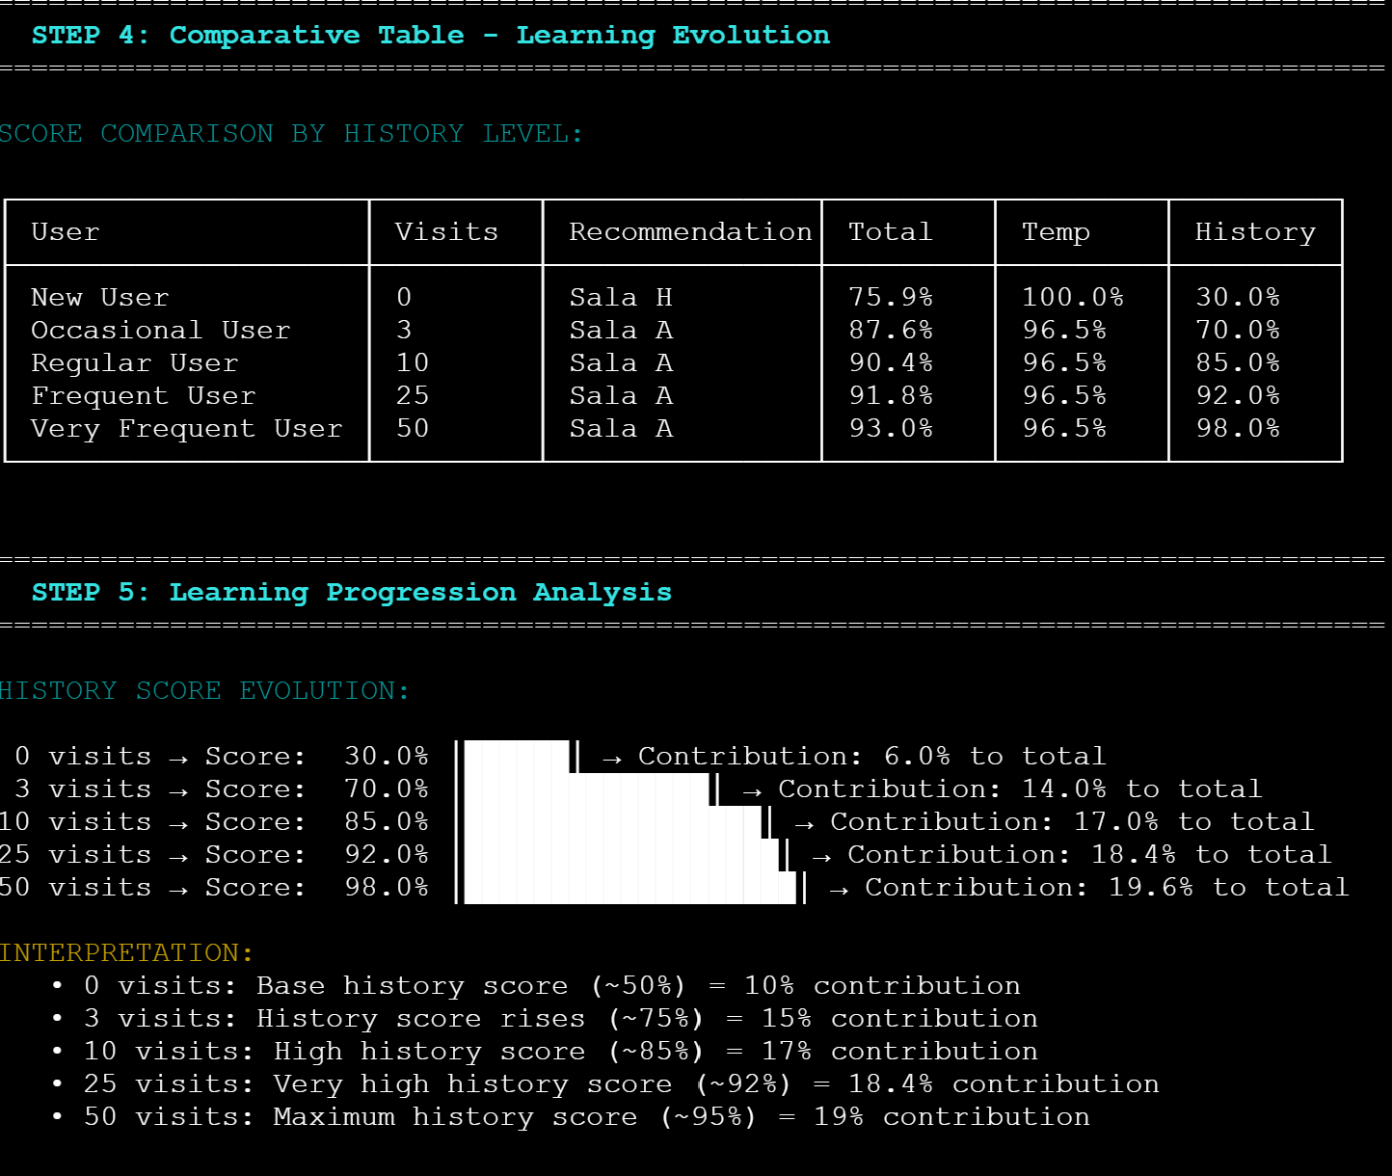
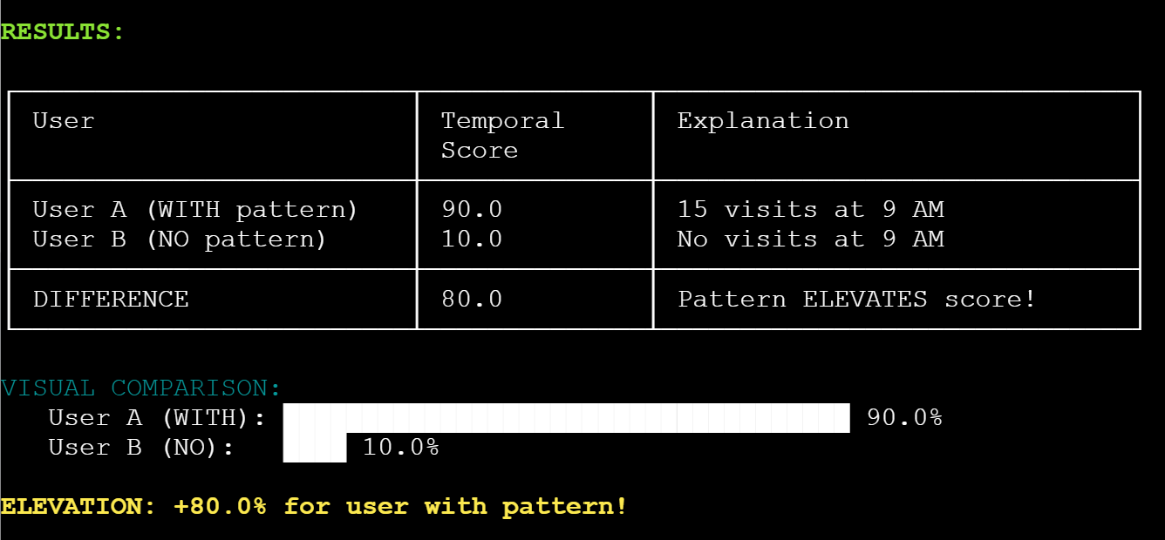
Testing
backend/src/ml/testMLHistorical.js
backend/src/ml/testTemporalSimple.js

Slide 33
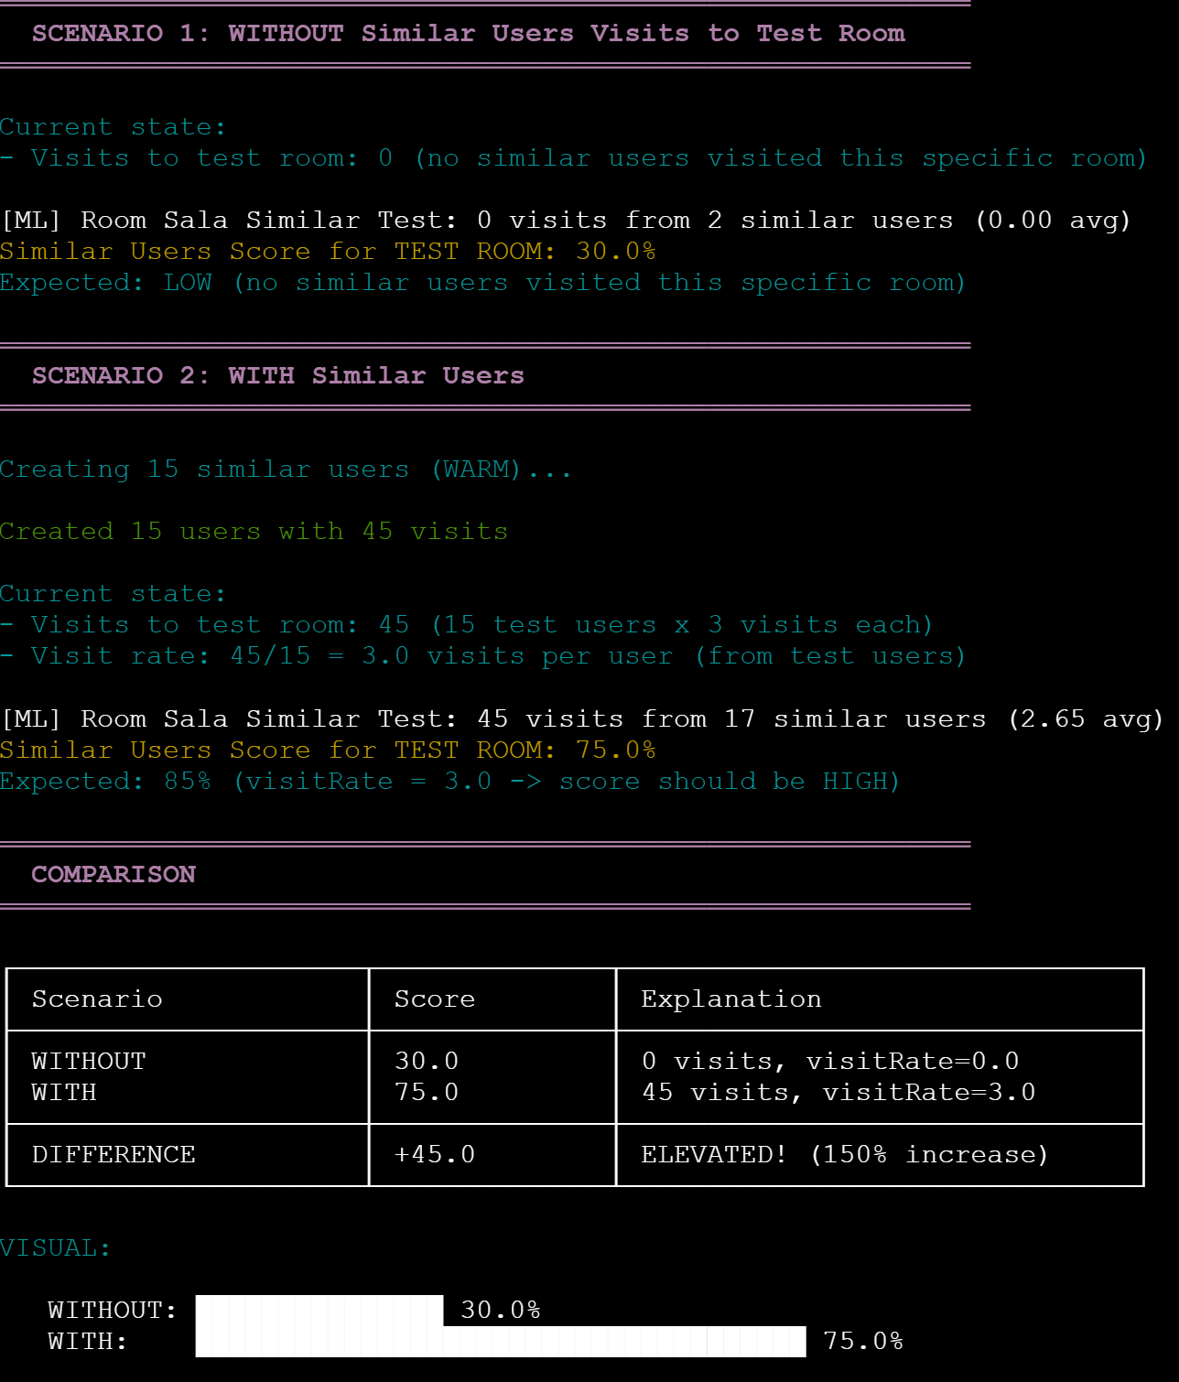
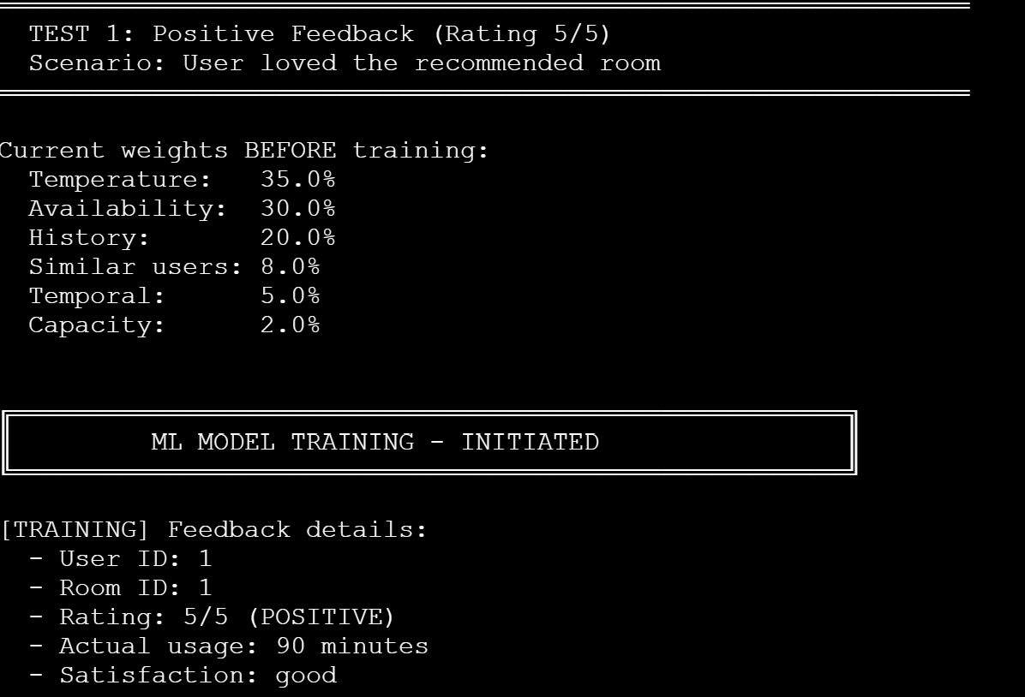
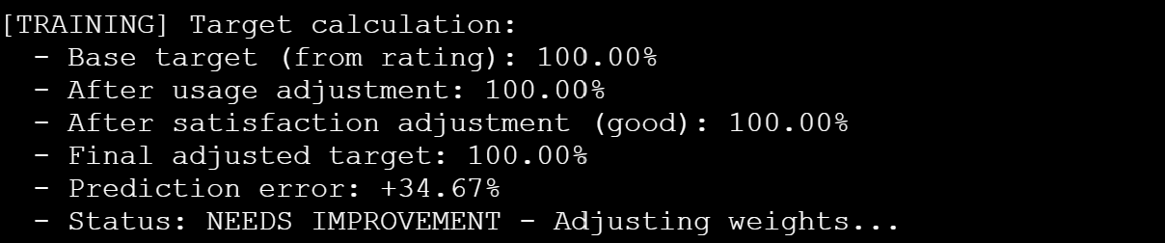
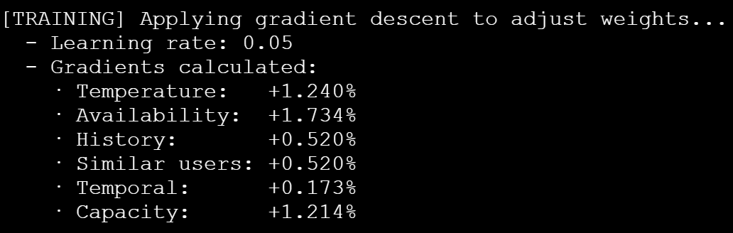
backend/src/ml/testTemporalSimple.js
backend/src/ml/testTrainingML.js

Slide 34
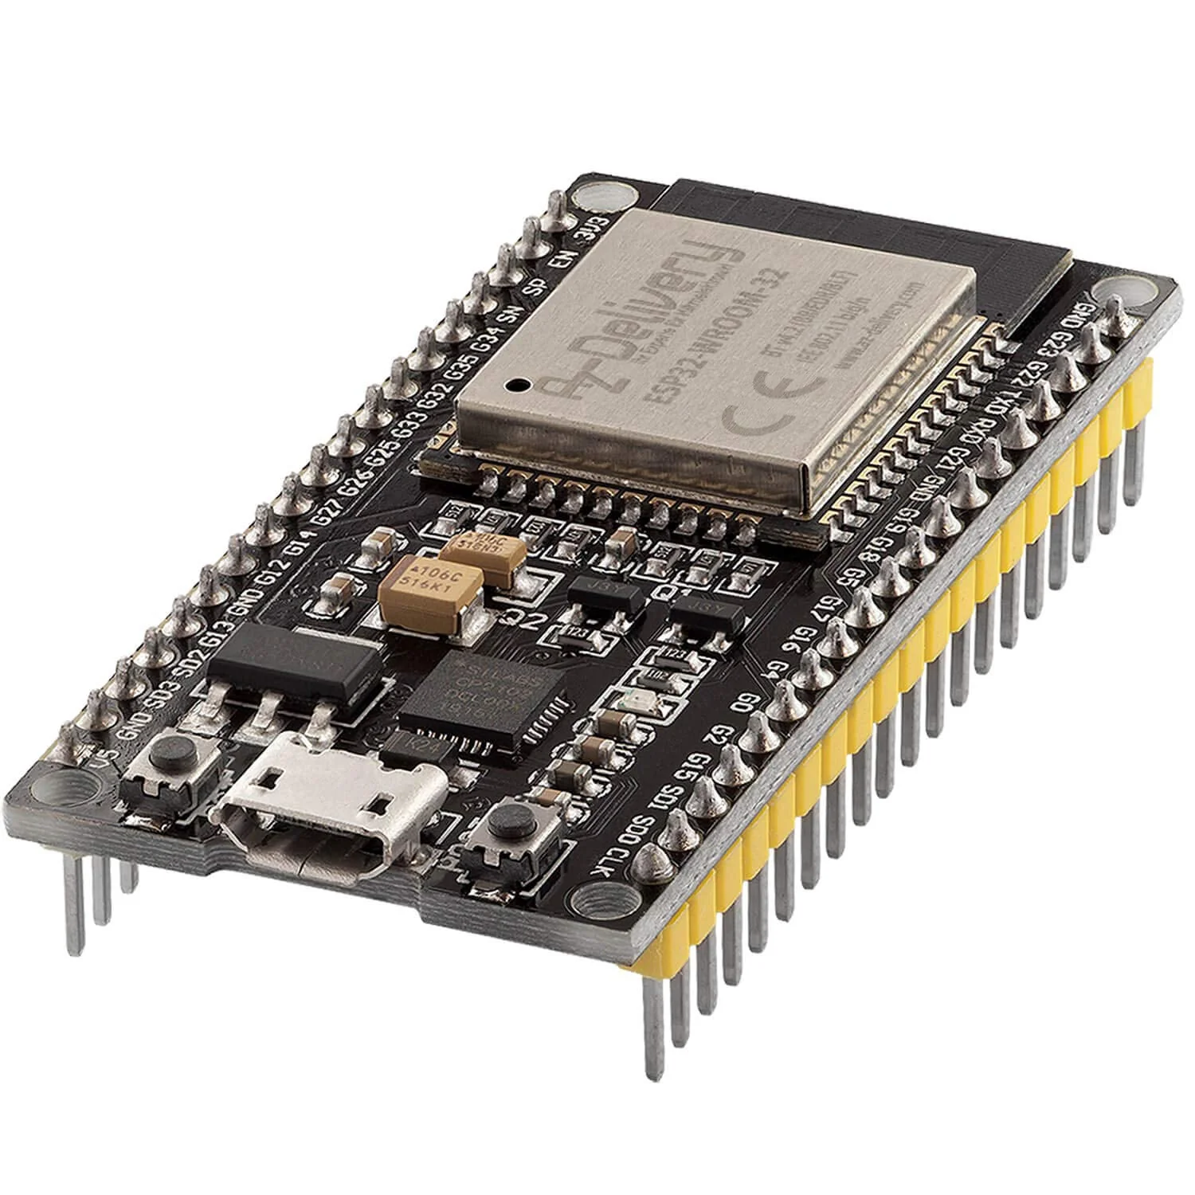
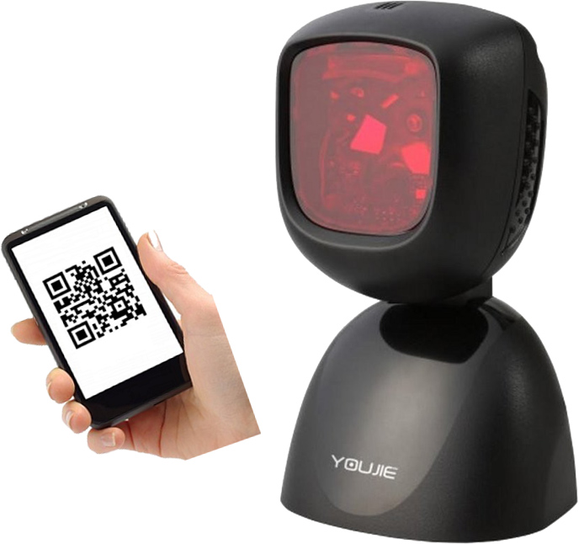
Future Improvements
Physical QR code reader
Multi-library management
AI Enhancement: addition of more variables (holidays or exams) or Deep Learning (hidden layers)
Arduino Serial → ESP32 (Wifi)

