Slide 1

SmartRisk
AI-Powered Insider Threat Detection
A machine learning-based cybersecurity system that detects potential insider threats by analyzing employee behavior patterns in real time — using a Random Forest Classifier and an interactive Streamlit dashboard.
PYTHON
SCIKIT-LEARN
PANDAS
STREAMLIT

Slide 2

The Insider Threat Problem
Organizations face growing risks from employees, contractors, and trusted users. Traditional security tools focus on external attacks — and consistently fail to detect suspicious internal behavior early enough to prevent incidents.
🔓 Unauthorized Access
Unapproved file access and system entry outside normal permissions
🔑 Failed Logins
Excessive failed login attempts signaling credential abuse
💾 USB Misuse
Unauthorized external device usage and data exfiltration
🌙 After-Hours Activity
Unusual downloads and system access outside working hours

Slide 3
Project Objectives
SmartRisk is designed to give security teams the intelligence they need — before an incident becomes a breach.
01
02
Detect Suspicious Activity
Generate Real-Time Risk Scores
Apply machine learning to employee behavior data for accurate threat identification
Assign a quantified risk probability to every user session or record
03
04
Support Bulk Analysis
Visualize & Report
Upload CSV datasets to analyze multiple user records simultaneously
Display feature importance and provide downloadable prediction reports

Slide 4
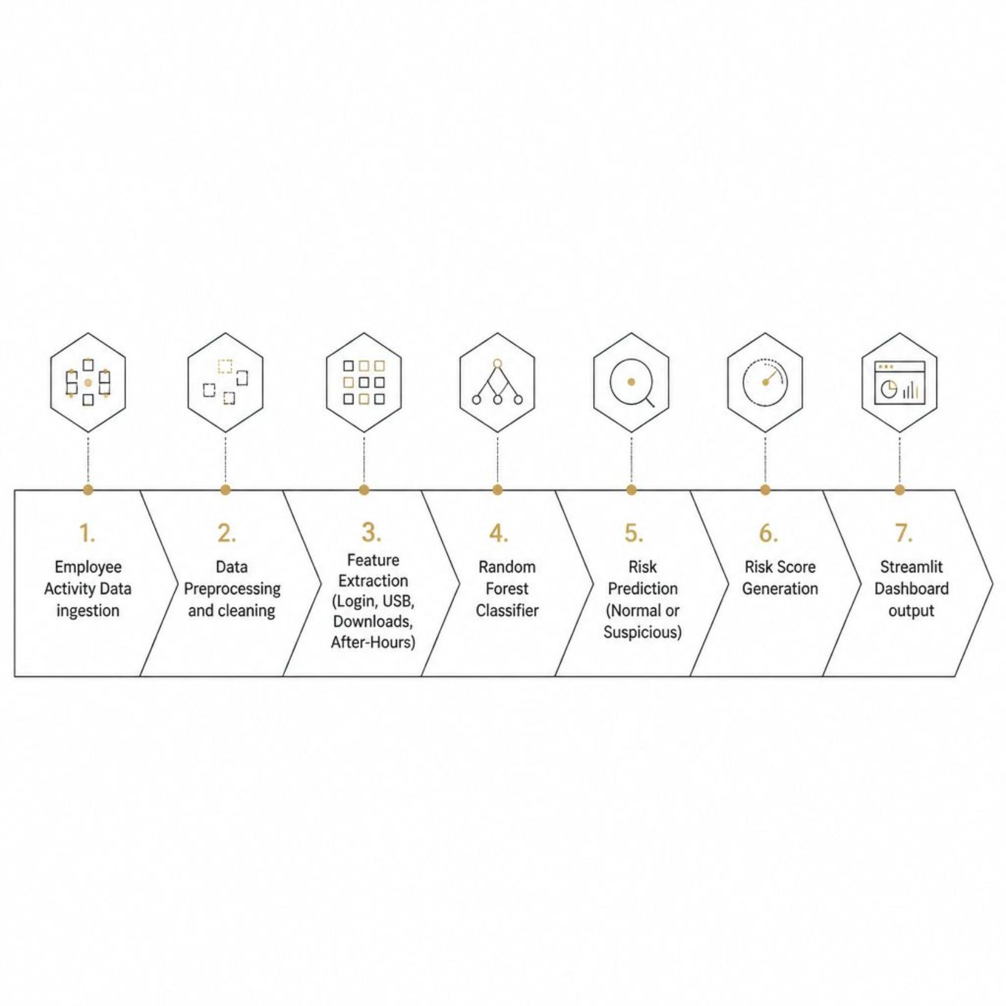
System Architecture
SmartRisk processes raw employee activity data through a structured ML pipeline — from ingestion to a real-time risk verdict displayed on the dashboard.
Login Time & Failed Attempts
USB Usage & File Access
Email Activity & Downloads
After-Hours Access Patterns

Slide 5

MACHINE LEARNING MODEL
Random Forest Classifier
SmartRisk uses an ensemble learning algorithm that combines multiple decision trees to deliver robust, accurate predictions — even on complex, noisy behavioral data.
High Accuracy
Handles Complex Data
Ensemble voting reduces individual tree errors
Works well with mixed categorical and numerical features
Reduces Overfitting
Fast Prediction
Random feature selection improves generalization
Low-latency inference suitable for real-time dashboards

Slide 6
Key Features of SmartRisk
Real-Time Prediction
Bulk CSV Upload
Instant classification of user activity as Normal or Suspicious
Analyze hundreds of user records in a single operation
Risk Score
Feature Importance
Quantified probability score (0–100%) for every prediction
Visual breakdown of which factors drove each decision
Report Download
Interactive Dashboard
Export prediction results for audit trails and compliance
Streamlit-powered UI for analysts and security teams

Slide 7
Technology Stack
SmartRisk is built on a mature, open-source Python ecosystem — ensuring reproducibility, scalability, and ease of deployment.
Technology
Role
Key Contribution
Python
Backend Development
Core application logic and ML pipeline
Pandas
Data Processing
Data cleaning, transformation, and CSV ingestion
NumPy
Numerical Computation
Efficient array operations for model input
Scikit-learn
Machine Learning
Random Forest model training and inference
Streamlit
Web Application
Interactive dashboard and user interface
Matplotlib
Visualization
Feature importance charts and graphs
Joblib
Model Storage
Persistent model serialization for deployment

Slide 8
Prediction Results in Action
Sample Input Record
Model Output
The dashboard delivers instant verdicts, supports CSV batch analysis, displays feature importance charts, and allows analysts to download full prediction reports for audit purposes.
Login Time
Failed Logins
Late Night
6 attempts
USB Usage
Downloads
Yes
High volume
After-Hours Access
Yes
⚠️ Prediction
📊 Risk Score
Suspicious Activity
92% probability

Slide 9
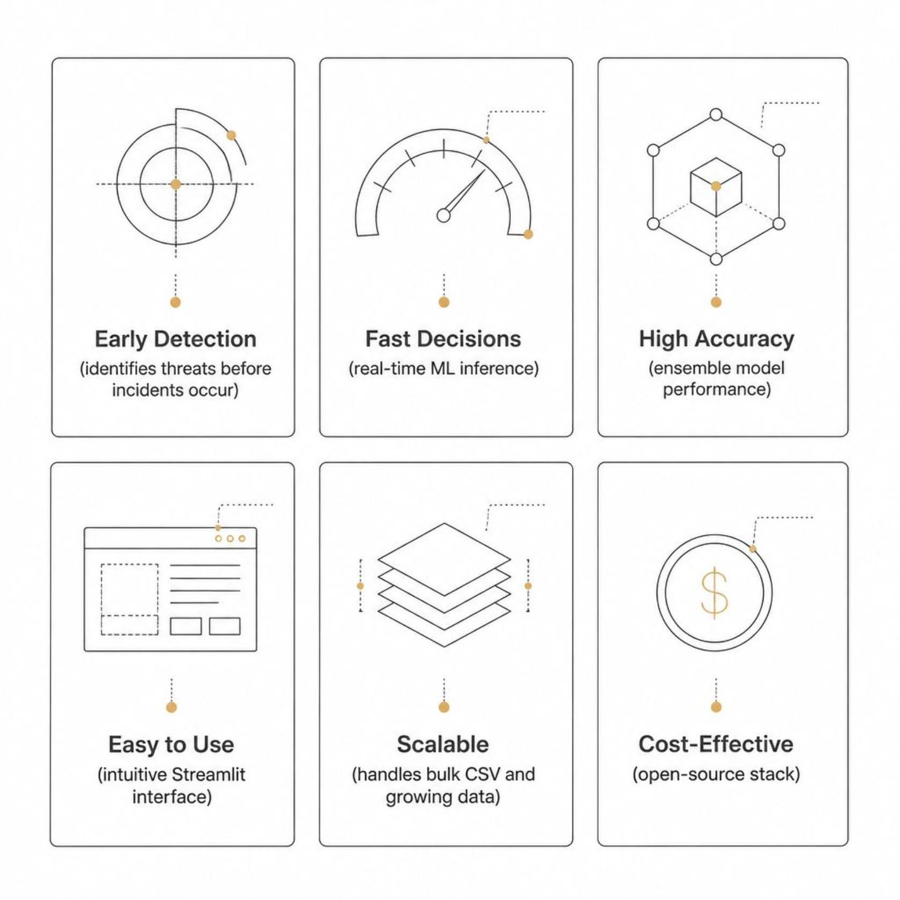
Advantages & Applications
Where SmartRisk Applies
Insider threat risk is universal — SmartRisk is designed for any organization with sensitive data and trusted user access.
Banking & Finance
Government & Defense
Protect customer data and prevent internal fraud
Secure classified systems and monitor contractor
access
Healthcare
Education & Enterprise
Safeguard patient records and comply with HIPAA
Monitor shared infrastructure across large user
bases

Slide 10

Conclusion & Future Scope
What SmartRisk Delivers
Roadmap Ahead
SmartRisk provides an intelligent, efficient solution for detecting insider threats. By analyzing employee behavior patterns and generating real-time risk predictions, it helps organizations strengthen cybersecurity posture and reduce internal security risks — before they become incidents.
Deep Learning Detection
LSTM and neural network models for temporal behavior analysis
SIEM Integration
SmartRisk demonstrates that accessible ML tools can deliver enterprise-grade insider threat detection without proprietary infrastructure.
Connect with Splunk, QRadar, and other enterprise platforms
Explainable AI (XAI)
Transparent, auditable prediction reasoning for compliance
Cloud & Alerting
Cloud deployment with automated email and SMS notifications

Slide 11
THANK YOU

