Slide 1
Safety in the Emergency Department
Notes:
Medical Science = three categories
Understanding disease biology
Developing effective therapies
Ensuring therapies are delivered effectively
This last one is dramatically under-researched! Viewed as the art of medicine

Slide 2
Quality
Notes:
What is quality? What are the components of quality?
Value/cost
Crossing the Quality Chasm (2001)
Safe: avoiding injuries to patients from the care that is intended to help them.
Effective: providing services based on scientific knowledge to all who could benefit, and refraining from providing services to those not likely to benefit.
Patient-centered: providing care that is respectful of and responsive to individual patient preferences, needs, and values, and ensuring that patient values guide all clinical decisions.
Timely: reducing waits and sometimes harmful delays for both those who receive and those who give care.
Efficient: avoiding waste, including waste of equipment, supplies, ideas, and energy.
Equitable: providing care that does not vary in quality because of personal characteristics such as gender, ethnicity, geographic location, and socioeconomic status.

Slide 3
A Pioneers of Quality
Ernest Codman – recording & reporting of individual physician outcomes
Joseph Juran – established the field of quality management, statistical control processes, and the Pareto Principle
Donald Berwick – one of the first to apply business quality management practices to healthcare
Peter Provonost – ICU checklists
Notes:
- Emergency medicine is where serious illnesses get diagnosed and treated in today’s healthcare system.
Diagnosis is often secondary to treatment of a specific problem – this is contrary to many other specialties, though by treating a problem you are by definition making a diagnosis (though this may be preliminary)
Because EM does not always have the luxury of seeing patients over multiple visits and establishing a long-term relationship, it is critical that quality improvement be incorporated into the practice of emergency medicine.
Ernest Codman (1869 – 1940) – codman’s triangle as well as an insistence on recording and reporting outcomes of individual docs. Was also one of the first to institute M&Ms. Lost admitting privileges to MGH for his efforts.
Joseph Juran (1904 – 2008) – EE from UMN - applied statistics to quality control but also recognized the importance of human factors and ability to apply quality control principles to service industries. Pareto principle or 80/20 rule = “the vital few and the useful many”
Donald Berwick (1980s-) – Pediatrician from Harvard – Crossing the Quality Chasm (2001),
Peter Provonost (2000s-) – critical care physician at Hopkins – ICU checklist saves 1500 lives over 18 months (Keystone ICU project). Included more than just a checklist – daily monitoring and discussion of central lines, changes to culture, etc.

Slide 4
Safety
High patient volume
High acuity and complexity
Time constraints
Multiple interruptions
Disrupted sleep cycles
High risk diagnostic/therapeutic interventions
Notes:
Defined as “freedom from accidental injury”
Working against safety:
high patient volume
patient acuity and complexity
time constraints
multiple interruptions
disrupted sleep cycles for health care workers
High risk diagnostic and therapeutic interventions

Slide 5
Errors in the Emergency Department
Fordyce et al, 2003: errors occurred at a rate of 1 for every 5 patients
Calder et al, 2010: adverse events occurred in 8.5% of patient visits
Notes:
Fordyce queried nurses, techs, physicians etc during shifts to catch errors/mishaps/mismanagement.
Reviewed them and decided whether it represented a true error
346 errors logged over a 7 day period
98% of those errors were not associated with an adverse outcome
Seizure after delay in obtaining antiepileptic levels
Needlestick while drawing from HIV+ patient
Incorrect eye meds
Respiratory distress after patient taken off BiPAP during transport to ICU
Pulmonary edema after too-rapid NS infusion
Vomiting after esophageal intubation
2 IVs removed, necessitating emergent central line placement
---------------------------------------------------------------------------
Calder – 503 patients over 4 months. In Canada. More intense follow-up of patients included calling 14 days after discharge or reviewing inpatient admission records.
- 6% of all discharged patients had some form of adverse event

Slide 6
What to do?
Wears, 2003:
Investigate accidents
Carefully study normal operations as well
✓
Sensing & Perception
Processing & Decision-Making
Taking Action
Notes:
Wears, 2003: editorial outlining some of the practices of atomic energy, mass transit, and other high-reliability organizations
Model for processes needed to perform any action
Where do we focus our training? Processing & Decision-Making, Taking Action (e.g. learning to put in a chest tube). One could argue that taking action is not as well researched in terms of *safely* taking action.
But do we focus completely on sensing & perception?

Slide 7
Human Factors
“Human error in medicine, and the
adverse events that may follow, are problems
of psychology and engineering,
not of medicine.”^{ǂ}
Failures of People
^{ǂ} Senders JW. Chapter 9: Medical devices, medical errors, and medical accidents. In: Bogner MS, eds. Human error in medicine. Hillsdale, NJ: Lawrence Erlbaum Associates, 1994:159–77.

Slide 8
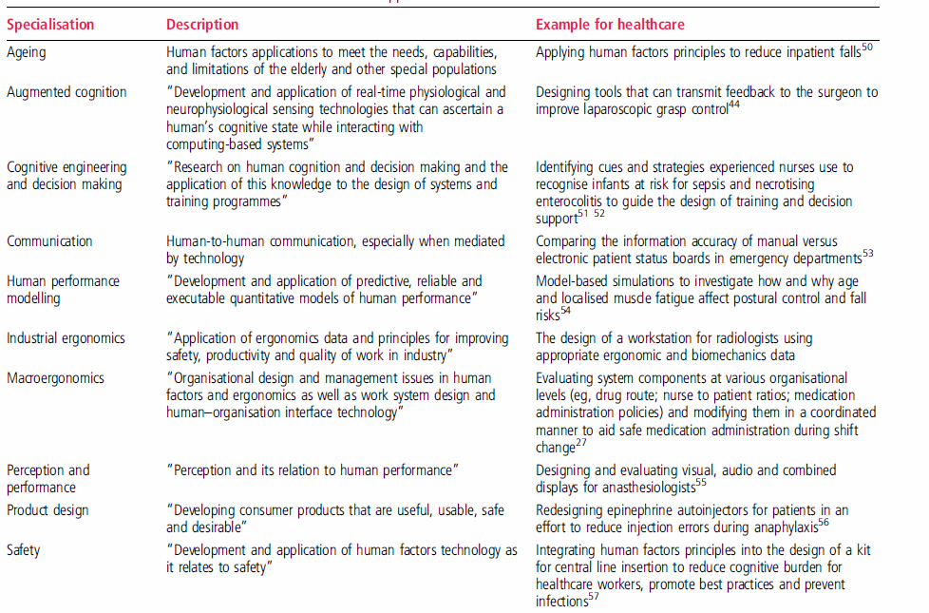
Human Factors
Notes:
Compare and contrast the industrial ergonomics of car interiors vs. ultrasound machines/drug pumps/EMRs

Slide 9
References
Committee on Quality Health Care in America, Institute of Medicine. (2001). Crossing the quality chasm : a new health system for the 21st century. Washington, D.C. National Academy Press.
Kelly, J. J., Thallner, E., Broida, R. I., & Cheung, D. (2010). Emergency Medicine Quality Improvement and Patient Safety Curriculum. Academic Emergency Medicine, 17(S2), E110-E129.
Stang, A. S., Wingert, A. S., Hartling, L., & Plint, A. C. (2013). Adverse Events Related to Emergency Department Care: A Systematic Review. PLOS ONE, 8(9). E74214.
Fordyce, J., Blank, F. S., Pekow, P., & Smithline, H. A. (2003). Errors in a Busy Emergency Department. Annals of Emergency Medicine, 42(3), 324-333.
Calder, L. A., Forster, A., Nelson, M., & Leclair, J. (2010). Canadian Journal of Emergency Medicine. Canadian Journal of Emergency Medicine, 12(5), 421-430.
Wears, R. L. (2003). A Different Approach to Safety in Emergency Medicine. Annals of Emergency Medicine, 42(3), 334-336.
Russ, A., Fairbanks, R. J., Karsh, B., & Militello, L. G. (2013). The Science of Human Factors: Separating Fact from Fiction. BMJ Quality & Safety, 22, 802-808.

