Slide 1
MuST-Walk
Multi-Scale Temporal Walk Encodings for Efficient Temporal Link Prediction
Abhi Raj (23125003) · Manas Dnyaneshvar Patil (23125020) · Kamranjeet Singh (23125016)
DAL 518: Graph Machine Learning, Project 4.3
Code and results: github.com/MDP2004/MuST-Walk
Notes:
Project 4.3: efficient temporal link prediction using temporal walk encodings. Three parts of six slides each. Part 1, slides 1 to 6: problem, literature and its problems. Part 2, slides 7 to 12: our methods and setup. Part 3, slides 13 to 18: results and what explains them.

Slide 2
Problem statement: predict the next edge in a stream of timed edges
The task
What this project asks
A dynamic graph is a stream of edges (u, v, t)
Given all edges before t, score the pair (u, v) at time t
Used in recommendation, communication analysis and forecasting
Two signals dominate: recent contact, and connection through shared neighbours
Can temporal walks give scalable, time-aware structural encodings?
Do several decay rates on one projection beat a single rate?
What does that cost in time and memory?
On which graphs does it help, and why?
Baseline: TPNet [1]. Proposed: MuST-Walk (several decay rates) and MuST-HN (with historical negatives [3]).
[1] Lu et al., NeurIPS 2024 [3] Poursafaei et al., NeurIPS D&B 2022
Notes:
State the task and the questions. The rest of the talk follows the literature, its problems, our methods, then the results.

Slide 3
Literature review
Area | Work | Main idea
Node memory | TGN (Rossi et al. 2020) [5] | Keep a state per node, updated by events
Walk sampling | CAWN (Wang et al. 2021) [6] | Sample anonymous walks around each pair
Sequence models | DyGFormer (Yu et al. 2023) [4] | Encode co-occurrence in first-hop histories
Supra-graph | SLATE (Karmim et al. 2024) [7] | Laplacian encoding of a multi-layer graph
Walk sketch | TPNet (Lu et al. 2024) [1] | Random projection of temporal walk matrices
Evaluation | Poursafaei et al. 2022 [3]; TGB, Huang et al. 2023 [2] | Historical negatives; standard benchmarks
Negative sampling | ENS 2024 [11]; CurNM 2025 [12]; ATNSF 2026 [13] | Harder negatives during training
Batching | Zhang et al. 2026 [9]; Lampert et al. 2026 [10] | Same-time information in batched models
Notes:
TPNet shows that many relative encodings are choices of a walk score and a readout. It is our baseline. The next two slides give its maths.

Slide 4
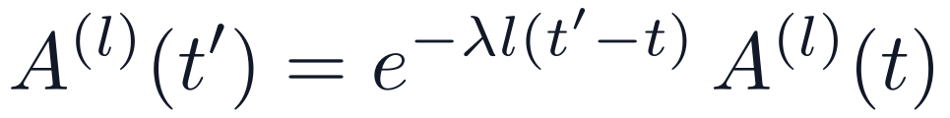
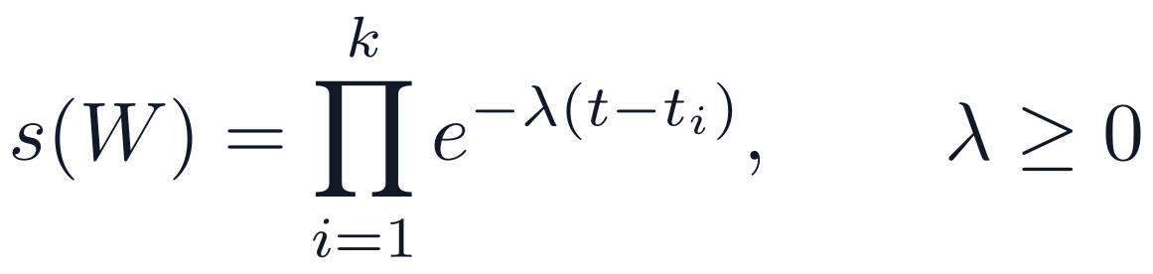
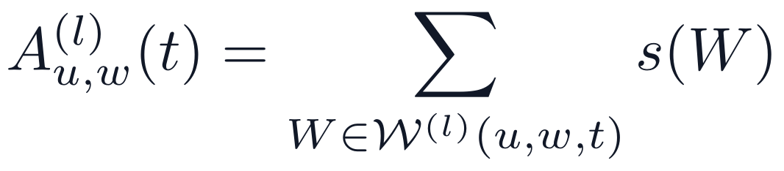
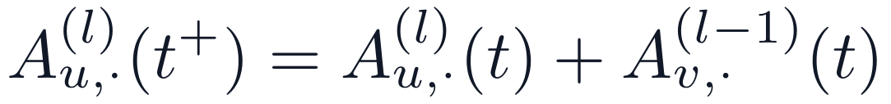
Literature: TPNet [1] scores temporal walks with one decay rate
Definition
Lemma 1: aging
A k-step walk leaves its start over its newest edge and moves to strictly older edges.
Proof: the walks do not change, and each of the l factors gains the same decay.
Lemma 2: event (u, v, t), with t the newest
Proof: times strictly decrease, so a new edge can only be a first hop. Its factor at t is 1, and the rest is an (l−1)-walk from v over older edges.
A⁽⁰⁾ = I. The matrix needs n × n numbers per depth, so it cannot be stored on a stream.
These two rules give all the dynamics of the walk matrix.
[1] Lu et al., NeurIPS 2024
Notes:
The score is a product of exponential decays, one per step. Lemma 2 is the key structural fact: a walk using the new edge uses it exactly once, as its first hop.

Slide 5
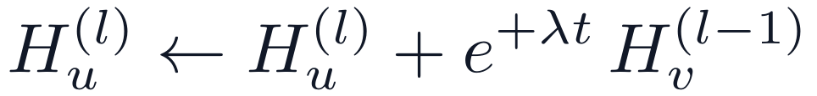
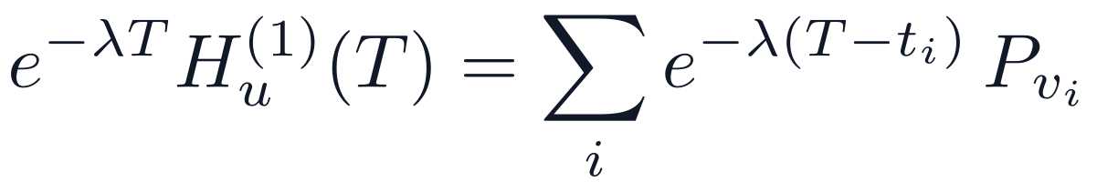
Literature: the sketch equals the walk matrix times a random P [1]
Stored update and theorem
Why the update carries +λ
Old edges are never shrunk; new edges are inflated, and the readout divides by today’s inflation
This is forward decay [8]
UN Vote: λt ≈ 2.2 × 10⁴, but a double overflows at e⁷⁰⁹, so the code ages every row
Walks use at most one edge per batch, so equal times never chain
Proof by induction over events
Start: both sides are 0 for l ≥ 1, and layer 0 is P
Between events: H is constant, so H̃ ages as in Lemma 1
At an event: multiply the update by e^(−λlt):
This is Lemma 2 times P, which closes the induction.
For λ > 0 every walk weight decays. The +λ is only the stored form of the same quantity.
[1] Lu et al., NeurIPS 2024 [8] Cormode et al., ICDE 2009
Notes:
This answers why the update has a positive sign while the walk score decays. Multiply the update by e^(-lambda l t): the exponents combine to e^(-lambda (l-1) t), the lower layer in decayed form.

Slide 6
Problems with the existing work
Method | Problem
Node memory [5] | Does not itself describe how two nodes relate
Walk sampling [6] | Sampling cost at every query
Sequence models [4] | Limited structural depth
Supra-graph [7] | Memory close to the full multi-layer graph
TPNet [1], our baseline
One memory length: one rate gives every pair one exponential memory
A rate tied to the time unit: 1e-5 gives e⁻³¹⁵ per year on yearly data
Cost in practice: independent of n in theory, but the code ages every row
Same-time leak: batches split a year, so same-year edges reach the sketch [9, 10]
Benchmarks
Random negatives are often true edges: 95.7% on UN Vote
Historical test [3] scores can reward test construction, not learning
We keep the sketch’s efficiency and address its memory, its cost and its correctness.
[1] Lu et al., NeurIPS 2024 [3] Poursafaei et al., NeurIPS D&B 2022 [4] Yu et al., NeurIPS 2023 [5] Rossi et al., ICML GRL Workshop 2020 [6] Wang et al., ICLR 2021 [7] Karmim et al., NeurIPS 2024 [9] Zhang et al., arXiv 2610.04869 [10] Lampert et al., TMLR 2026
Notes:
The families are described qualitatively. We do not compare numbers with them. The leak was first reported by Zhang et al.; we confirmed it independently. Hand over to the next speaker: these are the problems, and the next part shows what we built to address them.

Slide 7
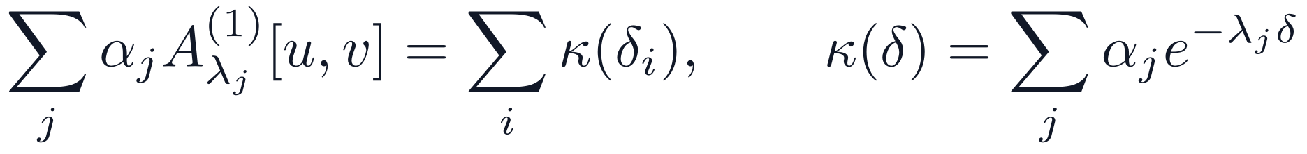
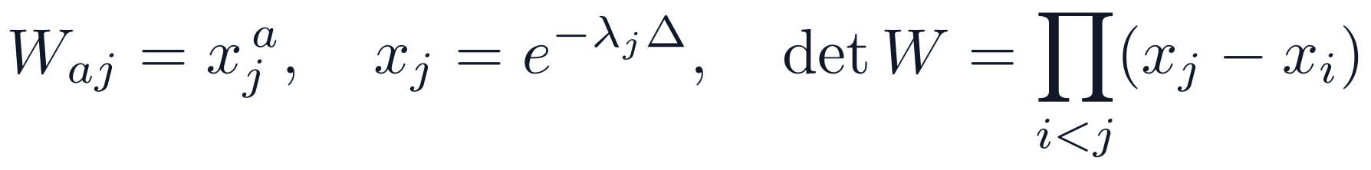
Our method 1: MuST-Walk uses several decay rates
Model
Read weight of each rate on yearly data
The sketch theorem [1] holds per scale, so no new approximation
Shared P makes inner products across scales meaningful
Proposition: a mix of rates is a learned memory kernel
One rate fixes κ to one exponential. Distinct xⱼ give an invertible Vandermonde matrix, so J rates fit any target on J ages.
Only rates in this window are distinct. Our ladder gives x ≈ 0, 0.043, 0.5, 1: four usable scales.
Fusion: concat is the main model; gate and average are ablations. Half-lives: 19 h at 1e-5, 8 d at 1e-6, 80 d at 1e-7, 1 y at 2.2e-8.
[1] Lu et al., NeurIPS 2024
Notes:
The update runs unchanged per scale. Sharing P saves J-1 copies of n d_R numbers, and with independent projections the expected inner product across scales is 0. A uniform ladder 1e-4 to 1e-7 gives x about 0, 0, 2e-14, 0.043: only about two usable scales.

Slide 8
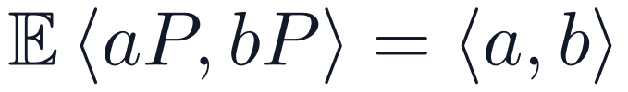
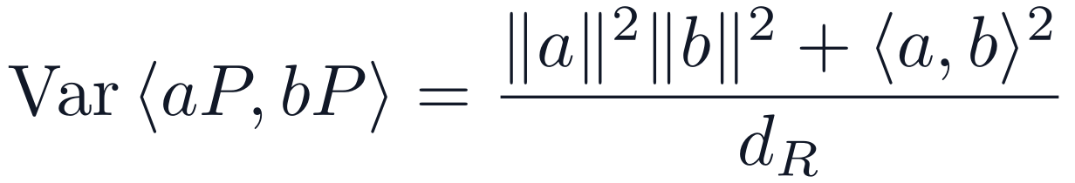
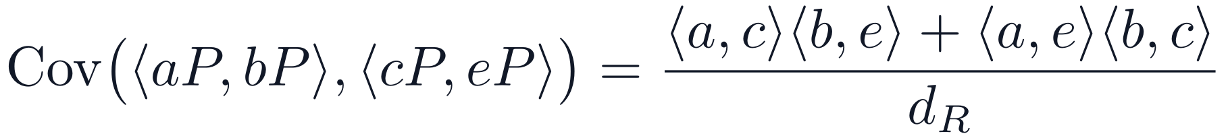
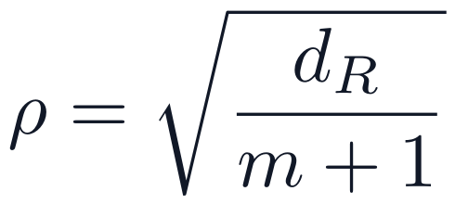
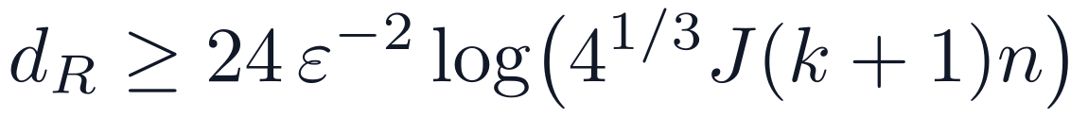
MuST-Walk: every sketched feature has exact noise
Proposition, by Isserlis’ theorem [16]
Measured separation ρ
Columns of P are independent Gaussians, so Isserlis applies per column.
Corollary: one contact among m
Theorem: guarantee across J scales [1, 17]
Take b = eᵥ with unit weights. A node with about dR contacts resolves one contact at about 1σ.
Chernoff, polarisation, union bound. Sharing P adds only log J.
At ε = ½ the bound asks for dR of 810 to 1,040; the code uses 110 to 140, so the variance formula is what applies.
dR = min(⌊ln 2E⌋ · 10, n). ρ = median aᵥ√dR / ‖a‖ for test positives. Near-duplicate scales also have near-duplicate noise, by the covariance formula.
[1] Lu et al., NeurIPS 2024 [16] Isserlis, Biometrika 1918 [17] Johnson and Lindenstrauss, Contemp. Math. 1984
Notes:
In one column X_a and X_b are jointly Gaussian with covariance <a,b>/d_R. Isserlis gives the covariance of products, and d_R columns sum. Theorem proof: for unit z the chi-squared Chernoff bound gives 2 exp(-d eps^2/6) for eps at most 1/2; polarisation handles inner products; union over N^2 pairs and two norms; the assumption means d >= 8 eps^-2 log(4N^3). Dense graphs resolve one contact near one noise unit.

Slide 9
Our method 2: MuST-HN trains on historical negatives
Method
Same model as MuST-Walk
About half of the fake training pairs are replaced by historical negatives [3]: stored pairs seen strictly before the batch and not active in its time interval
The best epoch is chosen on historical validation
 | Training fakes | What the model learns | At test, every fake is familiar
MuST-Walk | Random, so unfamiliar | Familiar means real | The score suffers
MuST-HN | Half were seen before | Familiarity alone proves nothing | The score rises
All-time contact count has AUC 0.35 on US Legis. and Can. Parl., below chance, so the signal changes sign
Linear walk features gain +4.27 to +22.11 from the same change
The gain is from training, not multi-scale: a single-rate model with the same training scores about the same (−0.25 AP).
Historical negatives are from [3]. Similar training: ENS [11], CurNM [12], ATNSF [13]. Training and selection changed together, so the gain cannot be split between them.
[3] Poursafaei et al., NeurIPS D&B 2022 [11] Gao et al., Neural Networks 2024 [12] Chen et al., Neural Networks 2025 [13] Jiang et al., IJCAI 2026
Notes:
MuST-HN against TPNet was not a pre-registered comparison, so it is exploratory. The cost is random AP, lower on 4 of 6 datasets.

Slide 10
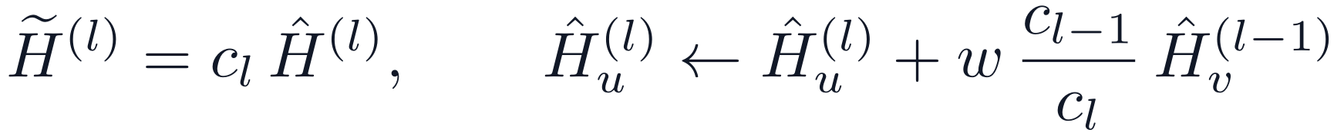

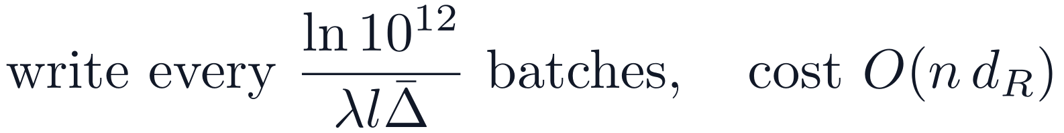
Efficiency: a lazy update removes the batch-wide write
Released code [1]: every row ages
Proposition: lazy update, using forward decay [8]
Proof: multiply the update by cₗ and the invariant gives the decay form. Aging only changes cₗ.
Lazy vs decay form, J = 4 | 10K | 100K | 1M
Speed-up | 1.2× | 2.6× | 24.4×
J = 4 vs 1: 4.1× update, 4.0× pair feature, 3.25× state. MuST-Walk runs took 1.7–2.8× as long as TPNet.
Only renormalisation still grows with n. Our graphs are far smaller, so 24.4× is a benchmark figure.
[1] Lu et al., NeurIPS 2024 [8] Cormode et al., ICDE 2009
Notes:
Without renormalisation c_(l-1)/c_l equals e^(+lambda (t - t0)), so the positive exponent returns relative to a moving origin. The benchmark has no renormalisation: gaps of 100 s per batch over 220 batches. State formula: 7,934.6 MiB predicted, 7,935.1 MiB measured at J = 4. Streaming against rebuild: 2.47 ms vs 11.93 s, about 4,800 times cheaper.

Slide 11
Correctness: a strict buffer, and what the sketch actually reads
The same-timestamp leak
Proposition: read weight
Cause: a yearly timestamp spans many 200-edge batches
Effect: batch 2 is predicted with batch 1 of that year already in the sketch
Size: 85–99% of direct-connection weight on yearly data
The sketch ages only when edges are applied, and a read applies no decay. So its clock stops at the last applied step.
Proposition: strict buffer
Tuned rate | e^(−λΔ) | Read, 1 step | Read, 2 steps | AUC
US Legis., 1e-6 | 2e-14 | 1 | 2e-14 | 0.772
Can. Parl., 1e-5 | 1e-137 | 1 | 0 | 0.966
UN Trade, 1e-7 | 0.043 | 1 | 0.043 | 0.745
UN Vote, 1e-5 | 1e-137 | 1 | 0 | 0.610
Edges wait until older than the batch’s earliest time. Proof: edges enter only if s < t_min ≤ t. Each moves once, so O(1) amortised.
TPNet [1], historical AP | US Legis. | Can. Parl. | UN Trade | UN Vote
Original code, 30 epochs | 91.11 | 83.43 | 71.98 | 74.94
Fixed code, 100 epochs | 66.25 | 81.37 | 61.00 | 57.18
Same epochs, US Legis. seed 0: the leak alone moves TPNet from 93.41 to 67.19.
Leak first reported by Zhang et al. [9]; see also Lampert et al. [10]; confirmed independently here. Table rows also differ in training length. AUC: pairs active one step ago against pairs seen only earlier.
[1] Lu et al., NeurIPS 2024 [9] Zhang et al., arXiv 2610.04869 [10] Lampert et al., TMLR 2026
Notes:
Measured on the real eager and lazy modules: a one-step-old edge is read at weight 1, and decay acts from the second step back. On UCI and Enron the clock lags by under a batch. Every result here uses the code as it ran.

Slide 12
Experimental setup: six graphs with very different structure
Dataset | Nodes | Edges | Steps | Density | Transitivity | Persistence | New-node edges | Free positives
US Legis. | 225 | 60,396 | 12 | 0.661 | 0.81 | 0.786 | 22.7% | 34.3%
Can. Parl. | 734 | 74,478 | 14 | 0.170 | 0.44 | 0.297 | 1.8% | 51.3%
UN Trade | 255 | 507,497 | 32 | 0.639 | 0.82 | 0.884 | 0.0% | 2.0%
UN Vote | 201 | 1,035,742 | 72 | 0.981 | 0.99 | 0.991 | 0.0% | 0.3%
UCI | 1,899 | 59,835 | 58,911 | 0.008 | 0.06 | 0.209 | 22.9% | 42.1%
Enron | 184 | 125,235 | 22,632 | 0.132 | 0.37 | 0.468 | 1.5% | 11.2%
US Legis. has a cliff: chance of return is 0.77 at one step, 0.015 at two, then exactly 0. Memory is not one exponential.
Primary metric: historical AP [3]. 100 epochs, patience 20, 3 seeds, 70/15/15 split in time order, 232 runs. Datasets: DyGLib [4], plus four from TGB [2].
[2] Huang et al., NeurIPS D&B 2023 [3] Poursafaei et al., NeurIPS D&B 2022 [4] Yu et al., NeurIPS 2023
Notes:
Density is the share of pairs that ever interact. Persistence: a pair active in one period stays active in the next, per step or per week on streams. Free positives are explained on slide 15. UCI pairs return in a median 20 minutes, Enron in 22.5 hours. Four TGB datasets are also evaluated; tgbl-wiki and tgbl-review were not inspected at the pair level. Hand over to the next speaker: this is the setup, and the next part gives the results.

Slide 13
Results: MuST-Walk is mixed, and MuST-HN beats TPNet on all six
Gain over TPNet | TPNet [1] | MuST-Walk | Seeds | MuST-HN | Seeds
US Legis. | 66.25 ± 10.86 | +9.64 | 2/3 | +24.28 | 3/3
Can. Parl. | 81.37 ± 4.39 | +4.74 | 3/3 | +9.95 | 3/3
UN Trade | 61.00 ± 1.20 | −0.79 | 2/3 | +26.48 | 3/3
UN Vote | 57.18 ± 4.22 | +2.72 | 2/3 | +14.77 | 3/3
UCI | 86.57 ± 0.61 | −1.02 | 0/3 | +9.74 | 3/3
Enron | 81.51 ± 1.26 | −2.35 | 0/3 | +9.01 | 3/3
MuST-Walk: 3 of 6 pass, 9 of 18 seeds, adjusted p = 0.4688
MuST-HN: 6 of 6, 18 of 18 seeds, exploratory
Noise alone would pass about 1.3 datasets by a rough model
MuST-HN’s gain is from training: a single-rate model with the same training scores about the same (−0.25 AP).
Other tests vs TPNet. MuST-Walk: random mean −0.13, inductive up on 5 of 6. MuST-HN: random lower on 4 of 6, inductive up on all six.
Bold: mean gain ≥ +1.0 AP and at least 2 of 3 seeds. Mean ± std over 3 seeds. The cross-dataset test [14, 15] could not reach 0.05: minimum 4 · 2⁻⁶ = 0.0625.
[1] Lu et al., NeurIPS 2024 [14] Wilcoxon, Biometrics Bulletin 1945 [15] Holm, Scand. J. Statistics 1979
Notes:
Start of part 3. MuST-Walk per seed: US Legis. +16.14, +17.58, -4.79; UN Vote -0.83, +0.41, +8.57. One seed carries UN Vote. Random validation carries little signal: two UN Vote TPNet seeds had validation 56.57 and scored 60.25 and 52.37. A confirmation on new seeds on the original code gave -0.57 AP, 4 of 8 wins, p = 0.63. MuST-HN against TPNet was not pre-registered.

Slide 14
Results: TGB and ablations, each against TPNet
TGB [2], test MRR
Ablations on fixed code: US Legis., TPNet at 66.25
Dataset | TPNet | MuST-Walk | MuST-HN
tgbl-wiki | 0.8239 | 0.8260 | 0.7673
tgbl-review | 0.4033 | 0.4025 | 0.4939
tgbl-enron | 0.5909 | 0.5837 | 0.5854
tgbl-uci | 0.2620 | 0.3868 | 0.3192
Configuration | AP | Gain | Seeds
J = 5, concat (MuST-Walk) | 75.90 | +9.64 | 2/3
J = 3 | 75.21 | +8.96 | 2/3
Uniform ladder 1e-4 … 1e-7 | 69.40 | +3.15 | 2/3
Log-spaced half-lives | 70.72 | +4.47 | 2/3
Average fusion | 80.88 | +14.63 | 3/3
Gate fusion | 81.72 | +15.47 | 3/3
Gate + LayerNorm | 72.59 | +6.34 | 2/3
Blue: mean gain ≥ +0.005 and at least 2 of 3 seeds
TGB negatives are fixed, so the free-positive effect need not apply
TPNet seed 0 on tgbl-uci is low at 0.1784
tgbl-review got 5–9 epochs, unevenly
The uniform ladder gains least: its scales collapse to about two values on yearly data, and it has no slow scale.
Ablations cover one dataset, so fusion and scale choices are not settled across graphs.
TGB: means of three seeds, not leaderboard entries, since our validation rule differs. TPNet on tgbl-wiki is within the pre-registered 0.02 of its published 0.827 [1]. Streaming vs rebuild: about 4,800× cheaper.
[1] Lu et al., NeurIPS 2024 [2] Huang et al., NeurIPS D&B 2023
Notes:
MuST-HN against TPNet on TGB: +0.091 on tgbl-review, +0.057 on tgbl-uci, -0.057 on tgbl-wiki, -0.005 on tgbl-enron. On a synthetic task built to need two time scales MuST-Walk beat the best single rate by +2.69 and +2.21. A confirmation on new seeds on the original code gave -0.57 AP, 4 of 8 wins, p = 0.63.

Slide 15
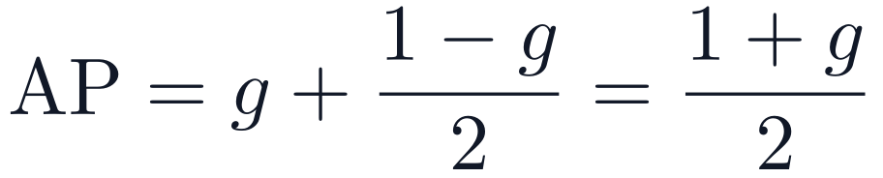
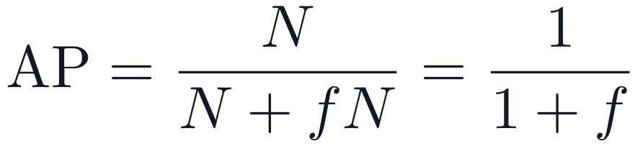
Results explained: a never-seen pair cannot be a historical negative
Proposition: free positives
Effect on scores
A historical negative [3] was seen in its stored direction, by definition. So a pair never seen that way is certainly real.
Historical AP | g | Floor | Novelty rule | TPNet [1] | MuST-HN
US Legis. | 34.3% | 67.1 | 89.59 | 66.25 | 90.54
Can. Parl. | 51.3% | 75.7 | 93.92 | 81.37 | 91.32
UN Trade | 2.0% | 51.0 | 84.58 | 61.00 | 87.48
UN Vote | 0.3% | 50.1 | 86.32 | 57.18 | 71.95
UCI | 42.1% | 71.0 | 97.36 | 86.57 | 96.31
Enron | 11.2% | 55.6 | 93.20 | 81.51 | 90.52
Proof: gN pairs reach precision 1. The other positives tie with the N negatives at precision ½.
Proposition: random-test level
A fraction f of random fakes are true edges, tied with positives. UN Vote: f = 95.7%, level 51.1.
The novelty rule uses no learning: never seen in stored direction first, then last contact.
A rule with no learning beats both proposed methods on four of six datasets.
[1] Lu et al., NeurIPS 2024 [3] Poursafaei et al., NeurIPS D&B 2022
Notes:
Proof of the floor: gN pairs score above everything with precision 1 up to recall g; the other (1-g)N positives tie with the N negatives, so the next step reaches recall 1 at precision 1/2. AP = g + (1-g)/2. The novelty rule is measured on our replication of the test; its plain last-contact version gives 70.78, 64.56, 73.52, 54.84, 78.48, 85.53. Direction-aware geometric recency on the real test gave 94.58 on UN Trade and 96.27 on UN Vote.

Slide 16
Results explained: why several rates gain, and where the gain goes
Proposition: fast decay ties novelty with absence
Ladder gain over tuned rate, linear walk features
A slow scale separates pairs that the tuned rate reads the same
At the tuned rate 77.7% of negatives read zero on US Legis., 88.3% on Can. Parl.
On UCI none do: its half-life is 80 days
Proposition: direction blindness
The update is symmetric in u and v, so reversing a stored edge changes nothing. UN Vote: 81.0% of negatives are active in reverse.
Remove the free positives and most of the gain disappears: +13.65 to +1.32 on US Legis., +27.77 to +5.18 on Can. Parl.
No neural network here, and exploratory. The gain has the same sign in linear features and neural models on 5 of 6 datasets. On UCI the ladder lacks the 1e-5 rate the graph needs.
Notes:
This is the central result. What remains is modest real signal. Whether the neural MuST-Walk uses novelty exactly this way is likely, not proven. Proof of the tie: under the read weight a contact a steps old contributes at most exp(-lambda (a-1) Delta), near zero when lambda Delta is large; at lambda = 0 each contact contributes 1.

Slide 17
Results explained: graph structure decides each outcome
Dataset | Structure | Why the result came out this way | MuST-Walk | MuST-HN
US Legis. | Cohort turnover, memory cliff | Slow scale breaks the tie; +1.32 without free positives | +9.64 | +24.28
Can. Parl. | New pairs among known nodes | Most real gain, +5.18; two-hop AUC 0.87 vs 0.65 direct | +4.74 | +9.95
UN Trade | Dense, persistent, few new pairs | Any rate works: 92.5 linear; random training hurts | −0.79 | +26.48
UN Vote | Near complete, walks saturate | Only direction matters, and the sketch cannot see it | +2.72 | +14.77
UCI | Sparse, bursty, 20-minute returns | Half-life of 80 days is too slow; 1e-5 is not in the ladder | −1.02 | +9.74
Enron | Hubs, smooth memory | Tuned rate already right: 8-day half-life, no headroom | −2.35 | +9.01
MuST-Walk helps when two conditions hold: many novel positives, and a tuned rate fast enough to tie them. This fits 5 of 6 datasets; UN Vote’s gain rests on one seed
MuST-HN gains everywhere because it fixes the sign of the signal, which is a separate effect
Gains are over TPNet [1]. Readings of the neural models are likely explanations, tested at feature level only.
[1] Lu et al., NeurIPS 2024
Notes:
Can. Parl.: at the tuned rate common neighbours reach AUC 0.87 against 0.65 for direct contact. UN Vote: common neighbours are 197 for both classes, AUC 0.55, and one contact sits at 0.81 noise units. UCI: half of active nodes are gone a month later.

Slide 18
Limitations, conclusions and references
Limitations
Conclusions
References
Three seeds, and a rule that noise can pass
Six graphs cannot give a structural law
Feature-level test is linear and idealised
No neural single-rate sweep on fixed code
MuST-HN changed training and selection together, not pre-registered
Ablations on one dataset; leak isolated on one seed
Sketch width is below the theorem’s bound
Several rates are cheap and clean: linear in J, no new approximation
Not a general improvement: 3 of 6 datasets, 9 of 18 seeds
Most of that gain comes from how the historical test is built
MuST-HN beats TPNet on all six, from training, not scales
Report simple rules beside any model
[1] Lu et al. TPNet. NeurIPS 2024
[2] Huang et al. TGB. NeurIPS D&B 2023
[3] Poursafaei et al. NeurIPS D&B 2022
[4] Yu et al. DyGFormer, DyGLib. NeurIPS 2023
[5] Rossi et al. TGN. ICML GRL Workshop 2020
[6] Wang et al. CAWN. ICLR 2021
[7] Karmim et al. SLATE. NeurIPS 2024
[8] Cormode et al. Forward decay. ICDE 2009
[9] Zhang et al. arXiv 2610.04869
[10] Lampert et al. TMLR 2026
[11] Gao et al. ENS. Neural Networks 2024
[12] Chen et al. CurNM. Neural Networks 2025
[13] Jiang et al. ATNSF. IJCAI 2026
[14] Wilcoxon. Biometrics Bulletin 1945
[15] Holm. Scand. J. Statistics 1979
[16] Isserlis. Biometrika 1918
[17] Johnson, Lindenstrauss. Contemp. Math. 1984
Code, tests, run lists and results: github.com/MDP2004/MuST-Walk
Notes:
At feature level the ladder differs from the best single rate by +3.47, +10.61, -0.29, +3.21, -0.93 and +0.53. Next steps: a historical test that also samples unseen pairs, a neural single-rate sweep on fixed code, ladders set from each graph’s own memory, and a direction-aware sketch update.

