Slide 1
MuST-Walk
Multi-Scale Temporal Walk Encodings for Efficient Link Prediction
Abhi Raj (23125003) · Manas Dnyaneshvar Patil (23125020) · Kamranjeet Singh (23125016)
DAL 518: Graph Machine Learning, Project 4.3
Code and results: github.com/MDP2004/MuST-Walk
Notes:
Project 4.3: efficient temporal link prediction using temporal walk encodings.

Slide 2
A single decay rate cannot serve both short and long memory
Problem
This project
Stream of timed edges (u, v, t); predict who interacts next
Recency and frequency of contact are the strongest signals
TPNet encodes temporal walks with one decay rate λ per dataset
On yearly data, λ = 1e-5 leaves a factor of e⁻³¹⁵ ≈ 1e-137 after one year
MuST-Walk: J decay rates on one shared random projection
Lazy update: true O(k·dR) per edge, 24× faster at 1M nodes
Data inspection: a timestamp leak, a score ceiling and a direction effect
Evaluation: 232 runs on 10 datasets, rules fixed in advance
Multi-scale helps where the tuned rate erases recent history. Hard negatives change results far more.
Notes:
State the main result here so the audience knows where the talk is heading.

Slide 3
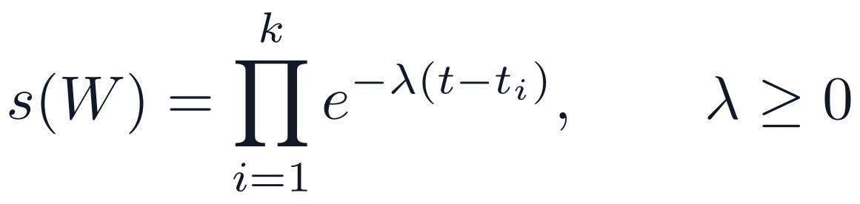
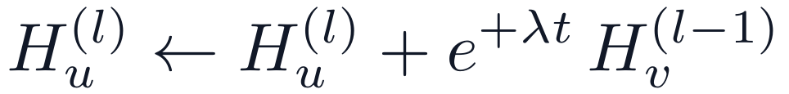
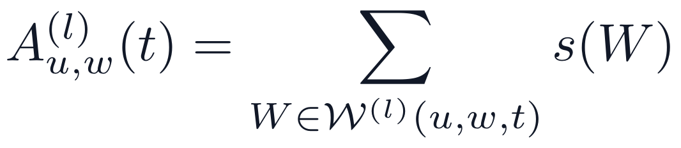
TPNet maintains a temporal walk matrix through a random projection
Temporal walk score
Update on edge (u, v, t), l = k … 1
Readout
Layer 0 is P: a random Gaussian matrix, n × dR, entries N(0, 1/dR)
Pair feature: inner products among both nodes’ layers, D = (2k+2)²
Guarantee: with dR ≥ 24 ε⁻² log(4^(1/3) (k+1) n), inner products are preserved within ε
Notes:
k is walk depth, n nodes, dR sketch width. The readout and the update have opposite signs, which the next slide explains.

Slide 4
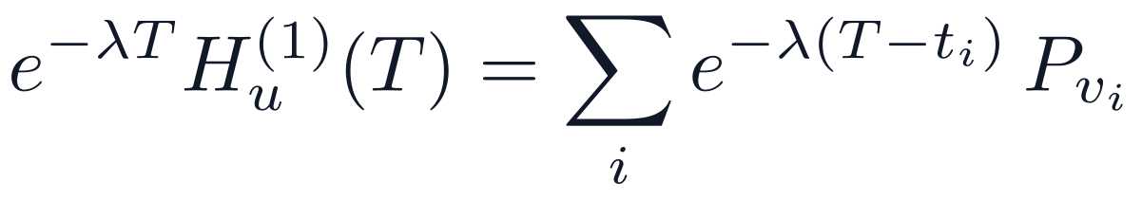
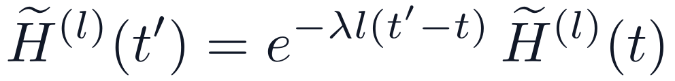

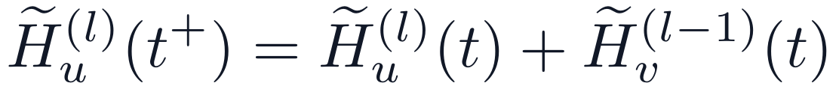
The update grows with +λ, while the true walk weight decays with −λ
Proposition: both forms are the same recursion
One-line view, l = 1
Define the decayed state:
Between events H is constant, so:
New edges are inflated, and the readout divides by today’s inflation.
Why the code cannot store e^(+λt)
At an event, multiply the update by e^(−λlt):
UN Vote at λ = 1e-5 overflows a double, so the released code applies the decay form to every row.
For λ > 0 every walk weight decays. The +λ is only the stored form of the same quantity.
Notes:
This is forward decay, Cormode et al. 2009. The decay form is numerically safe but it touches every node, which is the cost we fix later.

Slide 5
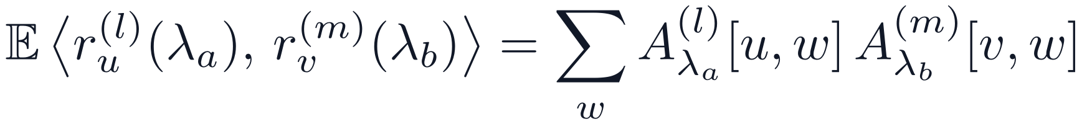
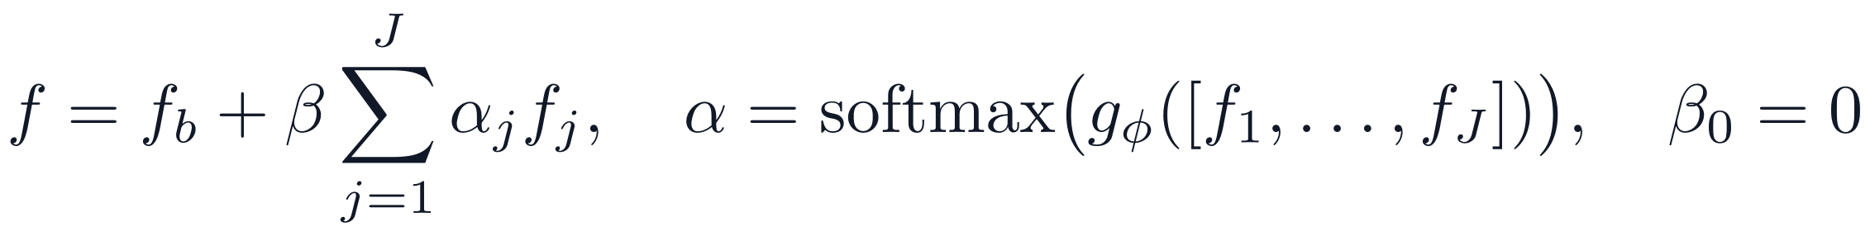
MuST-Walk keeps J sketches on one shared projection
Sketches
Why one shared projection
Theorem 1 holds per scale by linearity
Rates spread around the tuned rate, plus λ = 0
JL bound gains only a log J term
Shared P makes inner products between scales meaningful; independent projections give 0 in expectation
Measures how u’s recent contacts overlap v’s older contacts
MuST-Cross adds J(J−1)(k+1)² such features, with no extra state
MuST-Equal uses width dR/J, so total memory equals TPNet’s
Fusion
Concat became the main model: early gate results were unstable.
Notes:
Proof of the cross-scale result: r_u = A[u,:] P, so the inner product is A_a[u,:] P P^T A_b[v,:]^T and E[P P^T] = I. The union bound over J scales adds log J inside the JL bound.

Slide 6
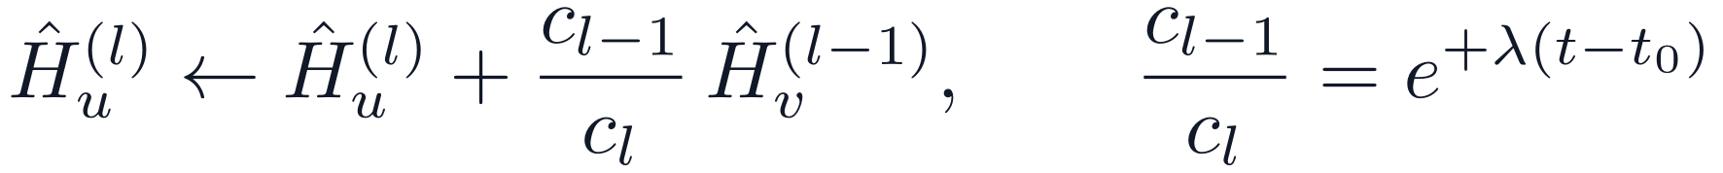

A lazy update delivers the O(k·dR) per-edge cost
Decay form: every row ages
Full cost
Operation | Cost
Update, released code | O(J k dR (1 + n/b)) per edge
Update, lazy | O(J k dR) per edge
Strict-time buffer | O(1) amortised per edge
Pair feature | O(J (2k+2)² dR) per query
MuST-Cross features | O(J² (k+1)² dR) per query
Gate | O(J D²) per query
Full rebuild | O(J k dR E) for E edges
Sketch state | (1 + Jk) n dR numbers
Lazy: age one number per layer
A layer is written out only when its scale drops below 1e-12. Values match the decay form to about 1e-7.
Forward decay: Cormode et al., ICDE 2009. k depth, J scales, n nodes, dR width, b batch size, E edges.
Notes:
In the lazy form the ratio c_(l-1)/c_l equals e^(+lambda (t - t0)), so the positive exponent returns relative to a moving origin. Renormalisation is a full write that happens rarely.

Slide 7
Measured cost matches the analysis
Measure | Result
Lazy vs decay form, 1M nodes, J = 4 | 24.4× faster
Streaming vs rebuild, J = 4 | ≈ 4,800× cheaper
Lazy, J = 1 to 4, µs per edge | 3.4, 7.0, 10.3, 14.1
Memory, predicted vs measured
n = 1M, dR = 160 | Formula | Measured
J = 1 | 2,441.4 MiB | 2,441.5 MiB
J = 4 | 7,934.6 MiB | 7,935.1 MiB
Notes:
Tesla T4, batch size 200. Streaming: 2.47 ms against 11.93 s at 100K nodes and 1M past edges on an RTX 6000 Ada. The formula counts P once.

Slide 8
Six datasets inspected pair by pair, four more evaluated on TGB
Dataset | Nodes | Edges | Timestamps | Same-time sketch weight | Random fakes truly real | Test pairs never seen
US Legis. | 225 | 60,396 | 12 | 96% | 44.0% | 22.8%
Can. Parl. | 734 | 74,478 | 14 | 98% | 8.3% | 48.4%
UN Trade | 255 | 507,497 | 32 | 85% | 59.9% | 0.9%
UN Vote | 201 | 1,035,742 | 72 | 99% | 95.7% | 0.0%
UCI | 1,899 | 59,835 | 58,911 | 0.0% | 0.1% | 17.9%
Enron | 184 | 125,235 | 22,632 | 3.3% | 5.3% | 9.2%
TGB: tgbl-wiki (157K edges), tgbl-review (4.9M), tgbl-uci, tgbl-enron
Checks: two hand-traced graphs, and the sketch against brute-force walks, error about 1e-7
Also found: unscaled edge features, max 52,504,548 on UN Trade; 18–32% of early edges miss the sketch
Notes:
Same-time weight is the share of one-hop sketch weight that comes from edges at the query timestamp, at the tuned rate. Yearly graphs are near complete, which explains the false negatives.

Slide 9
Tied timestamps leaked into the sketch on yearly data
Cause: thousands of edges share one yearly timestamp, and fixed 200-edge batches split them
Effect: batch 2 of a year is predicted with batch 1 of that year already in the sketch
Size: 85–99% of one-hop weight on yearly data; 0.0% on UCI, 3.3% on Enron
Fix: a strict-time buffer
Edges wait until strictly older than the earliest timestamp in the batch.
Identical to the original on graphs with no ties, which we verified.
Baseline TPNet, historical AP | US Legis. | Can. Parl. | UN Trade | UN Vote
Original code, 30 epochs | 91.11 | 83.43 | 71.98 | 74.94
Fixed code, 100 epochs | 66.25 | 81.37 | 61.00 | 57.18
First reported by Zhang et al. (SNAM, arXiv 2610.04869); found independently here. Both rows differ in training length as well.
Notes:
The paper handles ties as a set, which is sound. The released code uses fixed-size batches. All results that follow use the fixed code.

Slide 10
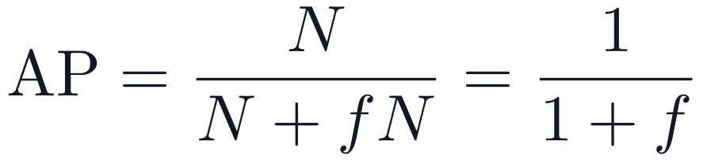
Two properties of these benchmarks limit what a score can mean
Random negatives have a ceiling
Hard negatives have a direction effect
If a fraction f of random fakes are real and tied with positives:
Many hard fakes are real in reverse: 81.0% on UN Vote, 23.2% on UN Trade, at most 12.7% elsewhere.
Historical AP | Direction-blind rule | Direction-aware rule | Best model
US Legis. | 71.76 | 69.96 | 90.54
Can. Parl. | 66.56 | 67.18 | 92.21
UN Trade | 88.99 | 94.58 | 88.42
UN Vote | 55.05 | 96.27 | 73.74
UCI | 78.56 | 75.07 | 96.75
Enron | 85.91 | 86.32 | 90.95
Random AP | Ceiling | Baseline
US Legis. | 69.4 | 69.71
Can. Parl. | 92.3 | 80.55
UN Trade | 62.5 | 67.53
UN Vote | 51.1 | 55.23
A simple recency rule beats every model on UN Trade and UN Vote, so those scores need care.
Notes:
Proof of the ceiling: all N(1+f) true edges tie at the top, so precision is 1/(1+f). A model can exceed it slightly by ranking test pairs above other true pairs. The rules use no learning: recency weighted by age, and last-seen time on UCI and Enron. Exploratory.

Slide 11
Evaluation: 232 runs under rules fixed before results existed
Model | Definition
TPNet | Tuned single rate, fixed code
MuST-Walk | Rate ladder, concat
MuST-Cross | MuST-Walk + cross-scale features
MuST-Equal | MuST-Walk with width dR/J
-HN | Trained on hard negatives
Protocol: 100 epochs, patience 20, 3 seeds, 70/15/15 split in time order
Primary metric: historical AP; random and inductive AP also reported
Model selection: best validation epoch, tested once
Supported: mean gain ≥ +1.0 AP and at least 2 of 3 seeds won
Block | Runs | Compute hours
Main experiment | 126 | 276.8
Large datasets | 52 | 211.1
Ablations, learned decay, synthetic | 54 | 46.8
Total | 232 | 534.7
About 45 elapsed hours: 12× from running in parallel
Limit: 17 runs stopped at a time cap and used their best checkpoint
Notes:
Each epoch gives a new model version; we keep the one with the best validation score and test it once. Cross-dataset Wilcoxon with Holm over 4 tests cannot go below 4/64 = 0.0625 with 6 datasets, which we noticed after the runs and report as is.

Slide 12
Hard-negative training gives the best score on all six datasets
Historical AP | TPNet | MuST-Walk | MuST-Cross | MuST-Equal | TPNet-HN | MuST-HN | Cross-HN
US Legis. | 66.25 | 75.90 | 81.36 | 74.32 | 89.37 | 90.54 | 89.79
Can. Parl. | 81.37 | 86.11 | 82.32 | 88.19 | 92.21 | 91.32 | 91.38
UN Trade | 61.00 | 60.21 | 61.30 | 61.01 | 86.62 | 87.48 | 88.42
UN Vote | 57.18 | 59.89 | 60.42 | 63.98 | 73.74 | 71.95 | 68.32
UCI | 86.57 | 85.55 | 86.57 | 86.45 | 96.75 | 96.31 | 95.30
Enron | 81.51 | 79.16 | 81.07 | 79.17 | 90.95 | 90.52 | 90.86
MuST-Walk beats TPNet on 3 of 6, and MuST-Equal matches that pattern with no extra memory
With hard negatives on, multi-scale adds little: MuST-HN vs TPNet-HN is −1.79 to +1.16
Notes:
Mean over 3 seeds. The best-per-dataset highlight is descriptive. UN Vote MuST-Walk and MuST-HN seeds 1 and 2 stopped at time caps near 52 and 29 epochs.

Slide 13
Per-dataset gains, and what hard negatives cost
Gain, AP points | US Legis. | Can. Parl. | UN Trade | UN Vote | UCI | Enron | Supported
MuST-Walk vs TPNet | +9.64 | +4.74 | −0.79 | +2.72 | −1.02 | −2.35 | 3 of 6
MuST-Cross vs MuST-Walk | +5.47 | −3.79 | +1.09 | +0.53 | +1.02 | +1.91 | 4 of 6
MuST-Equal vs TPNet | +8.06 | +6.82 | +0.01 | +6.80 | −0.12 | −2.34 | 3 of 6
TPNet-HN vs TPNet | +23.12 | +10.84 | +25.62 | +16.56 | +10.18 | +9.44 | 6 of 6
MuST-HN vs MuST-Walk | +14.64 | +5.21 | +27.27 | +12.06 | +10.76 | +11.36 | 6 of 6
TPNet-HN, random AP | +0.10 | −0.40 | −6.36 | +0.56 | −3.97 | −1.10 | Cost
TPNet-HN, inductive AP | +15.22 | +5.83 | +24.90 | +10.47 | +15.39 | +11.03 | Benefit
Blue means supported under the fixed rule
Cross-dataset test: adjusted p = 0.4688 for three comparisons and 0.0625 for MuST-HN, so none reach 0.05
Seed level, exploratory: MuST-Walk wins 9 of 18 against TPNet, hard negatives 18 of 18
Hard negatives follow Poursafaei et al. 2022. Similar training appears in ENS, CurNM and ATNSF.
Notes:
With 6 datasets and 4 tests, the smallest possible Holm-adjusted p is 0.0625. We keep that rule as written. Hard training and selection on hard validation were changed together.

Slide 14
Comparison with published methods, DyGLib and TGB
Historical AP | TGN | CAWN | EdgeBank | DyGFormer | TPNet | Ours
US Legis. | 74.00 | 68.82 | 63.22 | 85.30 | 94.55 | 90.54
Can. Parl. | 68.42 | 66.53 | 63.84 | 97.00 | 86.61 | 92.21
UN Trade | 58.44 | 55.71 | 81.32 | 64.41 | 85.22 | 88.42
UN Vote | 69.37 | 51.26 | 84.89 | 60.84 | 74.68 | 73.74
UCI | 80.43 | 65.30 | 65.50 | 82.17 | 86.34 | 96.75
Enron | 73.91 | 64.73 | 76.53 | 75.63 | 80.79 | 90.95
Test MRR | TPNet | MuST-Walk | MuST-Cross | MuST-HN
tgbl-wiki | 0.8239 | 0.8260 | 0.8226 | 0.7673
tgbl-review | 0.4033 | 0.4025 | 0.4018 | 0.4939
tgbl-enron | 0.5909 | 0.5837 | 0.5913 | 0.5854
tgbl-uci | 0.2620 | 0.3868 | 0.4069 | 0.3192
Published MRR on wiki: TPNet 0.827, DyGFormer 0.798, CAWN 0.711, TGN 0.396. On review: TGN 0.349, DyGFormer 0.224, CAWN 0.193.
Hard negatives are mixed on TGB: +23% on tgbl-review, −7% on tgbl-wiki, −17% on tgbl-uci
Baseline tgbl-wiki 0.8239 sits close to the leaderboard’s 0.827
tgbl-review runs were cut to 2–9 epochs by time limits
Published AP: Lu et al. 2024, Table 7, on the original code and not rerun here. Published MRR: TGB leaderboard. Our validation rule differs, so comparisons are indicative.
Notes:
Ours is the best configuration per dataset, chosen after seeing test scores, so it is descriptive. We lead on UN Trade, UCI and Enron here, and we do not lead on the other three.

Slide 15
Ablations ran across datasets on both code versions
Original code, four datasets, historical AP
Fixed code, US Legis., vs MuST-Walk at 75.90
Config | US Legis. | Can. Parl. | UN Trade | UN Vote
J = 1, tuned | 91.11 | 83.43 | 71.98 | 74.94
J = 2, {1e-5, 0} | 93.30 | 86.55 | 74.59 | 74.15
J = 2, {1e-5, 2.2e-8} | 91.28 | 83.53 | 72.12 | 77.18
J = 4, concat | 93.53 | 86.82 | 80.13 | 76.27
J = 4, average | 94.06 | 85.05 | 64.02 | 75.39
J = 4, gate | 93.64 | 81.19 | 62.40 | 75.66
Change | AP | Gain
J = 3 | 75.21 | −0.69
Uniform ladder {1e-4 … 1e-7} | 69.40 | −6.50
Log-spaced ladder | 70.72 | −5.18
Average fusion | 80.88 | +4.98
Gate fusion | 81.72 | +5.82
Gate with LayerNorm | 72.59 | −3.30
Clean training negatives | 66.85 | −9.04
Log-scaled edge features | 75.16 | −0.74
Streaming vs recompute is on the efficiency slide; learned decay ran as 18 further runs
Original-code runs carry the timestamp leak and are the record of the ablation, not a final score
Notes:
106 original-code runs and 42 fixed-code ablation and learned-decay runs. Every run is listed with its result in the repository. J = 2 ran on original code only.

Slide 16
Why each method won or lost
Method | Outcome | Reason | Evidence
Multi-scale | Gains on 3 of 6 | Tuned rate erases last step there: weight 2e-14 to 1e-137 | Likely
Multi-scale | No gain on 3 of 6 | Recent edges already kept: 0.043 per year; 0.99, 0.92 per day | Likely
Equal memory | Same pattern as MuST-Walk | Right time scales matter, not more width | Likely
Cross-scale | Recovers MuST-Walk’s losses | Can. Parl. loss is mostly one seed (−11.00) | Open
Hard negatives | Large gain | “Seen before” alone scores 43–50 on this test | Measured
Gate, average | Unstable, then ahead on US Legis. | Fewer inputs may reduce overfitting | Open
Clean negatives | −9.04 AP | Fakes seen earlier fall from 49.1% to 29.4%, so training is easier | Likely
Learned decay | No supported gain | Gradient is exactly zero | Measured
Below float32’s smallest value, about 1e-45, so the gradient underflows to 0.
Notes:
Likely means the data fits but we did not test the mechanism directly. On UN Vote hard training may be learning stored direction, and we did not test that directly.

Slide 17
Conclusions
Findings
Limitations
Multiple decay rates restore recent history where the tuned rate erases it, at a cost linear in J
Multi-scale is not a general improvement, and the learned gate gave no reliable gain
The lazy update gives true O(k·dR) per edge, 24× faster at 1M nodes
Training negatives matter more than the number of scales, with a real cost on random tests
Simple recency rules should be reported beside any model on these benchmarks
Three seeds per configuration
Gate on fixed code: US Legis. only
J = 2 on original code only
Hard training and selection changed together
Direction effect on UN datasets
tgbl-review limited to 2–9 epochs
tgbl-wiki, tgbl-review not inspected pair by pair
Notes:
End on the explained mixed result and the efficiency gain.

Slide 18
References
Lu et al. TPNet. NeurIPS 2024
Huang et al. Temporal Graph Benchmark. NeurIPS D&B 2023
Poursafaei et al. Better evaluation for dynamic link prediction. NeurIPS D&B 2022
Yu et al. DyGFormer and DyGLib. NeurIPS 2023
Rossi et al. TGN. 2020
Wang et al. CAWN. ICLR 2021
Karmim et al. SLATE. NeurIPS 2024
Cormode et al. Forward decay. ICDE 2009
Johnson, Lindenstrauss. 1984
Zhang et al. SNAM. arXiv 2610.04869
Lampert et al. Link prediction to forecasting. TMLR 2026
Gao et al. ENS. Neural Networks 2024
Chen et al. CurNM. Neural Networks 2025
Jiang et al. ATNSF. IJCAI 2026
Wilcoxon 1945; Holm 1979
Code, tests, run lists and results: github.com/MDP2004/MuST-Walk
Notes:
Every number in this deck is in the repository.

