Slide 1

VIT Chennai · Multidisciplinary Project (MDP) · Review II
Smart Plant Health Monitoring & Automatic Irrigation System
A closed-loop ESP32 system that measures the soil, waters only when needed, and lets you watch and take over from a web dashboard
Discipline | Name | Reg. No.
CSE | Jeevan Kruthik G B | 26BCE1581
CSE | Ram Arusiya | 26BCE1582
CSE | Saunak Ghosh | 26BCE5517
ECE | Sri Hasini B | 26BEC1231
Mechatronics | Mann Hemang Shah | 26BMH1193
Guide: [Guide name], [Designation], [School]
Guide signature & date
Review date: 14 October 2026
Notes:
Title slide. Print this slide, get the guide's signature in the box, scan it, and replace this slide with the scanned image before the review.

Slide 2


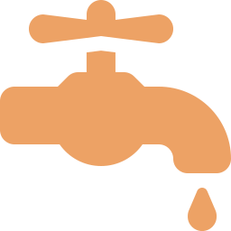

Introduction: why smart irrigation
Sense
~70%
Soil moisture, temperature and humidity, read every 2 s
Decide
of global freshwater withdrawals go to agriculture (FAO AQUASTAT)
ESP32 compares readings with calibrated thresholds
Most small-scale watering still runs on a fixed timer or by hand, so it ignores what the soil actually needs: some days the plant is stressed, other days the roots sit in water.
Act
Relay-driven pump waters in short bursts, then rechecks
Show
Live web dashboard, history, alerts and manual override
Notes:
Agriculture is the largest user of freshwater. Fixed timers and manual watering ignore the actual soil state. Our system closes the loop: sense, decide, act, and show the user what is happening.

Slide 3
Literature survey (1/2)
# | Paper | Approach | Key finding | Relevance to us
1 | Obaideen et al., 2022 Energy Nexus 7 | Review: IoT + sensor-based irrigation and UN SDG 6 | Smart irrigation raises water-use efficiency; cost and connectivity are main barriers | Frames the motivation
2 | Puig, Rodríguez Díaz & Soriano, 2022 Agronomy 12(12) | Low-cost open-source smart irrigation platform using LoRa | Long-range telemetry suited to large farms | We use Wi-Fi: one pot, lower cost
3 | Pereira, Chaari & Daroge, 2023 IoT (MDPI) 4(3) | ESP32 drip irrigation: soil, temp, humidity, flow sensors; Blynk app | Field-tested, grew green onions; manual override via app | Same MCU; we replace Blynk with our own server
4 | Schwamback et al., 2023 Sensors 23(5) | Lab + field test of 63 low-cost capacitive probes vs commercial sensors | Track daily changes well, accuracy moderate; single-point dry calibration proposed | Guides how we calibrate our probe
5 | Morchid et al., 2024 Ain Shams Eng. J. 15(3) | Review: IoT and sensors for food security | Perception → network → cloud → application layers | We follow this layered design
6 | Nsoh et al., 2024 Sensors 24 | Systematic review: IoT + machine learning for irrigation | Optimised pump scheduling can cut energy 30–40%; flags security and interoperability gaps | API key + open JSON API
Notes:
Papers 1 to 6: reviews establish the motivation; Puig and Pereira show low-cost platforms, and Pereira uses the same ESP32 as us but relies on the Blynk cloud app. Schwamback tells us how far to trust a cheap capacitive probe. Nsoh flags energy savings and the security gap.

Slide 4
Literature survey (2/2)
# | Paper | Approach | Key finding | Relevance to us
7 | Padhy et al., 2024 ASEC (MDPI Proc.) | IoT sensors + DT, NB, KNN to predict plant growth; LoRa | ML on moisture, temperature, humidity predicts growth | Our logs can train such models
8 | Abdelmoneim et al., 2025 Sensors 25(2) | Calibration of 12 capacitive probes at 5 moisture levels | Generalised calibration: R² 0.85–0.87, RMSE 4.5–4.9% | Sets the accuracy we can expect
9 | Kunt, 2025 arXiv 2506.11835 | ESP32 + per-pot LSTM; AI / Auto / Manual modes | Test MAE 0.014; halts irrigation on sensor failure | Same mode split; fault handling
10 | Das, George & Kumar, 2025 ICTCT 2025 (IEEE) | IoT sensor data + 5 ML models for disease detection | LightGBM best at 93.4% accuracy | Plant-health insight from sensor data
11 | Lokesh et al., 2025 EPJ Web of Conf. 343 | Review: AI + computer vision + IoT for crop health | CNN disease detection reported at ~92% accuracy | Camera module as an extension
12 | Boukri et al., 2026 Applied Water Science 16 | ESP32 + capacitive sensor + DHT11 + Blynk; on at 20%, off at 80% | 33% less water than fixed schedule over 30 days | Closest baseline; they note Wi-Fi drops
Notes:
Papers 7 to 12: Abdelmoneim gives the accuracy we can expect after calibration. ML work (Padhy, Kunt, Das, Lokesh) shows where the logged data can lead. Boukri 2026 is the closest baseline: 33% water saving versus a fixed schedule.

Slide 5



From the literature to our concept
What the papers show
Gaps we target
Our concept
Soil-moisture feedback saves 25–35% water vs fixed timers [12]
ESP32 + capacitive probe is the low-cost standard, after calibration [3][4][8][12]
Logged sensor data enables ML health insight [7][9][10]
Monitoring often tied to a third-party cloud app (Blynk) [3][9][12]
Wi-Fi drops and sensor faults reported as limitations [9][12]
Temp and humidity logged but not used in decisions [12]
Self-hosted Flask + SQLite server and web dashboard
Control loop runs on the ESP32 with five safety locks
Every reading stored, ready for analysis and ML
Notes:
Literature confirms feedback control saves water and the ESP32 is the right hardware. The gaps: dependence on Blynk, fragility when Wi-Fi or sensors fail, and unused environmental data. Our concept answers each one.

Slide 6




Problem statement
Timer-based or manual watering ignores the real state of the soil, causing both water stress and waterlogging. Low-cost automated systems react only to the current reading, depend on a third-party cloud app, and misbehave when the network or a sensor fails.
Over- and under-watering
Reactive, not predictive
Unsafe on faults
Fixed schedules water by the clock, not by what the soil needs
Systems wait until the soil is already dry instead of planning ahead
Bad sensor values, dry-running pumps and lost Wi-Fi go undetected
Goal: a low-cost, AI-assisted irrigation system that predicts water needs, waters safely, verifies the result, and keeps the user informed.
Notes:
State the problem: watering by the clock wastes water and stresses plants; existing low-cost systems only react to the current reading and are fragile when hardware or the network fails. Our goal answers all three.

Slide 7


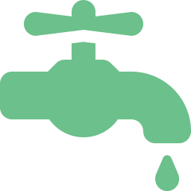





Project objectives
01
02
03
04
Real-time monitoring
AI-based prediction
Adaptive irrigation
Anomaly detection
Soil moisture, temperature, humidity and water level on the ESP32
Forecast soil moisture and irrigation needs with machine learning
Water from sensor data, AI predictions and safety limits
Flag abnormal readings and unexpected irrigation behaviour
05
06
07
08
Feedback verification
Smart dashboard
Water optimisation
System safety
Measure moisture change after watering to improve future decisions
Live readings, predictions, pump status, history and alerts
Compare AI-assisted and conventional irrigation for water savings
Prevent dry-running, over-watering and unsafe pump operation
Notes:
Eight objectives. 1 Real-time monitoring of soil moisture, temperature, humidity and water level. 2 AI-based prediction of future soil moisture and irrigation needs. 3 Adaptive irrigation combining sensor data, predictions and safety limits. 4 Anomaly detection for abnormal readings and unexpected irrigation. 5 Feedback verification: measure moisture after watering to improve decisions. 6 Smart dashboard. 7 Water optimisation against conventional methods. 8 System safety: no dry-running, over-watering or unsafe pump runs. Monitoring, dashboard and safety are built; prediction, anomaly detection and feedback verification are the next phase.

Slide 8
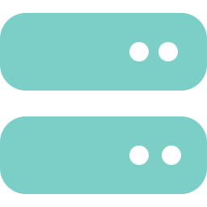


System design & architecture
SENSING
CONTROL (EDGE)
SERVER & USER
Soil moisture
readings every 2 s
Flask REST API
Capacitive probe, analog in
Python + SQLite. Stores readings, relays commands; makes no pump decisions
ESP32
commands
DHT22
Temperature + humidity
Control loop + safety locks
Settings kept in flash
Runs alone if Wi-Fi drops
Web dashboard
Reservoir level
Gauge, charts, alerts, settings, manual override
Optional; locks pump when empty
ACTUATION
TEAM OWNERSHIP
Relay → DC pump
Mech: tank, pump, rig
ECE: wiring, firmware
CSE: server, dashboard
~1.5 L/min mini pump
JSON over HTTP on the local Wi-Fi; API key on device endpoints
Notes:
Left to right: three sensors feed the ESP32. The ESP32 runs the control loop itself and drives the pump through a relay, so watering never depends on the network. It posts readings to our Flask server every 2 seconds and polls for commands. The dashboard only talks to the server.

Slide 9
Control algorithm (runs on the ESP32)
Read sensors
(every 2 s)
Tank
≤ 5%?
Moisture
≥ 60%?
Auto, settled
and < 30%?
Pump burst
6 s
no
no
yes
yes
yes
STOP / LOCK PUMP
Wait 20 s, then recheck
↺ loop back to Read
Watering threshold | 30% | Overwatering limit | 60%
Burst / recheck wait | 6 s / 20 s | Manual run limit | 15 s
Hard max run (failsafe) | 60 s | Offline → local auto | after 60 s
Notes:
Every 2 seconds the ESP32 reads its sensors. Two safety checks come first: an empty tank or moisture above the overwatering limit stops the pump immediately. Only in automatic mode, after the settle time and below 30 percent, does it run a 6-second burst, then waits 20 seconds and rechecks. Defaults will be calibrated on the real soil.

Slide 10
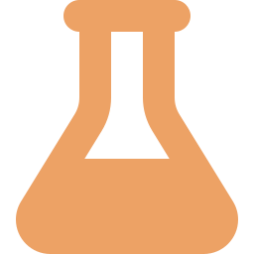
Implementation: modules & code
Firmware smart_plant.ino · Arduino C++
controlStep() · firmware excerpt
Control loop, failsafes, settings in flash, posts readings, polls commands
if (pumpOn && now - pumpStartMs >= hardMaxMs)
stopPump("failsafe max run time");
if (reservoirPct <= RESERVOIR_LOCK_PCT)
{ stopPump("reservoir empty"); return; }
if (moisturePct >= settings.overLimit)
{ stopPump("overwatering limit"); return; }
if (autoMode && !pumpOn && !settling
&& moisturePct < settings.threshold)
startPump(settings.duration, false);
Backend app.py · Flask + SQLite
Stores readings, validates settings ranges, relays commands, detects watering events
Simulator simulator.py · Python stdlib
Stand-in ESP32 with identical logic and a 2 L pot physics model
REST API
Dashboard HTML · CSS · JavaScript
ESP32: POST /api/device/readings
GET /api/device/commands
Browser: GET /api/readings/latest
POST /api/pump · /api/mode
Gauge, charts, alerts, settings; simulated or live-server mode
Notes:
Four modules. The firmware makes every watering decision. The backend only stores and relays, which keeps the safety logic in one place. The simulator runs the same control logic so we could test the full system before the ESP32 arrives. The code excerpt shows the order of the checks: safety first, watering last.

Slide 11
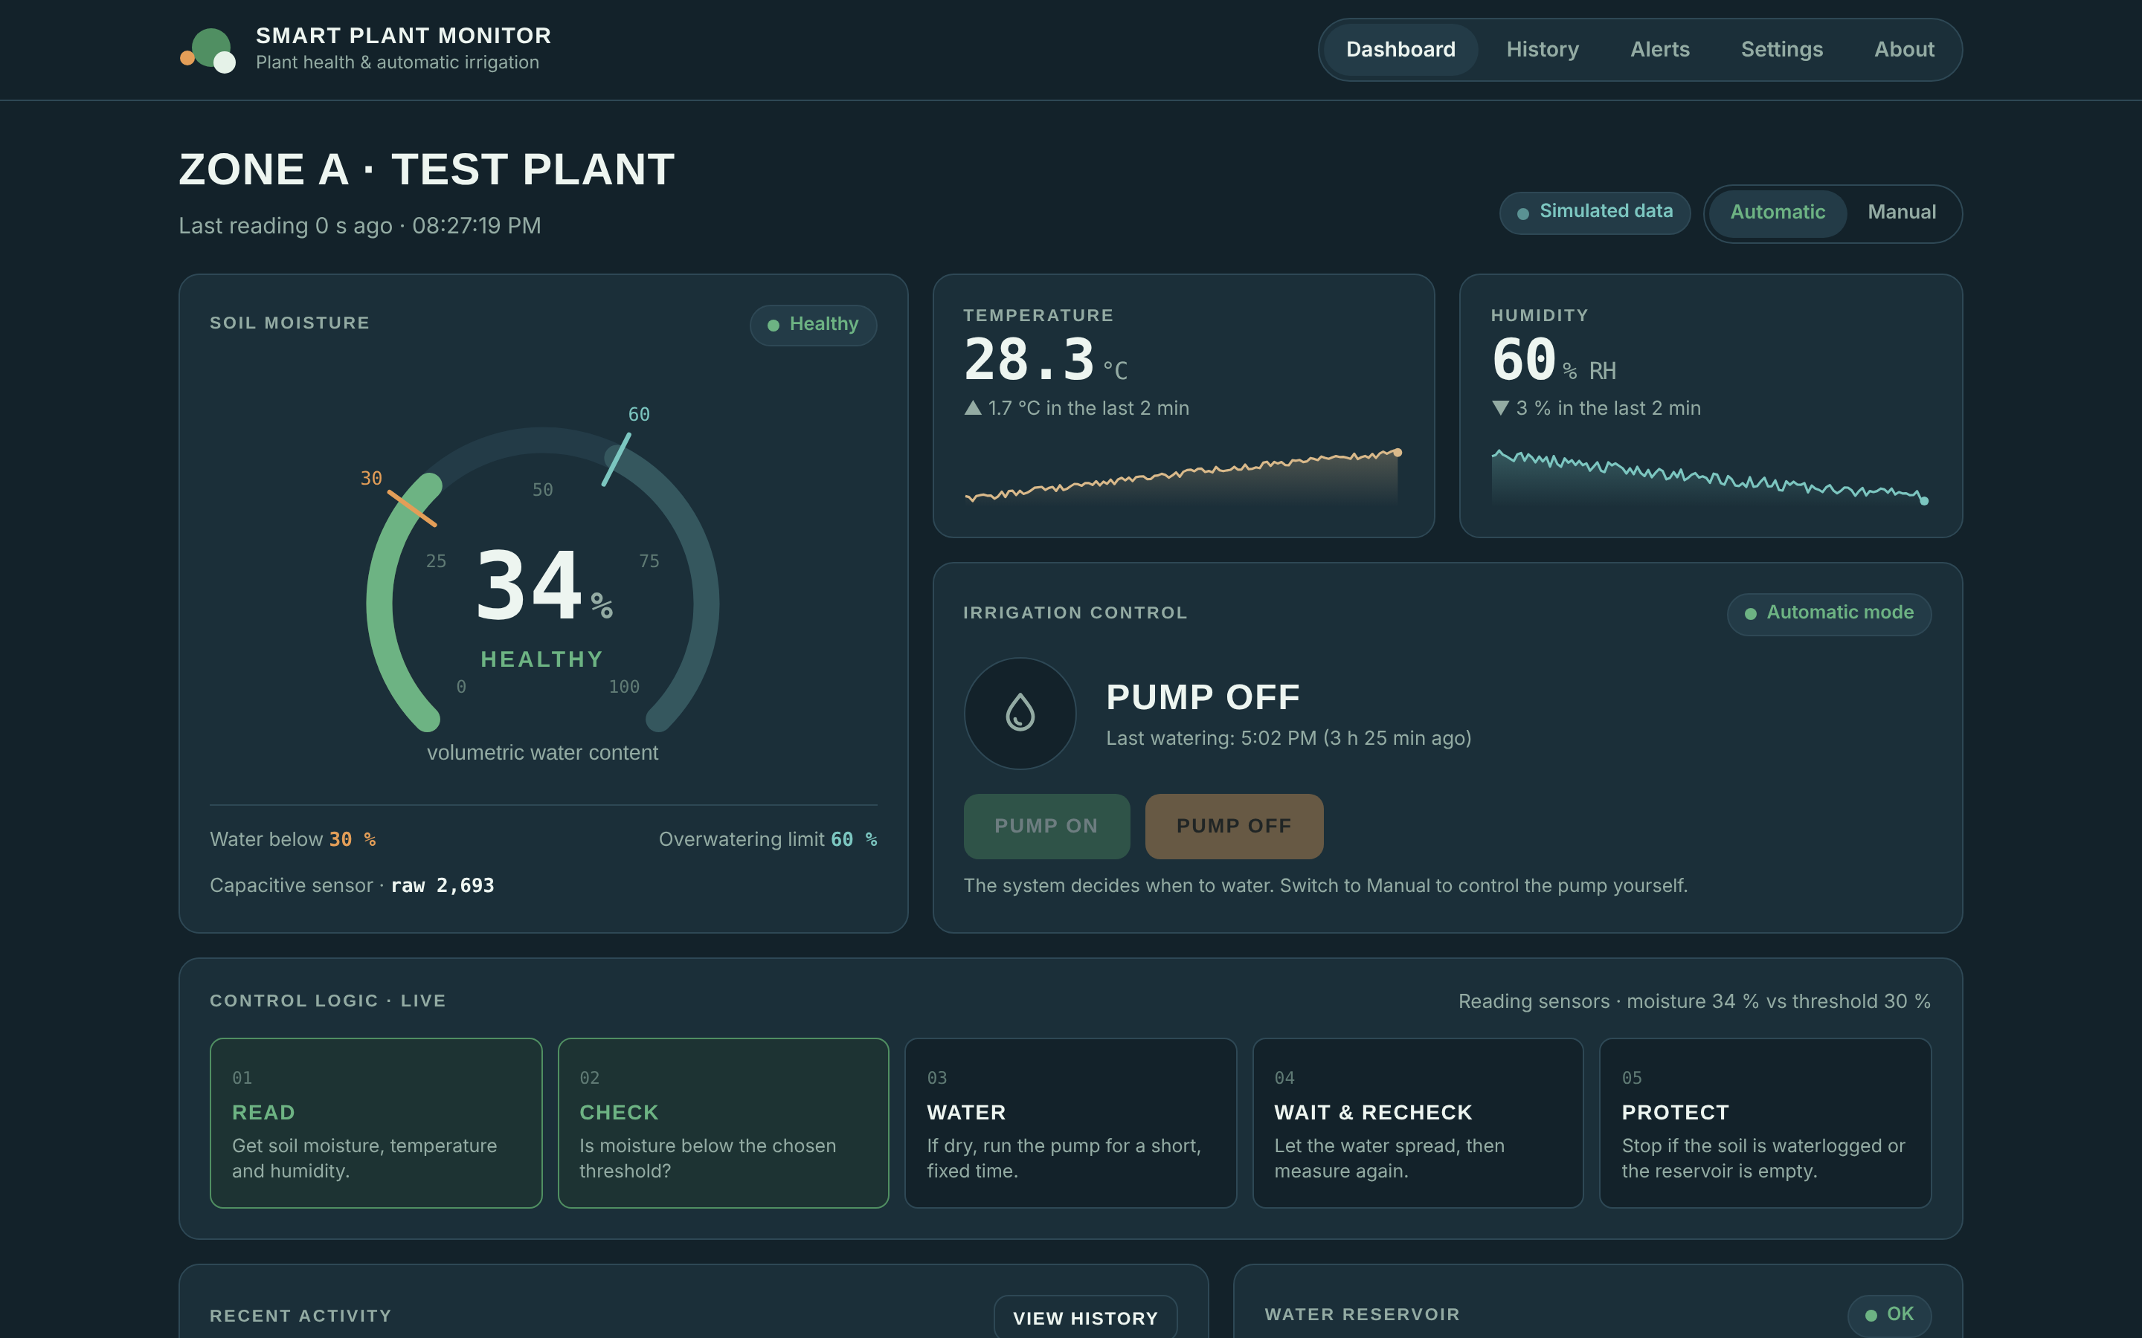
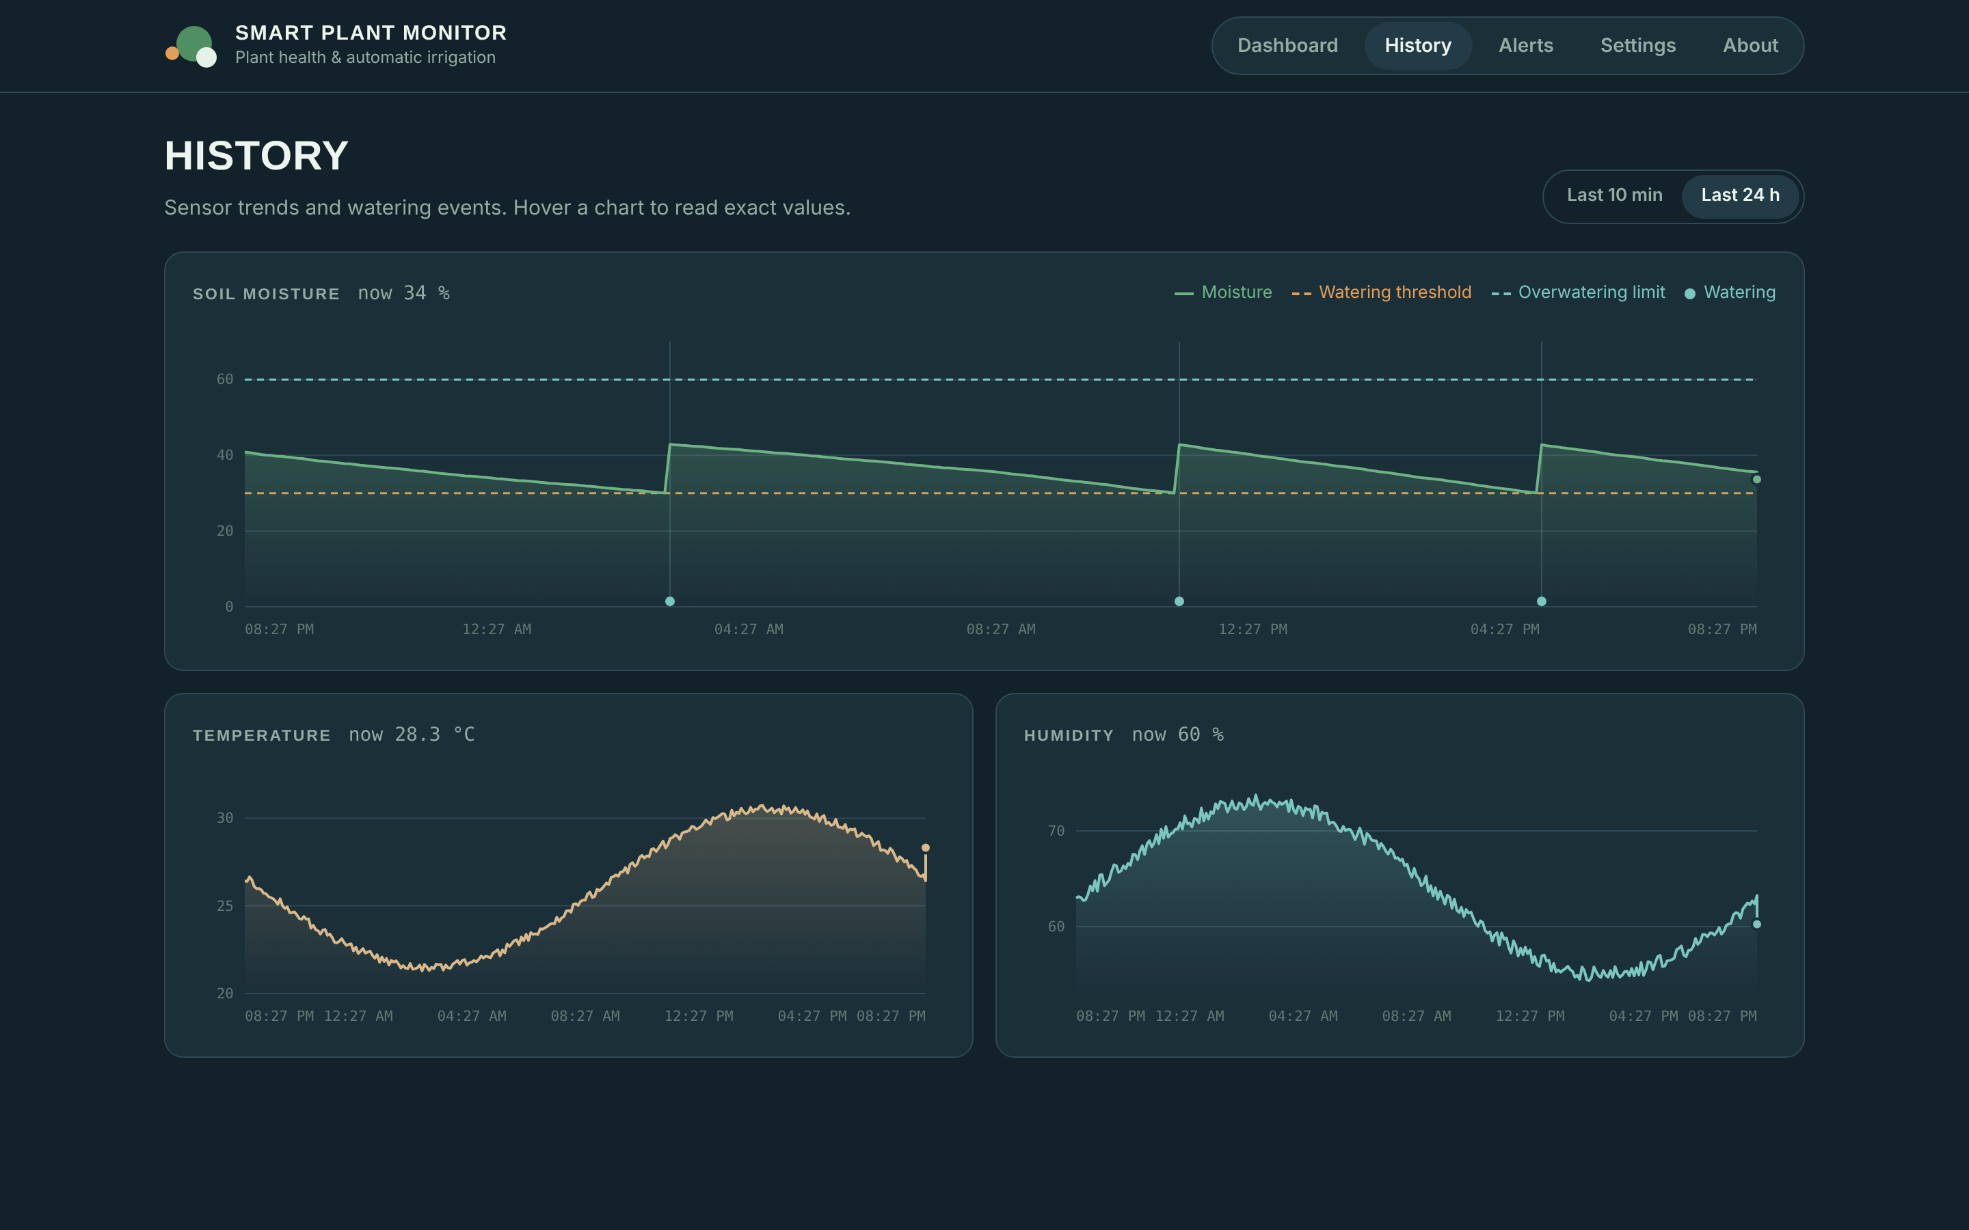
Web dashboard (completed)
Live view: moisture gauge with both limits, pump control, auto/manual switch, live control-logic steps
History: 24 h moisture with threshold and overwatering lines, watering events, temperature and humidity
Tested at desktop & phone widths
Alerts + settings pages
Simulated data label
Notes:
The dashboard is finished. It clearly labels simulated data. Show the gauge with both limits marked, the pump card and the live control steps; then the history page with watering events.

Slide 12
Results: 48 h moisture, closed loop vs timer
What it shows
Ours stays in a 30–42% band: short bursts only when needed
Timer overshoots toward 60% on cool days and keeps watering
Neither drops below the stress zone
Simulation of a 2 L pot with the project's simulator model; timer = 2 × 14 s/day. Real-sensor data follows once the ESP32 arrives.
Notes:
This is simulated, and we say so. Over 48 hours including hot days, our loop holds moisture between 30 and 42 percent. A typical fixed timer pushes the pot towards waterlogging. Real sensor results come after the hardware arrives.

Slide 13


Results & analysis: 7-day comparison
45%
0 h
0 h
Integration tests
Server ⇄ simulator ⇄ dashboard, live mode
less water
near waterlogging
in water stress
2.7 L vs 4.9 L in 7 days
vs 11.8 h for the timer (moisture > 50%)
moisture never fell below 27%
API checklist (curl): readings, pump, mode, settings
Browser tests at desktop and phone widths
Board offline / no-sensor scenarios flagged
Firmware on real ESP32 (pending hardware)
Notes:
Over seven simulated days the closed loop used 2.7 litres against 4.9 for a fixed timer, 45 percent less, and never approached waterlogging. Boukri et al. 2026 measured 25 to 35 percent savings in the field, so the direction matches; our exact figure depends on the timer setting we chose. On the right, the integration tests passed; firmware testing waits for the ESP32.

Slide 14





Challenges & how we handled them
ESP32 not yet available
Sensor calibration
Built a simulator with identical control logic to test everything end to end
Soil-specific calibration as in [4][8]; thresholds editable from the dashboard
Wi-Fi drops
Pump runaway / waterlogging
Board decides locally; reverts to auto mode after 60 s without the server
Overwatering lock, 15 s manual cap, 60 s hard failsafe
Three-discipline integration
Honest data
One fixed JSON API contract shared by firmware, server and dashboard
Dashboard labels simulated data; no simulated value shown as real
Notes:
Main challenge: no ESP32 yet, so we built a simulator with the same logic. The other challenges are handled by design: local decisions, failsafes, a fixed API contract across the three disciplines, and clear labelling of simulated data.

Slide 15
Work completed & timeline
Literature survey & problem formulation
Done
System design & architecture
Done
Web dashboard (CSE)
Done
Backend API + simulator, integration tests (CSE)
Done
ESP32 firmware (written, untested)
In progress
Hardware rig: sensors, relay, pump, tank (ECE + Mech)
In progress
Calibration & real-plant data collection
Next
AI prediction, anomaly detection, feedback check
Next
Notes:
Everything on the CSE side for this review is complete: survey, design, dashboard, backend, simulator and tests. The firmware is written; the hardware rig is being assembled by ECE and Mechatronics. Next: calibrate and collect real data, then train the prediction model and add anomaly detection and feedback verification.

Slide 16
Summary & next steps
Designed a closed-loop irrigation system grounded in 12 recent papers
Built dashboard, Flask + SQLite backend, simulator and firmware
Showed in simulation: moisture held at 30–42%, ~45% less water than a timer
Next hardware, calibration, then AI prediction and anomaly detection
Thank you · Questions?
Notes:
Close with the four lines, then invite questions.

Slide 17
References
[1] K. Obaideen et al., "An overview of smart irrigation systems using IoT," Energy Nexus, vol. 7, 100124, 2022.
[2] F. Puig, J. A. Rodríguez Díaz, M. A. Soriano, "Development of a low-cost open-source platform for smart irrigation systems," Agronomy, 12(12), 2909, 2022.
[3] G. P. Pereira, M. Z. Chaari, F. Daroge, "IoT-enabled smart drip irrigation system using ESP32," IoT (MDPI), 4(3), 2023.
[4] D. Schwamback et al., "Automated low-cost soil moisture sensors: Trade-off between cost and accuracy," Sensors, 23(5), 2451, 2023.
[5] A. Morchid et al., "Applications of IoT and sensors technology to increase food security and agricultural sustainability," Ain Shams Eng. J., 15(3), 102509, 2024.
[6] B. Nsoh et al., "IoT-based automated solutions utilizing machine learning for smart and real-time irrigation management: A review," Sensors, 24, 7480, 2024.
[7] N. Padhy et al., "Advanced IoT solutions for plant growth monitoring: A comparative analysis of ML approaches," Proc. 5th ASEC, MDPI, 2024.
[8] A. A. Abdelmoneim et al., "Calibration of low-cost capacitive soil moisture sensors for irrigation management applications," Sensors, 25(2), 343, 2025.
[9] Y. E. Kunt, "Development of IoT and AI based smart irrigation system," arXiv:2506.11835, 2025.
[10] V. Das, J. George, P. Kumar, "Early detection of plant diseases using IoT sensors and ML algorithms," Proc. ICTCT 2025, IEEE, pp. 344–350, 2025.
[11] H. Lokesh et al., "Smart monitoring system for enhancing plant health and sustainable growth," EPJ Web of Conf., 343, 04003, 2025.
[12] Y. Boukri et al., "Analysis and experimental implementation of affordable smart irrigation system using IoT," Applied Water Science, 16, 36, 2026.
Notes:
Reference list for the literature survey.

