Slide 1
앱 프로그래밍(1) 과제
Android Studio Report 10주차
소프트웨어융합과_코딩전공
2301111_김진용

Slide 2
Report 1
Activity_report1.xml
<?xml version="1.0" encoding="utf-8"?> <LinearLayout xmlns:android="http://schemas.android.com/apk/res/android" android:orientation="horizontal" android:layout_width="match_parent" android:layout_height="match_parent"> <FrameLayout android:id="@+id/fragment_container" android:layout_width="0dp" android:layout_weight="1" android:layout_height="match_parent" /> <LinearLayout android:layout_width="0dp" android:layout_weight="2" android:layout_height="match_parent" android:orientation="vertical" android:background="#B9ADFF" android:gravity="center" android:padding="16dp">

Slide 3
<TextView android:id="@+id/selected_item" android:layout_width="wrap_content" android:layout_height="wrap_content" android:text="행성을 선택하세요" android:textColor="#FF0000" android:textSize="24sp" /> </LinearLayout> </LinearLayout>

Slide 4
Report1.java
package com.example.week10; import android.os.Bundle; import android.widget.TextView; import androidx.appcompat.app.AppCompatActivity; public class Report1 extends AppCompatActivity implements Report1_ListFragment.OnPlanetSelectedListener { private TextView selectedItem; @Override protected void onCreate(Bundle savedInstanceState) { super.onCreate(savedInstanceState); setContentView(R.layout.activity_report1); selectedItem = findViewById(R.id.selected_item); if (savedInstanceState == null) { getSupportFragmentManager().beginTransaction() .replace(R.id.fragment_container, new Report1_ListFragment()) .commit(); } } @Override public void onPlanetSelected(String planet) { selectedItem.setText(planet); } }

Slide 5
Report1_ListFragment.java
package com.example.week10; import android.content.Context; import android.os.Bundle; import android.view.LayoutInflater; import android.view.View; import android.view.ViewGroup; import android.widget.AdapterView; import android.widget.ArrayAdapter; import androidx.annotation.NonNull; import androidx.annotation.Nullable; import androidx.fragment.app.ListFragment; public class Report1_ListFragment extends ListFragment { private OnPlanetSelectedListener callback; private int selectedPosition = -1; public interface OnPlanetSelectedListener { void onPlanetSelected(String planet); }

Slide 6
@Override public void onAttach(@NonNull Context context) { super.onAttach(context); if (context instanceof OnPlanetSelectedListener) { callback = (OnPlanetSelectedListener) context; } else { throw new ClassCastException(context.toString() + " must implement OnPlanetSelectedListener"); } } @Nullable @Override public View onCreateView(@NonNull LayoutInflater inflater, @Nullable ViewGroup container, @Nullable Bundle savedInstanceState) { return super.onCreateView(inflater, container, savedInstanceState); } @Override public void onActivityCreated(@Nullable Bundle savedInstanceState) { super.onActivityCreated(savedInstanceState); String[] planet = {"Sun", "Mercury", "Venus", "Earth", "Mars", "Jupiter", "Saturn", "Uranus", "Neptune", "Pluto"}; String[] planet_kor = {"태양", "수성", "금성", "지구", "화성", "목성", "토성", "천왕성", "해왕성", "명왕성"}; ArrayAdapter<String> adapter = new ArrayAdapter<String>(getActivity(), android.R.layout.simple_list_item_1, planet) {

Slide 7
@NonNull @Override public View getView(int position, @Nullable View convertView, @NonNull ViewGroup parent) { View view = super.getView(position, convertView, parent); if (position == selectedPosition) { view.setBackgroundColor(0xFFFF0000); } else { view.setBackgroundColor(0x00000000); // transparent color } return view; } }; setListAdapter(adapter); getListView().setOnItemClickListener(new AdapterView.OnItemClickListener() { @Override public void onItemClick(AdapterView<?> parent, View view, int position, long id) { selectedPosition = position; String selectedPlanet = planet[position]; String translatedPlanet = planet_kor[position]; callback.onPlanetSelected(translatedPlanet); adapter.notifyDataSetChanged(); } }); } }

Slide 8
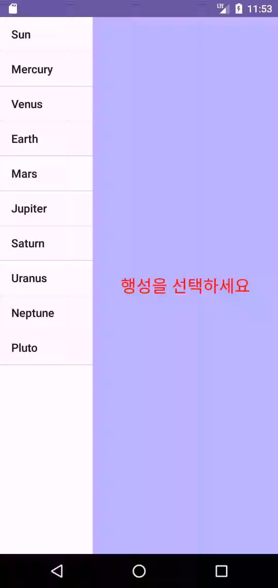
Report 1
실행화면

Slide 9
Report 2
Activity_report2.xml
<?xml version="1.0" encoding="utf-8"?> <LinearLayout xmlns:android="http://schemas.android.com/apk/res/android" android:layout_width="match_parent" android:layout_height="match_parent" android:orientation="vertical"> <TextView android:layout_width="match_parent" android:layout_height="wrap_content" android:text="대화상자 프래그먼트를 액티비티에 내장하였습니다." android:padding="16dp" android:textSize="15sp" android:gravity="center" /> <FrameLayout android:id="@+id/fragment_container" android:layout_width="match_parent" android:layout_height="match_parent" /> </LinearLayout>

Slide 10
Report2.java
package com.example.week10; import android.os.Bundle; import androidx.appcompat.app.AppCompatActivity; public class Report2 extends AppCompatActivity { @Override protected void onCreate(Bundle savedInstanceState) { super.onCreate(savedInstanceState); setContentView(R.layout.activity_report2); if (savedInstanceState == null) { Report2_DialogFragment inputFragment = new Report2_DialogFragment(); getSupportFragmentManager().beginTransaction() .replace(R.id.fragment_container, inputFragment) .commit(); } } }

Slide 11
dialog_Report2.xml
<?xml version="1.0" encoding="utf-8"?> <LinearLayout xmlns:android="http://schemas.android.com/apk/res/android" android:layout_width="match_parent" android:layout_height="wrap_content" android:orientation="vertical" android:layout_margin="10dp" android:padding="16dp" android:background="#B87763"> <LinearLayout android:layout_width="match_parent" android:layout_height="wrap_content" android:orientation="horizontal" android:layout_marginBottom="8dp"> <TextView android:layout_width="wrap_content" android:layout_height="wrap_content" android:text="이름" android:layout_marginTop="3dp" android:textSize="20sp" android:textStyle="bold"/>

Slide 12
<EditText android:id="@+id/name_edit_text" android:layout_width="0dp" android:layout_height="wrap_content" android:layout_weight="1" android:hint="이름을 입력하세요" android:layout_marginStart="8dp"/> </LinearLayout> <RadioGroup android:layout_width="wrap_content" android:layout_height="wrap_content"> <RadioButton android:id="@+id/male_radio_button" android:layout_width="wrap_content" android:layout_height="wrap_content" android:text="남자" android:checked="true"/> <RadioButton android:id="@+id/female_radio_button" android:layout_width="wrap_content" android:layout_height="wrap_content" android:text="여자" /> </RadioGroup>

Slide 13
<Button android:layout_gravity="center" android:id="@+id/confirm_button" android:layout_width="wrap_content" android:layout_height="wrap_content" android:text="확인" /> </LinearLayout>

Slide 14
Report2_DialogFragment.java
package com.example.week10; import android.os.Bundle; import android.view.LayoutInflater; import android.view.View; import android.view.ViewGroup; import android.widget.Button; import android.widget.EditText; import android.widget.RadioButton; import android.widget.Toast; import androidx.annotation.NonNull; import androidx.annotation.Nullable; import androidx.fragment.app.Fragment; public class Report2_DialogFragment extends Fragment { private EditText edit; private RadioButton male; private RadioButton female; @Nullable @Override public View onCreateView(@NonNull LayoutInflater inflater, @Nullable ViewGroup container, @Nullable Bundle savedInstanceState) { View view = inflater.inflate(R.layout.dialog_report2, container, false);

Slide 15
edit = view.findViewById(R.id.name_edit_text); male = view.findViewById(R.id.male_radio_button); female = view.findViewById(R.id.female_radio_button); Button button = view.findViewById(R.id.confirm_button); button.setOnClickListener(new View.OnClickListener() { @Override public void onClick(View v) { String name = edit.getText().toString().trim(); if (name.isEmpty()) { Toast.makeText(getActivity(), "이름을 입력해주세요", Toast.LENGTH_SHORT).show(); } else { String gender = male.isChecked() ? "남자" : "여자"; Toast.makeText(getActivity(), name + " " + gender, Toast.LENGTH_SHORT).show(); } } }); return view; } }

Slide 16
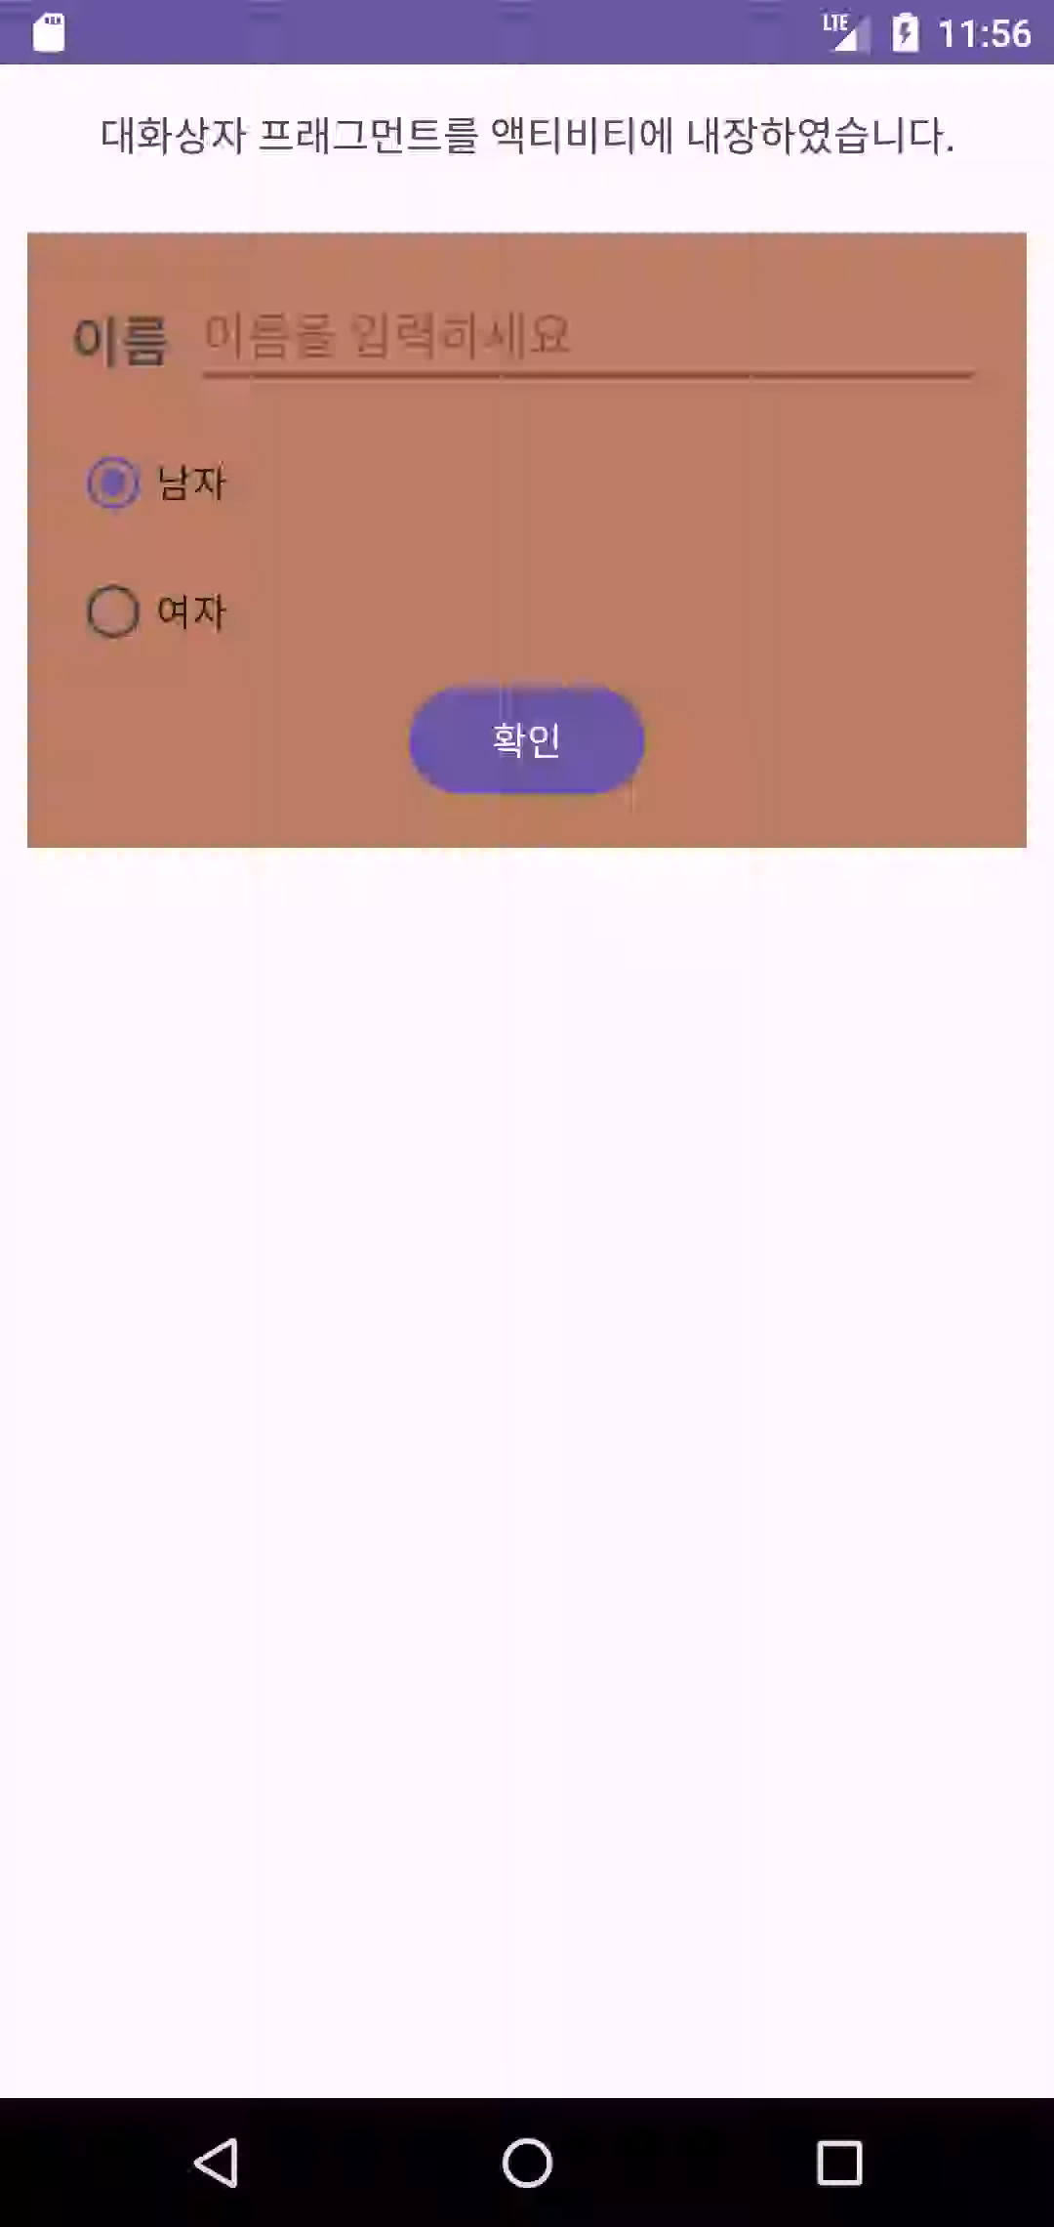
Report 2
실행화면

Slide 17
Report 3
Activity_report3.xml
<?xml version="1.0" encoding="utf-8"?> <LinearLayout xmlns:android="http://schemas.android.com/apk/res/android" xmlns:tools="http://schemas.android.com/tools" android:id="@+id/main" android:layout_width="match_parent" android:layout_height="match_parent" android:orientation="vertical" tools:context="com.example.week10.Report3"> <LinearLayout android:layout_width="match_parent" android:layout_height="wrap_content" android:layout_margin="5dp" android:orientation="horizontal"> <Button android:id="@+id/list_fragment_button" android:layout_width="0dp" android:layout_height="wrap_content" android:layout_weight="1" android:textSize="8dp" android:text="LISTFRAGMENT" />

Slide 18
<Button android:id="@+id/dialog_fragment_button" android:layout_width="0dp" android:layout_height="wrap_content" android:layout_weight="1" android:textSize="8dp" android:text="DIALOGFRAGMENT" /> <Button android:id="@+id/fragment_button" android:layout_width="0dp" android:layout_height="wrap_content" android:layout_weight="1" android:textSize="8dp" android:text="FRAGMENT" /> </LinearLayout> <FrameLayout android:id="@+id/fragment_container" android:layout_width="match_parent" android:layout_height="match_parent" /> </LinearLayout>

Slide 19
Report3.java
package com.example.week10; import android.os.Bundle; import android.view.View; import android.widget.Button; import androidx.appcompat.app.AppCompatActivity; import androidx.fragment.app.Fragment; import androidx.fragment.app.FragmentTransaction; public class Report3 extends AppCompatActivity implements Report3_ListFragment.OnItemSelectedListener { @Override protected void onCreate(Bundle savedInstanceState) { super.onCreate(savedInstanceState); setContentView(R.layout.activity_report3); Button listFragmentButton = findViewById(R.id.list_fragment_button); Button dialogFragmentButton = findViewById(R.id.dialog_fragment_button); Button fragmentButton = findViewById(R.id.fragment_button); listFragmentButton.setOnClickListener(v -> replaceFragment(new Report3_ListFragment()));

Slide 20
dialogFragmentButton.setOnClickListener(new View.OnClickListener() { @Override public void onClick(View v) { Report3_DialogFragment dialogFragment = new Report3_DialogFragment(); dialogFragment.show(getSupportFragmentManager(), "dialog"); } }); fragmentButton.setOnClickListener(v -> replaceFragment(new Report3_Fragment())); } @Override public void onItemSelected(String item) { } private void replaceFragment(Fragment fragment) { FragmentTransaction transaction = getSupportFragmentManager().beginTransaction(); transaction.replace(R.id.fragment_container, fragment); transaction.addToBackStack(null); transaction.commit(); } }

Slide 21
Fragment_report3_list.xml
<?xml version="1.0" encoding="utf-8"?> <LinearLayout xmlns:android="http://schemas.android.com/apk/res/android" android:layout_width="match_parent" android:layout_height="match_parent" android:orientation="vertical"> <ListView android:id="@android:id/list" android:layout_width="match_parent" android:layout_height="match_parent" /> </LinearLayout>

Slide 22
Report3_ListFragment.java
package com.example.week10; import android.content.Context; import android.os.Bundle; import android.view.LayoutInflater; import android.view.View; import android.view.ViewGroup; import android.widget.AdapterView; import android.widget.ArrayAdapter; import androidx.annotation.NonNull; import androidx.annotation.Nullable; import androidx.fragment.app.ListFragment; public class Report3_ListFragment extends ListFragment { private OnItemSelectedListener callback; public interface OnItemSelectedListener { void onItemSelected(String item); }

Slide 23
@Override public void onAttach(@NonNull Context context) { super.onAttach(context); if (context instanceof OnItemSelectedListener) { callback = (OnItemSelectedListener) context; } else { throw new ClassCastException(context.toString() + " must implement OnItemSelectedListener"); } } @Nullable @Override public View onCreateView(@NonNull LayoutInflater inflater, @Nullable ViewGroup container, @Nullable Bundle savedInstanceState) { return super.onCreateView(inflater, container, savedInstanceState); } @Override public void onActivityCreated(@Nullable Bundle savedInstanceState) { super.onActivityCreated(savedInstanceState); String[] items = {"Encapsulation", "Inheritance", "Polymorphism"};

Slide 24
ArrayAdapter<String> adapter = new ArrayAdapter<>(getActivity(), android.R.layout.simple_list_item_1, items); setListAdapter(adapter); getListView().setOnItemClickListener(new AdapterView.OnItemClickListener() { @Override public void onItemClick(AdapterView<?> parent, View view, int position, long id) { String selectedItem = items[position]; callback.onItemSelected(selectedItem); } }); } }

Slide 25
Report3_DialogFragment.java
package com.example.week10; import android.app.AlertDialog; import android.app.Dialog; import android.os.Bundle; import androidx.annotation.NonNull; import androidx.annotation.Nullable; import androidx.fragment.app.DialogFragment; public class Report3_DialogFragment extends DialogFragment { @NonNull @Override public Dialog onCreateDialog(@Nullable Bundle savedInstanceState) { AlertDialog.Builder builder = new AlertDialog.Builder(requireActivity()); builder.setTitle("DialogFragment"); builder.setIcon(android.R.drawable.ic_dialog_alert); builder.setMessage("DialogFragment 내용이 잘 보이지요"); builder.setPositiveButton("OK", (dialog, which) -> dismiss()); return builder.create(); } }

Slide 26
Fragment_report3_fragment.xml
<?xml version="1.0" encoding="utf-8"?> <LinearLayout xmlns:android="http://schemas.android.com/apk/res/android" android:layout_width="match_parent" android:layout_height="match_parent" android:orientation="vertical" android:gravity="center"> <TextView android:id="@+id/fragment_text" android:layout_width="wrap_content" android:layout_height="wrap_content" android:text="Three Fragment!!" android:textSize="40dp" android:textStyle="bold" /> </LinearLayout>

Slide 27
Report3_Fragment.java
package com.example.week10; import android.os.Bundle; import android.view.LayoutInflater; import android.view.View; import android.view.ViewGroup; import android.widget.TextView; import androidx.annotation.NonNull; import androidx.annotation.Nullable; import androidx.fragment.app.Fragment; public class Report3_Fragment extends Fragment { @Nullable @Override public View onCreateView(@NonNull LayoutInflater inflater, @Nullable ViewGroup container, @Nullable Bundle savedInstanceState) { View view = inflater.inflate(R.layout.fragment_report3_fragment, container, false); TextView textView = view.findViewById(R.id.fragment_text); return view; } }

Slide 28
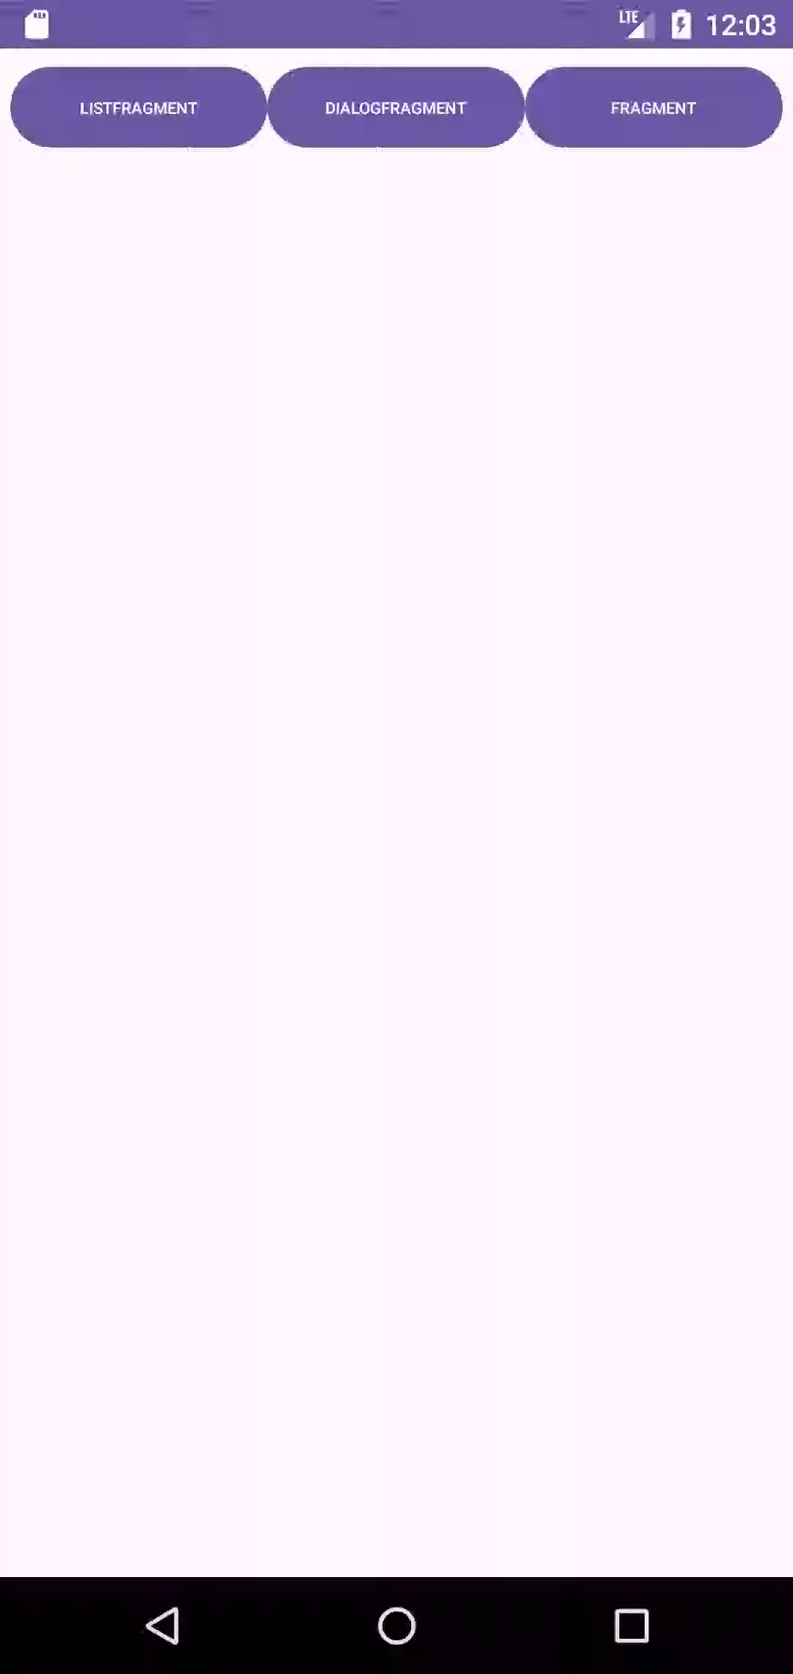
Report 3
실행화면

