Slide 1
앱 프로그래밍(1) 과제
Android Studio Report 8주차
소프트웨어융합과_코딩전공
2301111_김진용

Slide 2
Report 1
Activity_report1.xml
<?xml version="1.0" encoding="utf-8"?> <LinearLayout xmlns:android="http://schemas.android.com/apk/res/android" xmlns:tools="http://schemas.android.com/tools" android:id="@+id/main" android:layout_width="match_parent" android:layout_height="match_parent" android:layout_margin="10dp" android:orientation="vertical" tools:context=".Report1"> <TextView android:layout_width="match_parent" android:layout_height="wrap_content" android:background="#32B3E2" android:gravity="center" android:padding="10dp" android:text="아래 목록에서 좋아하는 과일을 선택하세요!" /> <TextView android:id="@+id/empty" android:layout_width="match_parent" android:layout_height="wrap_content" android:layout_weight="1" android:gravity="center" android:text="비었습니다"

Slide 3
android:textColor="#ff0000" android:visibility="gone" /> <ListView android:id="@+id/list" android:layout_width="match_parent" android:layout_height="wrap_content" android:layout_weight="1" /> <Button android:id="@+id/button" android:layout_width="match_parent" android:layout_height="wrap_content" android:text="결과보기" /> </LinearLayout>

Slide 4
Report1.java
package com.example.week8; import android.annotation.SuppressLint; import android.content.DialogInterface; import android.os.Bundle; import android.view.LayoutInflater; import android.view.Menu; import android.view.MenuInflater; import android.view.MenuItem; import android.view.View; import android.widget.AdapterView; import android.widget.ArrayAdapter; import android.widget.Button; import android.widget.EditText; import android.widget.ListView; import android.widget.TextView; import android.widget.Toast; import androidx.annotation.NonNull; import androidx.appcompat.app.AlertDialog; import androidx.appcompat.app.AppCompatActivity; import java.util.ArrayList; public class Report1 extends AppCompatActivity { ArrayList<String> items = new ArrayList<>();

Slide 5
ArrayAdapter<String> adapter; Button button; ArrayList<Boolean> select = new ArrayList<>(); int type = 0; @Override protected void onCreate(Bundle savedInstanceState) { super.onCreate(savedInstanceState); setContentView(R.layout.activity_report1); items = new ArrayList<>(); items.add("사과"); items.add("배"); items.add("귤"); items.add("바나나"); items.add("복숭아"); items.add("수박"); for (int i = 0; i < items.size(); i++) { select.add(false); } adapter = new ArrayAdapter<>(this, android.R.layout.simple_list_item_multiple_choice, items); ListView listView = findViewById(R.id.list); listView.setAdapter(adapter); listView.setChoiceMode(ListView.CHOICE_MODE_MULTIPLE);

Slide 6
listView.setOnItemClickListener(itemClickListener); TextView empty = findViewById(R.id.empty); listView.setEmptyView(empty); button = findViewById(R.id.button); button.setOnClickListener(new View.OnClickListener() { @Override public void onClick(View view) { showDialog(); } }); } private void showDialog() { StringBuilder selectedItems = new StringBuilder(); for (int i = 0; i < items.size(); i++) { if (select.get(i)) { selectedItems.append(items.get(i)).append("\n\n"); } } AlertDialog.Builder dialog = new AlertDialog.Builder(this); dialog.setTitle("선택한 과일 목록");

Slide 7
if (selectedItems.length() > 0) { dialog.setMessage(selectedItems.toString().trim()); } else { dialog.setMessage("선택된 항목이 없습니다."); } dialog.setNegativeButton("삭제", new DialogInterface.OnClickListener() { @Override public void onClick(DialogInterface dialogInterface, int i) { int count = 0; for (int j = select.size() - 1; j >= 0; j--) { if (select.get(j)) { items.remove(j); select.remove(j); count++; } } adapter.notifyDataSetChanged(); Toast.makeText(getBaseContext(), String.format("%d개 삭제하였습니다.", count), Toast.LENGTH_SHORT).show(); dialogInterface.dismiss(); } }); dialog.setPositiveButton("확인", new DialogInterface.OnClickListener() { @Override

Slide 8
public void onClick(DialogInterface dialogInterface, int i) { Toast.makeText(getBaseContext(), "확인하였습니다.", Toast.LENGTH_SHORT).show(); } }); dialog.show(); } AdapterView.OnItemClickListener itemClickListener = new AdapterView.OnItemClickListener() { @Override public void onItemClick(AdapterView<?> adapterView, View view, int i, long l) { select.set(i, !select.get(i)); String selected = items.get(i); Toast.makeText(getBaseContext(), selected, Toast.LENGTH_SHORT).show(); } }; @SuppressLint("ResourceType") @Override protected void onResume() { super.onResume(); if (type == 1) { for (int i = 0; i < select.size(); i++) { select.set(i, true); }

Slide 9
ListView listView = findViewById(R.id.list); for (int i = 0; i < items.size(); i++) { listView.setItemChecked(i, true); } } else if (type == 2) { for (int i = 0; i < select.size(); i++) { select.set(i, false); } ListView listView = findViewById(R.id.list); for (int i = 0; i < items.size(); i++) { listView.setItemChecked(i, false); } } else if (type == 3) { AlertDialog.Builder inputdialog = new AlertDialog.Builder(this); LayoutInflater inflater = LayoutInflater.from(this); View dialogView = inflater.inflate(R.layout.report1_input, null); inputdialog.setView(dialogView); TextView title = dialogView.findViewById(R.id.title); EditText input = dialogView.findViewById(R.id.input); inputdialog.setPositiveButton("확인", new DialogInterface.OnClickListener() { @Override public void onClick(DialogInterface dialog, int which) { String newItem = input.getText().toString().trim();

Slide 10
if (!newItem.isEmpty()) { items.add(newItem); select.add(false); adapter.notifyDataSetChanged(); } else { Toast.makeText(getBaseContext(), "항목을 입력하세요.", Toast.LENGTH_SHORT).show(); } } }); AlertDialog dialog = inputdialog.create(); dialog.show(); } else if (type == 4) { finish(); } } @Override public boolean onCreateOptionsMenu(Menu menu) { MenuInflater inflater = getMenuInflater(); inflater.inflate(R.menu.report1_menu, menu); return true;

Slide 11
@Override public boolean onOptionsItemSelected(@NonNull MenuItem item) { int check = item.getItemId(); if(check == R.id.item1) { type = 1; } else if (check == R.id.item2) { type = 2; } else if (check == R.id.item3) { type = 3; } else if (check == R.id.item4) { type = 4; } onResume(); item.setChecked(true); return true; } }

Slide 12
Report1_menu.xml
<?xml version="1.0" encoding="utf-8"?> <menu xmlns:android="http://schemas.android.com/apk/res/android"> <group android:checkableBehavior="none"> <item android:id="@+id/item1" android:title="전체선택" /> <item android:id="@+id/item2" android:title="선택해제" /> <item android:id="@+id/item3" android:title="데이터 입력" /> <item android:id="@+id/item4" android:title="종료" /> </group> </menu>

Slide 13
Report1_input.xml
<?xml version="1.0" encoding="utf-8"?> <LinearLayout xmlns:android="http://schemas.android.com/apk/res/android" android:layout_width="300dp" android:layout_height="wrap_content" android:layout_gravity="center" android:orientation="vertical"> <TextView android:id="@+id/title" android:layout_width="match_parent" android:layout_height="wrap_content" android:text="과일 입력" android:textColor="@color/black" android:padding="10dp" android:textSize="16dp" /> <LinearLayout android:layout_width="match_parent" android:layout_height="wrap_content" android:padding="10dp" android:orientation="vertical" android:background="#32B3E3"> <TextView android:id="@+id/message" android:layout_width="match_parent" android:layout_height="wrap_content" android:text="과일 이름 :" android:textColor="@color/black" />

Slide 14
<EditText android:id="@+id/input" android:layout_width="match_parent" android:layout_height="wrap_content" android:hint="과일 이름 입력해주세요" /> </LinearLayout> </LinearLayout>

Slide 15
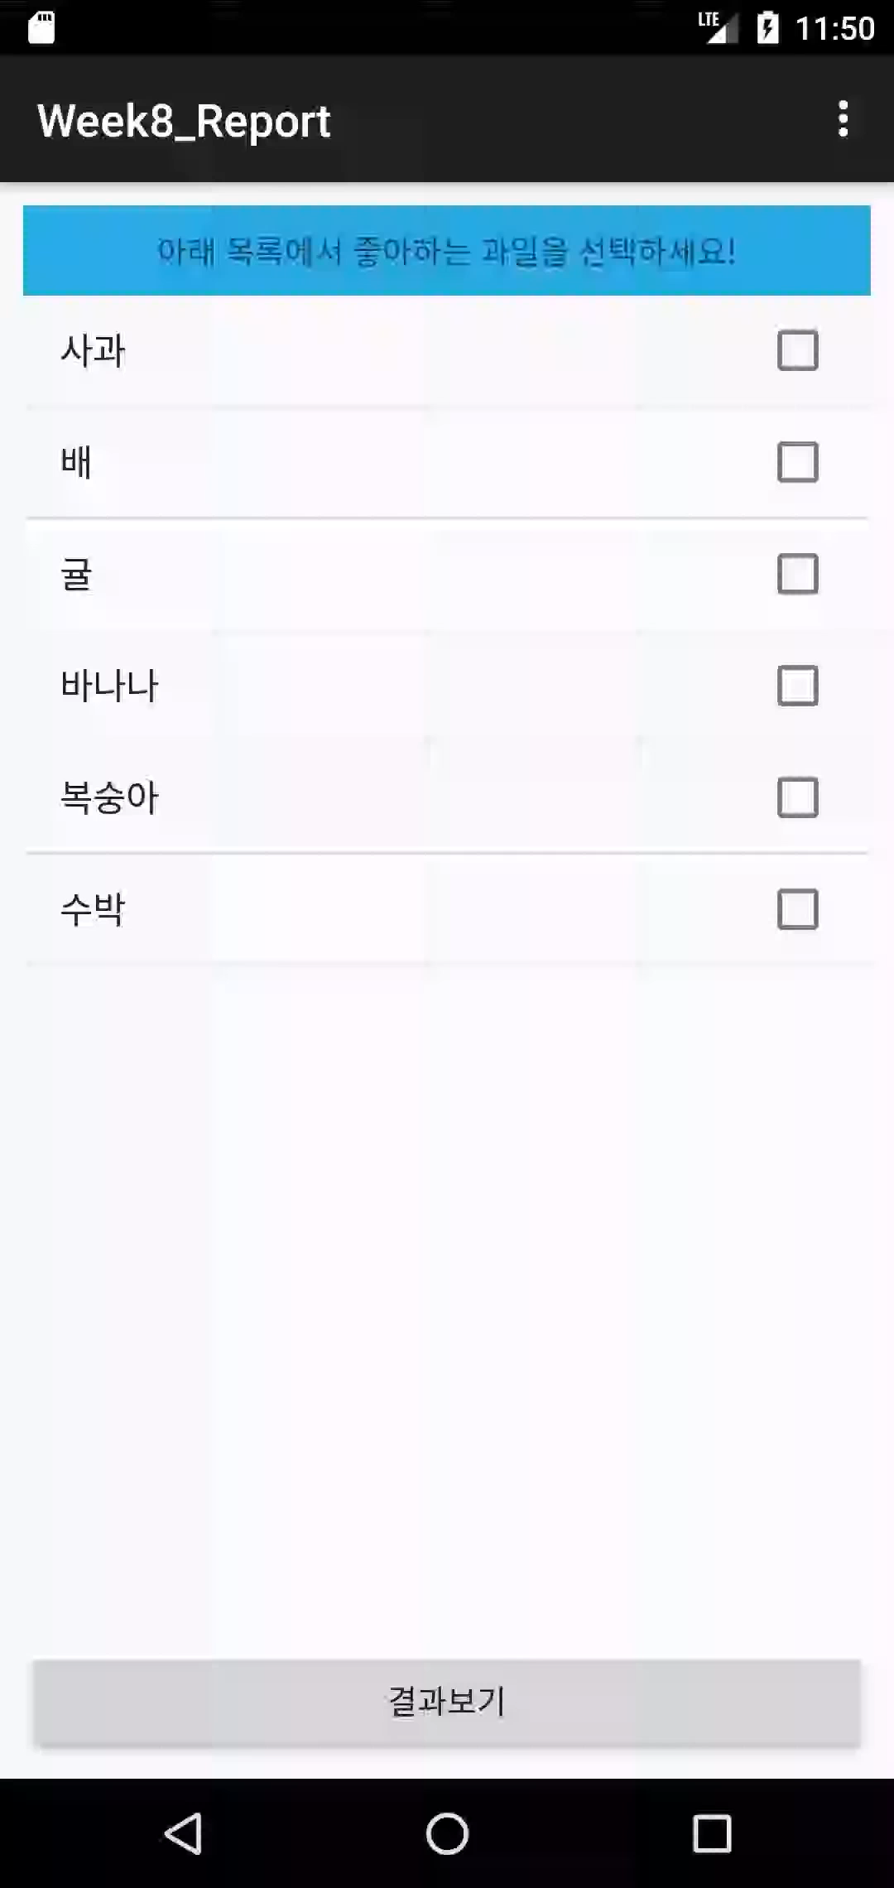
Report 1
실행화면

Slide 16
Report 2
Activity_report2.xml
<?xml version="1.0" encoding="utf-8"?> <LinearLayout xmlns:android="http://schemas.android.com/apk/res/android" xmlns:tools="http://schemas.android.com/tools" android:id="@+id/main" android:layout_width="match_parent" android:layout_height="match_parent" android:orientation="vertical" tools:context=".Report2"> <ListView android:id="@+id/report2_list" android:layout_width="match_parent" android:layout_height="wrap_content" android:layout_weight="1" /> </LinearLayout>

Slide 17
Report2.java
package com.example.week8; import android.content.DialogInterface; import android.os.Bundle; import android.view.LayoutInflater; import android.view.Menu; import android.view.MenuInflater; import android.view.MenuItem; import android.view.View; import android.widget.AdapterView; import android.widget.ArrayAdapter; import android.widget.EditText; import android.widget.ListView; import android.widget.TextView; import android.widget.Toast; import androidx.activity.EdgeToEdge; import androidx.annotation.NonNull; import androidx.appcompat.app.AlertDialog; import androidx.appcompat.app.AppCompatActivity; import androidx.core.graphics.Insets; import androidx.core.view.ViewCompat; import androidx.core.view.WindowInsetsCompat; import java.util.ArrayList;

Slide 18
public class Report2 extends AppCompatActivity { ListView listView; int type = 0; @Override protected void onCreate(Bundle savedInstanceState) { super.onCreate(savedInstanceState); setContentView(R.layout.activity_report2); listView = findViewById(R.id.report2_list); display(0); } private void display(int i) { if(i == 0) { ArrayList<String> arrayList = new ArrayList<>(); arrayList.add("일요일(SUN)"); arrayList.add("월요일(MON)"); arrayList.add("화요일(TUE)"); arrayList.add("수요일(WED)"); arrayList.add("목요일(THU)"); arrayList.add("금요일(FRI)"); arrayList.add("토요일(SAT)"); ArrayAdapter<String> adapter = new ArrayAdapter<>(this, android.R.layout.simple_list_item_1, arrayList); listView.setAdapter(adapter);

Slide 19
}else if (i == 1) { String[] list = getResources().getStringArray(R.array.days1); ArrayAdapter<String> adapter = new ArrayAdapter<>(this, android.R.layout.simple_list_item_1, list); listView.setAdapter(adapter); } else if (i == 2) { String[] list; list = new String[] {"일요일", "월요일", "화요일", "수요일", "목요일", "금요일", "토요일"}; ArrayAdapter<String> adapter = new ArrayAdapter<>(this, android.R.layout.simple_list_item_1, list); listView.setAdapter(adapter); } else if (i == 3) { ArrayAdapter<CharSequence> adapter = ArrayAdapter.createFromResource(this, R.array.days2, android.R.layout.simple_list_item_1); listView.setAdapter(adapter); } } @Override public boolean onCreateOptionsMenu(Menu menu) { MenuInflater inflater = getMenuInflater(); inflater.inflate(R.menu.report2_menu, menu); MenuItem menuItem = menu.findItem(R.id.menu1); menuItem.setChecked(true);

Slide 20
return true; } @Override public boolean onOptionsItemSelected(@NonNull MenuItem item) { int check = item.getItemId(); if (check == R.id.menu1) { display(0); } else if (check == R.id.menu2) display(1); else if (check == R.id.menu3) display(2); else display(3); item.setChecked(true); return true; } }

Slide 21
Report2_menu.xml
<?xml version="1.0" encoding="utf-8"?> <menu xmlns:android="http://schemas.android.com/apk/res/android"> <group android:checkableBehavior="single"> <item android:id="@+id/menu1" android:title="배열 사용" /> <item android:id="@+id/menu2" android:title="arrays.xml 사용" /> <item android:id="@+id/menu3" android:title="list 사용" /> <item android:id="@+id/menu4" android:title="createFromResource 사용" /> </group> </menu>

Slide 22
arrays.xml
<resources> <string-array name = "days1"> <item>Sunday</item> <item>Monday</item> <item>Tuesday</item> <item>wednesday</item> <item>Thursday</item> <item>Friday</item> <item>Saturday</item> </string-array> <string-array name = "days2"> <item>日曜日</item> <item>月曜日</item> <item>火曜日</item> <item>水曜日</item> <item>木曜日</item> <item>金曜日</item> <item>土曜日</item> </string-array> </resources>

Slide 23
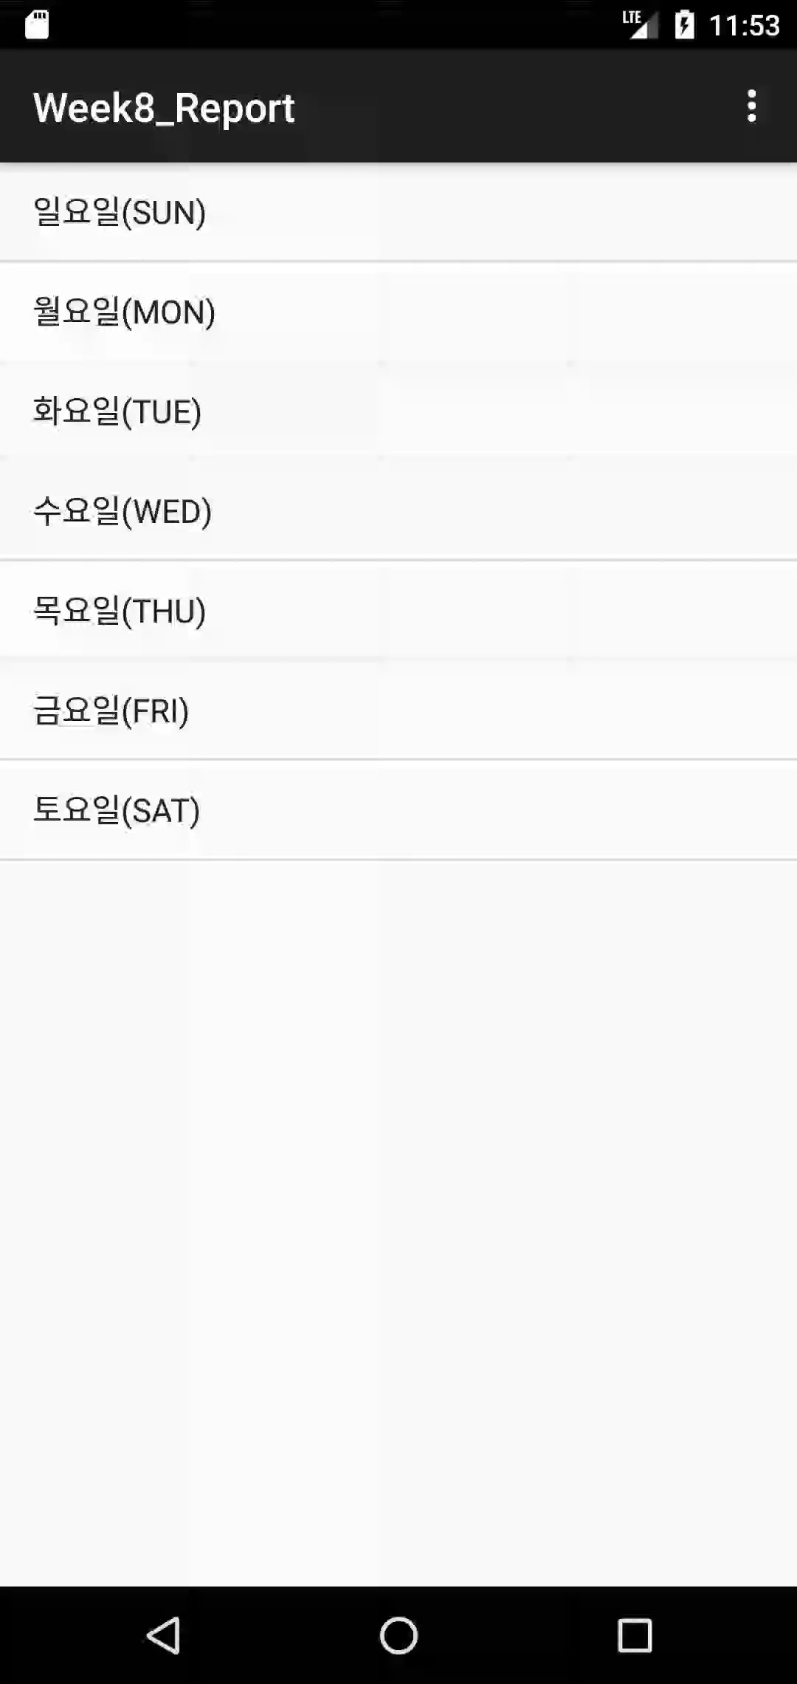
Report 2
실행화면

Slide 24
Report 3
Activity_report3.xml
<?xml version="1.0" encoding="utf-8"?> <LinearLayout xmlns:android="http://schemas.android.com/apk/res/android" xmlns:tools="http://schemas.android.com/tools" android:id="@+id/main" android:layout_width="match_parent" android:layout_height="match_parent" android:orientation="vertical" tools:context=".Report3"> <TextView android:layout_width="match_parent" android:layout_height="wrap_content" android:padding="10dp" android:text="먹고싶은 과일을 선택하세요?" /> <Spinner android:id="@+id/spinner" android:layout_width="match_parent" android:layout_height="wrap_content" android:spinnerMode="dropdown" /> </LinearLayout>

Slide 25
Report3.java
package com.example.week8; import android.graphics.Color; import android.os.Bundle; import android.view.View; import android.view.ViewGroup; import android.widget.AdapterView; import android.widget.ArrayAdapter; import android.widget.Spinner; import android.widget.SpinnerAdapter; import android.widget.TextView; import android.widget.Toast; import androidx.annotation.NonNull; import androidx.annotation.Nullable; import androidx.appcompat.app.AppCompatActivity; import org.w3c.dom.Text; import java.util.ArrayList; public class Report3 extends AppCompatActivity { @Override protected void onCreate(Bundle savedInstanceState) { super.onCreate(savedInstanceState); setContentView(R.layout.activity_report3);

Slide 26
Spinner spinner = findViewById(R.id.spinner); String[] fruits_list = getResources().getStringArray(R.array.fruits); ArrayAdapter<String> adapter = new ArrayAdapter<String>(this, android.R.layout.simple_spinner_item, fruits_list) { @NonNull @Override public View getDropDownView(int position, @Nullable View convertView, @NonNull ViewGroup parent) { View view = super.getDropDownView(position, convertView, parent); TextView textView = (TextView) view; if (position == 0) { textView.setTextColor(Color.RED); } return view; } }; adapter.setDropDownViewResource(android.R.layout.simple_spinner_dropdown_item); spinner.setAdapter(adapter); spinner.setOnItemSelectedListener(new AdapterView.OnItemSelectedListener() { boolean first = false;

Slide 27
@Override public void onItemSelected(AdapterView<?> adapterView, View view, int i, long l) { if (first) { if(i != 0) { Toast.makeText(Report3.this,String.format("%s는 맛있다.", adapter.getItem(i)), Toast.LENGTH_SHORT).show(); } } else { first = true; } } @Override public void onNothingSelected(AdapterView<?> adapterView) { } }); } }

Slide 28
arrays.xml
<resources> <string-array name="fruits"> <item>과일을 고르세요</item> <item>사과</item> <item>딸기</item> <item>수박</item> <item>바나나</item> <item>감</item> <item>복숭아</item> <item>자두</item> </string-array> </resources>

Slide 29
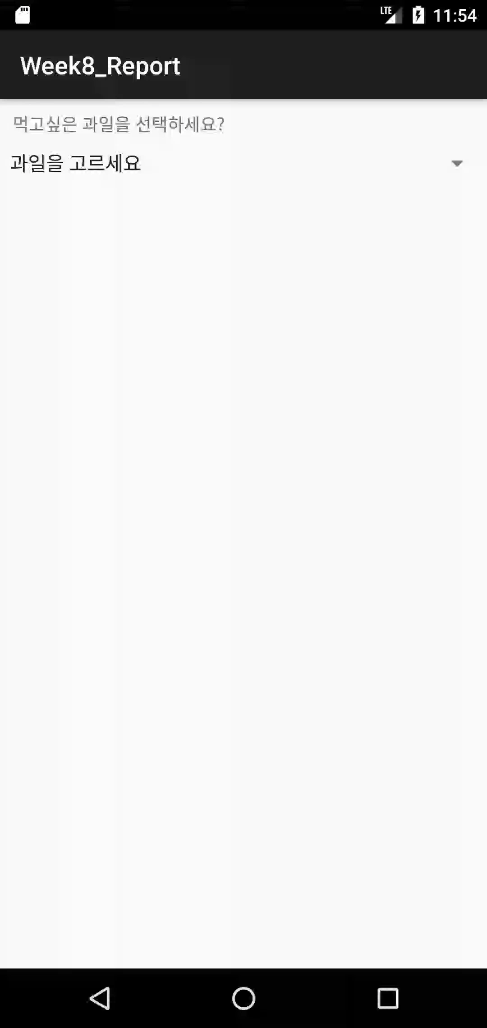
Report 3
실행화면

