Slide 1
앱 프로그래밍(1) 과제
Android Studio Report 1주차
소프트웨어융합과_코딩전공
2301111_김진용

Slide 2
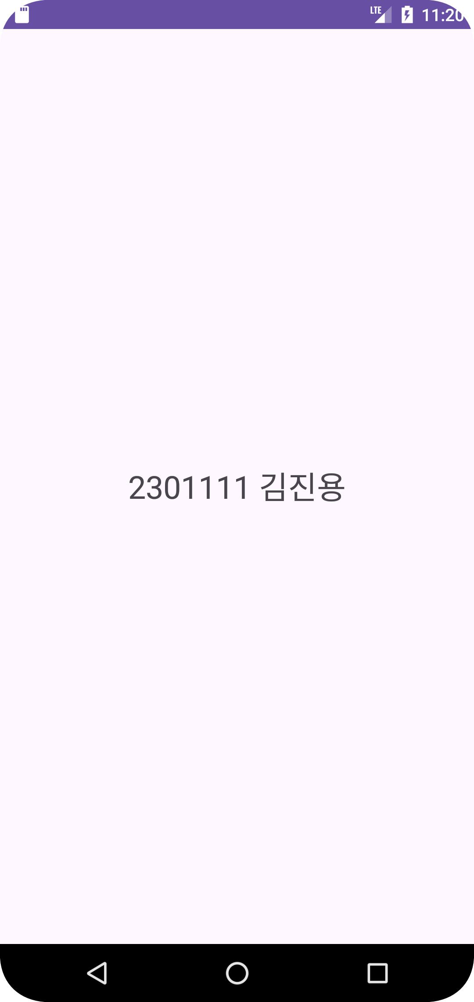
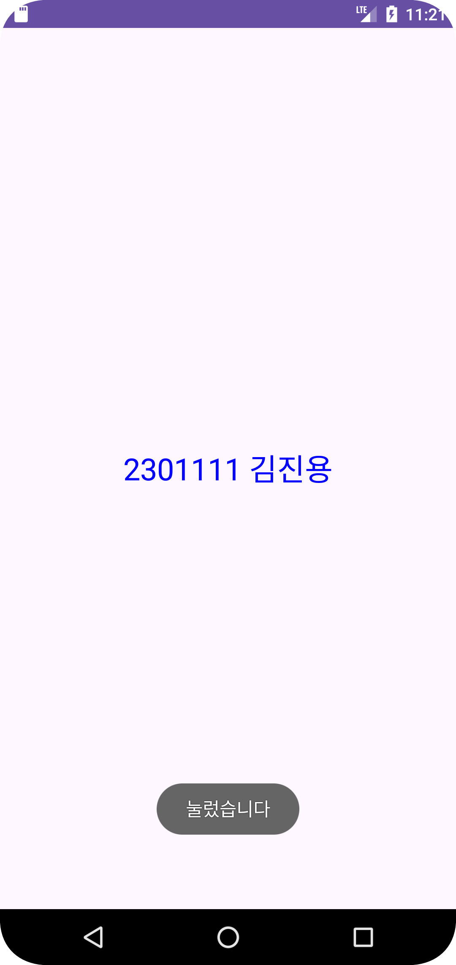
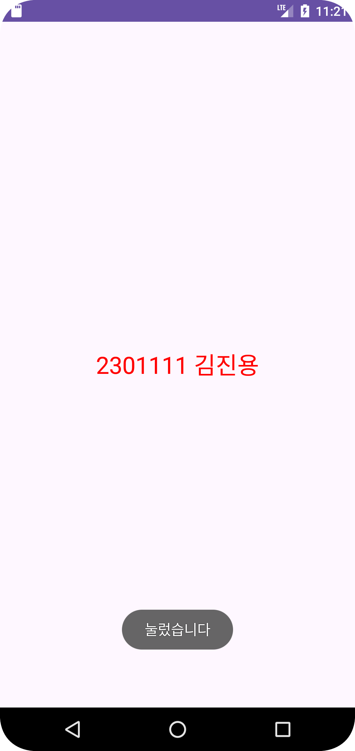
Report 1
MainActivity.java
Activity_main.xml
package com.example.myapplication; import android.graphics.Color; import android.os.Bundle; import android.view.View; import android.widget.TextView; import android.widget.Toast; import androidx.activity.EdgeToEdge; import androidx.appcompat.app.AppCompatActivity; import androidx.core.graphics.Insets; import androidx.core.view.ViewCompat; import androidx.core.view.WindowInsetsCompat; public class MainActivity extends AppCompatActivity { boolean flag = true; @Override protected void onCreate(Bundle savedInstanceState) { super.onCreate(savedInstanceState); setContentView(R.layout.activity_main); TextView textView = findViewById(R.id.textView); textView.setOnClickListener(new View.OnClickListener() { @Override public void onClick(View view) { Toast.makeText(getBaseContext(), "눌렀습니다", Toast.LENGTH_SHORT).show(); if(flag){ textView.setTextColor(Color.BLUE); flag = false; }else { textView.setTextColor(Color.RED); flag = true; } } }); } }
<?xml version="1.0" encoding="utf-8"?> <LinearLayout xmlns:android="http://schemas.android.com/apk/res/android" xmlns:app="http://schemas.android.com/apk/res-auto" xmlns:tools="http://schemas.android.com/tools" android:id="@+id/main" android:gravity="center" android:layout_width="match_parent" android:layout_height="match_parent" tools:context=".MainActivity"> <TextView android:id="@+id/textView" android:layout_width="wrap_content" android:layout_height="wrap_content" android:text="2301111 김진용" android:textSize="72px" app:layout_constraintBottom_toBottomOf="parent" app:layout_constraintEnd_toEndOf="parent" app:layout_constraintStart_toStartOf="parent" app:layout_constraintTop_toTopOf="parent" /> </LinearLayout>

