Slide 1
앱 프로그래밍(1) 과제
Android Studio Report 2주차
소프트웨어융합과_코딩전공
2301111_김진용

Slide 2
Report 1
Activity_report1.xml
<?xml version="1.0" encoding="utf-8"?> <LinearLayout xmlns:android="http://schemas.android.com/apk/res/android" xmlns:tools="http://schemas.android.com/tools" android:id="@+id/main" android:layout_width="match_parent" android:layout_height="match_parent" android:orientation="vertical" tools:context=".Report1"> <TextView android:layout_width="match_parent" android:layout_height="60dp" android:background="@color/pupple" android:gravity="center_vertical" android:paddingLeft="10dp" android:text="Report1_View02" android:textColor="@color/white" android:textSize="25dp" /> <LinearLayout android:layout_width="match_parent" android:layout_height="wrap_content" android:layout_margin="10dp" android:orientation="vertical" android:background="@color/green"> <TextView android:layout_width="100dp" android:layout_height="100dp" android:layout_gravity="center" android:background="@drawable/kyungbok" android:gravity="center" android:text="경복대학교"/> <TextView android:layout_width="match_parent" android:layout_height="100dp" android:layout_marginLeft="100dp" android:layout_marginTop="10dp" android:background="@color/Yellow" android:gravity="center" android:paddingLeft="100dp" android:text="Android Programming"/> </LinearLayout> </LinearLayout>

Slide 3
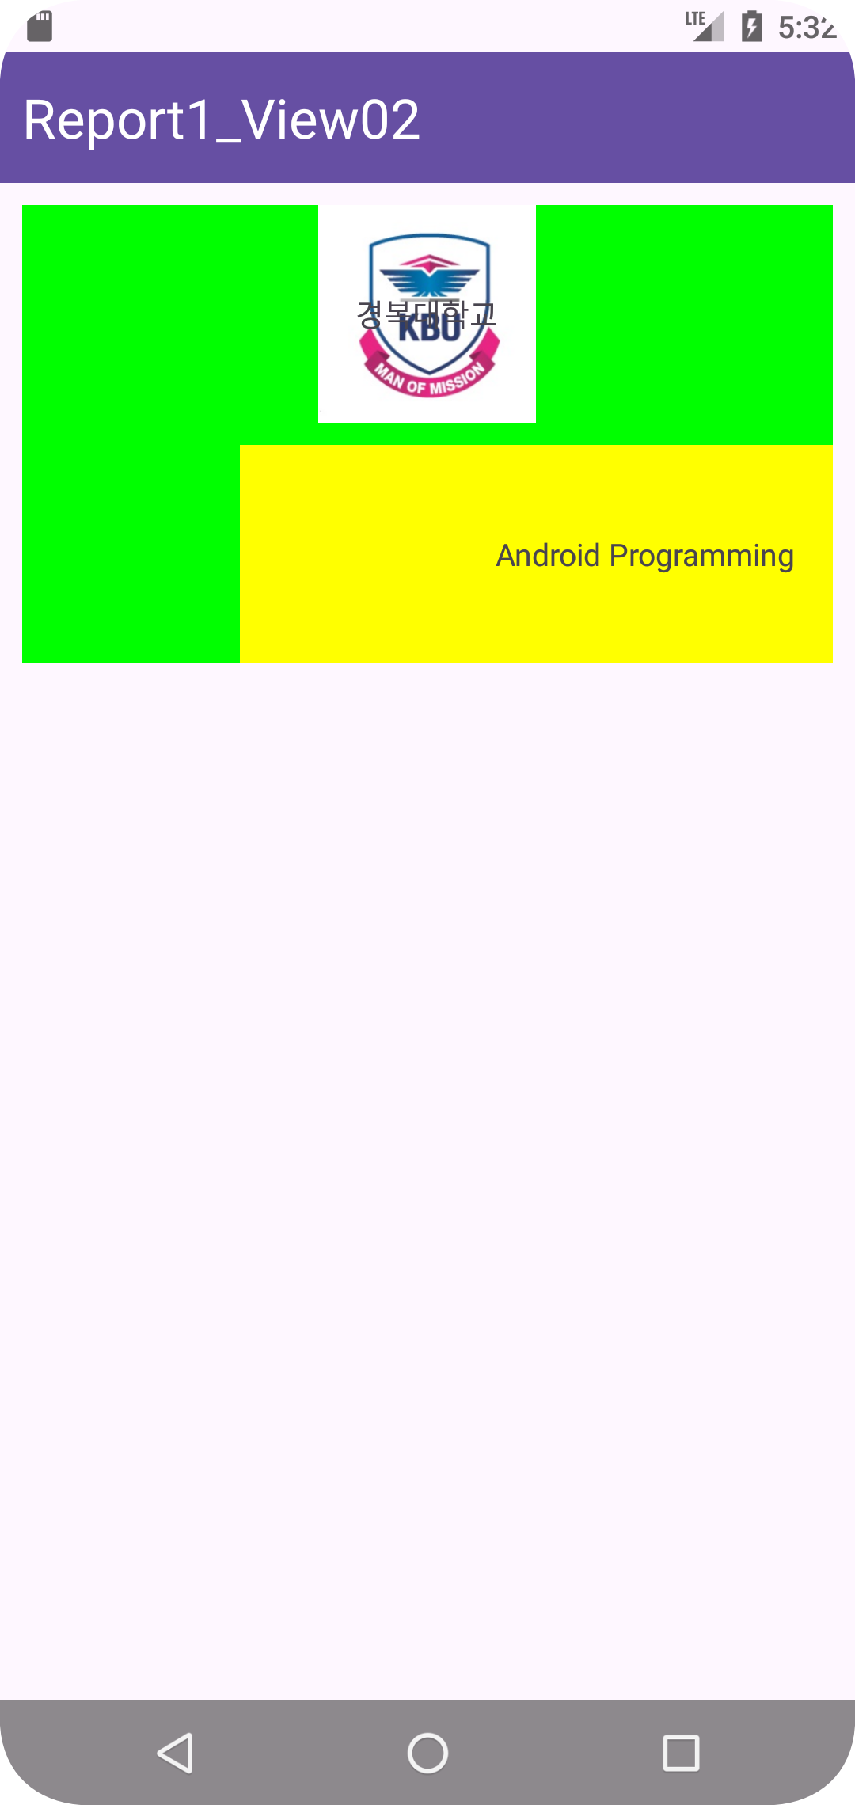
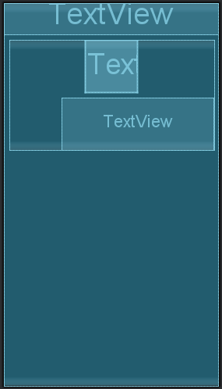
Report 1
실행화면

Slide 4
Report 2
Activity_report2.xml
<?xml version="1.0" encoding="utf-8"?> <LinearLayout xmlns:android="http://schemas.android.com/apk/res/android" xmlns:tools="http://schemas.android.com/tools" android:id="@+id/main" android:layout_width="match_parent" android:layout_height="match_parent" android:orientation="vertical" tools:context=".Report2"> <LinearLayout android:layout_width="match_parent" android:layout_height="wrap_content" android:orientation="vertical"> <TextView android:layout_width="match_parent" android:layout_height="60dp" android:background="@color/pupple" android:gravity="center_vertical" android:paddingLeft="10dp" android:text="Report2_온도 변환기" android:textColor="@color/white" android:textSize="25dp" /> <TextView android:layout_width="match_parent" android:layout_height="wrap_content" android:text="섭씨 온도를 입력하세요." /> <EditText android:id="@+id/C_editText" android:layout_width="match_parent" android:layout_height="wrap_content" android:layout_marginLeft="10dp" android:layout_marginRight="10dp" android:hint="섭씨 온도를 입력하세요" android:inputType="numberDecimal" android:padding="11dp" /> <Button android:id="@+id/CtoF_button" android:layout_width="match_parent" android:layout_height="wrap_content" android:layout_gravity="center" android:layout_marginLeft="10dp" android:layout_marginRight="10dp" android:text="화씨온도 계산" /> </LinearLayout>

Slide 5
Report 2
Activity_report2.xml
<LinearLayout android:layout_width="match_parent" android:layout_height="wrap_content" android:orientation="vertical"> <TextView android:layout_width="match_parent" android:layout_height="wrap_content" android:text="화씨 온도를 입력하세요." /> <EditText android:id="@+id/F_editText" android:layout_width="match_parent" android:layout_height="wrap_content" android:layout_marginLeft="10dp" android:layout_marginRight="10dp" android:hint="화씨 온도를 입력하세요" android:inputType="numberDecimal" android:padding="11dp" /> <Button android:id="@+id/FtoC_button" android:layout_width="match_parent" android:layout_height="wrap_content" android:layout_gravity="center" android:layout_marginLeft="10dp" android:layout_marginRight="10dp" android:text="섭씨온도 계산" /> </LinearLayout> <LinearLayout android:layout_width="match_parent" android:layout_height="wrap_content"> <TextView android:id="@+id/result_View" android:layout_width="match_parent" android:layout_height="wrap_content" android:text="결과" android:textSize="20dp" /> </LinearLayout> </LinearLayout>

Slide 6
Report 2
Report2.java
package com.example.week2; import android.os.Bundle; import android.view.View; import android.widget.Button; import android.widget.EditText; import android.widget.TextView; import android.widget.Toast; import androidx.activity.EdgeToEdge; import androidx.appcompat.app.AppCompatActivity; import androidx.core.graphics.Insets; import androidx.core.view.ViewCompat; import androidx.core.view.WindowInsetsCompat; import com.google.android.material.snackbar.BaseTransientBottomBar; public class Report2 extends AppCompatActivity { @Override protected void onCreate(Bundle savedInstanceState) { super.onCreate(savedInstanceState); setContentView(R.layout.activity_report2); // 섭씨 온도 입력칸 EditText C_editText = findViewById(R.id.C_editText); Button CtoF_button = findViewById(R.id.CtoF_button); // 화씨 온도 입력칸 EditText F_editText = findViewById(R.id.F_editText); Button FtoC_button = findViewById(R.id.FtoC_button); // 온도 변환 결과 TextView textView = findViewById(R.id.result_View); CtoF_button.setOnClickListener(new View.OnClickListener() { @Override public void onClick(View view) { String input = C_editText.getText().toString(); if (input.equals("")) { Toast.makeText(getBaseContext(), "온도를 입력해주세요.",Toast.LENGTH_SHORT).show(); } else { float C = Float.parseFloat(input); float trans = (float) ((9.0/5.0) * C + 32); textView.setText(String.format("섭씨 온도 %.2f도는\n화씨 온도로 %.2f 입니다.", C, trans)); Toast.makeText(getBaseContext(), String.format("%.2f", trans),Toast.LENGTH_SHORT).show(); } } });

Slide 7
Report 2
Report2.java
FtoC_button.setOnClickListener(new View.OnClickListener() { @Override public void onClick(View view) { String input = F_editText.getText().toString(); if (input.equals("")) { Toast.makeText(getBaseContext(), "온도를 입력해주세요.",Toast.LENGTH_SHORT).show(); } else { float F = Float.parseFloat(input); float trans = (float) ((5.0/9.0) * (F - 32)); textView.setText(String.format("화씨 온도 %.2f도는\n섭씨 온도로 %.2f 입니다.", F, trans)); Toast.makeText(getBaseContext(), String.format("%.2f", trans),Toast.LENGTH_SHORT).show(); } } }); } }

Slide 8
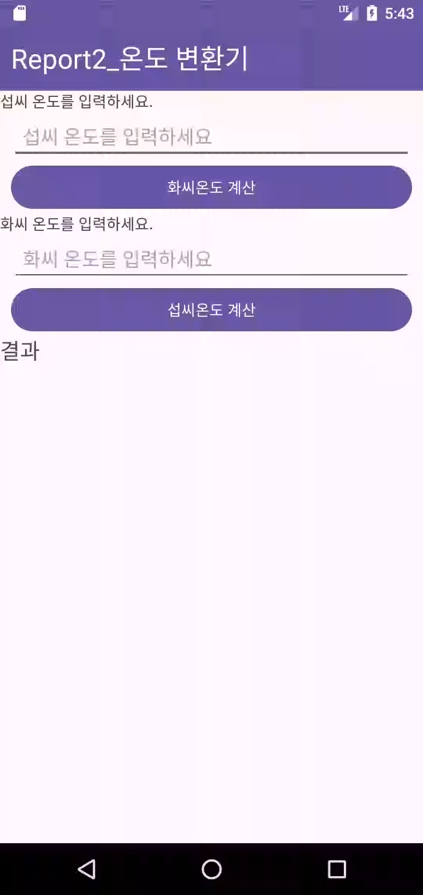
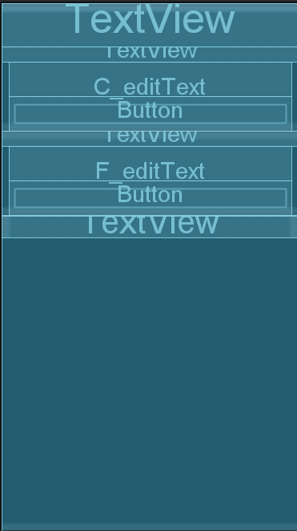
Report 2
실행화면

Slide 9
Report 3
Activity_report3.xml
<?xml version="1.0" encoding="utf-8"?> <LinearLayout xmlns:android="http://schemas.android.com/apk/res/android" xmlns:tools="http://schemas.android.com/tools" android:id="@+id/main" android:layout_width="match_parent" android:layout_height="match_parent" android:orientation="vertical" tools:context=".Report3"> <LinearLayout android:layout_width="match_parent" android:layout_height="wrap_content" android:orientation="vertical"> <TextView android:layout_width="match_parent" android:layout_height="60dp" android:background="@color/pupple" android:gravity="center_vertical" android:paddingLeft="10dp" android:text="Report3_나이 계산기" android:textColor="@color/white" android:textSize="25dp" /> <TextView android:layout_width="match_parent" android:layout_height="wrap_content" android:text="태어난 년도를 입력하세요." /> <EditText android:id="@+id/age_editText" android:layout_width="match_parent" android:layout_height="wrap_content" android:layout_marginLeft="10dp" android:layout_marginRight="10dp" android:gravity="center" android:hint="출생 년도를 입력하세요" android:inputType="numberDecimal" android:paddingTop="15dp" android:paddingBottom="15dp" /> <Button android:id="@+id/age_button" android:layout_width="match_parent" android:layout_height="wrap_content" android:layout_marginLeft="10dp" android:layout_marginRight="10dp" android:text="나이 계산" />

Slide 10
Report 3
Activity_report3.xml
</LinearLayout>
<LinearLayout android:layout_width="match_parent" android:layout_height="wrap_content" android:orientation="vertical"> <TextView android:layout_width="match_parent" android:layout_height="wrap_content" android:text="당신의 나이를 입력하세요." /> <EditText android:id="@+id/year_editText" android:layout_width="match_parent" android:layout_height="wrap_content" android:layout_marginLeft="10dp" android:layout_marginRight="10dp" android:gravity="center" android:hint="나이를 입력하세요" android:inputType="numberDecimal" android:paddingTop="15dp" android:paddingBottom="15dp" /> <Button android:id="@+id/year_button" android:layout_width="match_parent" android:layout_height="wrap_content" android:layout_marginLeft="10dp" android:layout_marginRight="10dp" android:text="태어난 해 계산" /> </LinearLayout> </LinearLayout>

Slide 11
Report 3
Report3.java
package com.example.week2; import android.os.Bundle; import android.view.View; import android.widget.Button; import android.widget.EditText; import android.widget.Toast; import androidx.appcompat.app.AppCompatActivity; import java.util.Calendar; public class Report3 extends AppCompatActivity { @Override protected void onCreate(Bundle savedInstanceState) { super.onCreate(savedInstanceState); setContentView(R.layout.activity_report3); // 나이 -> 출생년도 EditText age_editText = findViewById(R.id.age_editText); Button age_button = findViewById(R.id.age_button); // 출생년도 -> 나이 EditText year_editText = findViewById(R.id.year_editText); Button year_button = findViewById(R.id.year_button); age_button.setOnClickListener(new View.OnClickListener() { Calendar calendar = Calendar.getInstance(); @Override public void onClick(View view) { String input = age_editText.getText().toString(); if (input.isEmpty()) { Toast.makeText(getBaseContext(), "출생 년도를 입력해주세요.", Toast.LENGTH_SHORT).show(); } else if (input.length() != 4 && Integer.parseInt(input) <= 0 || Integer.parseInt(input) > calendar.get(calendar.YEAR)){ Toast.makeText(getBaseContext(),"출생 년도 4자리를 입력해주세요.", Toast.LENGTH_SHORT).show(); } else { int trans_input = Integer.parseInt(input); int year = calendar.get(calendar.YEAR); Toast.makeText(getBaseContext(),String.format("당신의 나이는 %d세입니다.", year - trans_input + 1), Toast.LENGTH_SHORT).show(); } } });

Slide 12
Report 3
Report3.java
year_button.setOnClickListener(new View.OnClickListener() { Calendar calendar = Calendar.getInstance(); @Override public void onClick(View view) { String input = year_editText.getText().toString(); if (input.isEmpty()) { Toast.makeText(getBaseContext(),"나이를 입력해주세요.", Toast.LENGTH_SHORT).show(); } else if (Integer.parseInt(input) <= 0 || Integer.parseInt(input) > 130){ Toast.makeText(getBaseContext(),"나이는 최대 130세 까지 입력 가능합니다.", Toast.LENGTH_SHORT).show(); } else { int T_year = calendar.get(calendar.YEAR); int year = Integer.parseInt(input); Toast.makeText(getBaseContext(),String.format("당신의 태어난 해는 %d년입니다.", T_year - year + 1), Toast.LENGTH_SHORT).show(); } } }); } }

Slide 13
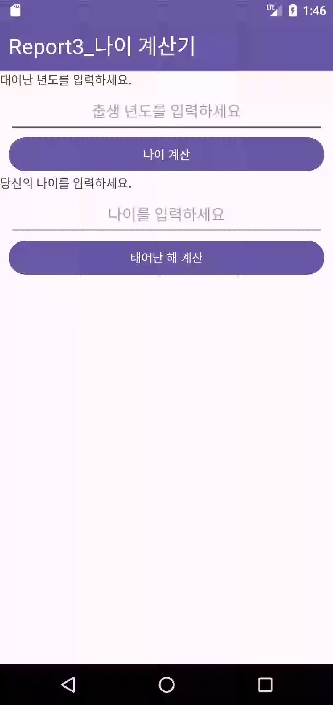
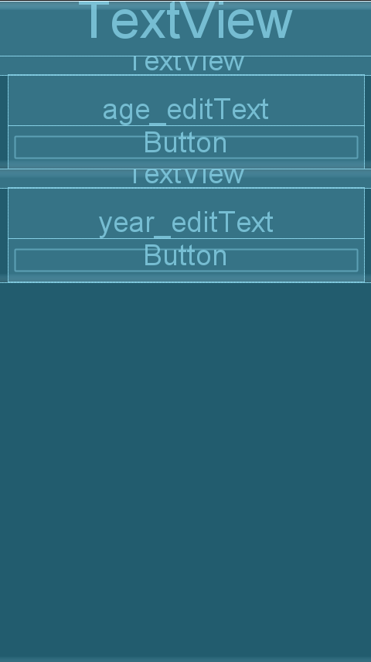
Report 3
실행화면

