Slide 1
앱 프로그래밍(1) 과제
Android Studio Report 5주차
소프트웨어융합과_코딩전공
2301111_김진용

Slide 2
Report 1
Activity_report1.xml
<?xml version="1.0" encoding="utf-8"?> <LinearLayout xmlns:android="http://schemas.android.com/apk/res/android" xmlns:tools="http://schemas.android.com/tools" android:id="@+id/main" android:layout_width="match_parent" android:layout_height="match_parent" android:orientation="vertical" tools:context=".Report1"> <TextView android:layout_width="match_parent" android:layout_height="wrap_content" android:layout_gravity="center" android:layout_margin="20dp" android:background="#FDFDC3" android:gravity="center" android:padding="5dp" android:text="BMI 계산기" android:textColor="@color/blue" android:textSize="30dp" /> <LinearLayout android:layout_width="match_parent" android:layout_height="wrap_content"

Slide 3
android:layout_margin="5dp" android:orientation="vertical"> <TextView android:layout_width="match_parent" android:layout_height="wrap_content" android:layout_margin="5dp" android:text="몸무게(35Kg ~ 150Kg)" android:textColor="@color/blue" android:textSize="23.5dp" /> <SeekBar android:id="@+id/weight" android:layout_width="match_parent" android:layout_height="wrap_content" android:layout_margin="5dp" android:max="230" /> <TextView android:id="@+id/weight_result" android:layout_width="match_parent" android:layout_height="wrap_content" android:layout_margin="5dp" android:text="35.0 Kg" android:textColor="@color/blue" android:textSize="23.5dp" />

Slide 4
</LinearLayout> <LinearLayout android:layout_width="match_parent" android:layout_height="wrap_content" android:layout_margin="5dp" android:orientation="vertical"> <TextView android:layout_width="match_parent" android:layout_height="wrap_content" android:layout_margin="5dp" android:text="키(90Cm ~ 230Cm)" android:textColor="@color/blue" android:textSize="23.5dp" /> <SeekBar android:id="@+id/height" android:layout_width="match_parent" android:layout_height="wrap_content" android:layout_margin="5dp" android:max="280" /> <TextView android:id="@+id/height_result" android:layout_width="match_parent"

Slide 5
android:layout_height="wrap_content" android:layout_margin="5dp" android:text="90.0 Cm" android:textColor="@color/blue" android:textSize="23.5dp" /> </LinearLayout> <LinearLayout android:layout_width="match_parent" android:layout_height="wrap_content" android:layout_margin="10dp" android:orientation="vertical"> <TextView android:id="@+id/BMI" android:layout_width="match_parent" android:layout_height="wrap_content" android:text="" android:textColor="@color/blue" android:textSize="23.5dp" /> <LinearLayout android:layout_width="wrap_content" android:layout_height="wrap_content" android:orientation="horizontal">
<TextView

Slide 6
android:id="@+id/BMI_result1" android:layout_width="wrap_content" android:layout_height="wrap_content" android:text="" android:textColor="@color/blue" android:textSize="23.5dp" /> <TextView android:id="@+id/BMI_result2" android:layout_width="wrap_content" android:layout_height="wrap_content" android:layout_marginLeft="5dp" android:layout_marginRight="5dp" android:text="" android:textColor="@color/red" android:textSize="23.5dp" /> <TextView android:id="@+id/BMI_result3" android:layout_width="wrap_content" android:layout_height="wrap_content" android:text="" android:textColor="@color/blue" android:textSize="23.5dp" /> </LinearLayout> </LinearLayout> </LinearLayout>

Slide 7
Report1.java
package com.example.week5; import android.os.Bundle; import android.os.Bundle; import android.widget.SeekBar; import android.widget.TextView; import android.widget.Toast; import androidx.appcompat.app.AppCompatActivity; public class Report1 extends AppCompatActivity { SeekBar weight; TextView weight_result; SeekBar height; TextView height_result; TextView BMI; TextView BMI_result1; TextView BMI_result2; TextView BMI_result3; float Kg; float Cm; float M; float BMI_value;

Slide 8
@Override public void onStopTrackingTouch(SeekBar seekBar) { } }); height.setOnSeekBarChangeListener(new SeekBar.OnSeekBarChangeListener() { @Override public void onProgressChanged(SeekBar seekBar, int i, boolean b) { Cm = (height.getProgress() * 0.5f) + 90; height_result.setText(String.format("%.1f Cm", Cm)); calculateBMI(); } @Override public void onStartTrackingTouch(SeekBar seekBar) { } @Override public void onStopTrackingTouch(SeekBar seekBar) { } }); } private void calculateBMI() { if (Kg < 35 || 150 < Kg) { Toast.makeText(getBaseContext(),"몸무게를 입력해주세요.",Toast.LENGTH_SHORT).show();

Slide 9
} else if (Cm < 90 || 230 < Cm) { Toast.makeText(getBaseContext(),"키를 입력해주세요.",Toast.LENGTH_SHORT).show(); } else { M = Cm * 0.01f; BMI_value = Kg / (M * M); if (BMI_value < 18.5f) { BMI_result2.setText("저체중"); } else if (18.5f <= BMI_value && BMI_value < 23.0f) { BMI_result2.setText("정상 체중"); } else if (23.0f <= BMI_value && BMI_value < 25.0f) { BMI_result2.setText("과체중"); } else if (25.0f <= BMI_value && BMI_value < 30.0f) { BMI_result2.setText("비만"); } else { BMI_result2.setText("고도 비만"); } BMI.setText(String.format("BMI : %.2f", BMI_value)); BMI_result1.setText("당신은"); BMI_result3.setText("입니다!"); } } }

Slide 10
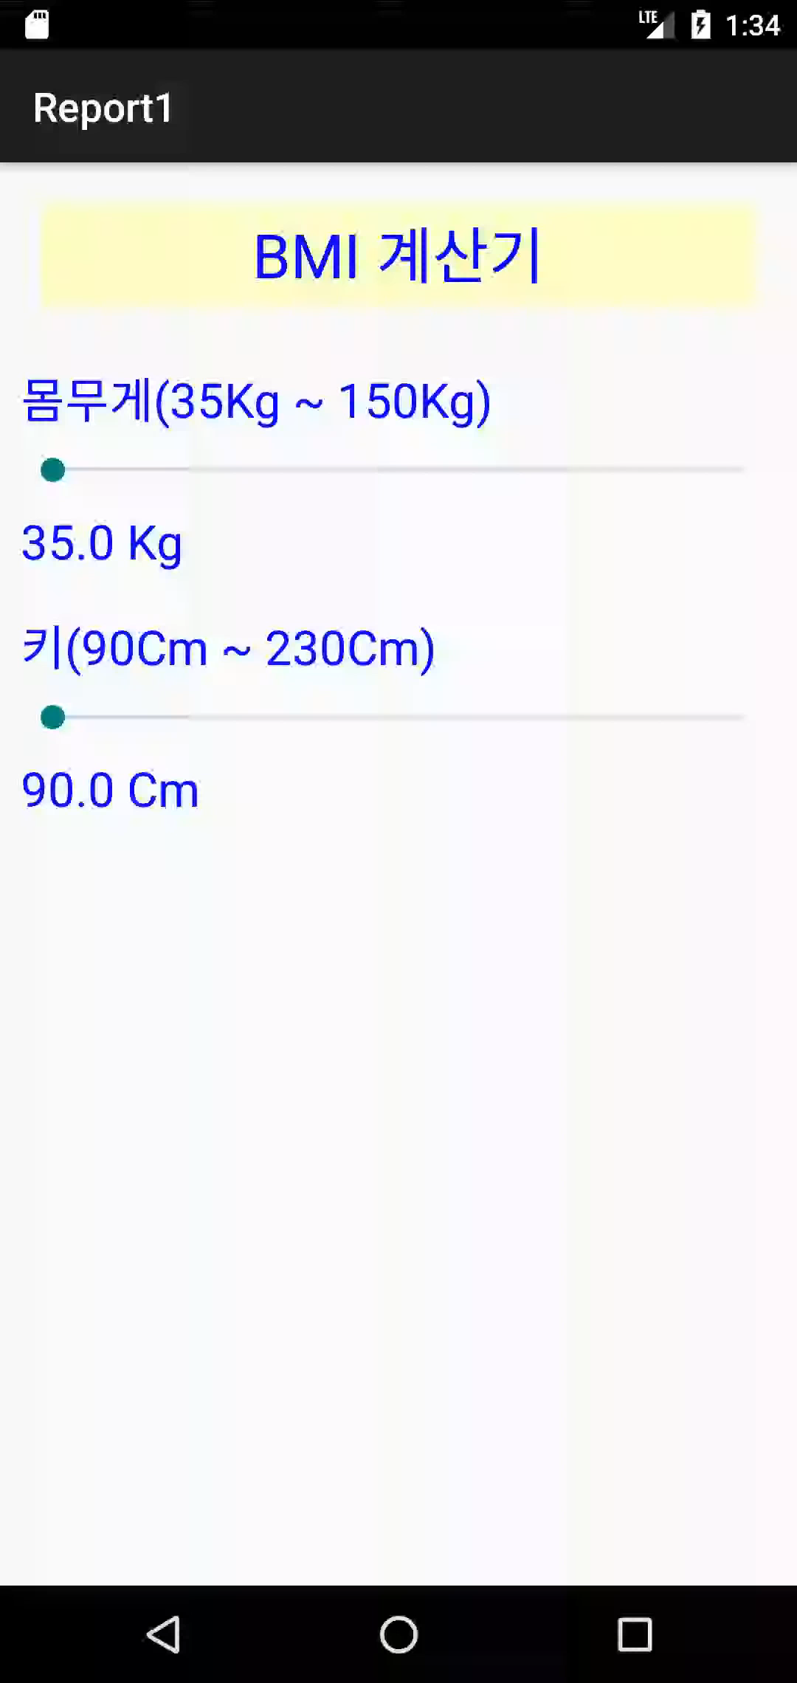
Report 1
실행화면

Slide 11
Report 2
Activity_report2.xml
<?xml version="1.0" encoding="utf-8"?> <LinearLayout xmlns:android="http://schemas.android.com/apk/res/android" xmlns:tools="http://schemas.android.com/tools" android:id="@+id/main" android:layout_width="match_parent" android:layout_height="match_parent" android:orientation="vertical" tools:context=".Report2"> <LinearLayout android:layout_width="match_parent" android:layout_height="wrap_content" android:layout_margin="5dp"> <TextView android:layout_width="wrap_content" android:layout_height="wrap_content" android:text="섭씨온도(" /> <TextView android:id="@+id/c_tem" android:layout_width="wrap_content" android:layout_height="wrap_content" android:text="0.0" />

Slide 12
<TextView android:layout_width="wrap_content" android:layout_height="wrap_content" android:layout_marginLeft="5dp" android:text="℃)" /> <SeekBar android:id="@+id/c_seekbar" android:layout_width="match_parent" android:layout_height="wrap_content" android:layout_marginLeft="30dp" android:max="200" /> </LinearLayout> <LinearLayout android:layout_width="match_parent" android:layout_height="wrap_content" android:layout_margin="5dp"> <TextView android:layout_width="wrap_content" android:layout_height="wrap_content" android:text="화씨온도(" /> <TextView android:id="@+id/f_tem"

Slide 13
android:layout_width="wrap_content" android:layout_height="wrap_content" android:text="0.0" /> <TextView android:layout_width="wrap_content" android:layout_height="wrap_content" android:layout_marginLeft="5dp" android:text="℉)" /> <SeekBar android:id="@+id/f_seekbar" android:layout_width="match_parent" android:layout_height="wrap_content" android:layout_marginLeft="30dp" android:max="200" /> </LinearLayout> <LinearLayout android:layout_width="match_parent" android:layout_height="wrap_content" android:layout_margin="10dp" android:gravity="center" android:orientation="horizontal">

Slide 14
<RadioGroup android:layout_width="wrap_content" android:layout_height="wrap_content" android:orientation="vertical"> <RadioButton android:id="@+id/ctof" android:layout_width="wrap_content" android:layout_height="wrap_content" android:checked="true" android:text="섭씨를 화씨로" /> <RadioButton android:id="@+id/ftoc" android:layout_width="wrap_content" android:layout_height="wrap_content" android:text="화씨를 섭씨로" /> </RadioGroup> <Button android:id="@+id/trans" android:layout_width="0dp" android:layout_height="wrap_content" android:layout_marginLeft="50dp" android:layout_weight="1" android:text="변환" />

Slide 15
<Button android:id="@+id/clear" android:layout_width="0dp" android:layout_height="wrap_content" android:layout_weight="1" android:text="초기화" /> </LinearLayout> <LinearLayout android:layout_width="match_parent" android:layout_height="wrap_content" android:layout_margin="10dp" android:orientation="vertical"> <LinearLayout android:layout_width="match_parent" android:layout_height="wrap_content"> <TextView android:id="@+id/c_text1" android:layout_width="wrap_content" android:layout_height="wrap_content" android:textSize="20dp" /> <TextView android:id="@+id/c_result"

Slide 16
android:layout_width="wrap_content" android:layout_height="wrap_content" android:textSize="20dp" /> <TextView android:id="@+id/c_text2" android:layout_width="wrap_content" android:layout_height="wrap_content" android:textColor="@color/red" android:textSize="20dp" /> <TextView android:id="@+id/c_text3" android:layout_width="wrap_content" android:layout_height="wrap_content" android:textSize="20dp" /> </LinearLayout> <LinearLayout android:layout_width="match_parent" android:layout_height="wrap_content"> <TextView android:id="@+id/f_text1" android:layout_width="wrap_content" android:layout_height="wrap_content" android:textSize="20dp" />

Slide 17
<TextView android:id="@+id/f_result" android:layout_width="wrap_content" android:layout_height="wrap_content" android:textSize="20dp" /> <TextView android:id="@+id/f_text2" android:layout_width="wrap_content" android:layout_height="wrap_content" android:textColor="@color/red" android:textSize="20dp" /> </LinearLayout> </LinearLayout> </LinearLayout>
Report2.java
package com.example.week5; import android.os.Bundle; import android.view.View; import android.widget.Button; import android.widget.RadioButton; import android.widget.SeekBar; import android.widget.TextView; import android.widget.Toast;

Slide 18
import androidx.activity.EdgeToEdge; import androidx.appcompat.app.AppCompatActivity; import androidx.core.graphics.Insets; import androidx.core.view.ViewCompat; import androidx.core.view.WindowInsetsCompat; import org.w3c.dom.Text; public class Report2 extends AppCompatActivity { float C; float F; @Override protected void onCreate(Bundle savedInstanceState) { super.onCreate(savedInstanceState); setContentView(R.layout.activity_report2); TextView c_tem = findViewById(R.id.c_tem); SeekBar c_seekbar = findViewById(R.id.c_seekbar); c_seekbar.setProgress(100); RadioButton ctof = findViewById(R.id.ctof); TextView c_result = findViewById(R.id.c_result); TextView c_text1 = findViewById(R.id.c_text1); TextView c_text2 = findViewById(R.id.c_text2); TextView c_text3 = findViewById(R.id.c_text3);

Slide 19
TextView f_tem = findViewById(R.id.f_tem); SeekBar f_seekbar = findViewById(R.id.f_seekbar); f_seekbar.setProgress(100); RadioButton ftoc = findViewById(R.id.ftoc); TextView f_result = findViewById(R.id.f_result); TextView f_text1 = findViewById(R.id.f_text1); TextView f_text2 = findViewById(R.id.f_text2); Button trans = findViewById(R.id.trans); Button clear = findViewById(R.id.clear); c_seekbar.setOnSeekBarChangeListener(new SeekBar.OnSeekBarChangeListener() { @Override public void onProgressChanged(SeekBar seekBar, int i, boolean b) { C = c_seekbar.getProgress() - 100; c_tem.setText(String.format("%.2f", C)); } @Override public void onStartTrackingTouch(SeekBar seekBar) { } @Override public void onStopTrackingTouch(SeekBar seekBar) {

Slide 20
} }); f_seekbar.setOnSeekBarChangeListener(new SeekBar.OnSeekBarChangeListener() { @Override public void onProgressChanged(SeekBar seekBar, int i, boolean b) { F = f_seekbar.getProgress() - 100; f_tem.setText(String.format("%.2f",F)); } @Override public void onStartTrackingTouch(SeekBar seekBar) { } @Override public void onStopTrackingTouch(SeekBar seekBar) { } }); View.OnClickListener onClickListener = new View.OnClickListener() { @Override public void onClick(View view) { float c_temp = 0; float f_temp = 0; int button = view.getId();

Slide 21
if (ctof.isChecked()) { if (-100 <= C && C <= 100) { if (button == R.id.trans) { f_temp = (float) ((C * 1.8) + 32); c_text1.setText("섭씨온도 : "); c_text2.setText("℃"); c_text3.setText("는"); c_result.setText(String.format("%.2f", C)); f_text1.setText("화씨온도 : "); f_text2.setText("℉"); f_result.setText(String.format("%.2f", f_temp)); } else { c_seekbar.setProgress(100); f_seekbar.setProgress(100); c_text1.setText(""); c_text2.setText(""); c_text3.setText(""); c_result.setText(""); f_text1.setText(""); f_text2.setText(""); f_result.setText(""); } } } else { if (-100 <= F && F <= 100) { if (button == R.id.trans) {

Slide 22
c_temp = (float) ((F - 32) / 1.8); c_text1.setText("섭씨온도 : "); c_text2.setText("℃"); c_text3.setText("는"); c_result.setText(String.format("%.2f", c_temp)); f_text1.setText("화씨온도 : "); f_text2.setText("℉"); f_result.setText(String.format("%.2f", F)); } else { c_seekbar.setProgress(100); f_seekbar.setProgress(100); c_text1.setText(""); c_text2.setText(""); c_text3.setText(""); c_result.setText(""); f_text1.setText(""); f_text2.setText(""); f_result.setText(""); } } } } }; trans.setOnClickListener(onClickListener); clear.setOnClickListener(onClickListener); } }

Slide 23
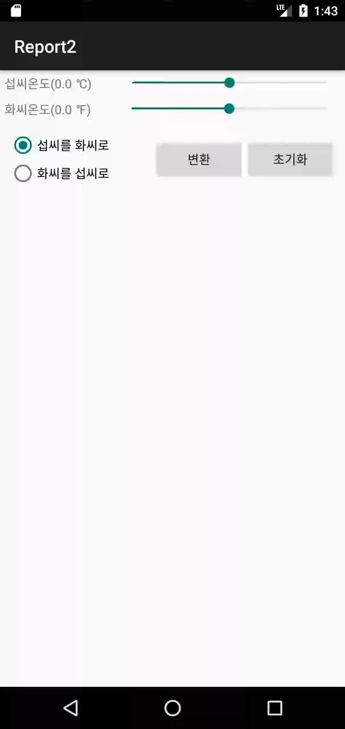
Report 2
실행화면

Slide 24
Report 3
Activity_report3.xml
<?xml version="1.0" encoding="utf-8"?> <LinearLayout xmlns:android="http://schemas.android.com/apk/res/android" xmlns:app="http://schemas.android.com/apk/res-auto" xmlns:tools="http://schemas.android.com/tools" android:id="@+id/main" android:layout_width="match_parent" android:layout_height="match_parent" android:layout_margin="20dp" android:orientation="vertical" tools:context=".Report3"> <LinearLayout android:layout_width="match_parent" android:layout_height="wrap_content" android:orientation="horizontal"> <TextView android:layout_width="wrap_content" android:layout_height="match_parent" android:gravity="center" android:text="신장(키)" /> <LinearLayout android:layout_width="match_parent"

Slide 25
android:layout_height="wrap_content"> <ImageButton android:id="@+id/plus" android:layout_width="50dp" android:layout_height="50dp" android:layout_weight="1" android:background="@android:color/transparent" android:scaleType="fitCenter" android:src="@drawable/plusbutton" /> <ImageButton android:id="@+id/minus" android:layout_width="50dp" android:layout_height="50dp" android:layout_weight="1" android:background="@android:color/transparent" android:scaleType="fitCenter" android:src="@drawable/minusbutton" /> </LinearLayout> </LinearLayout> <LinearLayout android:layout_width="match_parent" android:layout_height="wrap_content" android:orientation="horizontal">

Slide 26
<TextView android:layout_width="wrap_content" android:layout_height="wrap_content" android:text="몸무게" /> <SeekBar android:id="@+id/weight_seekbar" android:layout_width="match_parent" android:layout_height="wrap_content" android:layout_gravity="center" android:layout_marginLeft="10dp" android:max="95" /> </LinearLayout> <Button android:id="@+id/bmi" android:layout_width="match_parent" android:layout_height="wrap_content" android:layout_marginTop="20dp" android:text="BMI" android:textSize="20dp" /> <LinearLayout android:layout_width="wrap_content" android:layout_height="wrap_content" android:layout_gravity="center" android:orientation="horizontal">

Slide 27
<TextView android:layout_width="wrap_content" android:layout_height="wrap_content" android:text="신장(키) : " /> <TextView android:id="@+id/height_result" android:layout_width="wrap_content" android:layout_height="wrap_content" android:textColor="@color/red" /> <TextView android:id="@+id/cm" android:layout_width="wrap_content" android:layout_height="wrap_content" android:layout_marginLeft="5dp" /> </LinearLayout> <LinearLayout android:layout_width="wrap_content" android:layout_height="wrap_content" android:layout_gravity="center" android:orientation="horizontal"> <TextView android:layout_width="wrap_content" android:layout_height="wrap_content" android:text="몸무게 : " />

Slide 28
<TextView android:id="@+id/weight_result" android:layout_width="wrap_content" android:layout_height="wrap_content" android:textColor="@color/red" /> <TextView android:id="@+id/kg" android:layout_width="wrap_content" android:layout_height="wrap_content" android:layout_marginLeft="5dp" /> </LinearLayout> <TextView android:id="@+id/bmi_result" android:layout_width="wrap_content" android:layout_height="wrap_content" android:layout_gravity="center" android:textColor="@color/blue" android:textSize="20dp" /> </LinearLayout>

Slide 29
Report3.java
package com.example.week5; import android.os.Bundle; import android.os.Bundle; import android.view.View; import android.widget.Button; import android.widget.ImageButton; import android.widget.SeekBar; import android.widget.TextView; import android.widget.Toast; import androidx.activity.EdgeToEdge; import androidx.appcompat.app.AppCompatActivity; import androidx.core.graphics.Insets; import androidx.core.view.ViewCompat; import androidx.core.view.WindowInsetsCompat; public class Report3 extends AppCompatActivity { int temp = 165; int Kg; float M; float BMI; @Override protected void onCreate(Bundle savedInstanceState) {

Slide 30
super.onCreate(savedInstanceState); setContentView(R.layout.activity_report3); ImageButton plus = findViewById(R.id.plus); ImageButton minus = findViewById(R.id.minus); SeekBar weight_seekbar = findViewById(R.id.weight_seekbar); Button bmi = findViewById(R.id.bmi); TextView height_result = findViewById(R.id.height_result); TextView cm = findViewById(R.id.cm); TextView weight_result = findViewById(R.id.weight_result); TextView kg = findViewById(R.id.kg); TextView bmi_result = findViewById(R.id.bmi_result); View.OnClickListener onClickListener = new View.OnClickListener() { @Override public void onClick(View view) { int check = view.getId(); if (check == plus.getId()) { if (210 <= temp) { Toast.makeText(getBaseContext(), "더이상 증가할 수 없음",Toast.LENGTH_SHORT).show(); } else { temp++; } } else if (check == minus.getId()) {

Slide 31
if (temp <= 120) { Toast.makeText(getBaseContext(), "더이상 감소할 수 없음",Toast.LENGTH_SHORT).show(); } else { temp--; } } else { if (temp < 120 || 210 < temp && Kg < 45 || 140 < Kg) { Toast.makeText(getBaseContext(), "필수 정보가 입력되지 않았습니다.",Toast.LENGTH_SHORT).show(); } else { M = temp * 0.01f; BMI = Kg / (M * M); String BMI_Text; if (BMI < 16.0f) { BMI_Text = "체중 부족"; } else if (16.0f <= BMI && BMI < 18.5f) { BMI_Text = "저체중"; } else if (18.5f <= BMI && BMI < 25.0f) { BMI_Text = ("정상체중"); } else if (25.0f <= BMI && BMI < 30.0f) { BMI_Text = "과체중"; } else { BMI_Text = "비만"; } bmi_result.setText(String.format("BMI : %.2f\n결과 : %s", BMI, BMI_Text)); } }

Slide 32
height_result.setText(String.format("%d", temp)); cm.setText("Cm"); } }; plus.setOnClickListener(onClickListener); minus.setOnClickListener(onClickListener); bmi.setOnClickListener(onClickListener); weight_seekbar.setOnSeekBarChangeListener(new SeekBar.OnSeekBarChangeListener() { @Override public void onProgressChanged(SeekBar seekBar, int i, boolean b) { Kg = weight_seekbar.getProgress() + 45; weight_result.setText(String.format("%d", Kg)); kg.setText("Kg"); } @Override public void onStartTrackingTouch(SeekBar seekBar) { } @Override public void onStopTrackingTouch(SeekBar seekBar) { } }); } }

Slide 33
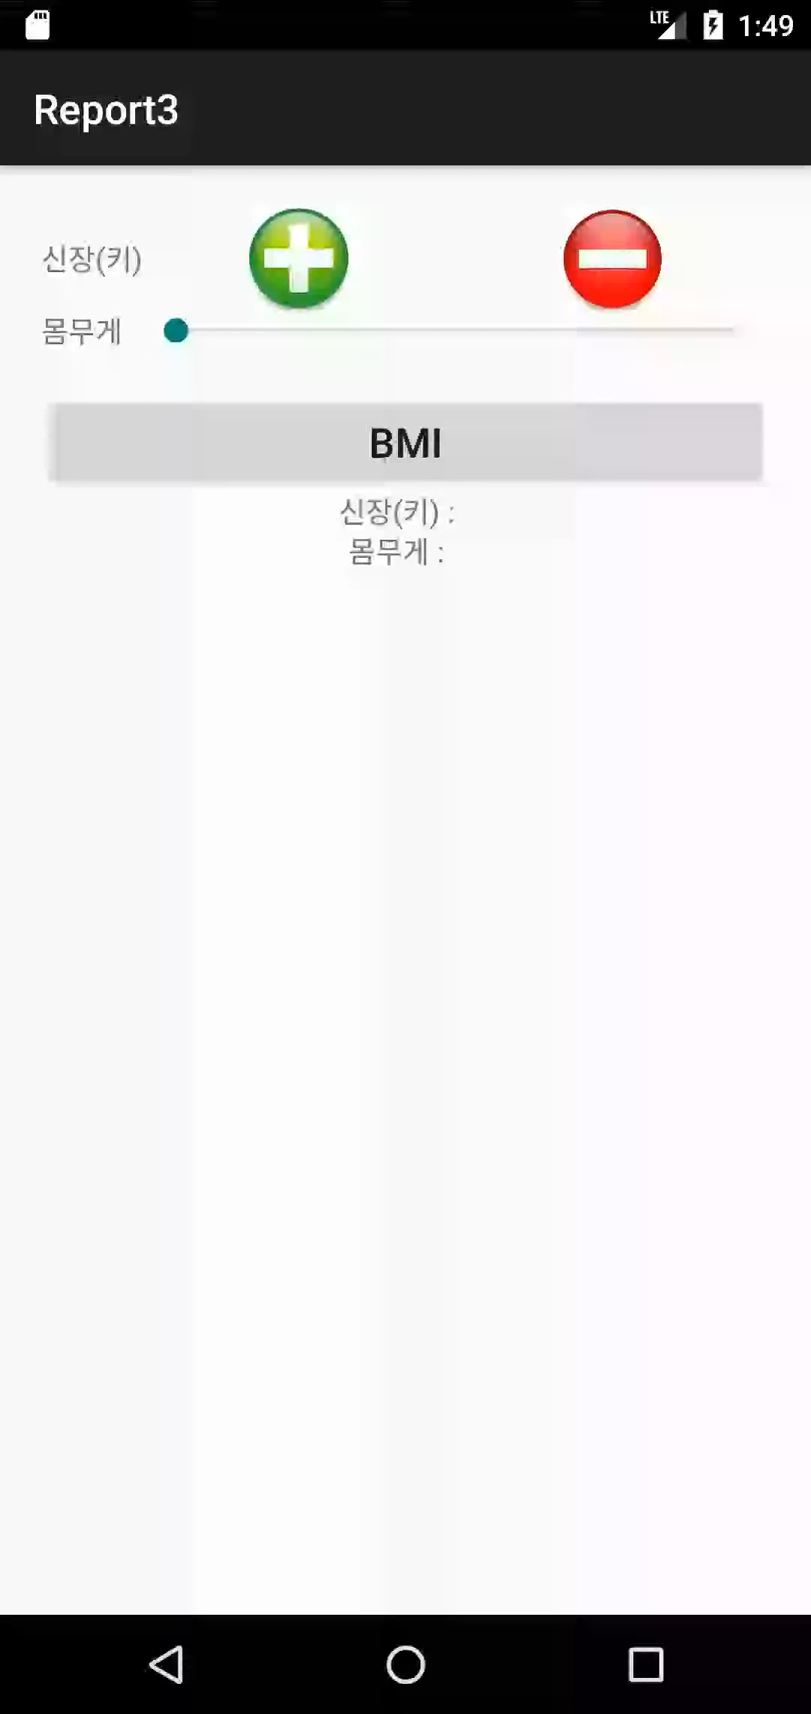
Report 3
실행화면

