Slide 1





앱 프로그래밍(2)
11주차 Report
김진용 | 소프트웨어융합과 코딩전공, 2301111

Slide 2
Activity_main.xml
<?xml version="1.0" encoding="utf-8"?> <FrameLayout xmlns:android="http://schemas.android.com/apk/res/android" android:id="@+id/fragment_container" android:layout_width="mㅁ<?xml version="1.0" encoding="utf-8"?> <LinearLayout xmlns:android="http://schemas.android.com/apk/res/android" android:id="@+id/main" android:orientation="vertical" android:layout_width="match_parent" android:layout_height="match_parent"> <LinearLayout android:orientation="horizontal" android:layout_width="match_parent" android:layout_height="wrap_content"> <Button android:id="@+id/btnInsert" android:layout_width="0dp" android:layout_weight="1" android:layout_height="wrap_content" android:text="INSERT"/> <Button android:id="@+id/btnSearch" android:layout_width="0dp" android:layout_weight="1" android:layout_height="wrap_content" android:text="SEARCH"/> </LinearLayout> <LinearLayout android:orientation="horizontal" android:layout_width="match_parent" android:layout_height="wrap_content">
<Button android:id="@+id/btnDelete1" android:layout_width="0dp" android:layout_weight="1" android:layout_height="wrap_content" android:text="DELETE1"/> <Button android:id="@+id/btnDelete2" android:layout_width="0dp" android:layout_weight="1" android:layout_height="wrap_content" android:text="DELETE2"/> </LinearLayout> <LinearLayout android:orientation="horizontal" android:layout_width="match_parent" android:layout_height="wrap_content"> <Button android:id="@+id/btnDelete3" android:layout_width="0dp" android:layout_weight="1" android:layout_height="wrap_content" android:text="DELETE3"/> <Button android:id="@+id/btnDeleteAll" android:layout_width="0dp" android:layout_weight="1" android:layout_height="wrap_content" android:text="DELETEALL"/> </LinearLayout>

Slide 3
Activity_main.xml
<LinearLayout android:orientation="horizontal" android:layout_width="match_parent" android:layout_height="wrap_content"> <Button android:id="@+id/btnUpdate1" android:layout_width="0dp" android:layout_weight="1" android:layout_height="wrap_content" android:text="UPDATE1"/> <Button android:id="@+id/btnUpdate2" android:layout_width="0dp" android:layout_weight="1" android:layout_height="wrap_content" android:text="UPDATE2"/> </LinearLayout> <ScrollView android:layout_width="match_parent" android:layout_height="0dp" android:layout_weight="1"> <TextView android:id="@+id/tvResults" android:layout_width="match_parent" android:layout_height="wrap_content" android:textSize="14sp"/> </ScrollView> </LinearLayout>
atch_parent" android:layout_height="match_parent"/>

Slide 4
MainActivity.java
package com.example.myapplication; import android.os.Bundle; import android.widget.Button; import android.widget.TextView; import android.widget.Toast; import androidx.activity.EdgeToEdge; import androidx.appcompat.app.AppCompatActivity; import androidx.core.graphics.Insets; import androidx.core.view.ViewCompat; import androidx.core.view.WindowInsetsCompat; import java.util.Arrays; import java.util.List; public class MainActivity extends AppCompatActivity { private DBHelper dbHelper; private TextView tvResults; @Override protected void onCreate(Bundle savedInstanceState) { super.onCreate(savedInstanceState); EdgeToEdge.enable(this); setContentView(R.layout.activity_main); ViewCompat.setOnApplyWindowInsetsListener(findViewById(R.id.main), (v, insets) -> { Insets sys = insets.getInsets(WindowInsetsCompat.Type.systemBars()); v.setPadding(sys.left, sys.top, sys.right, sys.bottom); return insets; }); dbHelper = new DBHelper(this); tvResults = findViewById(R.id.tvResults);
// 버튼 바인딩 Button btnInsert = findViewById(R.id.btnInsert); Button btnSearch = findViewById(R.id.btnSearch); Button btnDelete1 = findViewById(R.id.btnDelete1); Button btnDelete2 = findViewById(R.id.btnDelete2); Button btnDelete3 = findViewById(R.id.btnDelete3); Button btnDeleteAll = findViewById(R.id.btnDeleteAll); Button btnUpdate1 = findViewById(R.id.btnUpdate1); Button btnUpdate2 = findViewById(R.id.btnUpdate2); btnInsert.setOnClickListener(v -> { List<Product> list = Arrays.asList( new Product("CD-0100", "Cookie", 150f), new Product("CD-0101", "Candy", 80.5f), new Product("CD-0102", "Cake", 360f) ); dbHelper.insertProducts(list); Toast.makeText(this, "데이터 삽입 완료", Toast.LENGTH_SHORT).show(); refreshResults(); }); btnSearch.setOnClickListener(v -> { refreshResults(); Toast.makeText(this, "조회 완료", Toast.LENGTH_SHORT).show(); }); btnDelete1.setOnClickListener(v -> { dbHelper.deleteProduct("CD-0100"); Toast.makeText(this, "CD-0100 삭제 완료", Toast.LENGTH_SHORT).show(); refreshResults(); });

Slide 5
MainActivity.java
btnDelete2.setOnClickListener(v -> { dbHelper.deleteProductTransactional("CD-0101"); Toast.makeText(this, "CD-0101 삭제 완료", Toast.LENGTH_SHORT).show(); refreshResults(); }); btnDelete3.setOnClickListener(v -> { dbHelper.deleteProductTransactionalStatement("CD-0102"); Toast.makeText(this, "CD-0102 삭제 완료 ", Toast.LENGTH_SHORT).show(); refreshResults(); }); btnDeleteAll.setOnClickListener(v -> { dbHelper.deleteAllTransactionalStatement(); Toast.makeText(this, "모든 레코드 삭제 완료", Toast.LENGTH_SHORT).show(); refreshResults(); }); btnUpdate1.setOnClickListener(v -> { dbHelper.updateAllPricesReplace(2000f); Toast.makeText(this, "모든 가격 2000으로 변경", Toast.LENGTH_SHORT).show(); refreshResults(); }); btnUpdate2.setOnClickListener(v -> { dbHelper.updateAllPrices(3000f); Toast.makeText(this, "모든 가격 3000으로 변경", Toast.LENGTH_SHORT).show(); refreshResults(); }); // 앱 실행 시 최초 결과 표시 refreshResults(); }
// DB에서 가져온 상품 리스트를 문자열로 변환해 TextView에 세팅 private void refreshResults() { List<Product> all = dbHelper.getAllProducts(); if (all.isEmpty()) { tvResults.setText("저장된 상품이 없습니다."); return; } StringBuilder sb = new StringBuilder(); for (Product p : all) { sb.append(p.getCode()) .append(" - ").append(p.getName()) .append(" - ").append(p.getPrice()) .append("\n"); } tvResults.setText(sb.toString()); } }

Slide 6
DbHelper.java
package com.example.myapplication; import android.content.Context; import android.database.Cursor; import android.database.sqlite.SQLiteDatabase; import android.database.sqlite.SQLiteOpenHelper; import android.database.sqlite.SQLiteStatement; import java.util.ArrayList; import java.util.List; public class DBHelper extends SQLiteOpenHelper { private static final String DB_NAME = "product_db"; private static final int DB_VERSION = 1; public static final String TABLE_PRODUCT = "PRODUCT"; public DBHelper(Context context) { super(context, DB_NAME, null, DB_VERSION); } @Override public void onCreate(SQLiteDatabase db) { String createSQL = "CREATE TABLE " + TABLE_PRODUCT + " (" + "CODE TEXT PRIMARY KEY," + "name TEXT," + "price REAL CHECK(price > 0.0)" + ");"; db.execSQL(createSQL); } @Override public void onUpgrade(SQLiteDatabase db, int oldV, int newV) { db.execSQL("DROP TABLE IF EXISTS " + TABLE_PRODUCT); onCreate(db); }
// INSERT (Transaction + SQLiteStatement) public void insertProducts(List<Product> products) { SQLiteDatabase db = getWritableDatabase(); String sql = "INSERT OR REPLACE INTO " + TABLE_PRODUCT + "(CODE,name,price) VALUES(?,?,?)"; db.beginTransaction(); SQLiteStatement stmt = db.compileStatement(sql); try { for (Product p : products) { stmt.clearBindings(); stmt.bindString(1, p.getCode()); stmt.bindString(2, p.getName()); stmt.bindDouble(3, p.getPrice()); stmt.execute(); } db.setTransactionSuccessful(); } finally { db.endTransaction(); } } // SEARCH public List<Product> getAllProducts() { SQLiteDatabase db = getReadableDatabase(); Cursor c = db.rawQuery("SELECT CODE,name,price FROM " + TABLE_PRODUCT, null); List<Product> list = new ArrayList<>(); while (c.moveToNext()) { String code = c.getString(0); String name = c.getString(1); float price = c.getFloat(2); list.add(new Product(code, name, price)); }

Slide 7
DbHelper.java
c.close(); return list; } // DELETE1: 단일 레코드 삭제 public void deleteProduct(String code) { SQLiteDatabase db = getWritableDatabase(); db.delete(TABLE_PRODUCT, "CODE=?", new String[]{code}); } // DELETE2: 단일 레코드 삭제 + Transaction public void deleteProductTransactional(String code) { SQLiteDatabase db = getWritableDatabase(); db.beginTransaction(); try { db.delete(TABLE_PRODUCT, "CODE=?", new String[]{code}); db.setTransactionSuccessful(); } finally { db.endTransaction(); } } // DELETE3: 단일 레코드 삭제 + Transaction + SQLiteStatement public void deleteProductTransactionalStatement(String code) { SQLiteDatabase db = getWritableDatabase(); String sql = "DELETE FROM " + TABLE_PRODUCT + " WHERE CODE=?"; db.beginTransaction(); SQLiteStatement stmt = db.compileStatement(sql); try { stmt.bindString(1, code); stmt.executeUpdateDelete(); db.setTransactionSuccessful(); } finally { db.endTransaction(); } }
// DELETEALL: 모든 레코드 삭제 + Transaction + SQLiteStatement public void deleteAllTransactionalStatement() { SQLiteDatabase db = getWritableDatabase(); String sql = "DELETE FROM " + TABLE_PRODUCT; db.beginTransaction(); SQLiteStatement stmt = db.compileStatement(sql); try { stmt.execute(); db.setTransactionSuccessful(); } finally { db.endTransaction(); } } // UPDATE1: 모든 가격을 2000으로 (INSERT OR REPLACE + Transaction + SQLiteStatement) public void updateAllPricesReplace(float newPrice) { SQLiteDatabase db = getWritableDatabase(); String sql = "INSERT OR REPLACE INTO " + TABLE_PRODUCT + "(CODE,name,price) " + "SELECT CODE,name,? FROM " + TABLE_PRODUCT; db.beginTransaction(); SQLiteStatement stmt = db.compileStatement(sql); try { stmt.bindDouble(1, newPrice); stmt.execute(); db.setTransactionSuccessful(); } finally { db.endTransaction(); } }

Slide 8
DbHelper.java
// UPDATE2: 모든 가격을 3000으로 (Transaction + SQLiteStatement) public void updateAllPrices(float newPrice) { SQLiteDatabase db = getWritableDatabase(); String sql = "UPDATE " + TABLE_PRODUCT + " SET price=?"; db.beginTransaction(); SQLiteStatement stmt = db.compileStatement(sql); try { stmt.bindDouble(1, newPrice); stmt.execute(); db.setTransactionSuccessful(); } finally { db.endTransaction(); } } }

Slide 9
Product.java
package com.example.myapplication; public class Product { private String code; private String name; private float price; public Product(String code, String name, float price) { this.code = code; this.name = name; this.price = price; } public String getCode() { return code; } public void setCode(String code) { this.code = code; } public String getName() { return name; } public void setName(String name) { this.name = name; } public float getPrice() { return price; } public void setPrice(float price) { this.price = price; } }

Slide 10


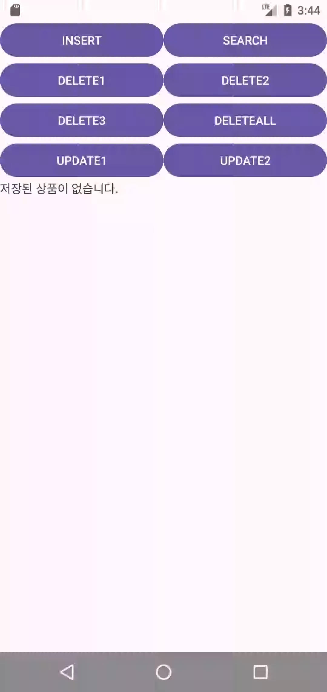
22/23
실행화면

