Slide 1


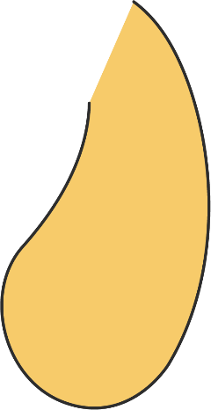


앱 프로그래밍(2)
12주차 Report
김진용 | 소프트웨어융합과 코딩전공, 2301111

Slide 2
Activity_main.xml
<?xml version="1.0" encoding="utf-8"?> <LinearLayout xmlns:android="http://schemas.android.com/apk/res/android" android:id="@+id/main" android:orientation="vertical" android:layout_width="match_parent" android:layout_height="match_parent"> <Button android:id="@+id/btnViewCustomers" android:layout_width="match_parent" android:layout_height="wrap_content" android:text="CUSTOMER TABLE 보기"/> <Button android:id="@+id/btnViewProducts" android:layout_width="match_parent" android:layout_height="wrap_content" android:text="PRODUCT TABLE 보기"/> <Button android:id="@+id/btnViewSales" android:layout_width="match_parent" android:layout_height="wrap_content" android:text="SALE_TABLE 보기"/> <Button android:id="@+id/btnViewHong" android:layout_width="match_parent" android:layout_height="wrap_content" android:text="홍길동이가 구입한 제품과 가격은"/> <Button android:id="@+id/btnViewKim" android:layout_width="match_parent" android:layout_height="wrap_content" android:text="김대한이 구입한 제품과 가격은"/>
<TextView android:id="@+id/tvResults" android:layout_width="match_parent" android:layout_height="0dp" android:layout_weight="1" android:background="#D3D3D3" android:padding="8dp" android:textSize="14sp"/> </LinearLayout>

Slide 3
MainActivity.java
package com.example.myapplication; import android.os.Bundle; import android.widget.Button; import android.widget.TextView; import androidx.activity.EdgeToEdge; import androidx.appcompat.app.AppCompatActivity; import androidx.core.graphics.Insets; import androidx.core.view.ViewCompat; import androidx.core.view.WindowInsetsCompat; import java.util.List; public class MainActivity extends AppCompatActivity { private DBHelper dbHelper; private TextView tvResults; @Override protected void onCreate(Bundle savedInstanceState) { super.onCreate(savedInstanceState); EdgeToEdge.enable(this); setContentView(R.layout.activity_main); ViewCompat.setOnApplyWindowInsetsListener( findViewById(R.id.main), (v, insets) -> { Insets sys = insets.getInsets(WindowInsetsCompat.Type.systemBars()); v.setPadding(sys.left, sys.top, sys.right, sys.bottom); return insets; } ); dbHelper = new DBHelper(this); tvResults = findViewById(R.id.tvResults);
Button btnViewCustomers = findViewById(R.id.btnViewCustomers); Button btnViewProducts = findViewById(R.id.btnViewProducts); Button btnViewSales = findViewById(R.id.btnViewSales); Button btnViewHong = findViewById(R.id.btnViewHong); Button btnViewKim = findViewById(R.id.btnViewKim); btnViewCustomers.setOnClickListener(v -> showCustomers()); btnViewProducts .setOnClickListener(v -> showProducts()); btnViewSales .setOnClickListener(v -> showSales()); btnViewHong .setOnClickListener(v -> showPurchases("홍길동")); btnViewKim .setOnClickListener(v -> showPurchases("김대한")); // 최초 한 번 표시 showCustomers(); } private void showCustomers() { List<Customer> list = dbHelper.getAllCustomers(); StringBuilder sb = new StringBuilder(); sb.append("--customer table--\n"); for (Customer c : list) { sb.append("id : ").append(c.getCid()) .append(", 고객명 : ").append(c.getCname()) .append("\n"); } tvResults.setText(sb.toString()); } private void showProducts() { List<Product> list = dbHelper.getAllProducts(); StringBuilder sb = new StringBuilder(); sb.append("--product table--\n");

Slide 4
MainActivity.java
for (Product p : list) { sb.append("id : ").append(p.getPid()) .append(", 제품명 : ").append(p.getPname()) .append(", 가격 : ").append(p.getCost()) .append("\n"); } tvResults.setText(sb.toString()); } private void showSales() { List<Sale> list = dbHelper.getAllSales(); StringBuilder sb = new StringBuilder(); sb.append("--sale table--\n"); for (Sale s : list) { sb.append("주문번호 : ").append(s.getOrdNo()) .append(", 고객번호 : ").append(s.getCid()) .append(", 상품코드 : ").append(s.getPid()) .append(", 수량 : ").append(s.getQty()) .append("\n"); } tvResults.setText(sb.toString()); } private void showPurchases(String cname) { List<Purchase> list = dbHelper.getPurchasesByCustomerName(cname); StringBuilder sb = new StringBuilder(); sb.append("--").append(cname).append(" 구매 목록--\n"); for (Purchase p : list) { sb.append("제품명 : ").append(p.getPname()) .append(" | 수량 : ").append(p.getQty()) .append(" | 가격 : ").append(p.getCost()) .append(" | 총금액 : ").append(p.getTotal()) .append("\n"); }
if (list.isEmpty()) { sb.append("구매 내역이 없습니다.\n"); } tvResults.setText(sb.toString()); } }

Slide 5
DbHelper.java
package com.example.myapplication; import android.content.Context; import android.database.Cursor; import android.database.sqlite.SQLiteDatabase; import android.database.sqlite.SQLiteOpenHelper; import java.util.ArrayList; import java.util.List; public class DBHelper extends SQLiteOpenHelper { private static final String DB_NAME = "app.db"; private static final int DB_VERSION = 1; public DBHelper(Context context) { super(context, DB_NAME, null, DB_VERSION); } @Override public void onConfigure(SQLiteDatabase db) { super.onConfigure(db); db.setForeignKeyConstraintsEnabled(true); } @Override public void onCreate(SQLiteDatabase db) { // 테이블 생성 db.execSQL("CREATE TABLE CUSTOMER(" + "CID TEXT PRIMARY KEY," + "CNAME TEXT)"); db.execSQL("CREATE TABLE PRODUCT(" + "PID TEXT PRIMARY KEY," + "PNAME TEXT," + "COST REAL)");
db.execSQL("CREATE TABLE SALE(" + "ORD_NO TEXT PRIMARY KEY," + "CID TEXT," + "PID TEXT," + "QTY INTEGER," + "FOREIGN KEY(CID) REFERENCES CUSTOMER(CID)," + "FOREIGN KEY(PID) REFERENCES PRODUCT(PID))"); // 샘플 데이터 삽입 db.execSQL("INSERT INTO CUSTOMER VALUES('C001','홍길동')"); db.execSQL("INSERT INTO CUSTOMER VALUES('C002','김대한')"); db.execSQL("INSERT INTO CUSTOMER VALUES('C003','이구슬')"); db.execSQL("INSERT INTO PRODUCT VALUES('P021','축구공',25000)"); db.execSQL("INSERT INTO PRODUCT VALUES('P022','배구공',19000)"); db.execSQL("INSERT INTO PRODUCT VALUES('P023','야구공', 8000)"); db.execSQL("INSERT INTO SALE VALUES('O1235','C001','P021',2)"); db.execSQL("INSERT INTO SALE VALUES('O1236','C002','P021',1)"); db.execSQL("INSERT INTO SALE VALUES('O1237','C002','P023',5)"); db.execSQL("INSERT INTO SALE VALUES('O1238','C003','P022',3)"); } @Override public void onUpgrade(SQLiteDatabase db, int oldV, int newV) { db.execSQL("DROP TABLE IF EXISTS SALE"); db.execSQL("DROP TABLE IF EXISTS PRODUCT"); db.execSQL("DROP TABLE IF EXISTS CUSTOMER"); onCreate(db); }

Slide 6
DbHelper.java
// CUSTOMER 전체 조회 public List<Customer> getAllCustomers() { SQLiteDatabase db = getReadableDatabase(); Cursor c = db.rawQuery("SELECT CID,CNAME FROM CUSTOMER", null); List<Customer> list = new ArrayList<>(); while (c.moveToNext()) { list.add(new Customer( c.getString(0), c.getString(1) )); } c.close(); return list; } // PRODUCT 전체 조회 public List<Product> getAllProducts() { SQLiteDatabase db = getReadableDatabase(); Cursor c = db.rawQuery("SELECT PID,PNAME,COST FROM PRODUCT", null); List<Product> list = new ArrayList<>(); while (c.moveToNext()) { list.add(new Product( c.getString(0), c.getString(1), c.getFloat(2) )); } c.close(); return list; }
// SALE 전체 조회 public List<Sale> getAllSales() { SQLiteDatabase db = getReadableDatabase(); Cursor c = db.rawQuery("SELECT ORD_NO,CID,PID,QTY FROM SALE", null); List<Sale> list = new ArrayList<>(); while (c.moveToNext()) { list.add(new Sale( c.getString(0), c.getString(1), c.getString(2), c.getInt(3) )); } c.close(); return list; } // 특정 고객이 구입한 제품명·수량·가격·총금액 조회 public List<Purchase> getPurchasesByCustomerName(String cname) { SQLiteDatabase db = getReadableDatabase(); String sql = "SELECT p.PNAME, s.QTY, p.COST, (s.QTY * p.COST) AS TOTAL " + "FROM SALE s " + "JOIN CUSTOMER c ON s.CID=c.CID " + "JOIN PRODUCT p ON s.PID=p.PID " + "WHERE c.CNAME=?"; Cursor c = db.rawQuery(sql, new String[]{cname}); List<Purchase> list = new ArrayList<>(); while (c.moveToNext()) { list.add(new Purchase( c.getString(0), // 상품명 c.getInt(1), // 수량 c.getFloat(2), // 가격 c.getFloat(3) // 총금액 )); }

Slide 7
DbHelper.java
c.close(); return list; } }

Slide 8
Customer.java
package com.example.myapplication; public class Customer { private String cid; private String cname; public Customer(String cid, String cname) { this.cid = cid; this.cname = cname; } public String getCid() { return cid; } public String getCname() { return cname; } }

Slide 9
Product.java
package com.example.myapplication; public class Product { private String pid; private String pname; private float cost; public Product(String pid, String pname, float cost) { this.pid = pid; this.pname = pname; this.cost = cost; } public String getPid() { return pid; } public String getPname() { return pname; } public float getCost() { return cost; } }

Slide 10
Sale.java
package com.example.myapplication; public class Sale { private String ordNo; private String cid; private String pid; private int qty; public Sale(String ordNo, String cid, String pid, int qty) { this.ordNo = ordNo; this.cid = cid; this.pid = pid; this.qty = qty; } public String getOrdNo() { return ordNo; } public String getCid() { return cid; } public String getPid() { return pid; } public int getQty() { return qty; } }

Slide 11
Purchases.java
package com.example.myapplication; public class Purchase { private String pname; private int qty; private float cost; private float total; public Purchase(String pname, int qty, float cost, float total) { this.pname = pname; this.qty = qty; this.cost = cost; this.total = total; } public String getPname() { return pname; } public int getQty() { return qty; } public float getCost() { return cost; } public float getTotal() { return total; } }

Slide 12
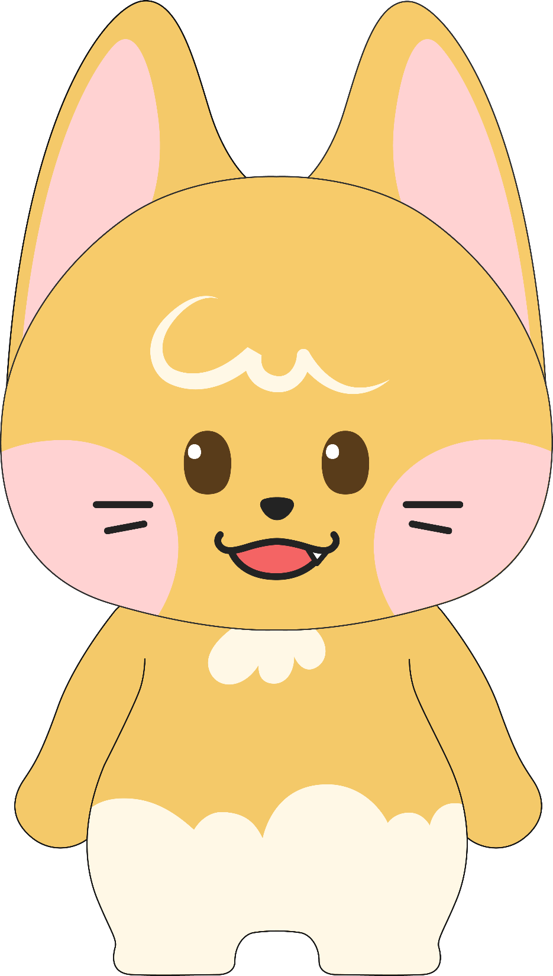
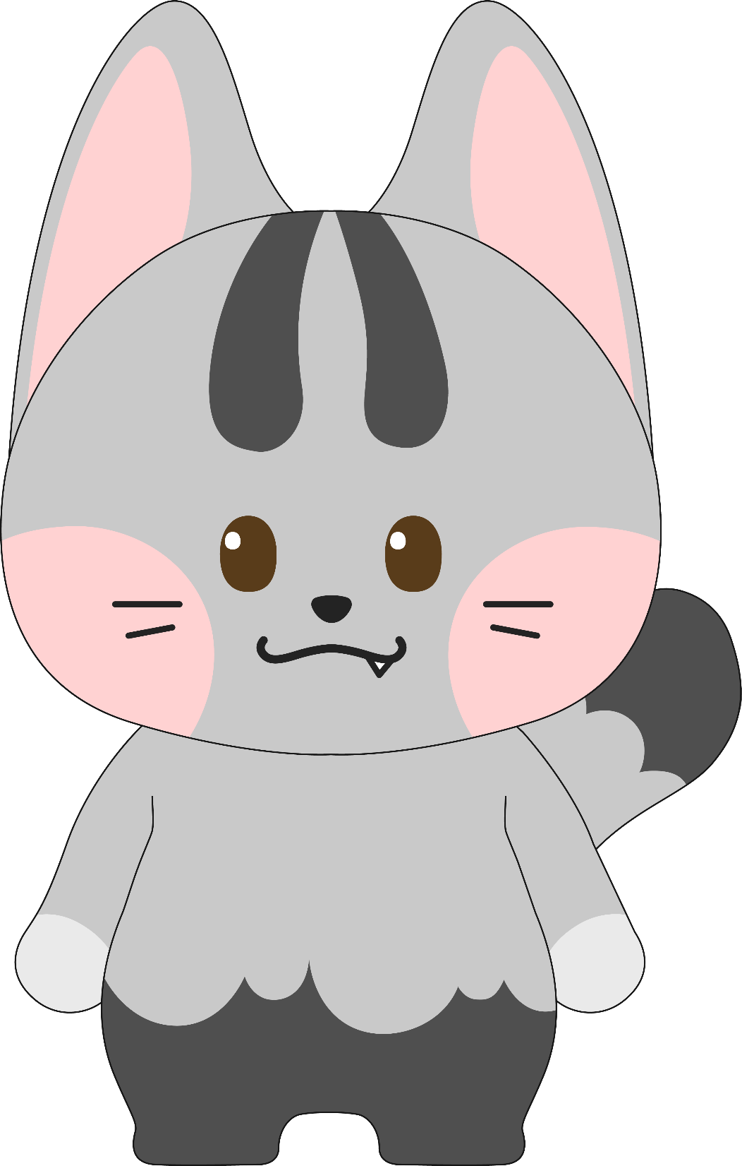
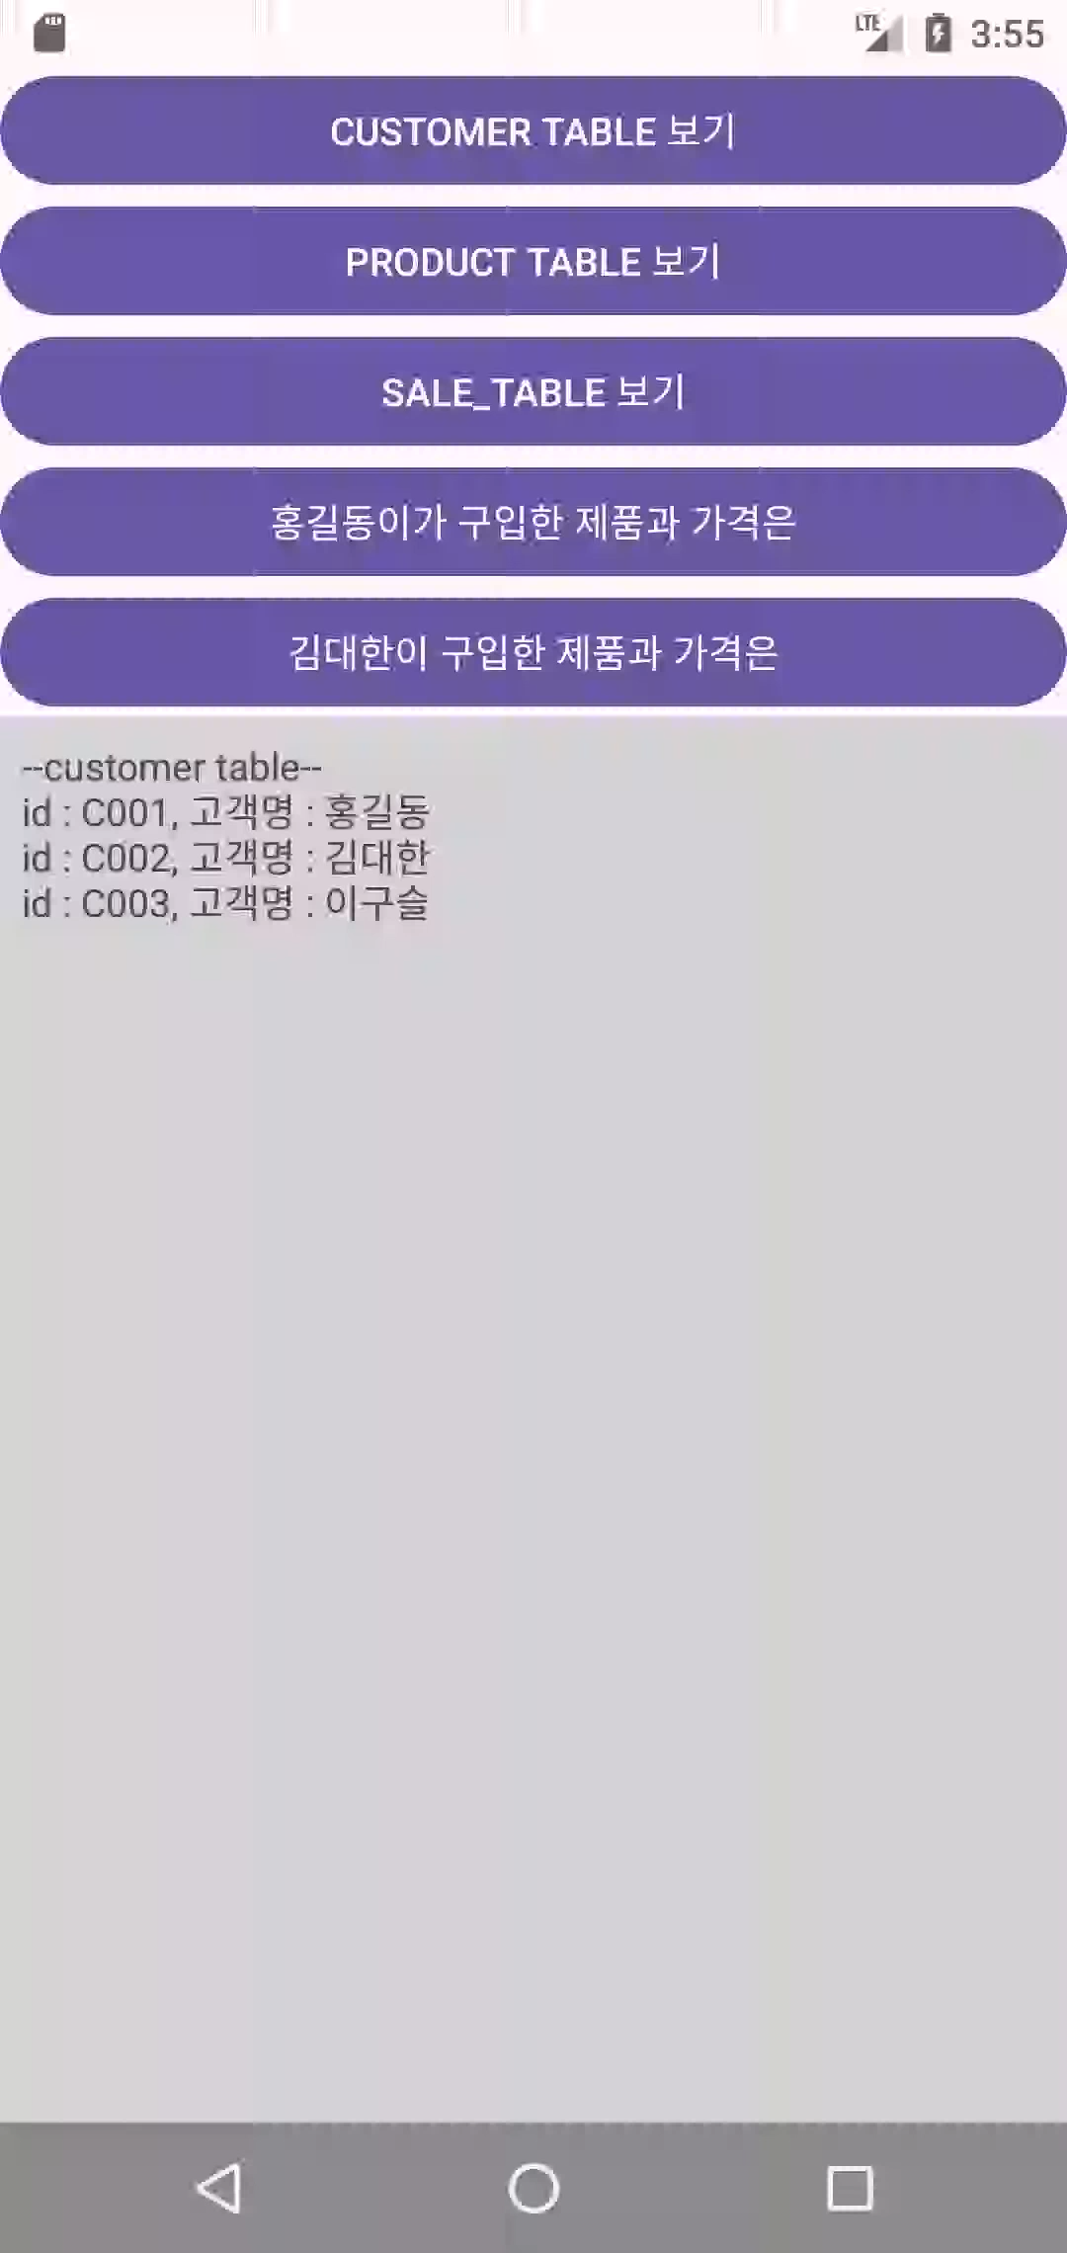
22/23
실행화면

