Slide 1





앱 프로그래밍(2)
2주차 Report
김진용 | 소프트웨어융합과 코딩전공, 2301111

Slide 2
Activity_main.xml
2/10
<?xml version="1.0" encoding="utf-8"?> <LinearLayout xmlns:android=http://schemas.android.com/apk/res/android xmlns:app="http://schemas.android.com/apk/res-auto" xmlns:tools="http://schemas.android.com/tools" android:id="@+id/main" android:layout_width="match_parent" android:layout_height="match_parent" android:background="#003F9A" android:orientation="vertical" tools:context=".MainActivity"> <TextView android:layout_width="match_parent" android:layout_height="wrap_content" android:layout_margin="10dp" android:background="#ED008C" android:gravity="center" android:padding="10dp" android:text="Service 종합 모음" android:textColor="#ffffff" android:textSize="20dp" /> <LinearLayout android:layout_width="match_parent" android:layout_height="match_parent" android:orientation="vertical" android:padding="10dp"> <Button android:id="@+id/buttonStartedService" android:layout_width="match_parent" android:layout_height="wrap_content" android:backgroundTint="#ED008C" android:text="started service" android:textAllCaps="true" />
<Button android:id="@+id/buttonBoundedService" android:layout_width="match_parent" android:layout_height="wrap_content" android:backgroundTint="#ED008C" android:text="bounded service(background service)" android:textAllCaps="true" /> <Button android:id="@+id/buttonIntentService" android:layout_width="match_parent" android:layout_height="wrap_content" android:backgroundTint="#ED008C" android:text="intent service" android:textAllCaps="true" /> <Button android:id="@+id/buttonForeGroundService" android:layout_width="match_parent" android:layout_height="wrap_content" android:backgroundTint="#ED008C" android:text="foreground service" android:textAllCaps="true" /> <Button android:id="@+id/buttonRemoteService" android:layout_width="match_parent" android:layout_height="wrap_content" android:backgroundTint="#ED008C" android:text="remote service" android:textAllCaps="true" /> </LinearLayout> </LinearLayout>

Slide 3
Activity_started_service.xml
3/10
<?xml version="1.0" encoding="utf-8"?> <LinearLayout xmlns:android="http://schemas.android.com/apk/res/android" xmlns:app="http://schemas.android.com/apk/res-auto" xmlns:tools="http://schemas.android.com/tools" android:id="@+id/main" android:layout_width="match_parent" android:layout_height="match_parent" android:background="#003F9A" android:orientation="vertical" tools:context=".MainActivity"> <TextView android:layout_width="match_parent" android:layout_height="wrap_content" android:layout_margin="10dp" android:background="#ED008C" android:gravity="center" android:padding="10dp" android:text="Lotto Service(Started Service)" android:textColor="#ffffff" android:textSize="20dp" /> <LinearLayout android:layout_width="match_parent" android:layout_height="match_parent" android:orientation="vertical" android:padding="10dp"> <Button android:id="@+id/lottoButton" android:layout_width="match_parent" android:layout_height="wrap_content" android:backgroundTint="#ED008C" android:text="lotto service" android:textAllCaps="true" />
<LinearLayout android:id="@+id/lottoLinearLayout" android:layout_width="match_parent" android:layout_height="match_parent" android:orientation="vertical"> <TextView android:id="@+id/lottoTextView" android:layout_width="match_parent" android:layout_height="wrap_content" android:gravity="center" android:text="Lotto 추첨 대기중.." android:textColor="#ffffff" /> </LinearLayout> </LinearLayout> </LinearLayout>

Slide 4
MainActivity.java
4/10
package com.example.week2; import android.content.Intent; import android.os.Bundle; import android.view.View; import android.widget.Button; import androidx.activity.EdgeToEdge; import androidx.appcompat.app.AppCompatActivity; import androidx.core.graphics.Insets; import androidx.core.view.ViewCompat; import androidx.core.view.WindowInsetsCompat; public class MainActivity extends AppCompatActivity { @Override protected void onCreate(Bundle savedInstanceState) { super.onCreate(savedInstanceState); setContentView(R.layout.activity_main); Button startedButton = findViewById(R.id.buttonStartedService); Button boundedButton = findViewById(R.id.buttonBoundedService); Button intentButton = findViewById(R.id.buttonIntentService); Button foregroundButton = findViewById(R.id.buttonForeGroundService); Button remoteButton = findViewById(R.id.buttonRemoteService); startedButton.setOnClickListener(new View.OnClickListener() { @Override public void onClick(View view) { startActivity(new Intent(MainActivity.this, StartedService.class)); } }); } }

Slide 5
StartedService.java
5/10
package com.example.week2; import android.content.Intent; import android.os.Bundle; import android.os.Handler; import android.os.Looper; import android.os.Message; import android.os.Messenger; import android.view.View; import android.widget.Button; import android.widget.TextView; import androidx.annotation.NonNull; import androidx.appcompat.app.AppCompatActivity; import java.util.List; public class StartedService extends AppCompatActivity { private MyApplication application; private TextView textView; private boolean isServiceRunning = false; private final Handler handler = new Handler(Looper.getMainLooper()) { @Override public void handleMessage(@NonNull Message msg) { if (msg.what == 1) { Bundle bundle = msg.getData(); List<Integer> numbers = bundle.getIntegerArrayList("lottoNumbers"); textView.setText("Lotto 번호: " + numbers.toString()); } } };
@Override protected void onCreate(Bundle savedInstanceState) { super.onCreate(savedInstanceState); setContentView(R.layout.activity_started_service); application = (MyApplication) getApplication(); textView = findViewById(R.id.lottoTextView); Button lottoButton = findViewById(R.id.lottoButton); Intent intent = new Intent(this, LottoStartedService.class); Messenger messenger = new Messenger(handler); lottoButton.setOnClickListener(view -> { intent.putExtra("Messenger", messenger); startService(intent); }); } }

Slide 6
MyApplication.java
6/10
package com.example.week2; import android.app.Application; import android.widget.Button; import android.widget.TextView; public class MyApplication extends Application { private Button button; private TextView textView; public MyApplication() { super(); } public Button getButton() { return button; } public void setButton(Button button) { this.button = button; } public TextView getTextView() { return textView; } public void setTextView(TextView textView) { this.textView = textView; } }

Slide 7
LottoStartedService.java
7/10
package com.example.week2; import android.app.Service; import android.content.Intent; import android.os.Bundle; import android.os.IBinder; import android.os.Message; import android.os.Messenger; import android.os.RemoteException; import android.widget.Toast; import java.util.ArrayList; import java.util.Collections; import java.util.List; public class LottoStartedService extends Service { private MyApplication application; public LottoStartedService() { } @Override public IBinder onBind(Intent intent) { return null; } @Override public void onCreate() { application = (MyApplication) getApplication(); }
@Override public int onStartCommand(Intent intent, int flags, int startId) { Messenger messenger = intent.getParcelableExtra("Messenger"); List<Integer> lotto = randomLottoNum(); Toast.makeText(this, String.format("Lotto 숫자: %s", lotto.toString()), Toast.LENGTH_SHORT).show(); if (messenger != null) { Message message = Message.obtain(); message.what = 1; Bundle bundle = new Bundle(); bundle.putIntegerArrayList("lottoNumbers", new ArrayList<>(lotto)); message.setData(bundle); try { messenger.send(message); } catch (RemoteException e) { throw new RuntimeException(e); } } stopSelf(); return START_NOT_STICKY; } private List<Integer> randomLottoNum() { List<Integer> numbers = new ArrayList<>(); for (int i = 1; i <= 45; i++) { numbers.add(i); } Collections.shuffle(numbers); return numbers.subList(0, 7); }

Slide 8
LottoStartedService.java
8/10
@Override public void onDestroy() { super.onDestroy(); } }

Slide 9


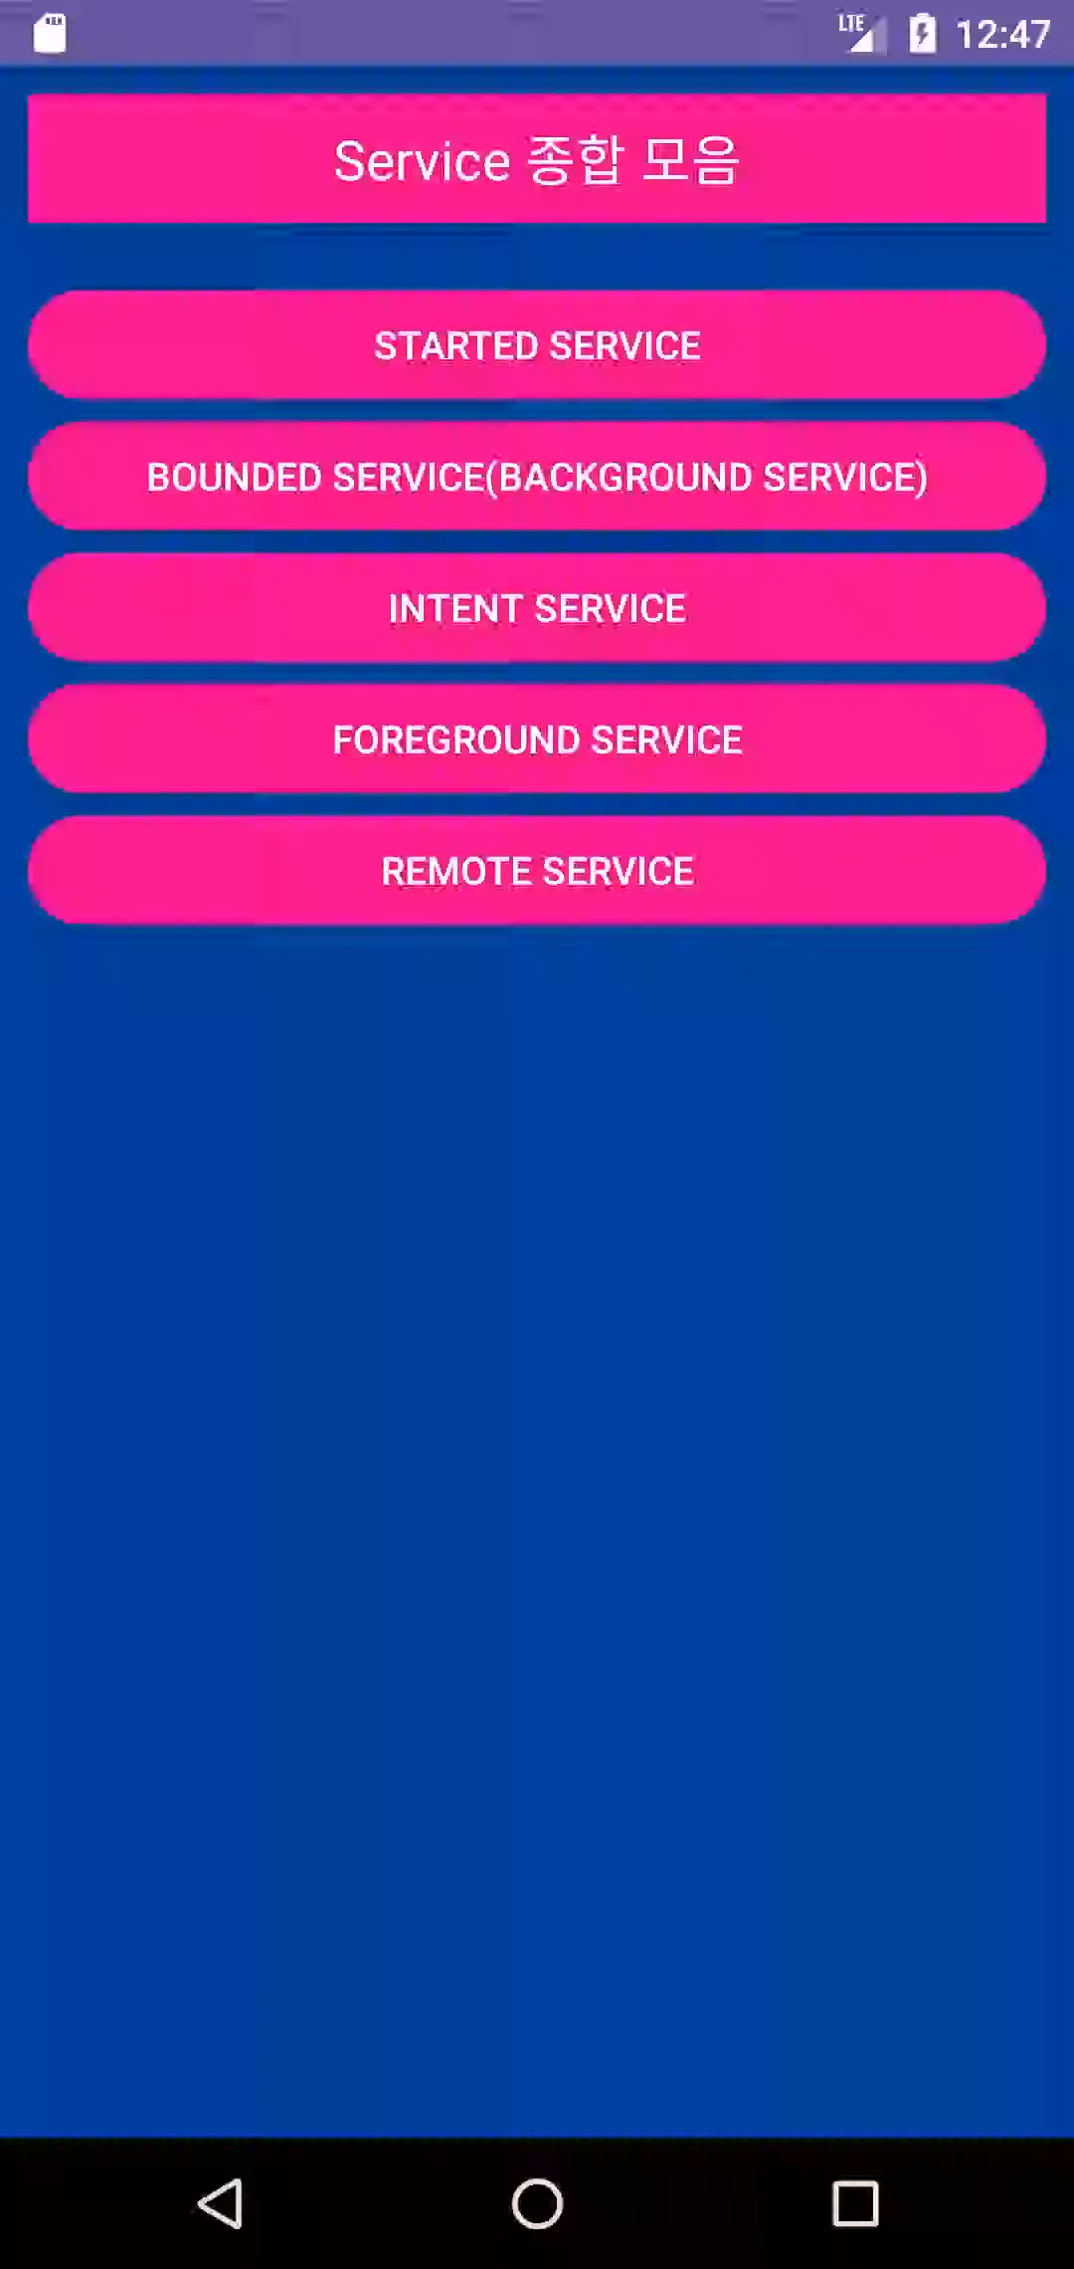
9/10
실행화면

Slide 10


10/10
느낀점
Service에 대해 배우고 혼자서 적용하는
과정에서 수업때 쫒아가지 못하는 부분들에서
그대로 막혔고 GPT를 통해 문제를 해결했지만,
동작 원리에 대해 아직 적응이 안된 느낌을 받았습니다.

