Slide 1

EpiScope: Public Health Surveillance & Preparedness
Synthetic disease encounter processing, anomaly signals, and seasonal planning
Robiul Hassan
Md. Samin Osman
Md. Mahafujul Alam
Walid Talal
ID: 0222220005101043
ID: 0222220005101042
ID: 0222220005101066
ID: 0222220005101045
Notes:
Introduce the EpiScope project: a distributed pipeline and dashboard prototype designed for large-scale synthetic disease surveillance and public health preparedness planning.
1

Slide 2

CHALLENGE & MOTIVATION
Late, messy data makes early detection hard
Public health teams require interpretable early signals while operating under real-world data imperfections.
Reporting delays
Inconsistent data quality
Decision-maker constraints
Data originating from disparate health facilities arrives asynchronously, creating variable lag that obscures acute transmission spikes.
Incoming encounter records contain malformed schemas, missing fields, and duplicates that corrupt downstream surveillance metrics.
Epidemiologists need transparent anomaly indicators with explicit boundaries, not black-box predictions that trigger false alarms.
02
Notes:
Discuss the surveillance gap: multi-source encounter data arrives with reporting lags and formatting discrepancies, preventing timely outbreak response unless cleaned systematically.
2

Slide 3
PROJECT SCOPE
Six objectives guided the project
01
02
03
Scale processing
Data validation
Outbreak signals
Demonstrate scalable processing across multi-million-row synthetic encounter datasets.
Validate schema adherence and quarantine malformed records systematically.
Generate experimental threshold and baseline deviation anomaly scores.
04
05
06
Short-term forecasts
Seasonal planning
Interactive dashboard
Produce short-term district-level case projections from historical encounter windows.
Demonstrate resource allocation models and seasonal preparedness action recommendations.
Serve public health officers through an interactive, browser-based visual dashboard.
03
Notes:
Review the six core engineering and analytical goals, framing the transition from distributed backend pipelines to analytical outputs and front-end surveillance interfaces.
3

Slide 4
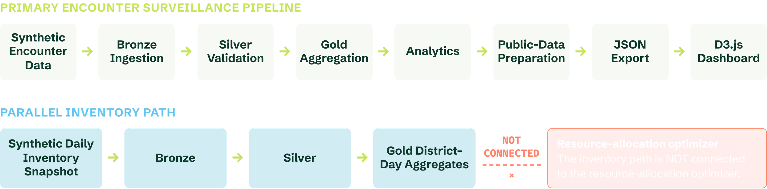
DATA FLOW & PIPELINES
System architecture: one main pipeline, one parallel inventory path
04
Notes:
Detail the Medallion flow from raw encounters to D3 export, highlighting explicitly that inventory runs as an uncoupled parallel path rather than an automated operational driver.
4

Slide 5
INFRASTRUCTURE STACK
Technologies and their roles
Python and PySpark
Apache Spark
Parquet
Pipeline code and transformations.
Distributed processing of large record volumes.
Columnar storage for layered data.
D3.js v7
JSON
Google Colab
GitHub and GitHub Pages
Interactive dashboard charts.
Export format between pipeline and dashboard.
Running the experiments.
Version control and dashboard hosting.
05
Notes:
Summarize the exact seven technology components used across compute, storage, orchestration, and frontend delivery.
5

Slide 6

MEDALLION ETL AUDIT
Bronze, Silver, Gold: 25 million rows, 0.7% quarantined
TOTAL INGESTED (BRONZE)
VALIDATED PASS (SILVER)
QUARANTINED ANOMALIES
25,000,000
24,825,210
174,790
Unfiltered raw synthetic intake logs restricted to pipeline compute boundaries.
Schema-conformant, deduplicated encounter records eligible for Gold aggregates.
Malformed records isolated for verification. Quarantine rate: 0.69916%.
Source note: Documented synthetic-data experiment results demonstrating automated pipeline schema gatekeeping.
06
Notes:
Walk through the data accounting: 25M total synthetic encounters, 24.8M clean records passing to Gold, and 174,790 quarantined rows isolated by data quality rules.
6

Slide 7
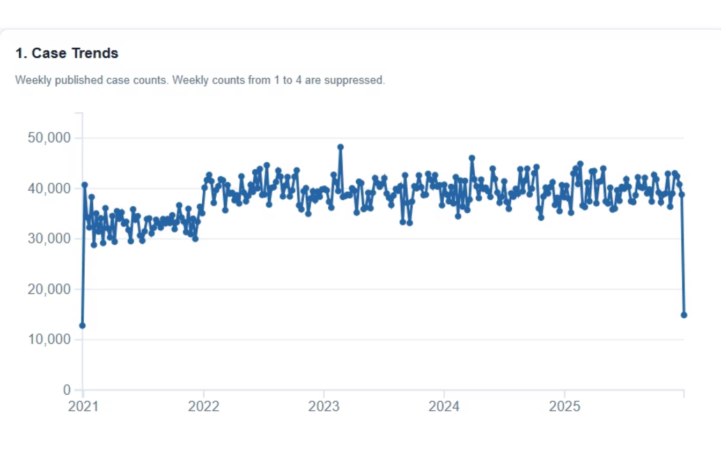
DASHBOARD MODULE: EPIDEMIOLOGY
Case Trends: Understanding Disease Activity
  Tracks weekly published disease counts across the synthetic surveillance window.
  Privacy safeguard: weekly counts between 1 and 4 cases are systematically suppressed.
  Dataset context: all displayed series are simulated synthetic health facility observations.
07
Notes:
Present the primary Case Trends visualization. Emphasize that counts between 1 and 4 are suppressed to demonstrate privacy-preserving reporting policies on synthetic encounter data.
7

Slide 8
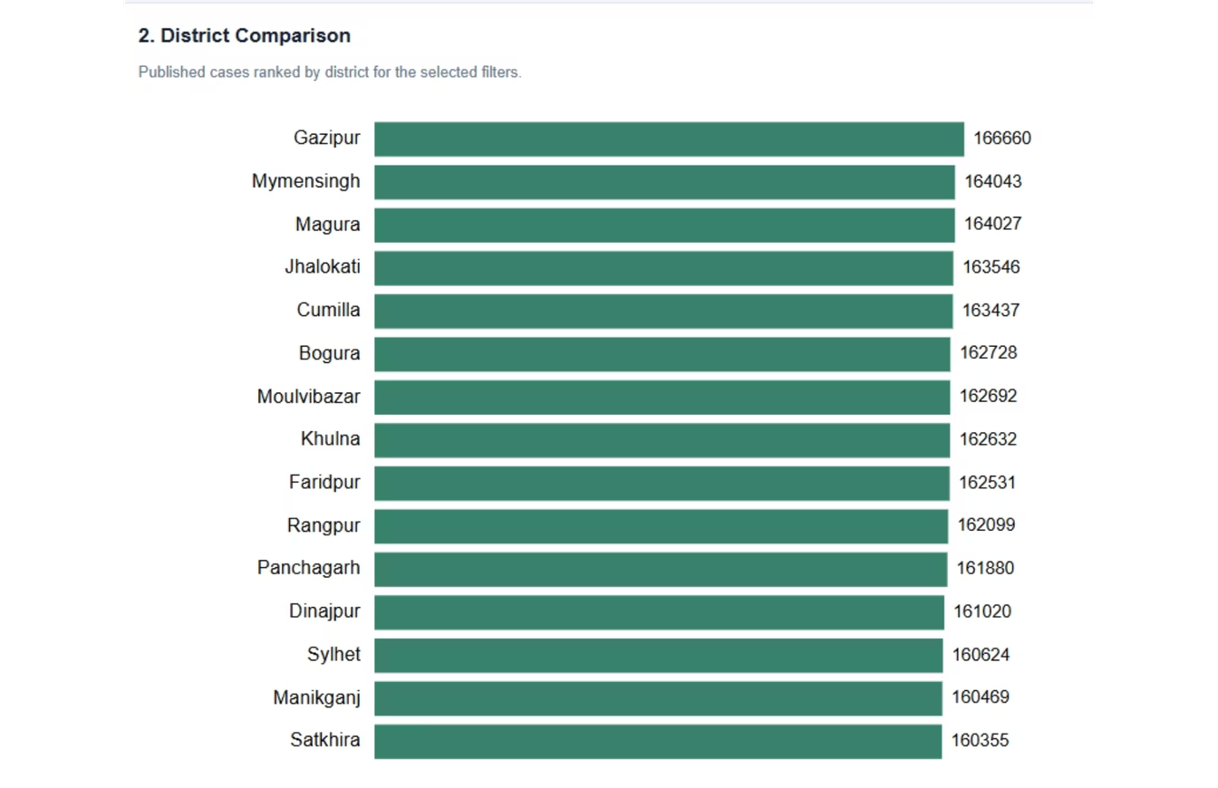
DASHBOARD MODULE: GEOGRAPHY
District-Level Case Comparison
  Ranks regional districts by published aggregate case counts under active UI filter parameters.
  Gazipur leads the displayed benchmark ranking in current snapshot counts.
  Raw count totals do not reflect population-adjusted incidence rates or confirmed regional risk.
08
Notes:
Explain the district comparison view, highlighting Gazipur's ranking and reiterating the critical caveat that raw totals are unadjusted for district baseline populations.
8

Slide 9
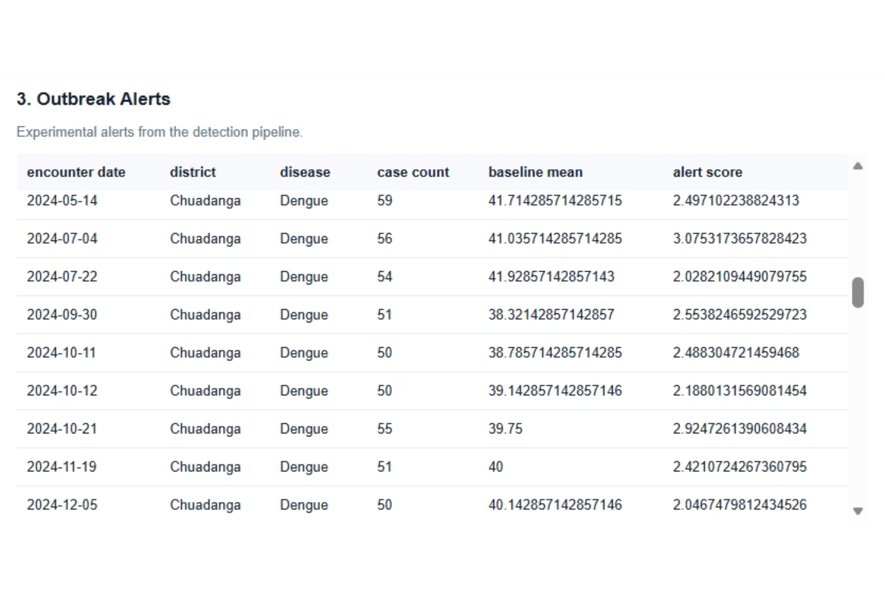
DASHBOARD MODULE: SURVEILLANCE SIGNALS
Experimental Outbreak Detection
Statistical baseline deviations flagged for review across date, district, disease, encounter count, and baseline mean.
SENSITIVITY
FALSE POSITIVE
PRECISION
52.92%
0.74%
4.37%
09
Notes:
Walk through Chuadanga Dengue outbreak signals in the table. Stress the statistical realities: 52.92% sensitivity, 4.37% FPR, and 0.74% precision, proving why human review is indispensable.
9

Slide 10
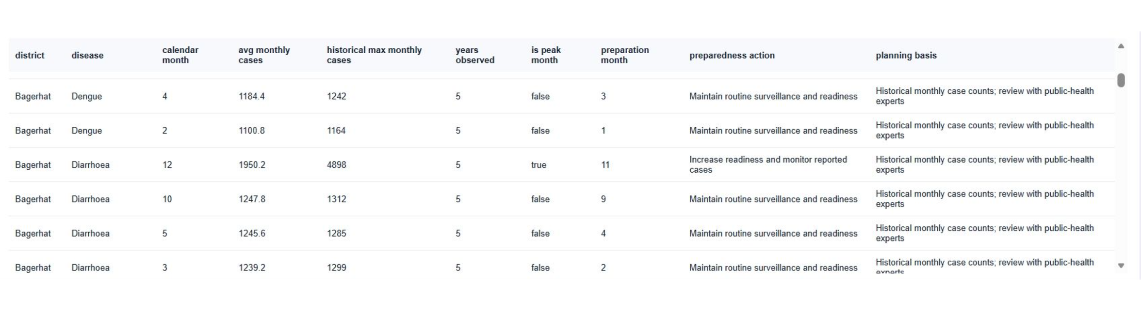
DASHBOARD MODULE: LOGISTICS
Seasonal Preparedness Planning
Fields: District, disease, calendar month, historical case statistics, peak-month flag, and preparedness action. Example: Bagerhat.
10
Notes:
Examine the Bagerhat seasonal planning matrix, showing how peak-month flags guide supply buffers and reminding evaluators that all recommendations are synthetic demonstrations.
10

Slide 11
DASHBOARD MODULE: LOGISTICS
Resource Allocation & Readiness
EpiScope demonstrates allocating 100 resource units across Bangladesh's 64 districts; the output illustrates how predicted demand could inform resource planning.
2
1
2
3
4
Forecast Demand
District-Level Weighting
Minimum Allocation Constraint
Final Resource Distribution
BUDGET PARAMETERS
Total allocation budget: 100 units
Minimum allocation: 0.16 units per district
Remaining resources are weighted according to forecast demand.
11
Notes:
11

Slide 12
ANALYTICS & EVALUATION
Short-Term Case Forecasting
A seven-day-average baseline repeated across a fixed 28-day forecast horizon (December 4–31, 2025).
OBSERVATIONS
MEAN ABSOLUTE ERROR
ROOT MEAN SQUARED ERROR
8,960
2.0182
2.6986
Synthetic-data test observations
Average absolute error in cases
Penalizes larger forecast errors
01
02
03
04
Prior 7 Days
Calculate Mean
Project Horizon
Test Evaluation
Synthetic cases window
Rolling window average
Repeat across 28 days
Score against test ground truth
12
Notes:
12

Slide 13
DATA GOVERNANCE
Privacy by Design - With Clear Boundaries
Internal Encounter Data → Validation & Identifier Handling → Aggregation & Small-Count Suppression → Public Dashboard Data
Controls
Remaining Risks
  Identifier hashing: Patient IDs hashed in Silver data.
  Restricted access: Bronze and quarantine data protected.
  Count suppression: Public counts of 1–4 hidden.
  Data aggregation: Only aggregated data published.
  Suppression cannot eliminate re-identification risks.
  No formal differential privacy guarantee exists.
Takeaway: Further privacy testing and security assessment are needed before deployment.
13
Notes:
13

Slide 14
EXPERIMENTAL EVALUATION
What We Learned - And What Comes Next
Benchmark: 25M synthetic rows · Pipeline runtime: ~27.40 min (data gen: ~7.17 min excluded) · Environment-dependent
Current Limitations
Future Improvements
  Synthetic Data: Real-world efficacy unverified.
  Low Precision: 0.74% with many false positives.
  Simple Forecast: Seasonal baseline comparison needed.
  Disconnected Inventory: Not linked to allocation.
  Validation Gaps: Privacy and reproducibility audits needed.
  Real Data: Validate with authorized clinical data.
  Better Alerts: Improve precision and sensitivity.
  Forecasting: Test seasonal models and longer horizons.
  Privacy Audits: Test disclosure risks.
  Inventory Integration: Connect hospital stock and bed data.
14
Notes:
14

Slide 15
CONCLUSION
From Big Data Processing to Public Health Preparedness
system Deliverables
  Bronze–Silver–Gold big-data processing workflow
  Documented 25-million-row synthetic encounter dataset
  Experimental outbreak-signal generation and short-term forecasting
  District comparison, resource allocation, and seasonal preparedness outputs
  Interactive D3.js dashboard.
15
Notes:
15

Slide 16
Thank You
16
Notes:
16

