Slide 1
Reactive-Python
Yunfan Wu
Jiahao Yuan
Notes:
Android help tonight 7 – 8 PM

Slide 2
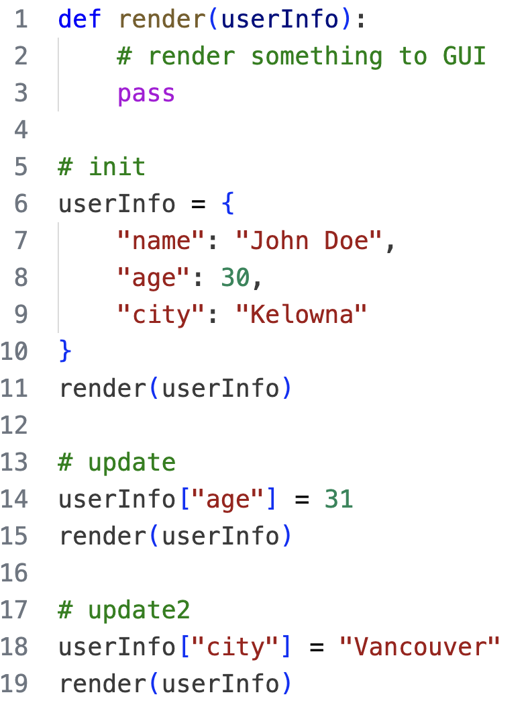
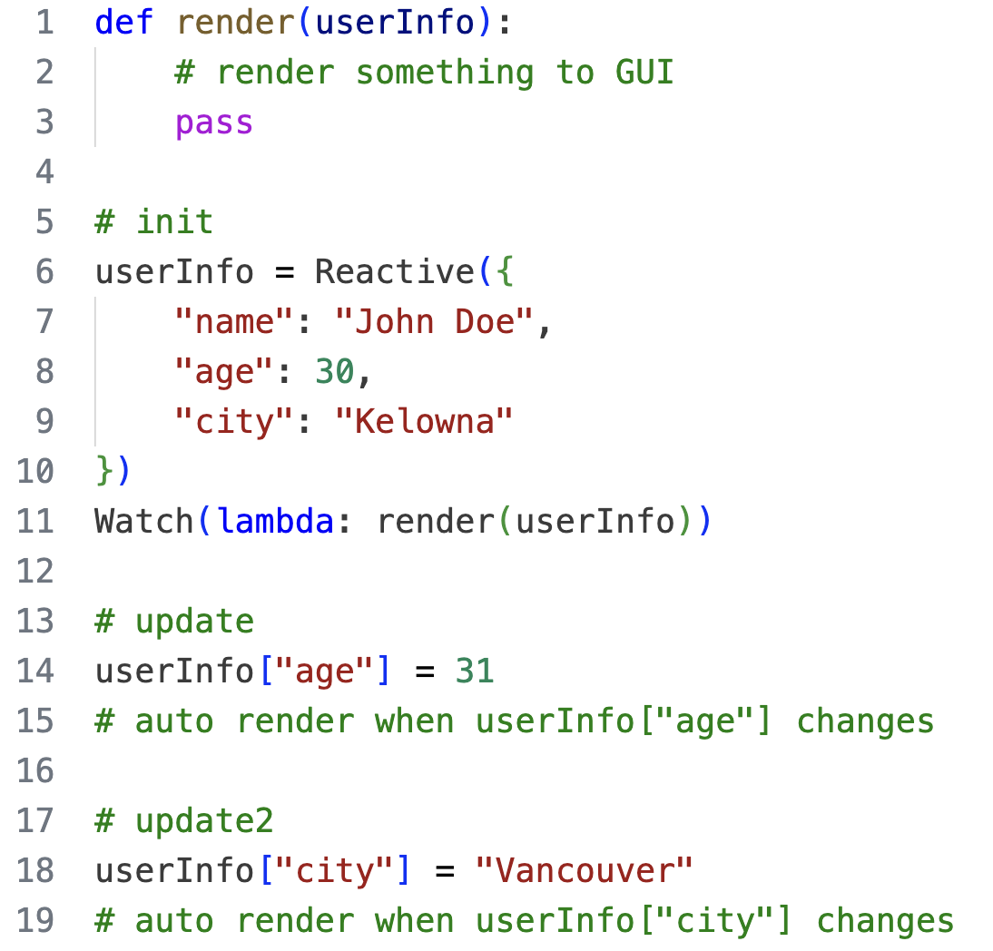
Introduction
What is our reactive programming?

Slide 3
Introduction
What is our reactive programming?
NASDAQ Data
NYSE Data
Forex Data
LME Data
LSE Data
US
UK
Global Financial Data

Slide 4
Submodule Outline
observable
observer
Reactive
Watch
Computed
WatchAttr

Slide 5
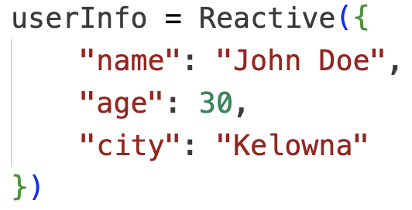
observable.Reactive
A base class for all Observable.
Has a private Map attribute to store all Observers.
Exposes public getter and setter attributes for observed data.

Slide 6
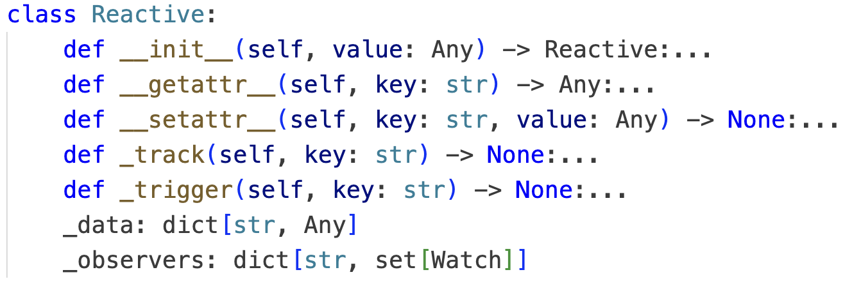
Methods
__init__: Set the private Map to store all Observers and store initial data.
__getattr__: Hijack data access to track observers.
__setattr__: Hijack data mutation and trigger observers.
_track: Implement of observer tracker for self.__getattr__.
_trigger: Implement of observer trigger for self.__setattr__.

Slide 7
observer.Watch
Accepts a pure lambda function, where Reactive object are accessed. Effect will track all accessed Reactive objects. And the lambda function will be executed every time these Reactive objects modified.
Has a private Map attribute to store all dependent Reactive objects.
Provides a method to stop observe.

Slide 8
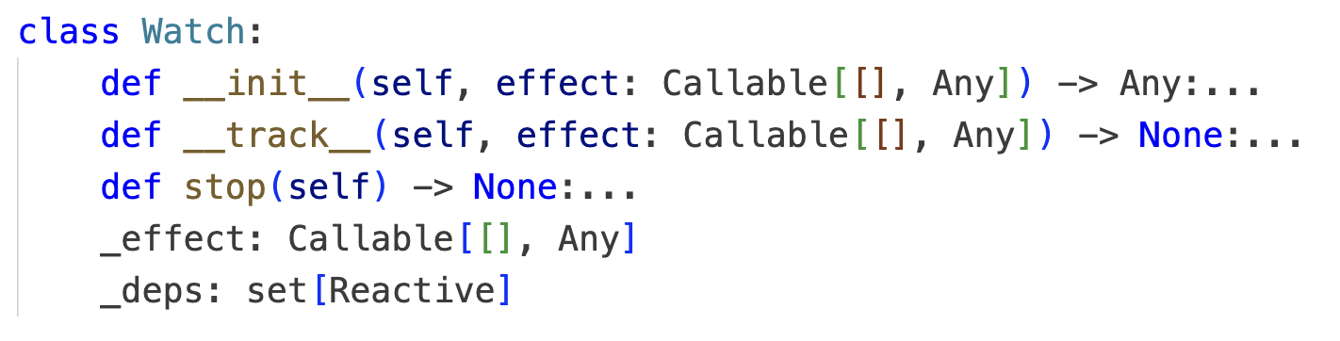
Methods
__init__: Store the initial lambda and call self._track method.
_track: Call the initial lambda function and track all dependent Reactive objects.
stop: Unregister from all dependent Reactive objects and stop observing.

Slide 9
observable.Computed
Inherited from base Reactive.
Accepts a Watch-like lambda function to do some computation of other Reactive objects.
Serves as a read-only computed Reactive object.
Observes all dependent Reactive objects and always provide the latest computed value.
A shortcut for Reactive + Watch.

Slide 10
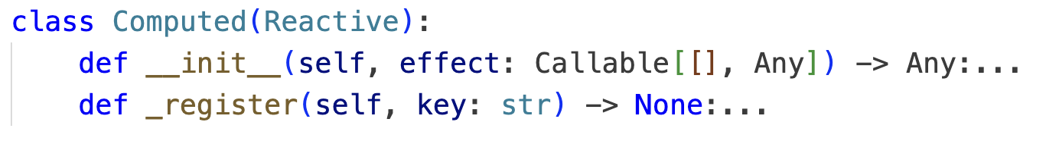
Methods
__init__: Accepts and pass the initial lambda function into self._register method. Set the initial data as {value: None}.
_register: Wrap the the initial lambda function with a mutation to self.data and pass the function into a Watch.
_setattr: Overwrite self._setattr method to make sure its value is read-only.

Slide 11
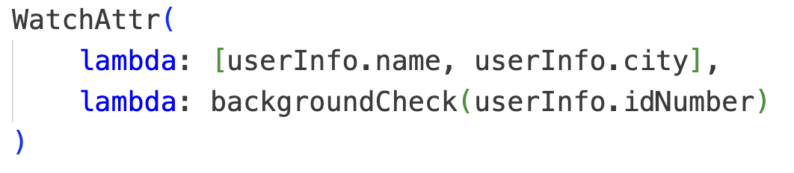
observer.WatchAttr
Inherited from base Watch.
Do not collect dependent Reactive object automatically. Receive specific reactive attributes to watch instead.

Slide 12
Methods
__init__: Store the initial lambda and call self._track method.
_track: Call the tracker function and track all listed Reactive attributes.
stop: Unregister from all dependent Reactive objects and stop observing.

