Slide 1
DOTS and BOXES Game
Presented by:
MD.SABBIR AHAMED
ROLL: 0937
Supervised by:
Md. Nurul Ahad Tawhid
Assistant Professor,IIT,DU.

Slide 2
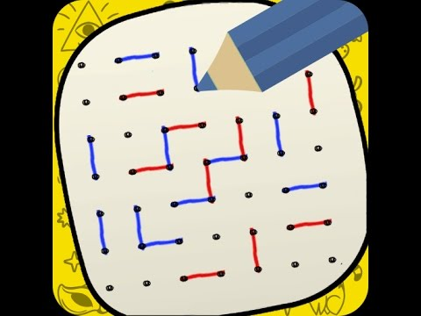
INTRODUCTION
Digitalized
Environment

Slide 3
PROGRESS
Initialize Board (4 x 4).
Show Board.
Take Input .
Make Move .(Using ‘-’,’|’)
https://github.com/MDSABBIRAHAMEDSOHAN/SPL1-2019-

Slide 4
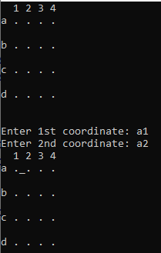
move

Slide 5
Plan
Add graphics.
Adding extra features

Slide 6
User Manual
Run the game from the code blocks.
Input width and height dots size.
Using space for different cursor.
Use right, left, up, down button for moving cursor.
Use enter for adjust two dots.

Slide 7
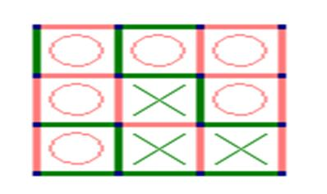
Game Play

Slide 8
Thank You

