Slide 1
Course Title: Computer Networks Laboratory
Course Code: CSE-360
COMPUTER NETWORKS
PRESENTED BY: MD. TANJIM HOSSEN AHAD
ROLL: 340

Slide 2
Lab 1: Wireshark — Ethernet & ARP Analysis

Slide 3

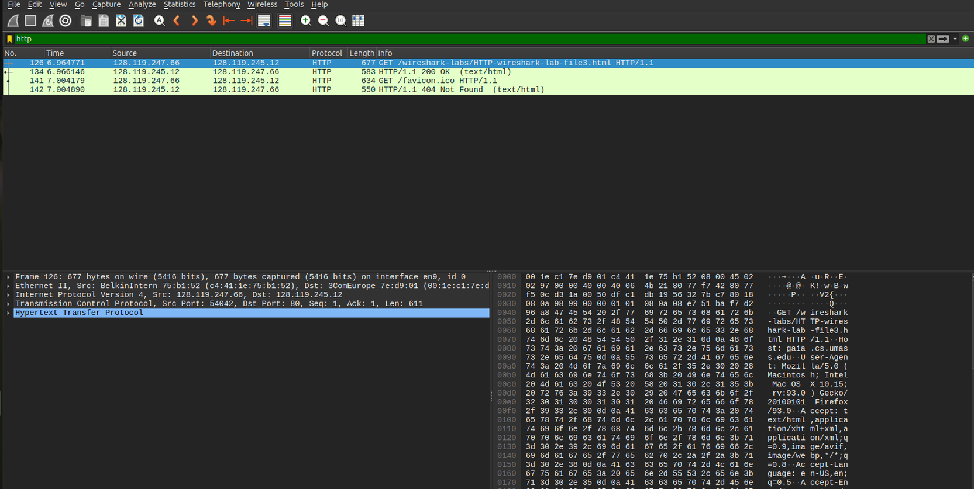
1. Capturing and Analyzing Ethernet Frames
HTTP Request Inspection & Link-Layer Encapsulation
Captured the client HTTP GET request directed to the remote web server. Crucially, Link-Layer encapsulation is verified: while the destination IP designates the target server, the Ethernet destination MAC address specifically targets the local default gateway router interface.

Slide 4
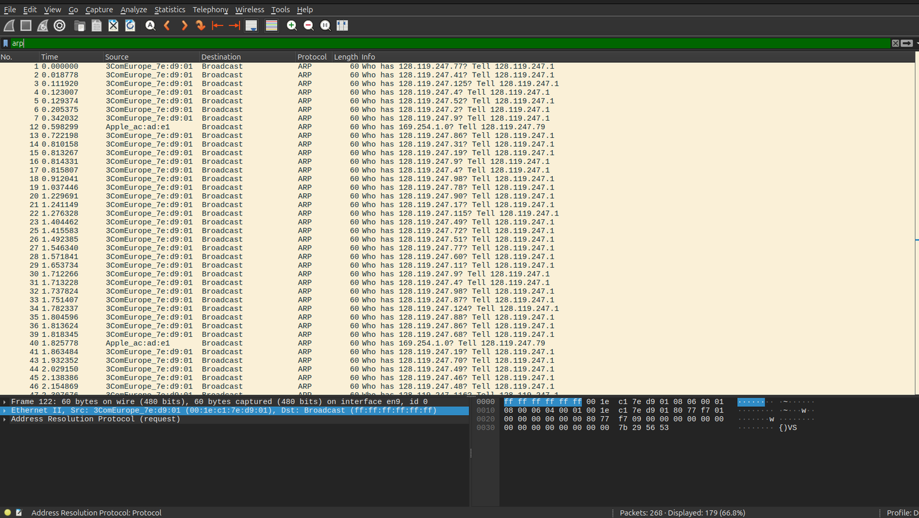
2. Address Resolution Protocol (ARP)
Subnet ARP Traffic Capture & Broadcast Analysis
Filtered capture trace isolating ARP operations across the local link. Highlights ARP query frames transmitted as Link-Layer broadcasts (ff:ff:ff:ff:ff:ff), prompting all hosts on the subnet to check and map the requested IP to its physical MAC address.

Slide 5
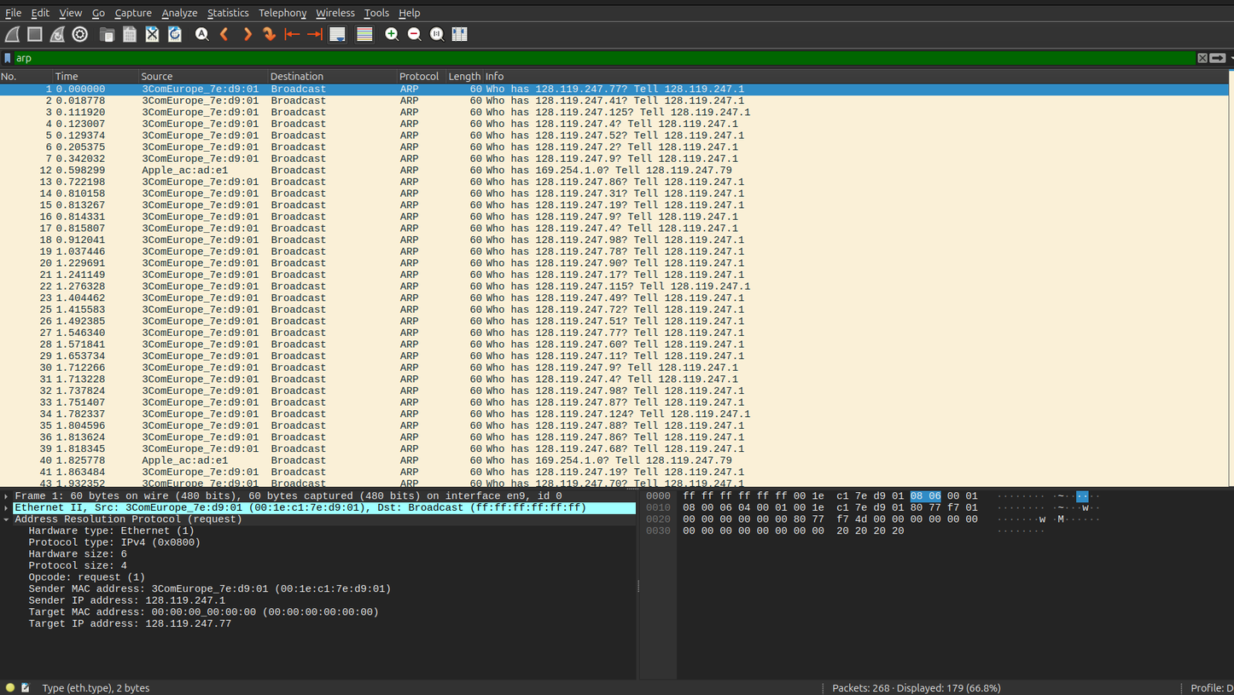
3. ARP Manipulation & Timing
Internal Structure of ARP Request Frame
Detailed inspection of Packet 1 header fields: Opcode 1 (Request), sender hardware/IP address, and queried target IP (128.119.247.77). Hex pane correlates raw payload bytes against EtherType 0x0806, verifying Link-Layer protocol identification.

Slide 6
Lab 2: Introduction to Packet Tracer

Slide 7
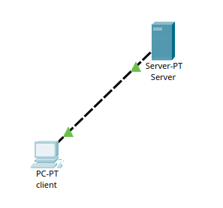
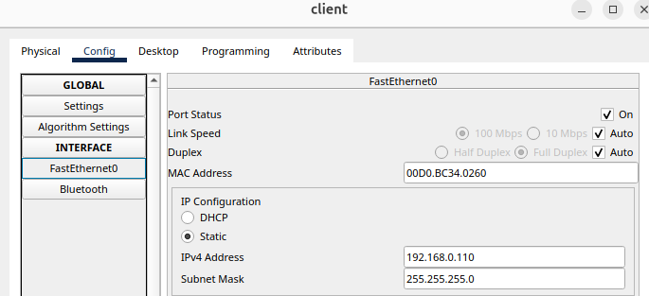
Expt-1: Basic Client-Server Architecture
Part 1:
Step 1: Ports and Cabling Setup
STEP 2: Client Interface Configuration
Dashed lines denote Ethernet crossover cabling; active green link lights verify Layer-1/2 convergence.
Device | IP Address | Subnet Mask
Server | 192.168.0.105 | 255.255.255.0
Client | 192.168.0.110 | 255.255.255.0
IP Configuration of Client and Server
Configure static IP parameters and set DNS Server to 192.168.0.105 in Client interface settings.
Provision FastEthernet0 with IP 192.168.0.110 and Subnet Mask 255.255.255.0:

Slide 8
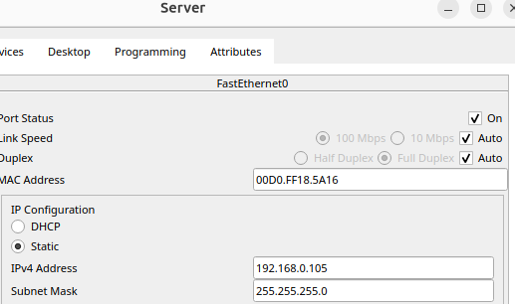
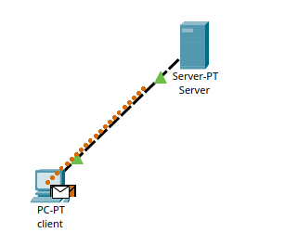
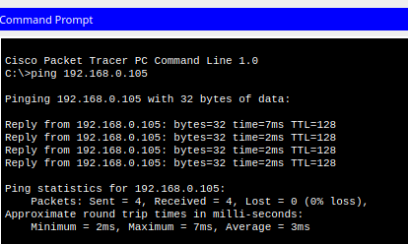
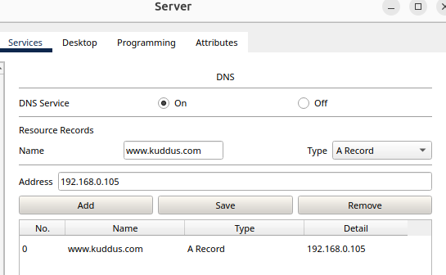
STEP 3: Server DNS Configuration
STEP 4: ICMP Verification
Verified end-to-end bidirectional reachability by sending test PDUs and executing ICMP ping from the client terminal (0% packet loss).

Slide 9
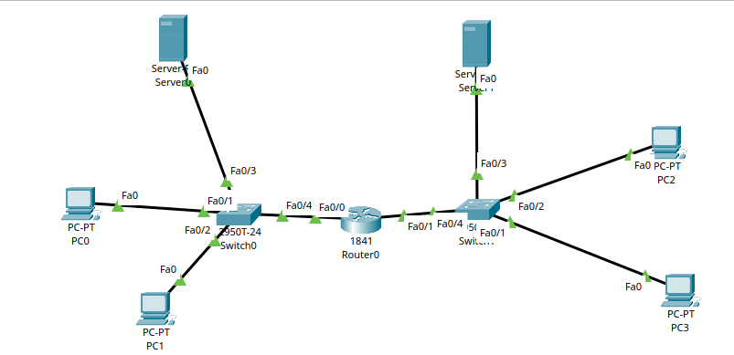
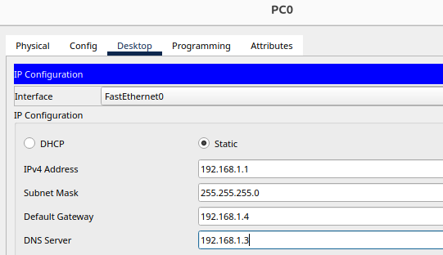
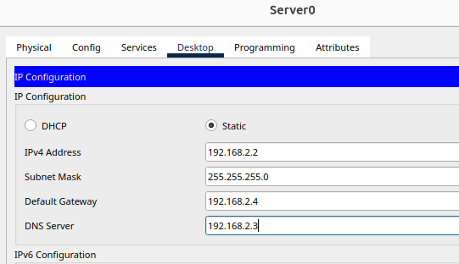
Part 2:
Step 1: Multi-Subnet DNS Architecture
STEP 2: Dual-Subnet IP Addressing
Integrated two distinct subnets via a central router, each network equipped with 2 PCs, a dedicated server, and a Layer-2 switch. Statically configured host addressing and default gateways.

Slide 10
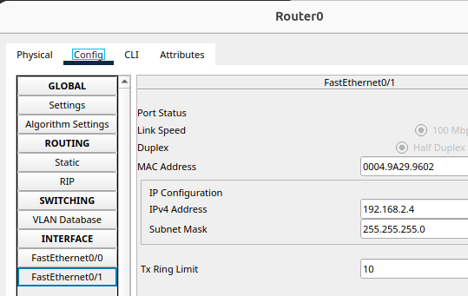
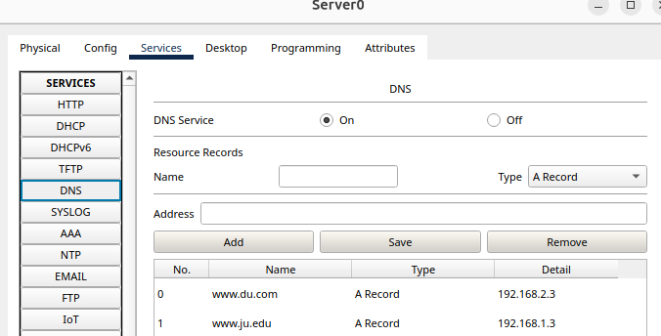
STEP 3: Router Gateway Configuration
STEP 4: Server DNS Table Setup
Configured router interfaces Fa0/0 (192.168.1.4) and Fa0/1 (192.168.2.4) as respective default gateways.
Populated DNS A-records on both servers: mapping www.ju.edu to 192.168.1.3 and www.du.com to 192.168.2.3.

Slide 11
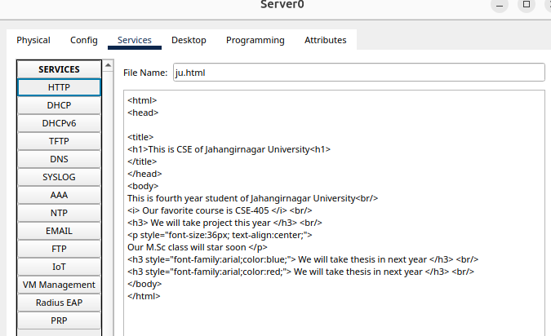
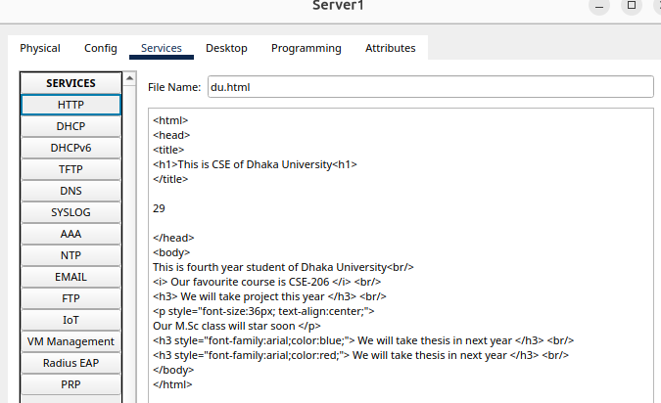
Step 5: Loading HTML Code
Authored and deployed custom institution web pages (ju.html and du.html) on HTTP services of Server0 and Server1.

Slide 12
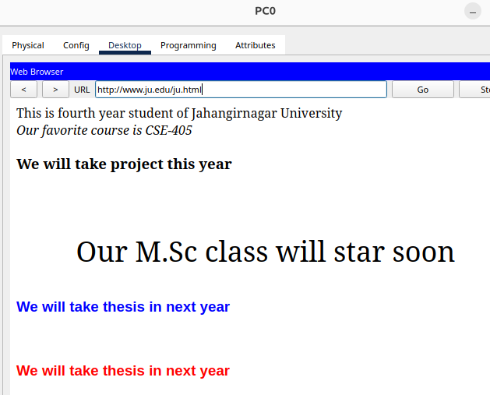

Step 6: End-to-End Verification
Validated cross-subnet web access on PC0 and PC2 web browsers, verifying complete DNS resolution and routed HTTP communication.

Slide 13
Lab 4: Inter-Router Communication & Routing

Slide 14
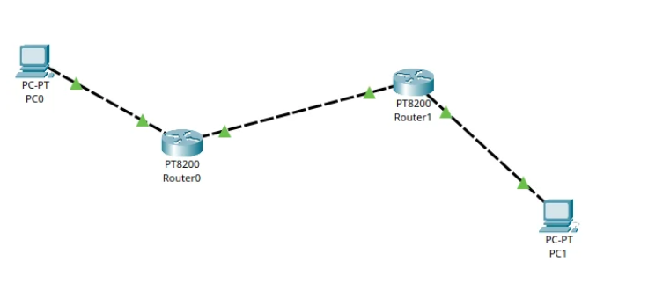
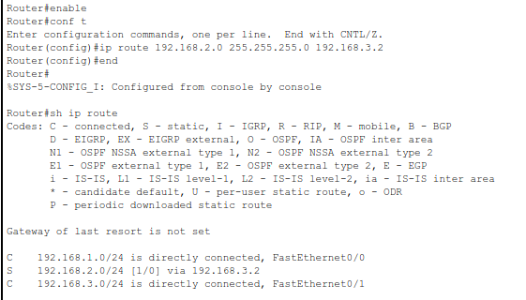
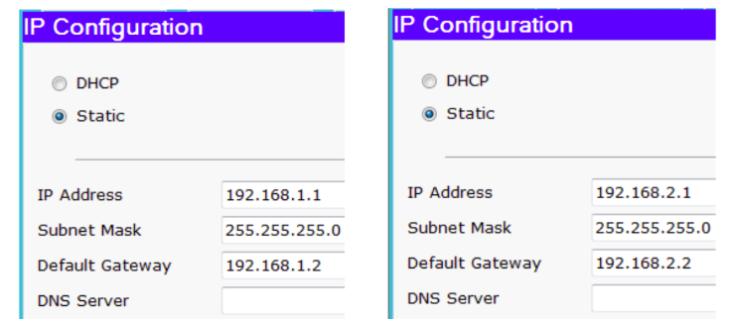
Expt-3: Connection of Two Routers
STEP 1: Interface Cabling & IP Addressing
STEP 2: Static Route Configuration
Configured static route tables on Router0 and Router1, establishing reciprocal next-hop forwarding across the 192.168.3.0/24 transit link.

Slide 15
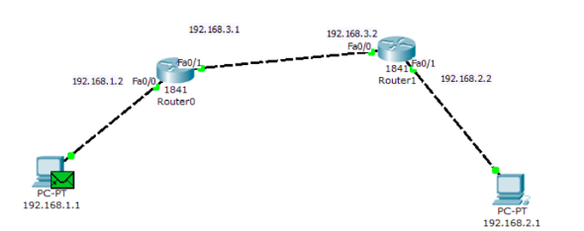
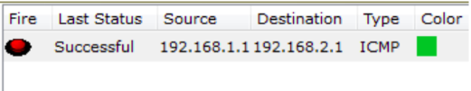
Step 3: Simulation & Packet Delivery Verification
Dispatched ICMP test packets between PC0 and PC1 in simulation mode; confirmed successful multi-hop delivery and reverse reply traversal.

Slide 16
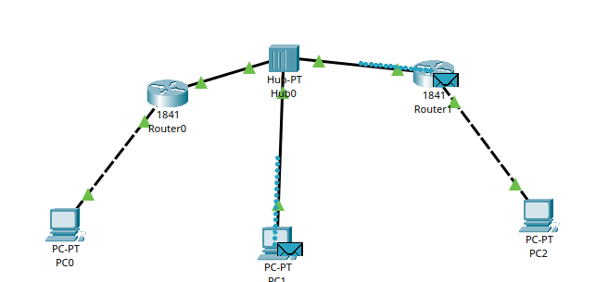
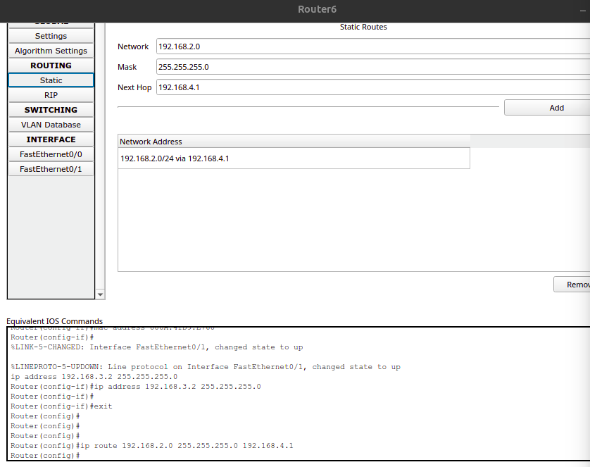
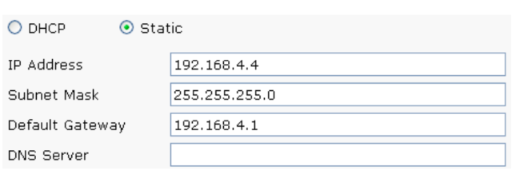
Expt-4: Connection of Two Routers with Intermediate Host Segment
STEP 1: Hub Transit Cabling & IP Scheme
STEP 2: Gateway & Route Redistribution

Slide 17
Step 3: End-to-End Routing Simulation Verification
Validated network convergence by routing packets across both routers and the intermediate transit segment, confirming successful end-to-end transmission.

Slide 18
Lab 5: Cascaded Series Multi-Router Topologies

Slide 19
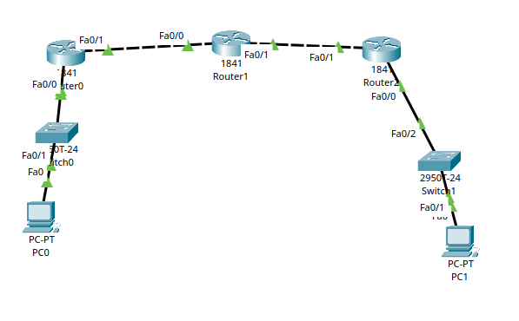
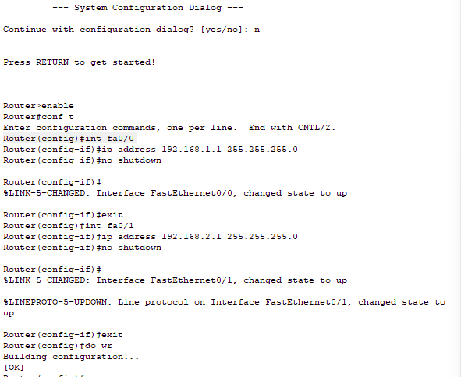
Expt-5: Cascaded Routing Across Three Routers in Series
STEP 1: Multi-Hop Topology Implementation
STEP 2: Router Configuration
  Interconnected three Cisco 1841 routers in a linear cascade; activated interface protocols and verified Layer-1/2 status.

Slide 20
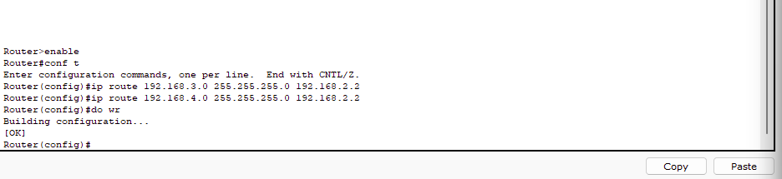
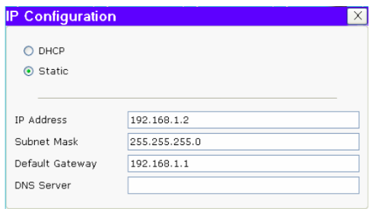
Step 3: Multi-Hop Static Routing Configuration
Step 4: Host Gateway & IP Configuration

Slide 21
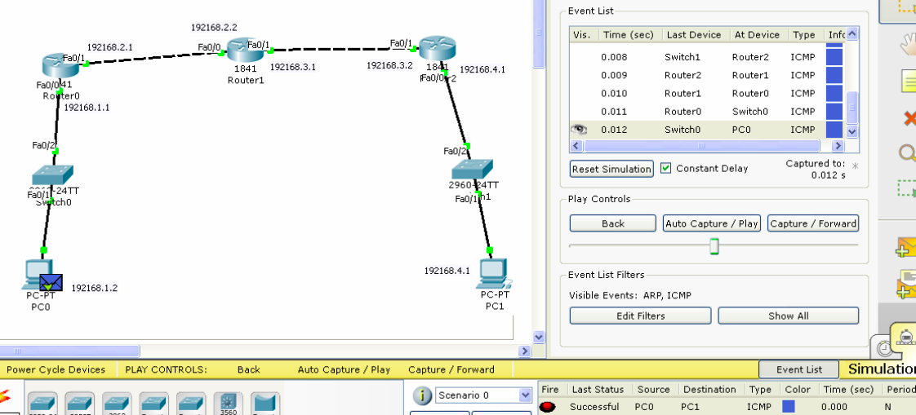
Step 5: Event Timeline & Simulation Trace Verification

Slide 22
Lab 6: Mesh Topologies & Complex Routed Networks

Slide 23
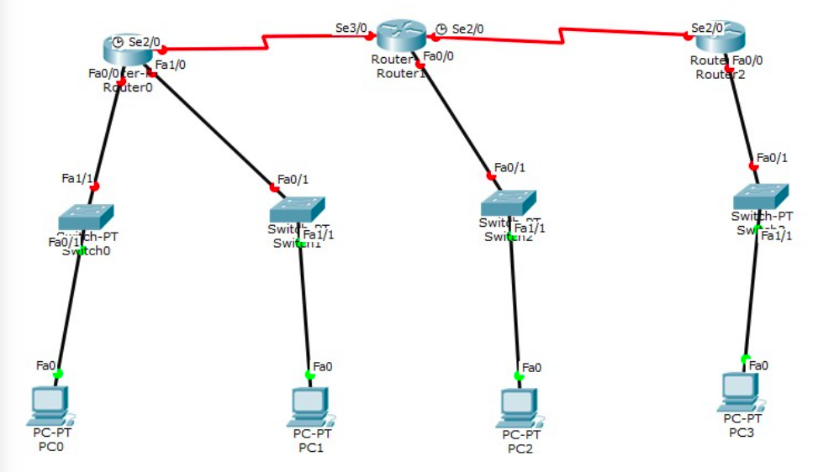
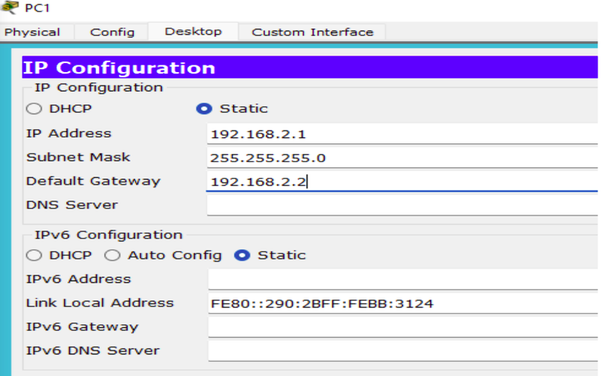
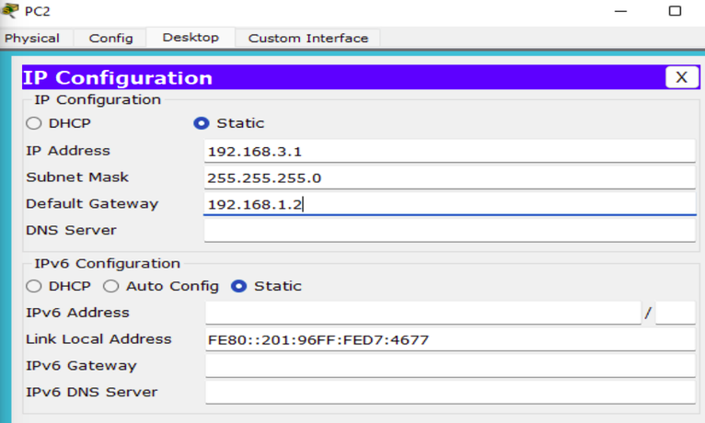
Expt-9: Packet Routing in Complex Meshed Topology
STEP 1: Meshed Topology Implementation
STEP 2: Host IP Configuration
  Constructed serial mesh interconnects across 3 routers; configured static IP parameters on PC0, PC1, PC2, and PC3.

Slide 24
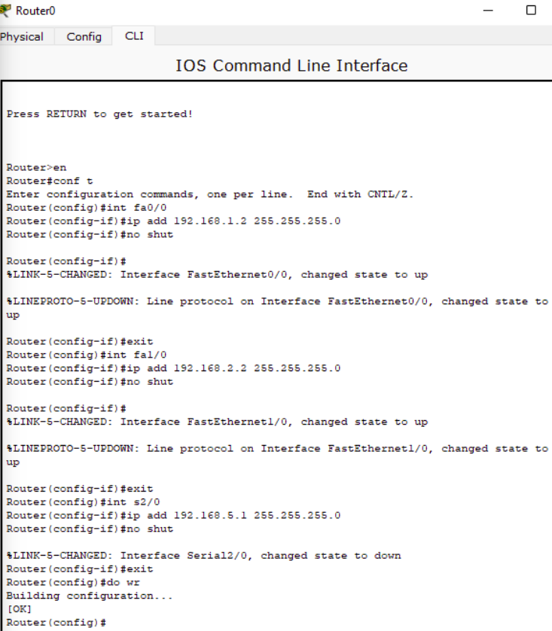
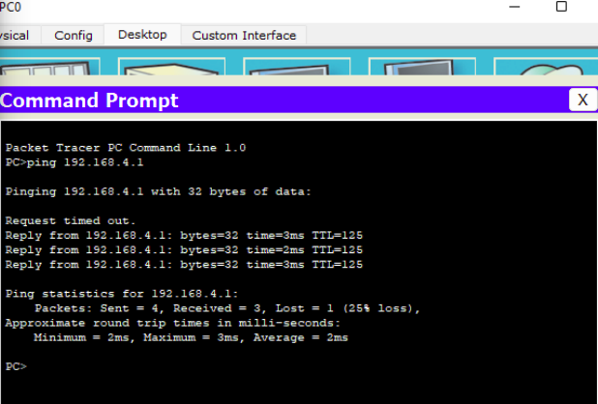
Expt-9: Packet Routing in Complex Meshed Topology
STEP 3: Router Configuration
STEP 4: ICMP Reachability Verification (ping 192.168.1.1)

Slide 25
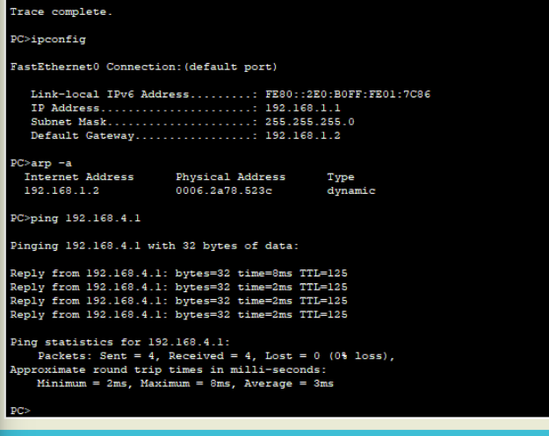
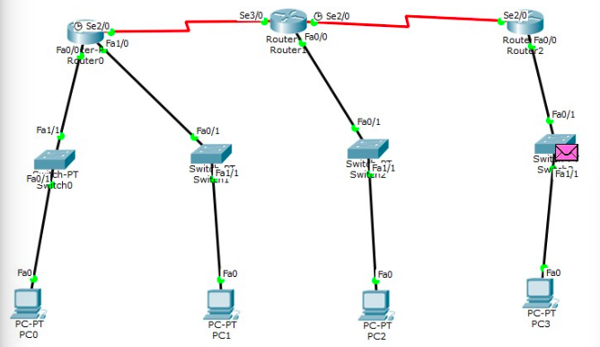
Expt-9: Packet Routing in Complex Meshed Topology
STEP 5: Diagnostics via traceroute, ipconfig & arp -a
STEP 6: Simulation Mode Path & Forwarding Inspection

Slide 26
Lab 7: VLAN Configurations & Layer-3 Switching

Slide 27
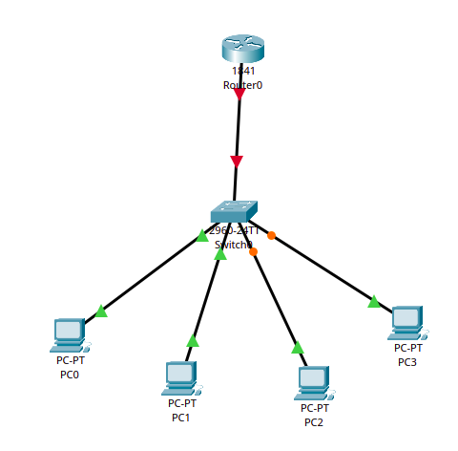
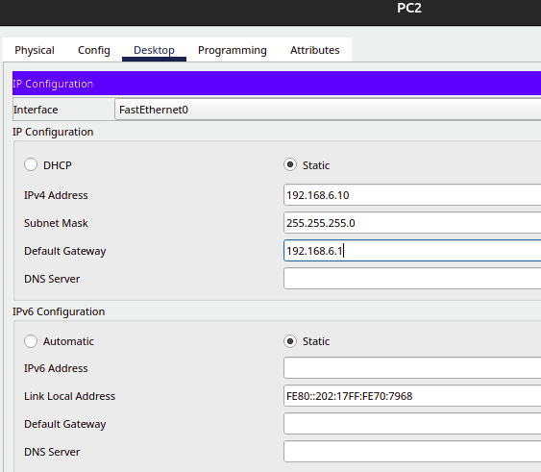
Expt-7: VLAN Configuration with Layer-3 Switch & Router
STEP 1: Implement the Network
STEP 2: Host IP Configuration
  Interconnected 2960 switch and 1841 router; provisioned hosts in VLAN 10 (192.168.1.0/24) and VLAN 20 (192.168.2.0/24).

Slide 28
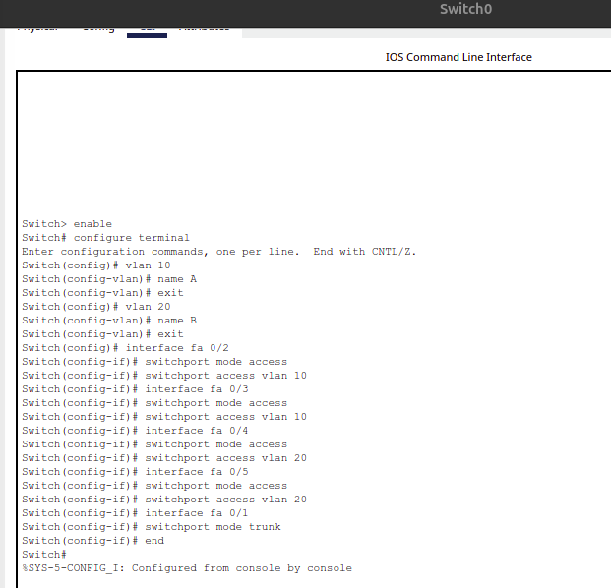
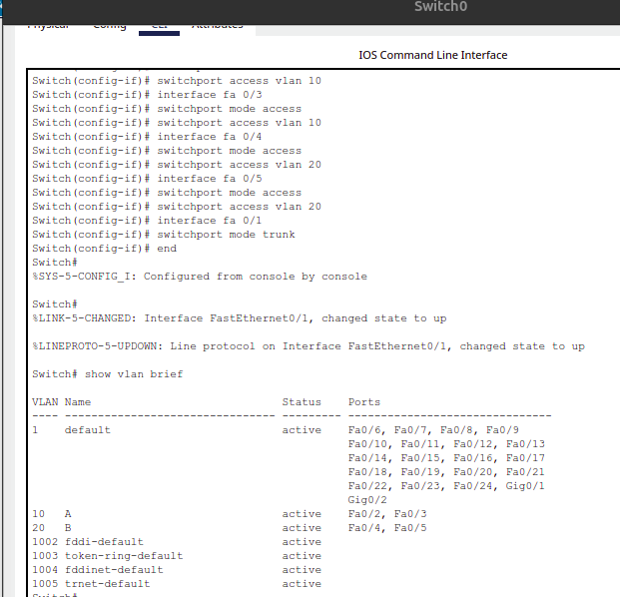
Expt-7: VLAN Configuration with Layer-3 Switch & Router
STEP 3: Switch & Router Configuration
STEP 4: VLAN Database Inspection (show vlan brief)

Slide 29
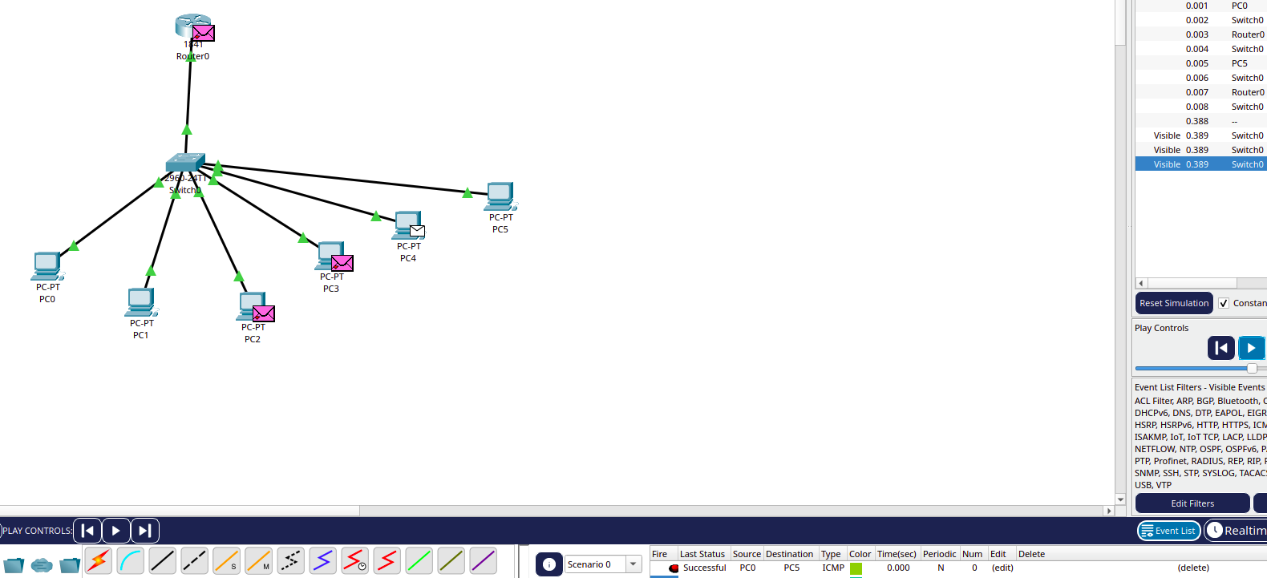
Expt-7: VLAN Configuration with Layer-3 Switch & Router
STEP 5: Inter-VLAN Packet Traversal & Simulation Verification

Slide 30
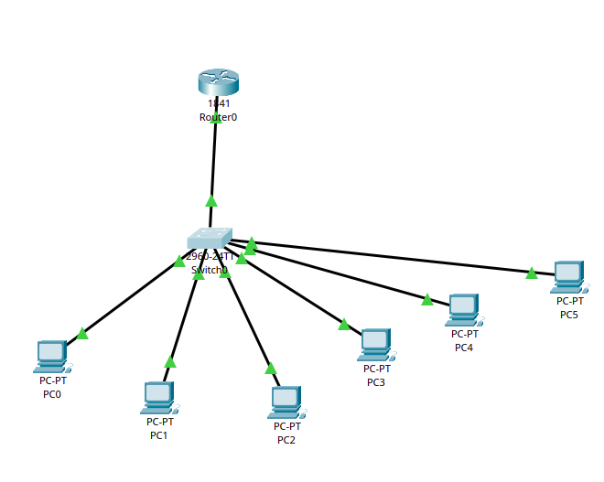
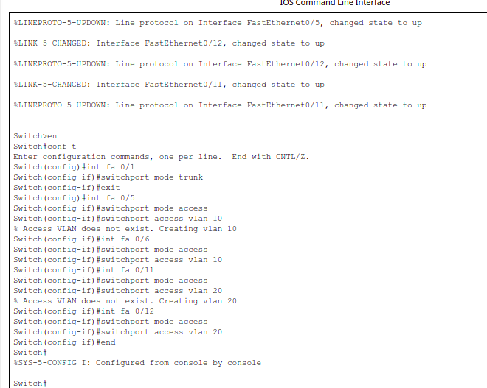
Expt-8: VLAN Configuration with Layer-3 Switch & Router using DHCP
STEP 1: Implement the Network
STEP 2: Switch Configuration
  Assigned switchports fa0/5-6 to VLAN 10, fa0/11-12 to VLAN 20, and configured fa0/1 as 802.1Q trunk.

Slide 31
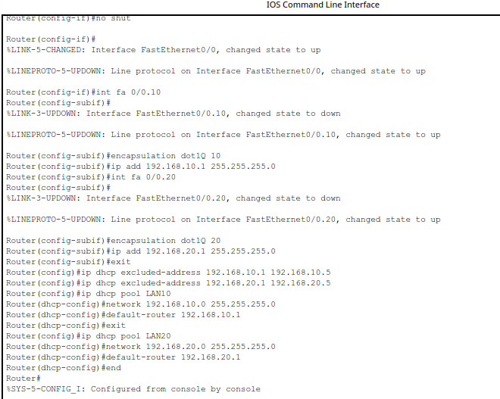
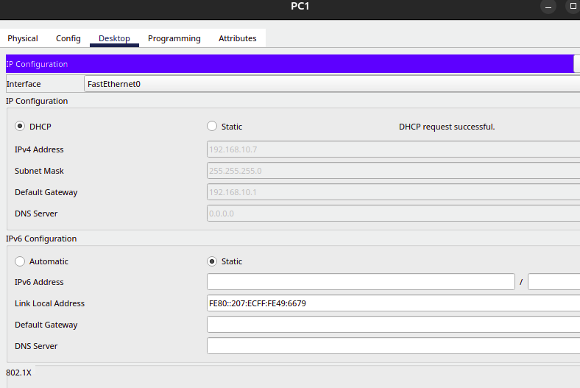
Expt-8: VLAN Configuration with Layer-3 Switch & Router using DHCP
STEP 3: Router Sub-Interfaces & DHCP Configuration
STEP 4: Host Dynamic IP Acquisition

Slide 32
Expt-8: VLAN Configuration with Layer-3 Switch & Router using DHCP
STEP 5: Dynamic Flow Verification in Simulation Mode

Slide 33
THANK YOU

