Slide 1
Course Title: Computer Networks Laboratory
Course Code: CSE-360
COMPUTER NETWORK
PRESENTED BY: MARUFA
ROLL: 365

Slide 2
Lab 1: Wireshark — Ethernet and ARP

Slide 3

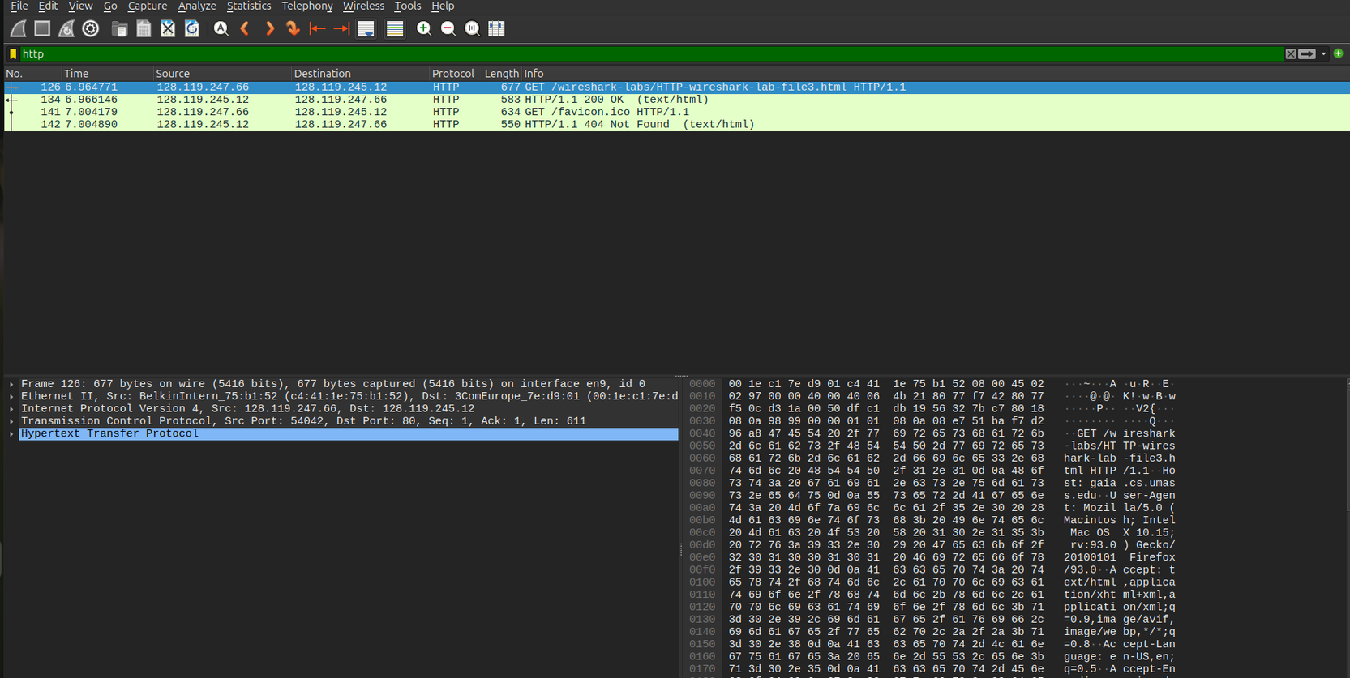
1. Capturing and Analyzing Ethernet Frames
HTTP GET Request and Encapsulation
Shows the client requesting the lab webpage using an HTTP GET message. Crucially, it illustrates Link-Layer encapsulation: while the IP destination points to the remote web server, the Ethernet destination MAC points to the local default gateway router.

Slide 4
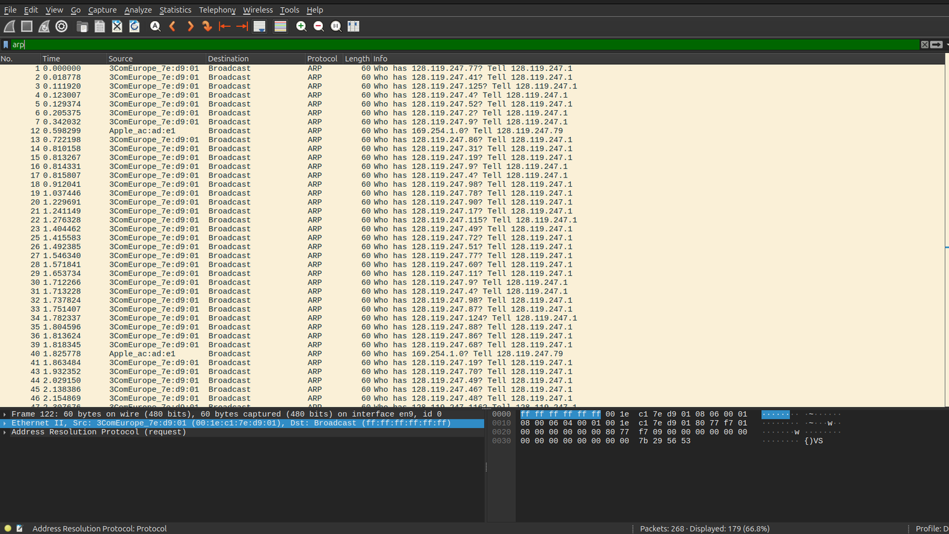
2. The Address Resolution Protocol (ARP)
ARP Traffic Overview
Shows the full list of captured ARP packets filtered in the trace. It highlights that ARP requests are sent as Link-Layer broadcasts (ff:ff:ff:ff:ff:ff) so every host on the subnet receives the query asking who owns a specific IP.

Slide 5
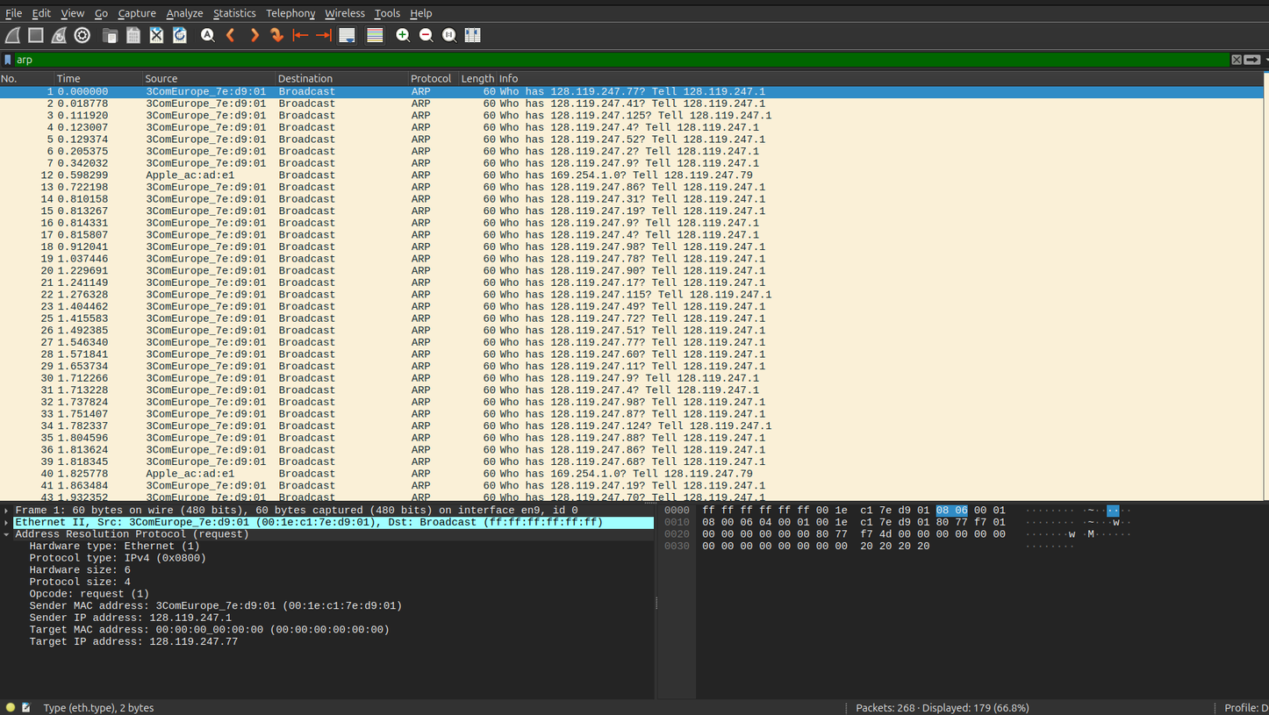
3. ARP Manipulation & Timing
ARP Request Packet Structure (Internal Details)
Shows the internal fields of an ARP request (Packet 1), displaying an Opcode of 1 (request), the sender's IP/MAC, the queried target IP (128.119.247.77), and the highlighted 0x0806 Ethernet Type field in the hex pane.

Slide 6
Lab 2: Introduction to Packet Tracer

Slide 7
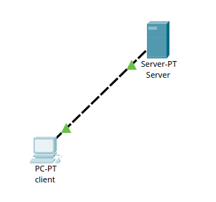
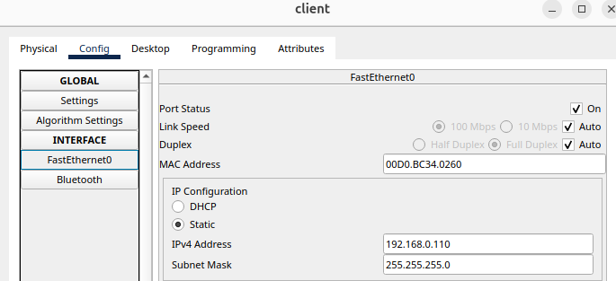
Expt-1: Basic Client Server Model
Part 1:
Step 1: Ports and cabling
STEP 2: Client Configuration
Dashed lines are crossover cables. Green triangles mean the link is up.
Device | IP Address | Subnet Mask
Server | 192.168.0.105 | 255.255.255.0
Client | 192.168.0.110 | 255.255.255.0
Ip configuration of client and server
Click on client and configure it using IP address of DNS server like below.
Click on FastEthernet and put IP address of the client like:

Slide 8
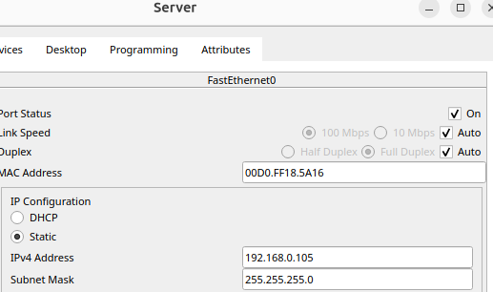
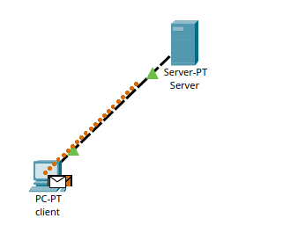
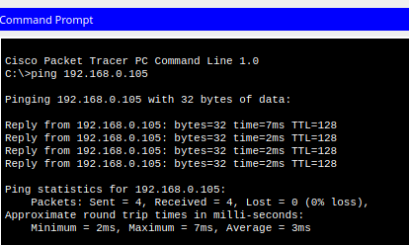
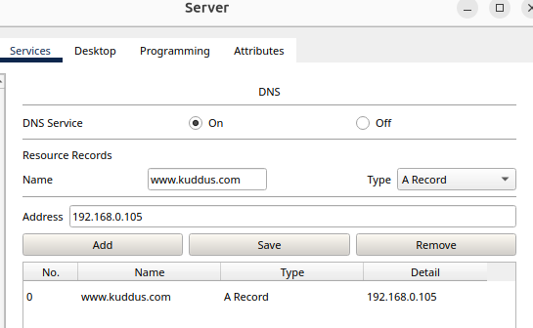
STEP 3: Server Configuration
STEP 4: Verification
Verification by sending test packet and pinging in the command prompt of client

Slide 9
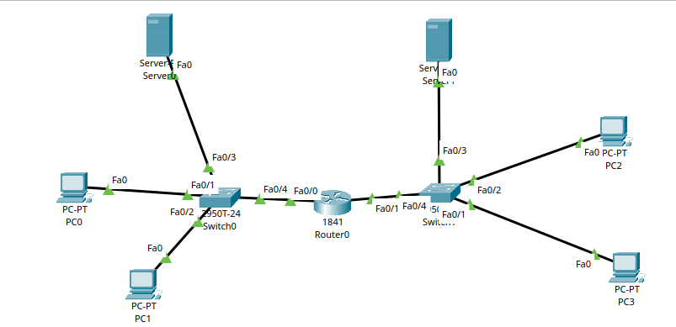
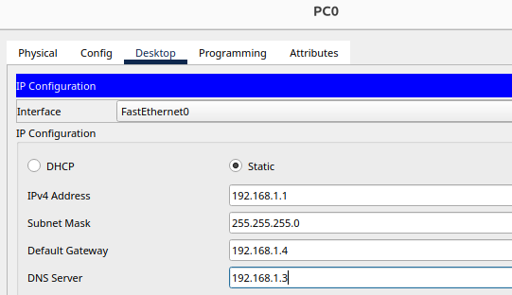
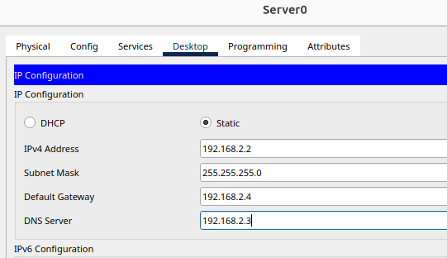
Part 2:
Step 1: DNS Server Configuration
STEP 2: IP Configuration
Connecting 2 network through router where in each network there are 2 pcs and 2 server and 1 switch . Also in step two ip configure both PC and server.

Slide 10
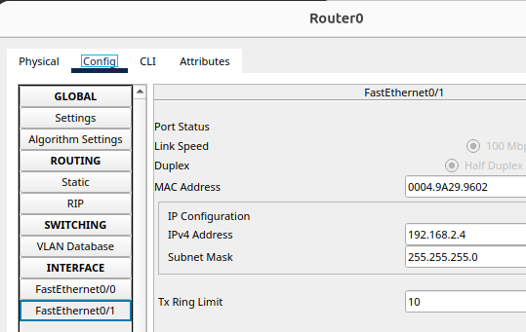
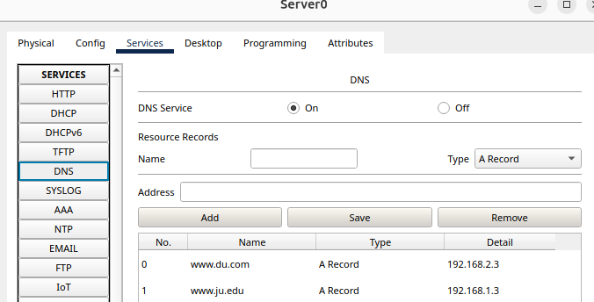
STEP 3: Router Configuration
STEP 4: Server Configuration
Click on router and configure it for port fa 0/0 and 0/1
Click on DNS then put DNS name, IP address then click on add button for each of the server of du(server 1) and ju(server 0) .

Slide 11
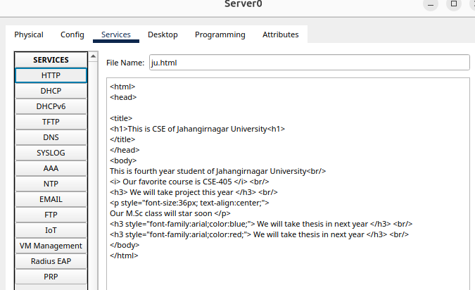
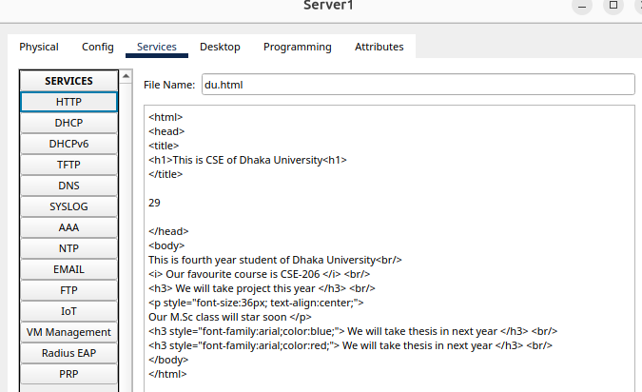
Step 5: Loading html code
Loading the specific html code for du and ju DNS server.

Slide 12
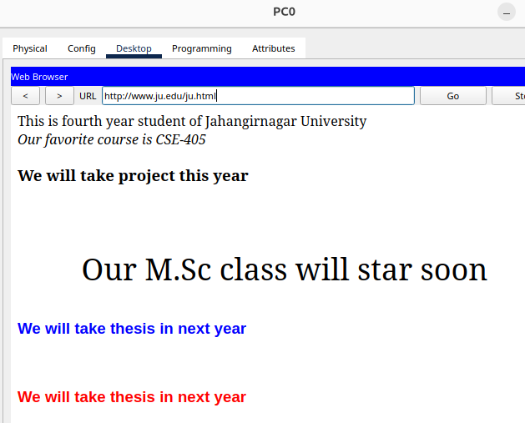

Step 6: Verification
Verify using the web browser of the pcs , here it is done using the pc0 and pc2

Slide 13
Lab 4: Connection of Routers

Slide 14
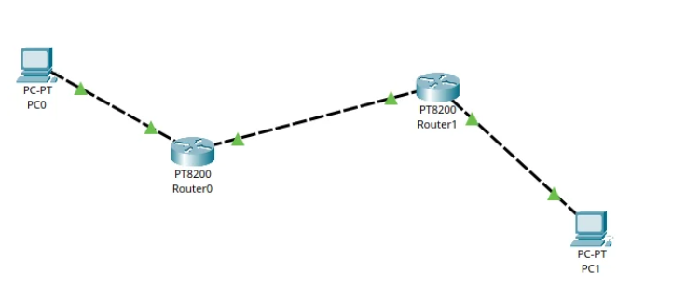
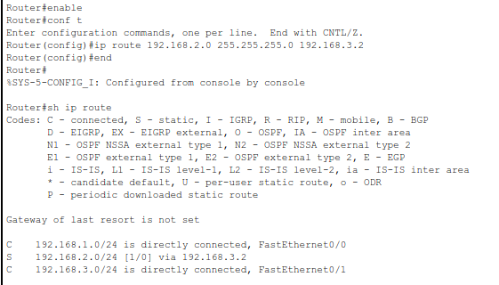
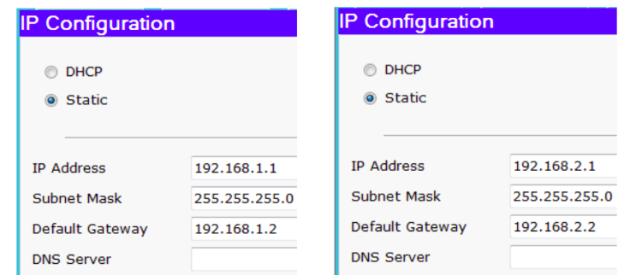
Expt-3: Connection of Two Routers
STEP 1: Ports and cabling & IP configuration
STEP 2: Router Configure
In step 2, first configure Router0, then Router1, and then Router0 and Router1 again.

Slide 15
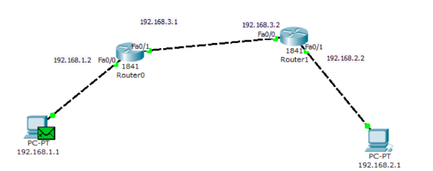
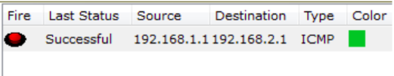
Step 3: Verification
To verify the connection, send a packet from one PC to another and start the simulation. The packet transmit successfully.

Slide 16
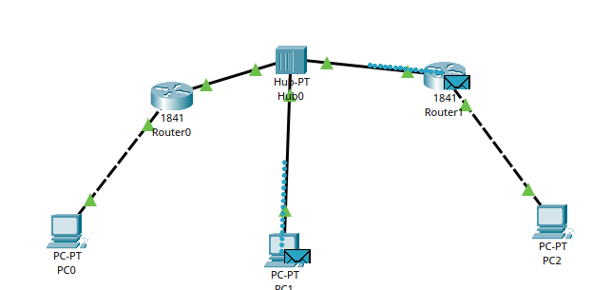
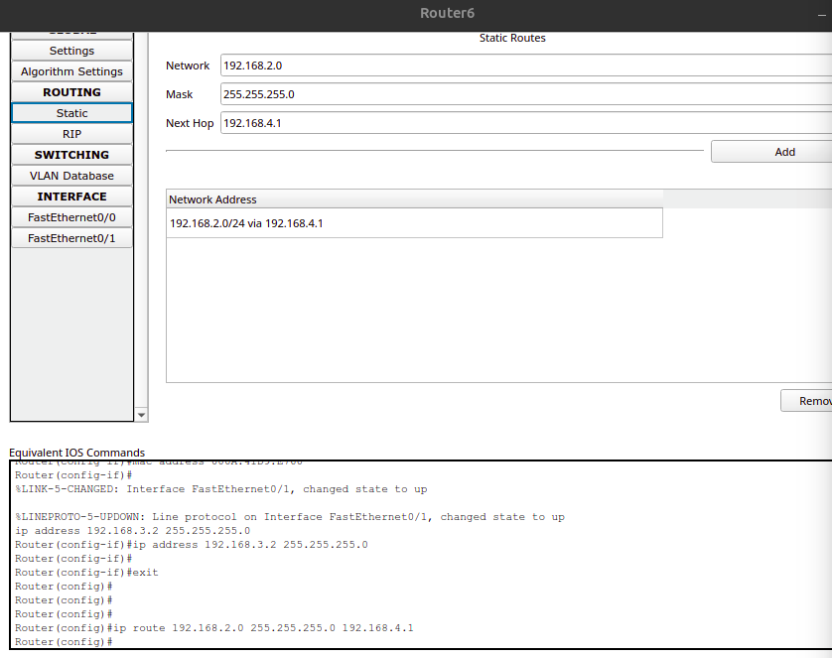
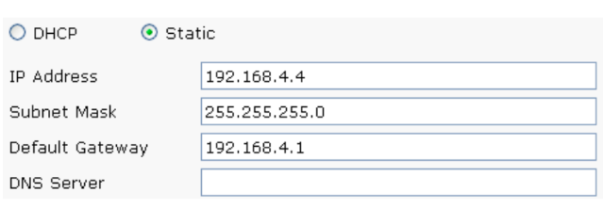
Expt-4: Connection two routers and incorporation of host between them
STEP 1: Ports and cabling & IP configuration
STEP 2: Router Configure

Slide 17
Step 3: Verify The Network
To verify the connection, send a packet from one PC to another and start the simulation. The packet transmit successfully.

Slide 18
Lab 5: Connection_of_routers_in_series

Slide 19
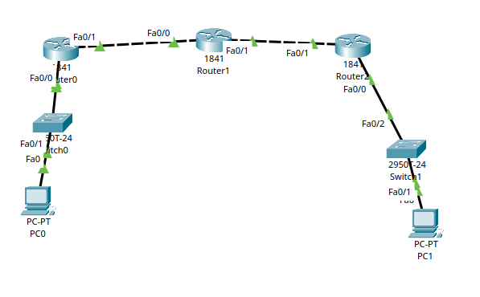
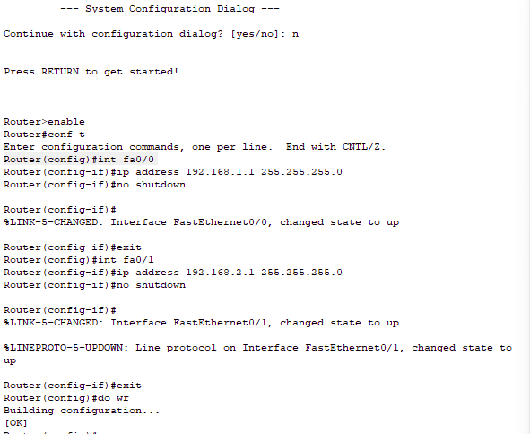
Expt-5: Routing through Multiple Routers in Series
STEP 1: Implement the network
STEP 2: Router Configure
  Connect the circuits.
  Configure Routers 0, 1, and 2.

Slide 20
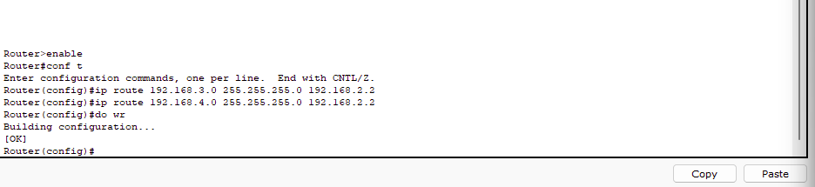
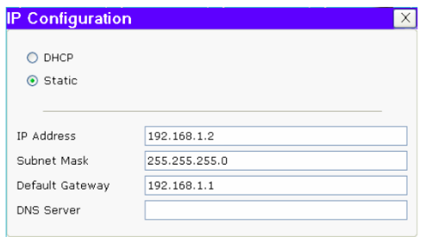
Step 3: Configuring the Routers again
Step 4: Configuring the PC

Slide 21
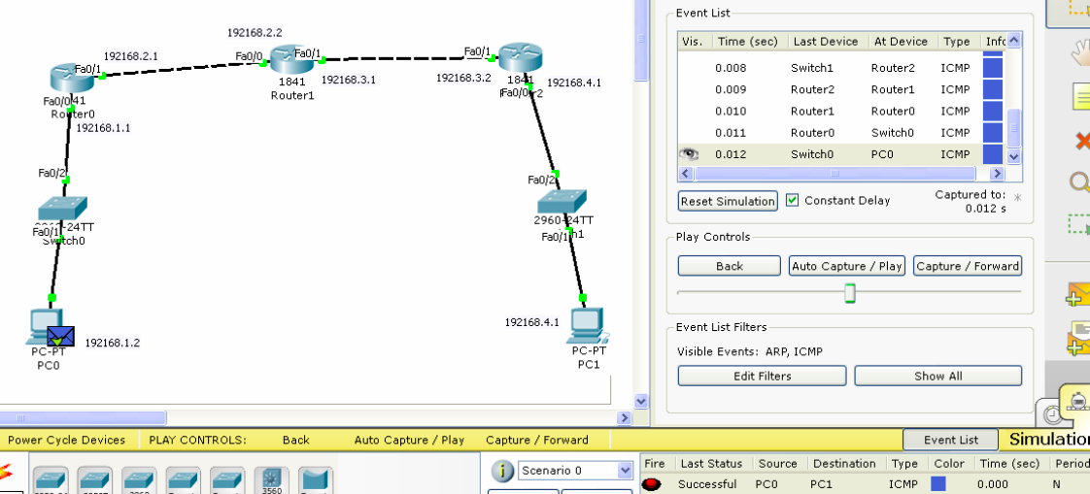
Step 5: Verification

Slide 22
Lab 6: Connections of Routers in a Complex Networks

Slide 23
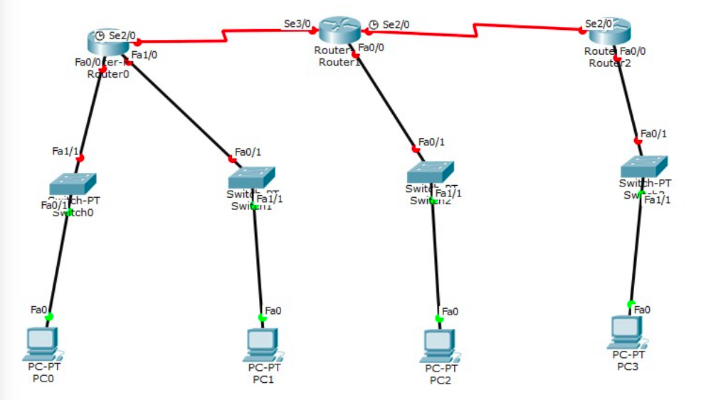
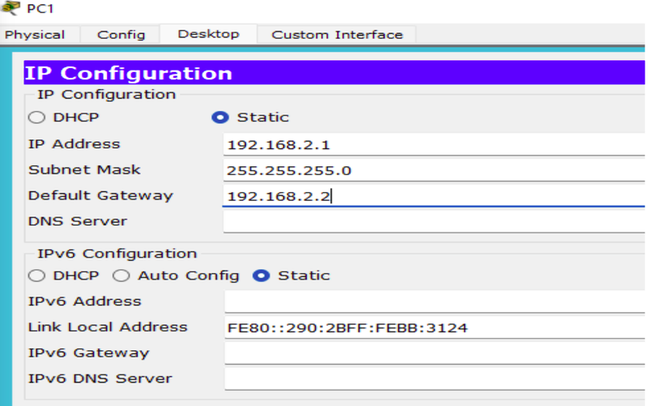
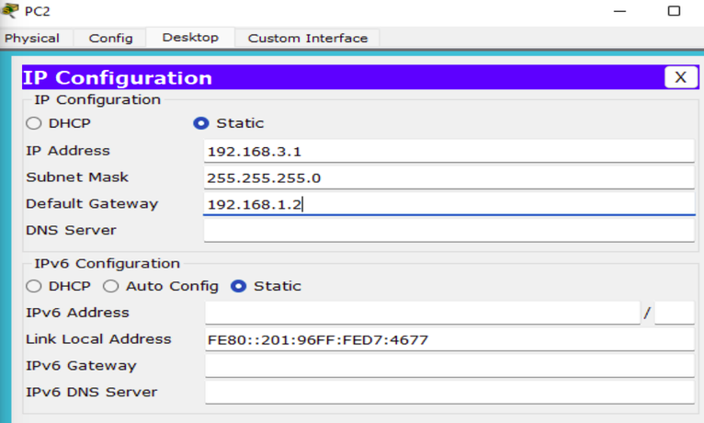
Expt-9: Routing of Packet through Complicated Network
STEP 1: Implement the network
STEP 2: PC IP Configure
  Connect the circuits.
  Configure PC 0,1,2,3

Slide 24
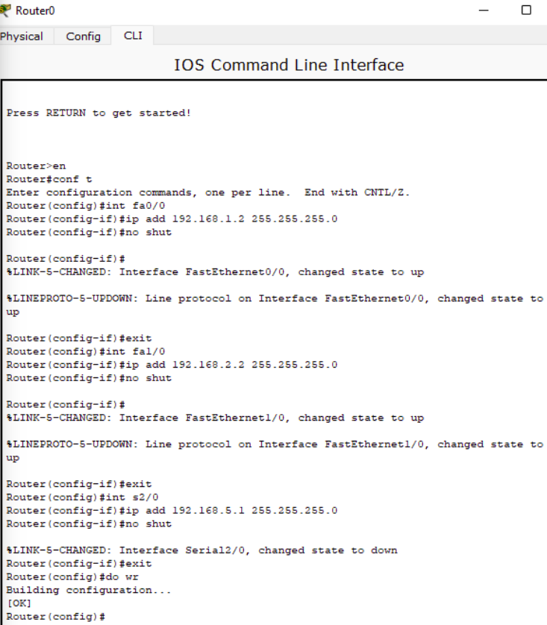
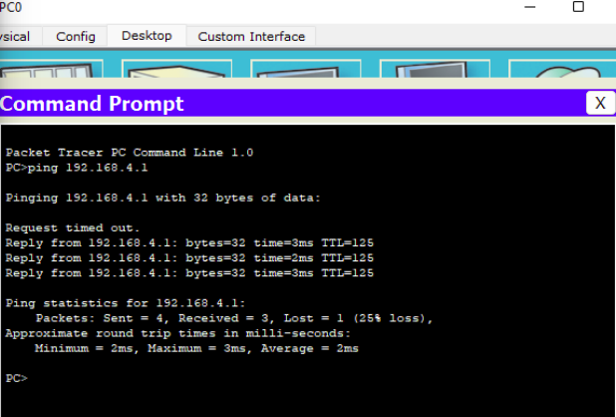
Expt-9: Routing of Packet through Complicated Network
STEP 3: Router Configure
STEP 4: Verify the ping command on PC of 192.168.1.1

Slide 25
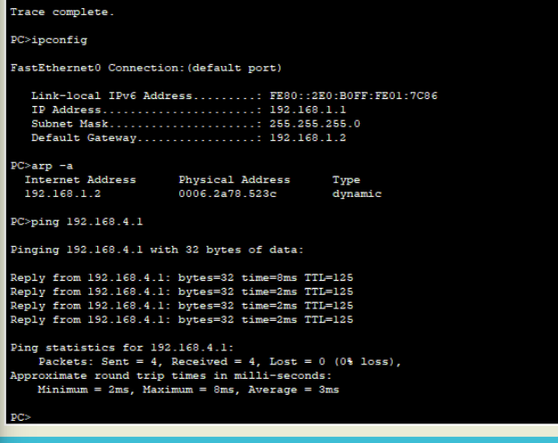
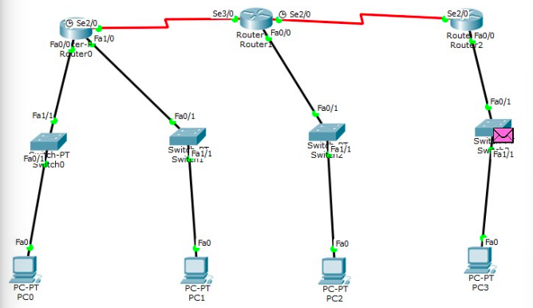
Expt-9: Routing of Packet through Complicated Network
STEP 5: Verify the tracert, ipconfg and arp –a commands
STEP 6: Verify the packet routing from simulation mode.

Slide 26
Lab 7: VLAN Configurations

Slide 27
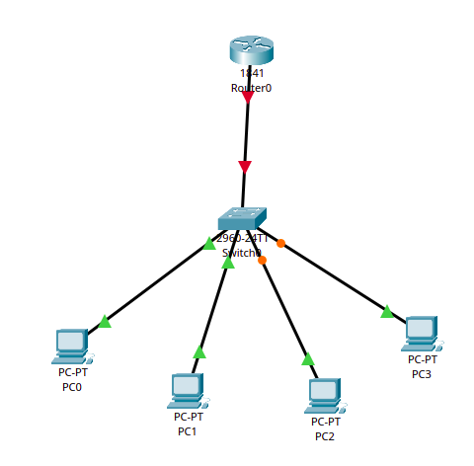
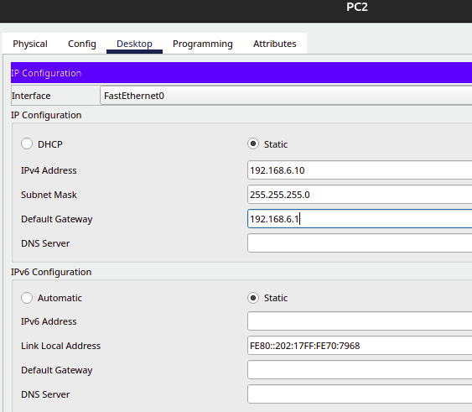
Expt-7: VLAN Configuration with Layer 3 Switch and Router
STEP 1: Implement the network
STEP 2: PC IP Configure
  Connect the circuits.
  Configure PC 0,1,2,3

Slide 28
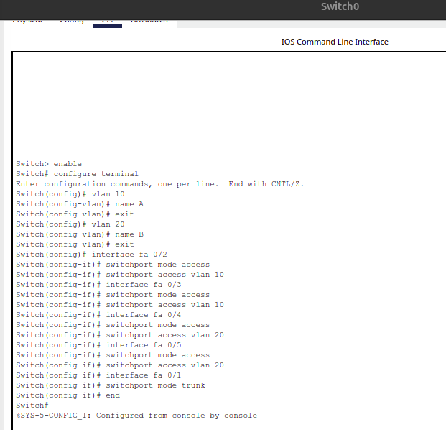
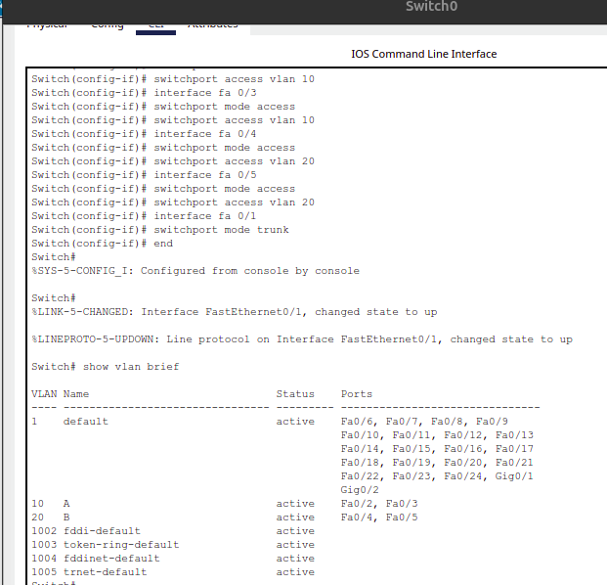
Expt-7: VLAN Configuration with Layer 3 Switch and Router
STEP 3: Switch & Router Configure
STEP 4: In switch observe VLAN configuration

Slide 29
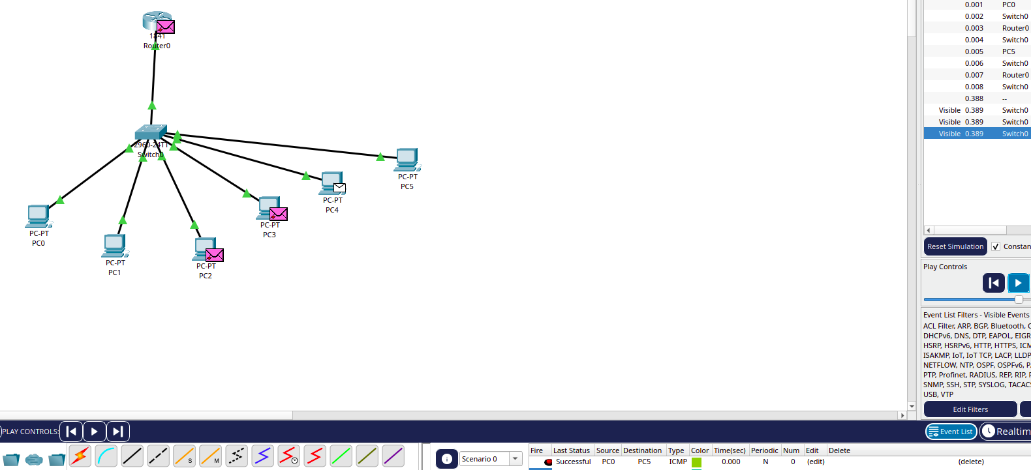
Expt-7: VLAN Configuration with Layer 3 Switch and Router
STEP 5: Verify the routing of packet under simulation mode

Slide 30
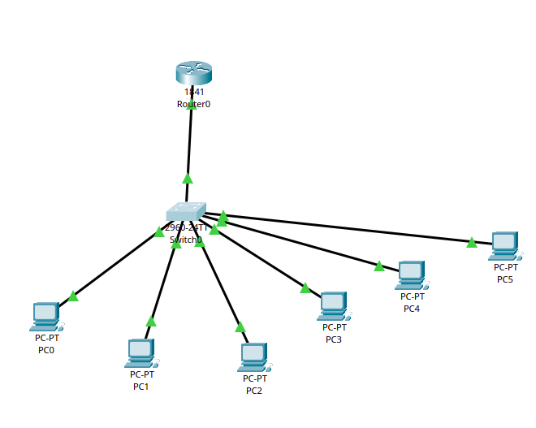
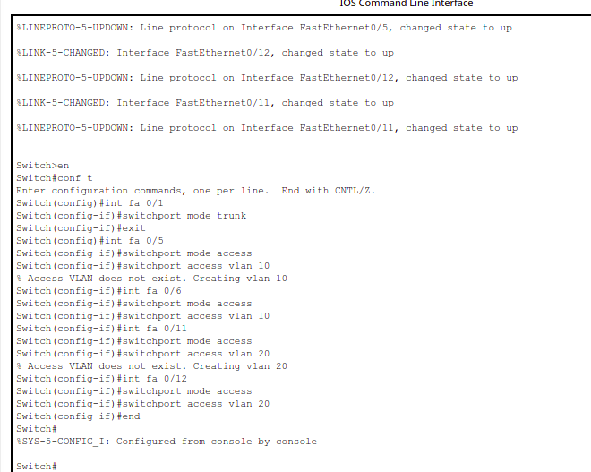
Expt-8: VLAN Configuration with Layer 3 Switch and Router using DHCP
STEP 1: Implement the network
STEP 2: Switch Configure
  Connect the circuits.
  Configure the switch.

Slide 31
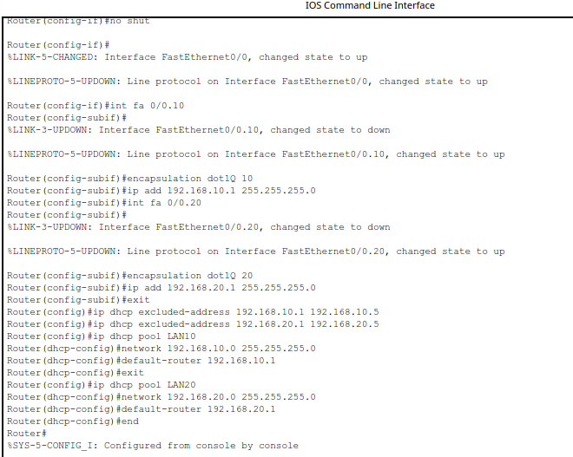
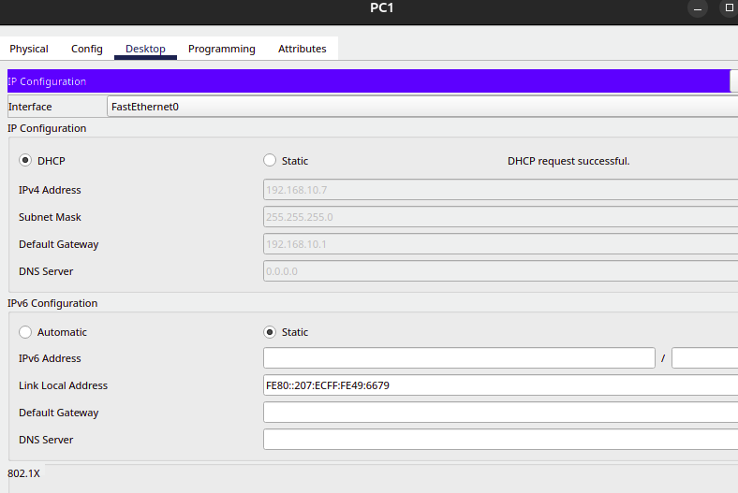
Expt-8: VLAN Configuration with Layer 3 Switch and Router using DHCP
STEP 3: Router Configure
STEP 4: PC IP Configure

Slide 32
Expt-8: VLAN Configuration with Layer 3 Switch and Router using DHCP
STEP 5: Verify the flow of packet in simulation mode

Slide 33
THANK YOU

