Slide 1


MAJOR PROJECT Project Group ID: BT4351 Made by – MD Talha -Kashif Ahmad
GALGOTIAS UNIVERSITY
Plot No.2, Sector 17-A, Yamuna Expressway
Greater Noida, Gautam Buddha Nagar,
Uttar Pradesh 201310.
School of Computing Science and Engineering
Breast Cancer Detection using Machine
Learning

Slide 2
INTRODUCTION
One of the most usual cancers is Breast Cancer, affects women highly worldwide, exemplifying the majority of other cancer types.
The amount of death can be controlled by earlier diagnosis and it save people life significantly. Accurate diagnosing finds the stages of the cancer as benign, malignant, and severe malignant; it leads to apply timely treatment to the cancer
Therefore, accurate diagnosis of cancer classes is the matter of several recent researches. Numerous approaches have been proposed for diagnosing the breast cancer data whereas the accuracy of classification is less. Since the breast cancer dataset has various and unique advantages of clinical features, machine learning algorithms have been used.

Slide 3
Basic Requirements (Software)
Python 2.6, 2.7, or Python 3.3+.
Any code editor (VS code editor used )
Pip installed
To install pip use command
The language which you will used must be installed in the OS.
Jupyter Notebook
Dataset provided by Kaggle.

Slide 4
Approaches To Detect Fraud
Some of the currently used approaches to detection of such fraud are:
Artificial Neural Network
Fuzzy Logic
Genetic Algorithm
Logistic Regression
Decision tree
Support Vector Machines
Bayesian Networks
Hidden Markov Model
K-Nearest Neighbour

Slide 5
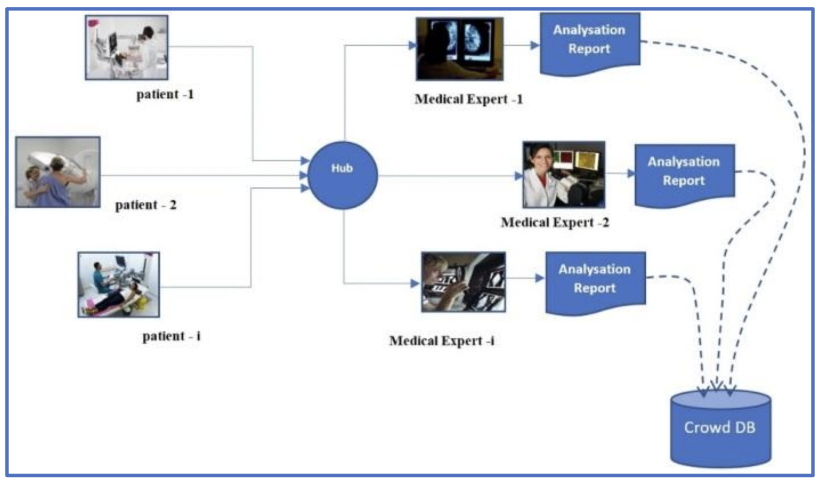
Architecture diagram

Slide 6
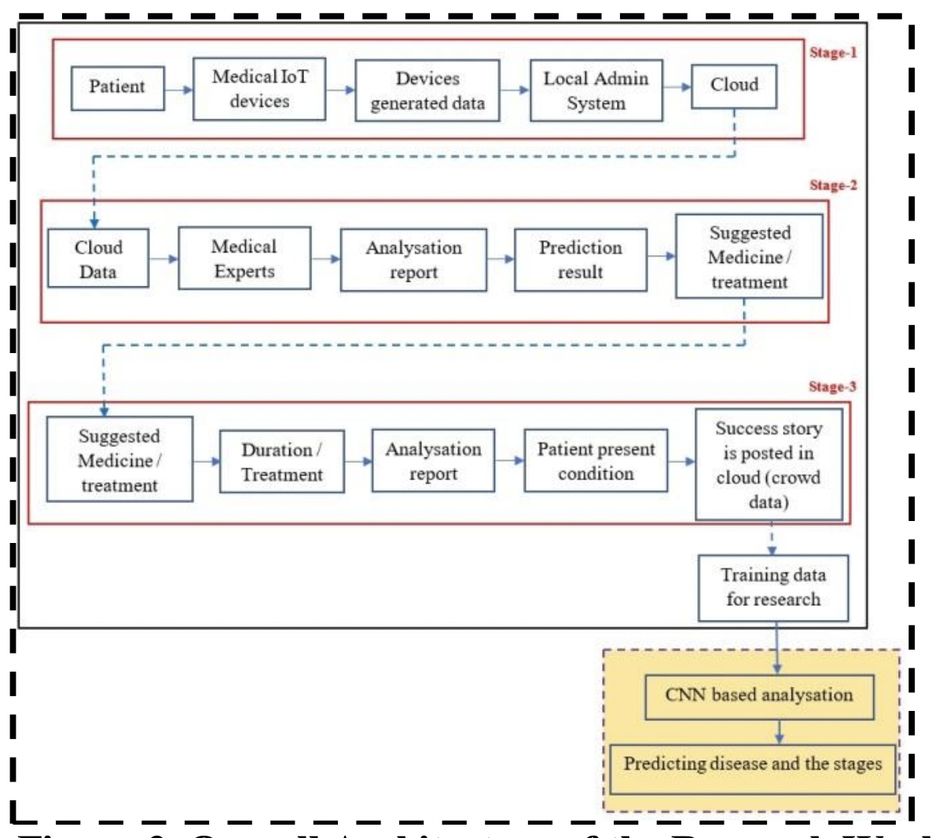
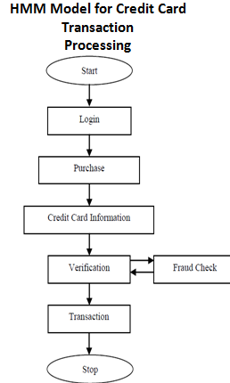
Work Flow

Slide 7


