Slide 1
Project Product Data
By Martin Tsifondarof, Petar Borisov, Stoicho Dimitrov

Slide 2
Why did we create the Project PA
We created the Project PA to help people who run different kinds of shops. Our project’s goal is to make organizing a shop as easy as possible. We have come a long way since the start of the project and learned that programing is very powerful tool. We did our best and we are looking to improve Project PA.
You can download version 1.0 at our website ProjectPA.com
You can leave feedback at ProjectPA.com/feedback

Slide 3
Features
Here are a few of the current features:
Products are user created
Products can be easily found by our search option
Products can be easily edited
Products can be sorted by different parameters
Products can be made available or unavailable

Slide 4
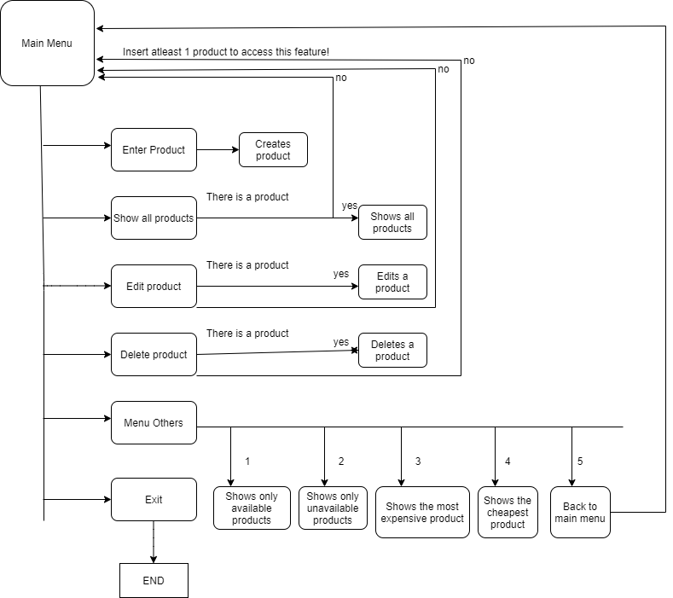
The basic algorithm of the program

Slide 5
Future?
In the close future we are planning to fix all current bugs. We would love If you can share your experience and report any new bugs you find at ProjectPA.com/ feedback. You can see the current bugs we are working on at ProjectPA.com
We are planning to add a few more features and optimize the current code.
The first big update we will be releasing will be GUI. We are planning to release it at the end of the summer but it is too early to say.

Slide 6

Our team
Our team consists of 3 people who just started learning about the world of programing last year. We think we have come a long way.
Martin Tsifondarov
Stoicho Dimitrov
Petar Borisov
Coder
Coder
Bug tester/fixer

Slide 7
Thank you for your attention!

