Slide 1
HW Meeting
2024-09-09

Slide 2
Intro
Har alla en ungefärlig idé om hur roboten ska byggas?
  Komponenter, struktur etc

Slide 3
Areas for hardware
Initial idé om indelning för hårdvara där vi kan läsa in oss djupare för att hitta bra stöd från litteraturen och kan gör ett utbildat val för respektive komponent.

Slide 4
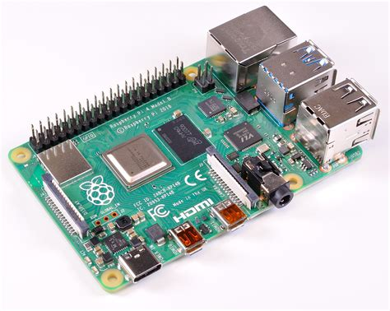
Processing Unit
Varje robot kommer behöva sin egna processor för att kunna köra AI, kommunicera genom RF/ROS2.
Input från sensorer
  En ADC kan kopplas innan ifall Raspberry pi används. T.ex. Pico eller extern ADC.
Sammarbete med Software (SW)
Programmering med ROS2/C++

Slide 5

Communication
Robotarn måste kunna kommunicera med varandra och med en extern datorn.
Hur ska denna kommunikation se ut, vilken form etc.
  E.g. Radio frequency (RF)
  Bluetooth är ej tillåtet.
  Wi-Fi

Slide 6
Battery management
All the components will require power
This group should create protection circuitry for the batteries, provide the correct voltage for the other components
  Processing unit might require 5V and motor 12V
Electrical design
  Multisim or Eagle CAD can be used

Slide 7
Motor control
Decide which type of motors that should be used
  Roller
  Wheels
Motor controller such as H-bridges
  Can be designed or purchased as is depending on motor
Electrical engineering

Slide 8
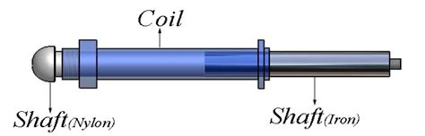
Kicker
The kicker should most probably be a solenoid, and a electric schematic will be necessary for this.
Decide which solenoid to be used
3D design of the kicker
  Ideally it should be able to pass and chip the ball
Electrical engineering
CAD

Slide 9
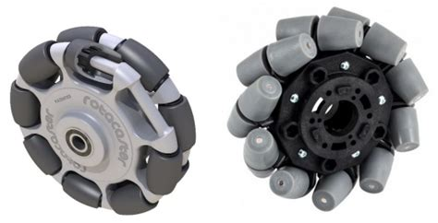
Wheels
Decide what type of wheels we should use and how many wheels.
Physics

Slide 10
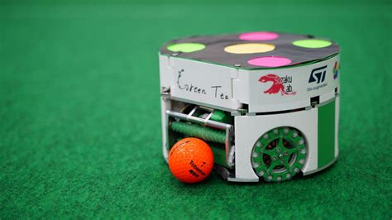
3D design of the robot body
Initial 3D design of the robot
CAD

Slide 11
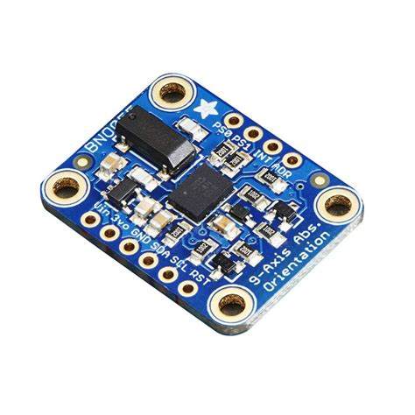
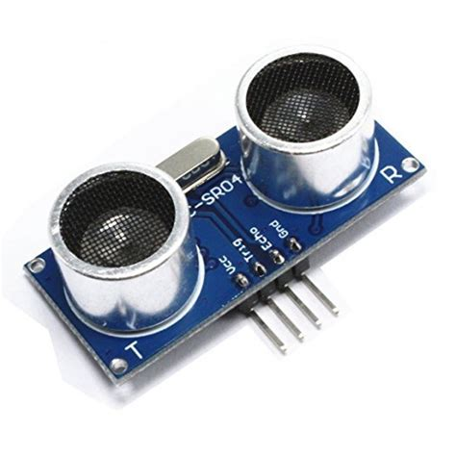
Sensors
Decide what type of sensor we should use for detecting other robots, position of the robot etc
  IMU
  IR
  Ultrasonic
Sensor knowledge

Slide 12
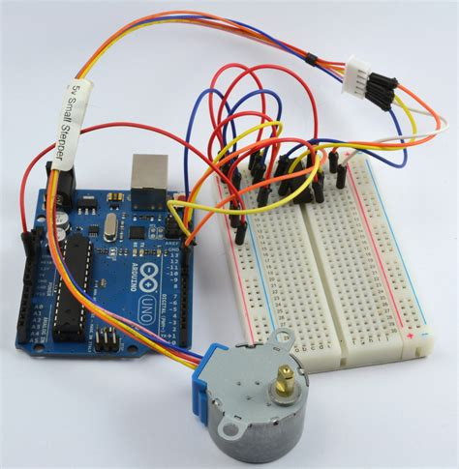
Develop a testing environment
We will need a standardized way to calibrate the robot, a way to validate that the robot behaves as we say it does and that the stakeholders requirements are met
  Real-time monitoring tools
    MyDAQ
    LabView

Slide 13
Documentation
Each component used should be described in its own section on the hardware page WIKI
I will add more information about how this should be done

Slide 14
Additional
Additional training to access the battery cabinet
  2024-09-16 (1 week from now)
PRO1 – 2024-09-27
  18 Days (2 weeks)
Develop our plan for the hardware (Ideally a draft at the end of the week)
  Decide which components to use
  Cost
I will create more detailed instructions for each group and add more requirements

