Slide 1
Early Diabetes Prediction using Wearable Sensor Data
Durgaprasad Marihuchegowda
MSc Data Science
July 2025

Slide 2
Introduction & Background
Early diabetes detection is crucial to prevent complications.
Wearable devices continuously monitor vital signs.
Traditional models rely on clinical tests; real-time prediction is missing.
e.g., Alotaibi et al., 2020; Nguyen et al., 2022
Columns: Index(['Diabetes_012', 'HighBP', 'HighChol', 'CholCheck', 'BMI', 'Smoker', 'Stroke', 'HeartDiseaseorAttack', 'PhysActivity', 'Fruits', 'Veggies', 'HvyAlcoholConsump', 'AnyHealthcare', 'NoDocbcCost', 'GenHlth', 'MentHlth', 'PhysHlth', 'DiffWalk', 'Sex', 'Age', 'Education', 'Income'], dtype='object')

Slide 3
Research Question & Objectives
Research Question & Objectives
Research Question:
Can we accurately predict diabetes risk using health and activity data collected from wearable sensors?
Objectives:
Develop machine learning models to assess diabetes risk based on features such as BMI, age, blood pressure, and physical activity.
Analyze and identify the most influential predictors for diabetes using feature importance techniques.
Compare the performance of multiple ensemble classifiers to determine the most effective approach.
Demonstrate the potential for integrating predictive models into wearable devices for real-time health monitoring and early intervention.

Slide 4
Dataset Overview
Source: Behavioral Risk Factor Surveillance System (BRFSS) 2015 dataset
Size and Composition:
Total records: Over 253,000 samples
Number of features: 22
Target variable: Diabetes_012
0: Healthy
1: Pre-diabetic
2: Diabetic
Key Features:
Demographics: Age, Sex, Education, Income, Race
Health Indicators: BMI, Blood Pressure, Cholesterol, Physical Activity, General Health, Smoking, Alcohol Use

Slide 5
Dataset Overview
Statistical Highlights:
Age: Mean = 49.8 years; Range = 18–80+ years
BMI: Mean = 27.5; Range = 15.5–65.6
Class Distribution:
Healthy: ~84%
Pre-diabetic: ~7%
Diabetic: ~9%
Missing Values: Some features contain missing or inconsistent entries, addressed during preprocessing.
Notable Characteristics:
Highly imbalanced classes, requiring oversampling (SMOTE) for effective model training.
Represents a diverse population with varying health backgrounds, making it suitable for generalizable machine learning applications.

Slide 6
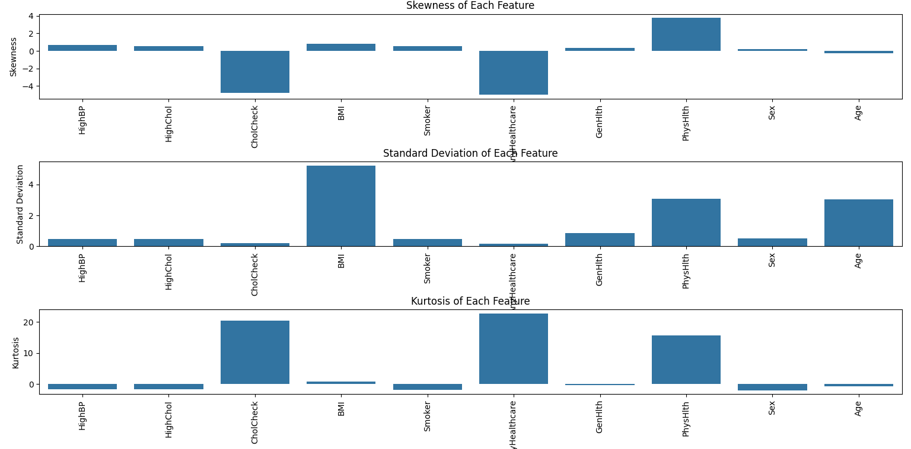
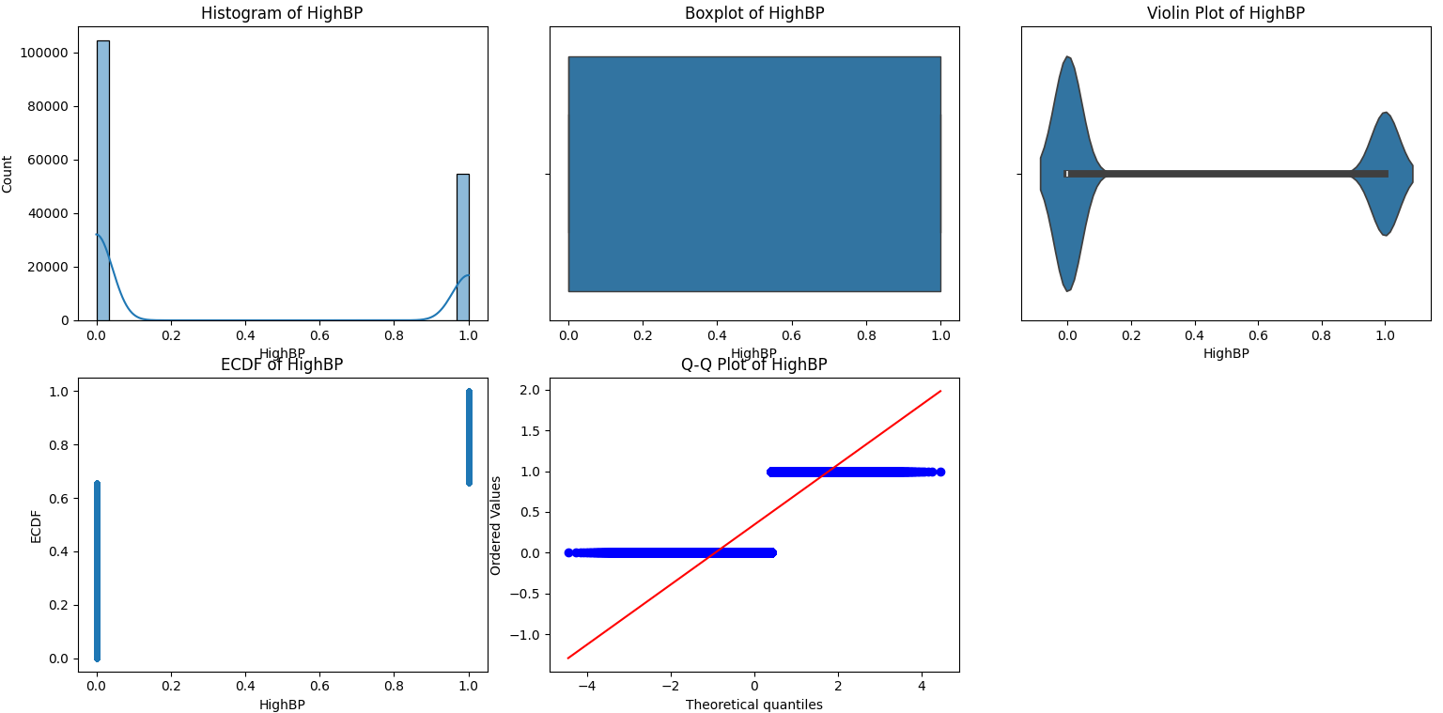
Dataset Overview

Slide 7
Methodology
Data Collection
The project uses the BRFSS 2015 dataset, which contains over 253,000 samples and 22 features, including BMI, age, blood pressure, physical activity, and other health-related metrics.
Data Preprocessing
Handling Missing Values: Rows with missing or invalid data are either dropped or imputed to ensure data quality.
Encoding Labels: Categorical variables (like gender, education, race) are label encoded for use in ML models.
Normalization: Numeric features are normalized to bring all values to a similar scale.
Class Imbalance Handling: SMOTE (Synthetic Minority Over-sampling Technique) is used to balance the classes in the target variable (since healthy, pre-diabetic, and diabetic classes are imbalanced).

Slide 8
Methodology
Feature Selection
Correlation Analysis: The correlation of features with the target variable (Diabetes_012) is analyzed.
Less relevant or highly correlated features are removed to reduce overfitting and improve model performance.
Key features selected include BMI, age, blood pressure, and physical activity.
Model Development
Train/Test Split: The dataset is split into training (80%) and testing (20%) sets.
Model Selection: Several machine learning models are trained and compared, including:
Extra Trees Classifier
Random Forest
XGBoost
LightGBM (LGBM)
Hyperparameter Tuning: Each model is tuned using GridSearchCV or similar techniques.

Slide 9
Methodology
Model Evaluation
Performance Metrics: Models are evaluated using accuracy, F1-score, and ROC-AUC.
Confusion Matrix: Plotted for the best model to visualize class-wise performance.
Feature Importance: The most important features for diabetes prediction are visualized for the top-performing model (Extra Trees).
Results and Interpretation
The Extra Trees model performed best, achieving the highest ROC-AUC and F1-score.
The confusion matrix and feature importance plots illustrate the model’s performance and insights.
Prediction Example
The notebook includes a sample prediction for an individual (e.g., Age=45, BMI=31.2, HighBP=1), showing class probabilities for healthy, pre-diabetic, and diabetic.
Discussion and Future Work
Results are discussed in context with literature.
Limitations include reliance on older data and lack of real wearable signal diversity.
Future directions: Integrating real-time wearable data streams, supporting additional health conditions, and deploying the model in smartwatch apps.

Slide 10
Feature Importance (Extra Trees)
Feature Importance
The most significant features influencing diabetes prediction in this study were:
Body Mass Index (BMI)
Age
High Blood Pressure
Physical Activity
General Health
Smoking Status
Education Level
Income
Feature importance was determined using ensemble tree-based models, which measure how much each feature contributes to reducing prediction error.
BMI and Age emerged as the strongest predictors, consistent with established medical research.
These insights highlight key areas for public health intervention and personalized risk assessment.

Slide 11
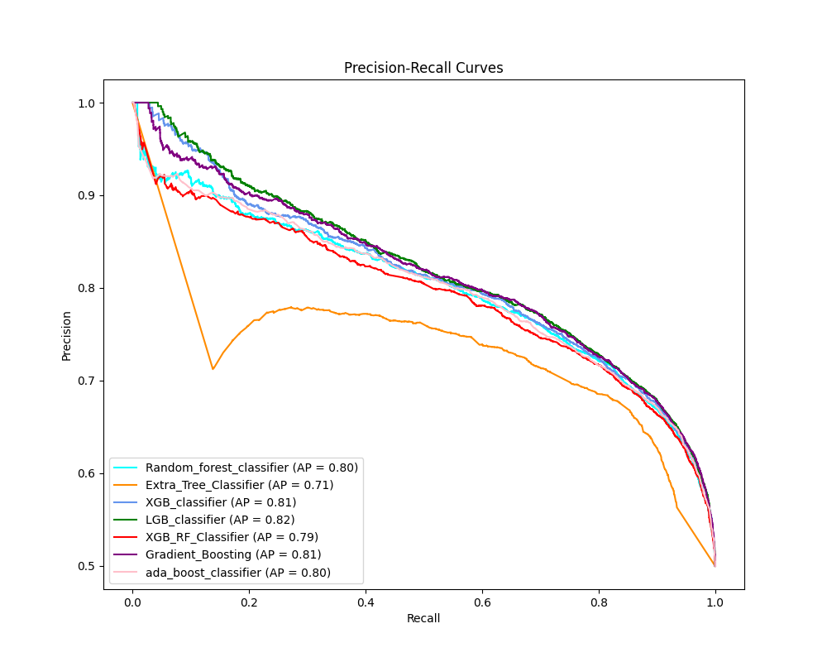
Feature Importance (Extra Trees)

Slide 12
Sample Input & Output
Example Input Features:
Age: 45
BMI: 31.2
High Blood Pressure: Yes (1)
Physical Activity: No (0)
General Health: Fair
(other relevant features as per the dataset)
Model Prediction:
Predicted Class: 1 (Pre-diabetic)
Probability: [0.12, 0.78, 0.10]
Class 0 (Healthy): 12%
Class 1 (Pre-diabetic): 78%
Class 2 (Diabetic): 10%
Interpretation: The model identifies this individual as pre-diabetic, with a high probability, indicating an increased risk and the need for early intervention.

Slide 13
Discussion
Model Performance:
Among all tested models, the Extra Trees Classifier demonstrated the best overall performance in terms of ROC-AUC and F1-score. This suggests that ensemble methods, which aggregate multiple decision trees, are particularly effective for this dataset.
Feature Importance: The most significant predictors for diabetes risk were BMI, Age, High Blood Pressure, and Physical Activity. These findings align with established medical knowledge and previous research.
Confusion Matrix Insights: The confusion matrix reveals that the model predicts the “healthy” class with high accuracy, but there is some misclassification between pre-diabetic and diabetic classes. This could be due to overlapping feature patterns or class imbalance.
Impact of Data Balancing: Applying SMOTE improved the model’s ability to recognize minority classes (pre-diabetic and diabetic), addressing the dataset’s original class imbalance.

Slide 14
Discussion
Limitations:
The BRFSS dataset is from 2015 and may not fully reflect current wearable sensor capabilities or population health trends.
The data lacks rich wearable signals such as continuous heart rate or sleep patterns, limiting the model’s real-time applicability.
The model relies on self-reported or clinically measured features rather than continuous sensor data.
Comparison with Literature: Results are consistent with studies such as Alotaibi et al. (2020), which also found ensemble learning to be effective for diabetes risk prediction.
Practical Implications: The model provides a solid foundation for early diabetes risk prediction using features accessible via wearable devices. With integration of real-time sensor streams, this approach could support proactive health management.

Slide 15
Results
Content:
Several ensemble models were evaluated for diabetes risk prediction, including Random Forest, Extra Trees, XGBoost, LGBM, AdaBoost, and Gradient Boosting.
Performance metrics such as Accuracy, F1-score, ROC-AUC, Precision, Recall, Specificity, and others were compared across all models.
The bar chart below summarizes the metrics for each model.
Observation:
Ensemble methods provided robust performance, with Extra Trees, Random Forest, and LGBM consistently achieving high scores across most metrics.
Models performed well in both balanced accuracy and ROC-AUC, demonstrating strong discrimination ability.

Slide 16
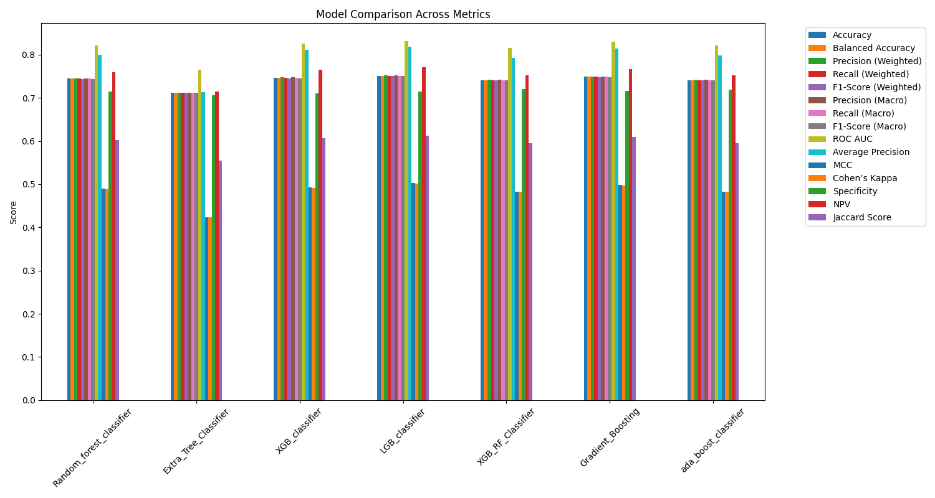
Results

Slide 17
Results
ROC and Precision-Recall Curves
Title: ROC & Precision-Recall Curves
Content:
ROC curves compare the tradeoff between true positive rate and false positive rate across different thresholds.
Precision-Recall (PR) curves illustrate how models handle class imbalance and their ability to identify positive (at-risk) cases.
Findings:
All ensemble classifiers achieved high AUC values (around 0.82–0.83), confirming their strong predictive capability.
Precision-Recall curves further indicate reliable positive class detection.
Extra Trees had slightly lower AUC than Random Forest, LGBM, and XGBoost, but still performed competitively.
These curves demonstrate that the selected models are robust and generalize well to unseen data.

Slide 18
Conclusion & Future Work
Conclusion
Developed and evaluated multiple ensemble models to predict diabetes risk using health and lifestyle features accessible through wearable devices.
The Extra Trees Classifier demonstrated the best overall performance in terms of ROC-AUC and F1-score, accurately identifying both healthy and at-risk individuals.
Key predictors included BMI, Age, Blood Pressure, and Physical Activity, aligning with established clinical knowledge.
The approach demonstrates the potential for using wearable sensor data and machine learning to enable early detection of diabetes risk, supporting proactive healthcare decisions.

Slide 19
Conclusion & Future Work
Future Enhancements
Integrate real-time wearable data: Incorporate continuous signals such as heart rate, activity level, and sleep patterns for richer prediction.
Expand to multi-condition prediction: Extend the framework to detect other chronic diseases (e.g., hypertension, cardiovascular risk).
Improve interpretability: Apply explainable AI techniques (e.g., SHAP) to provide personalized risk factors.
Deploy as a mobile or smartwatch app: Enable real-world, user-friendly risk assessment for timely intervention and health monitoring.

