Slide 1
All are equal

Slide 2
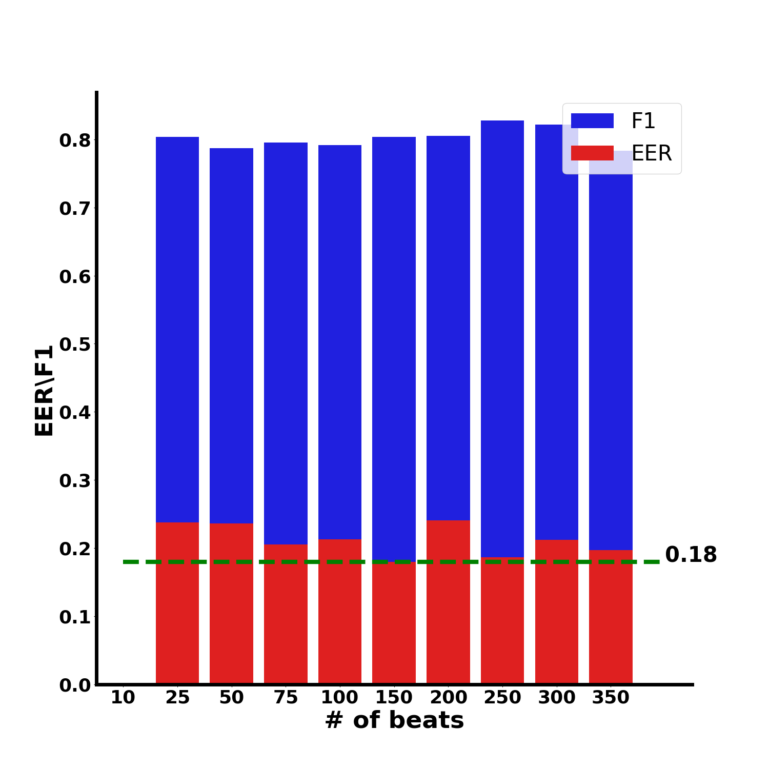
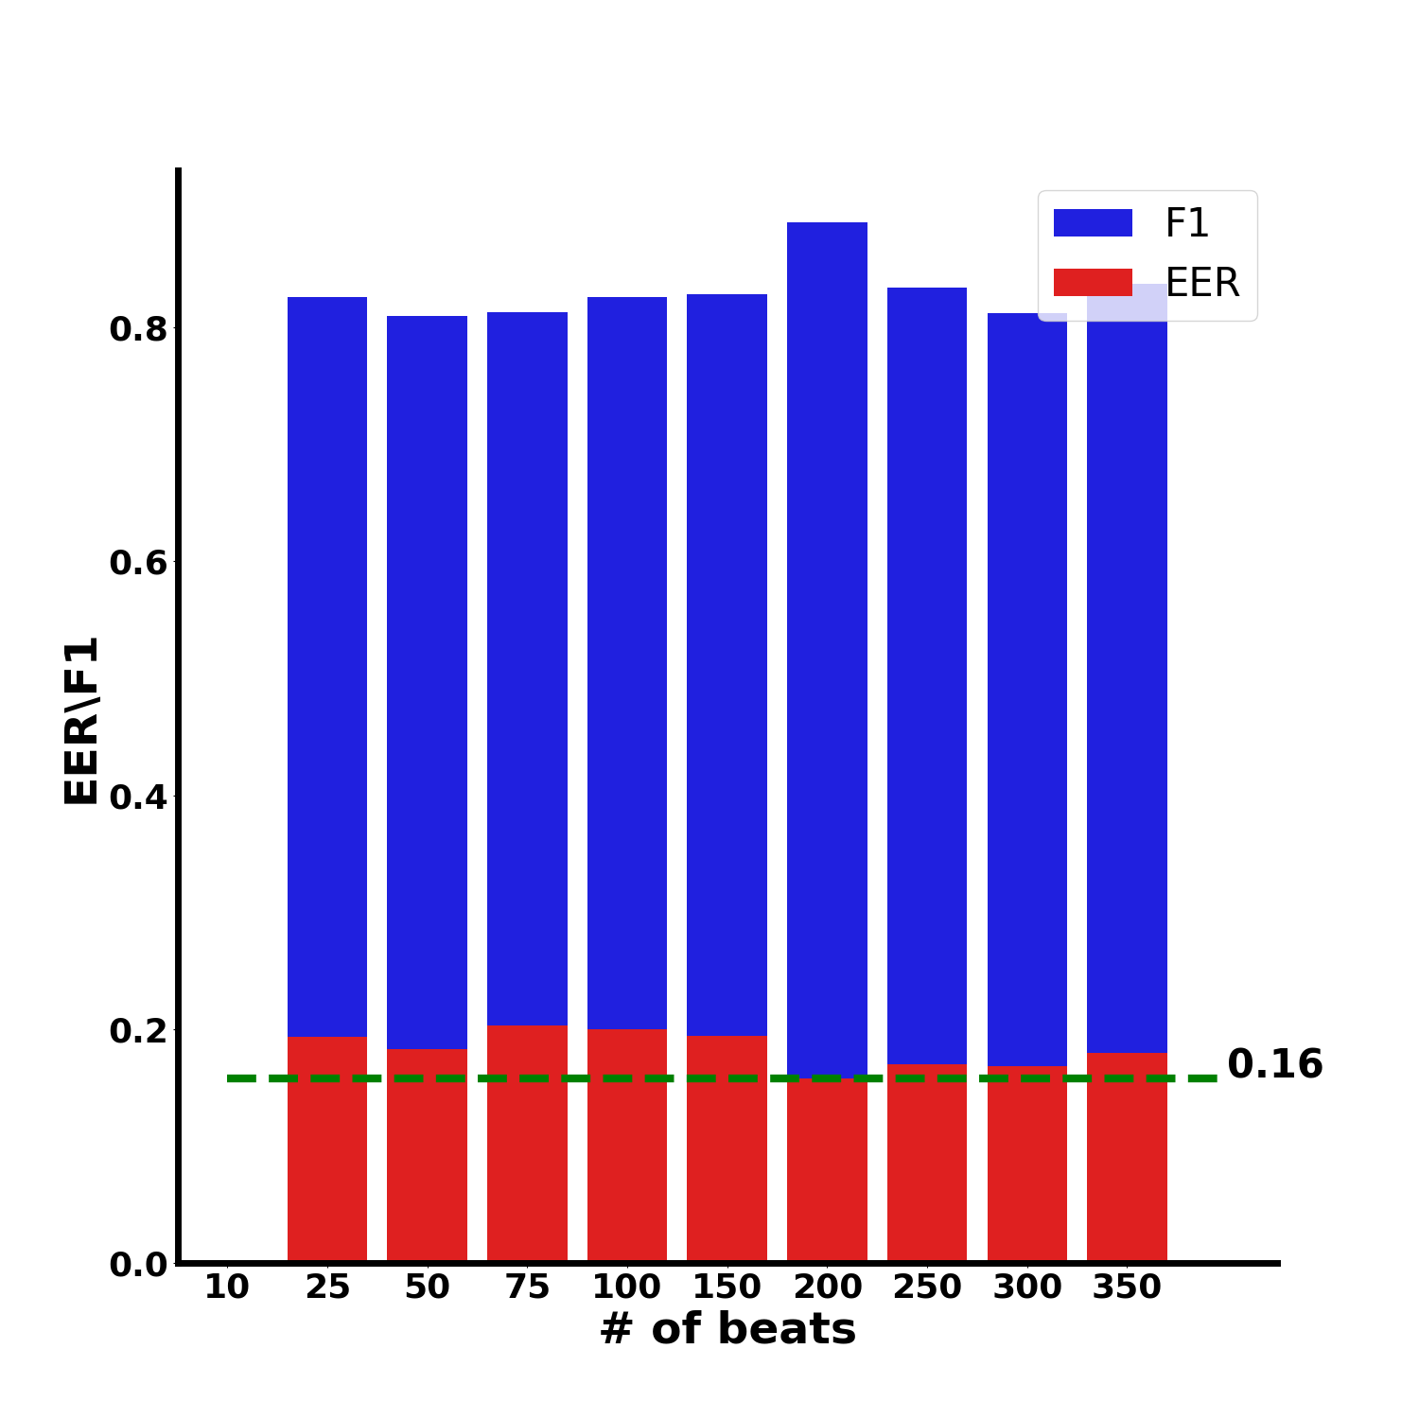
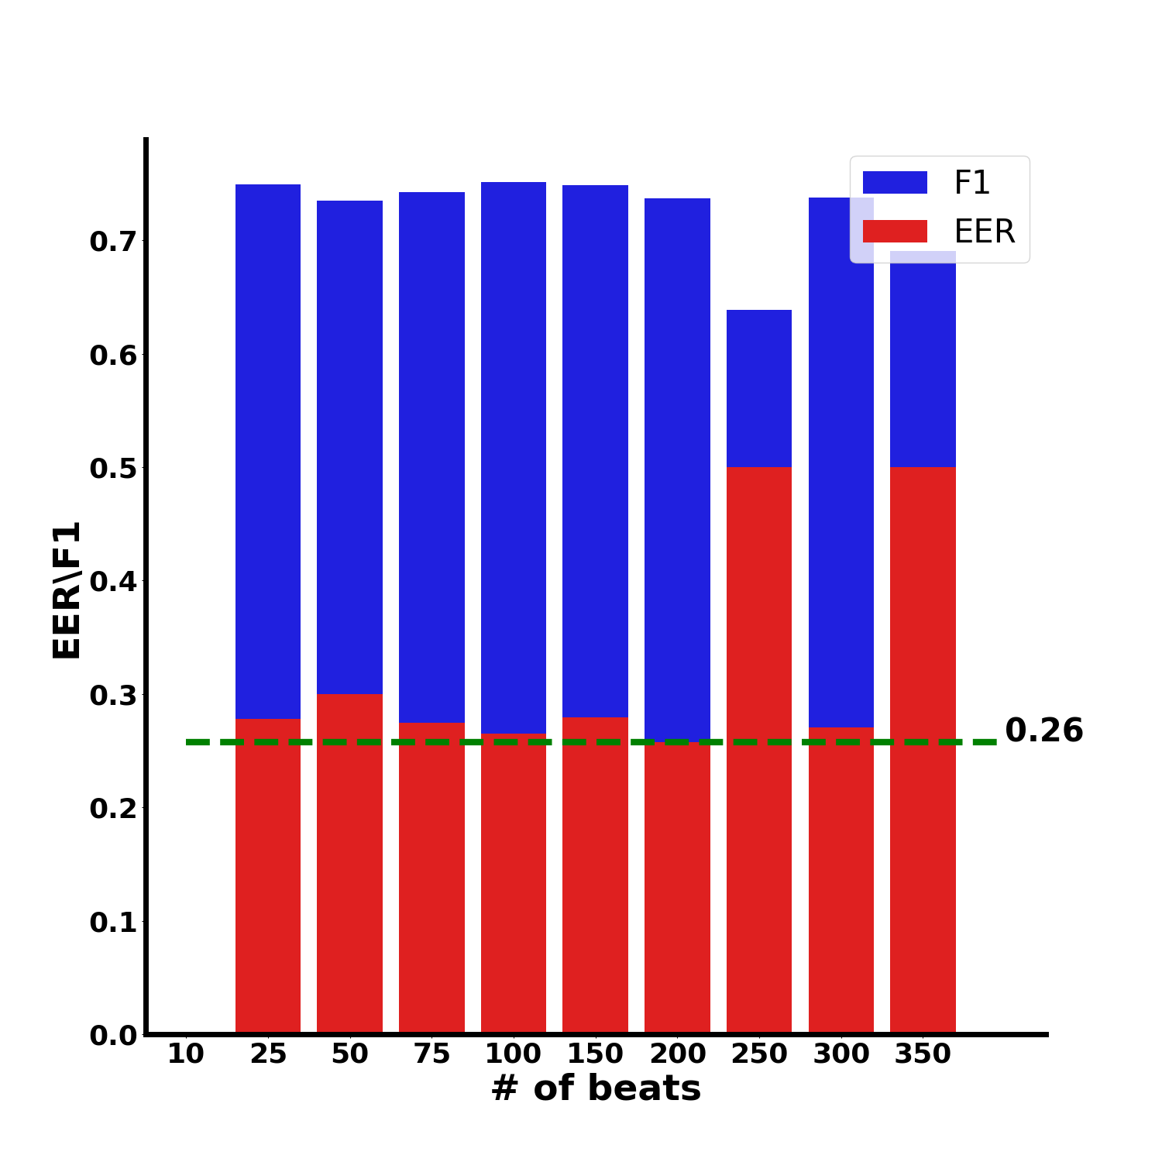
CD: function of number of beats (age of 6[m])
Basal
Intrinsic
Combined

Slide 3
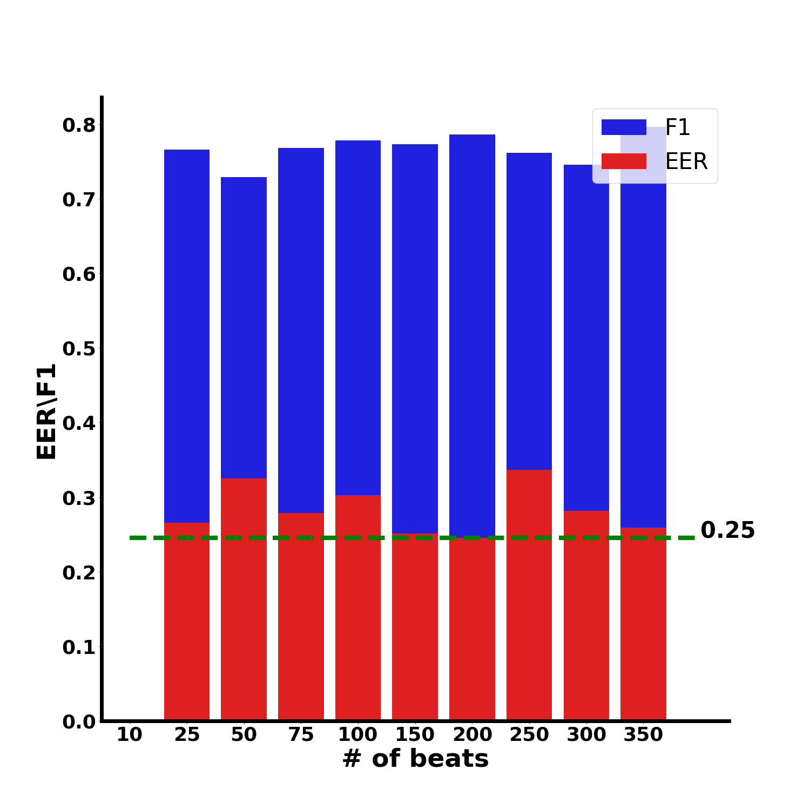
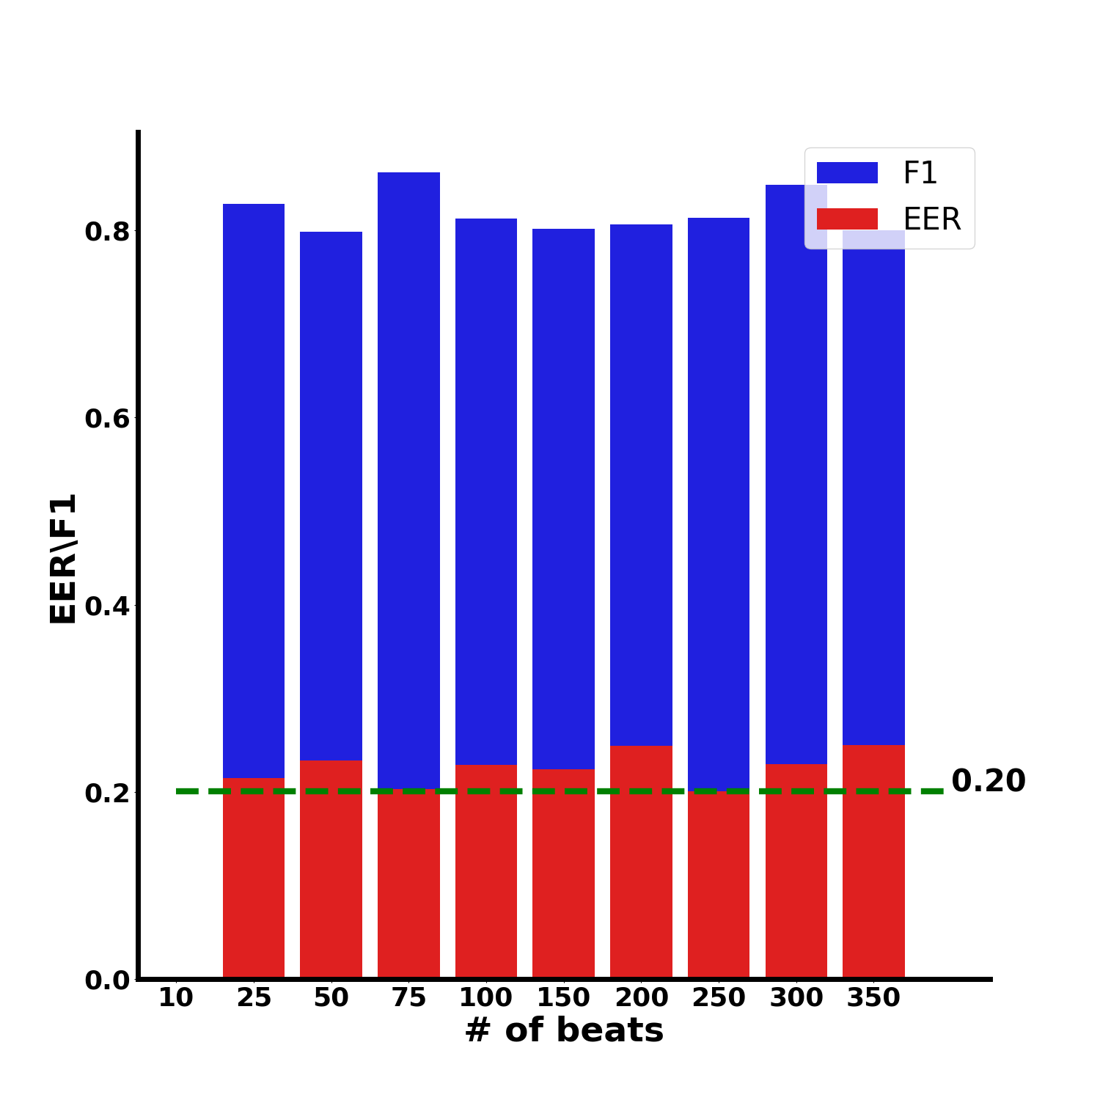
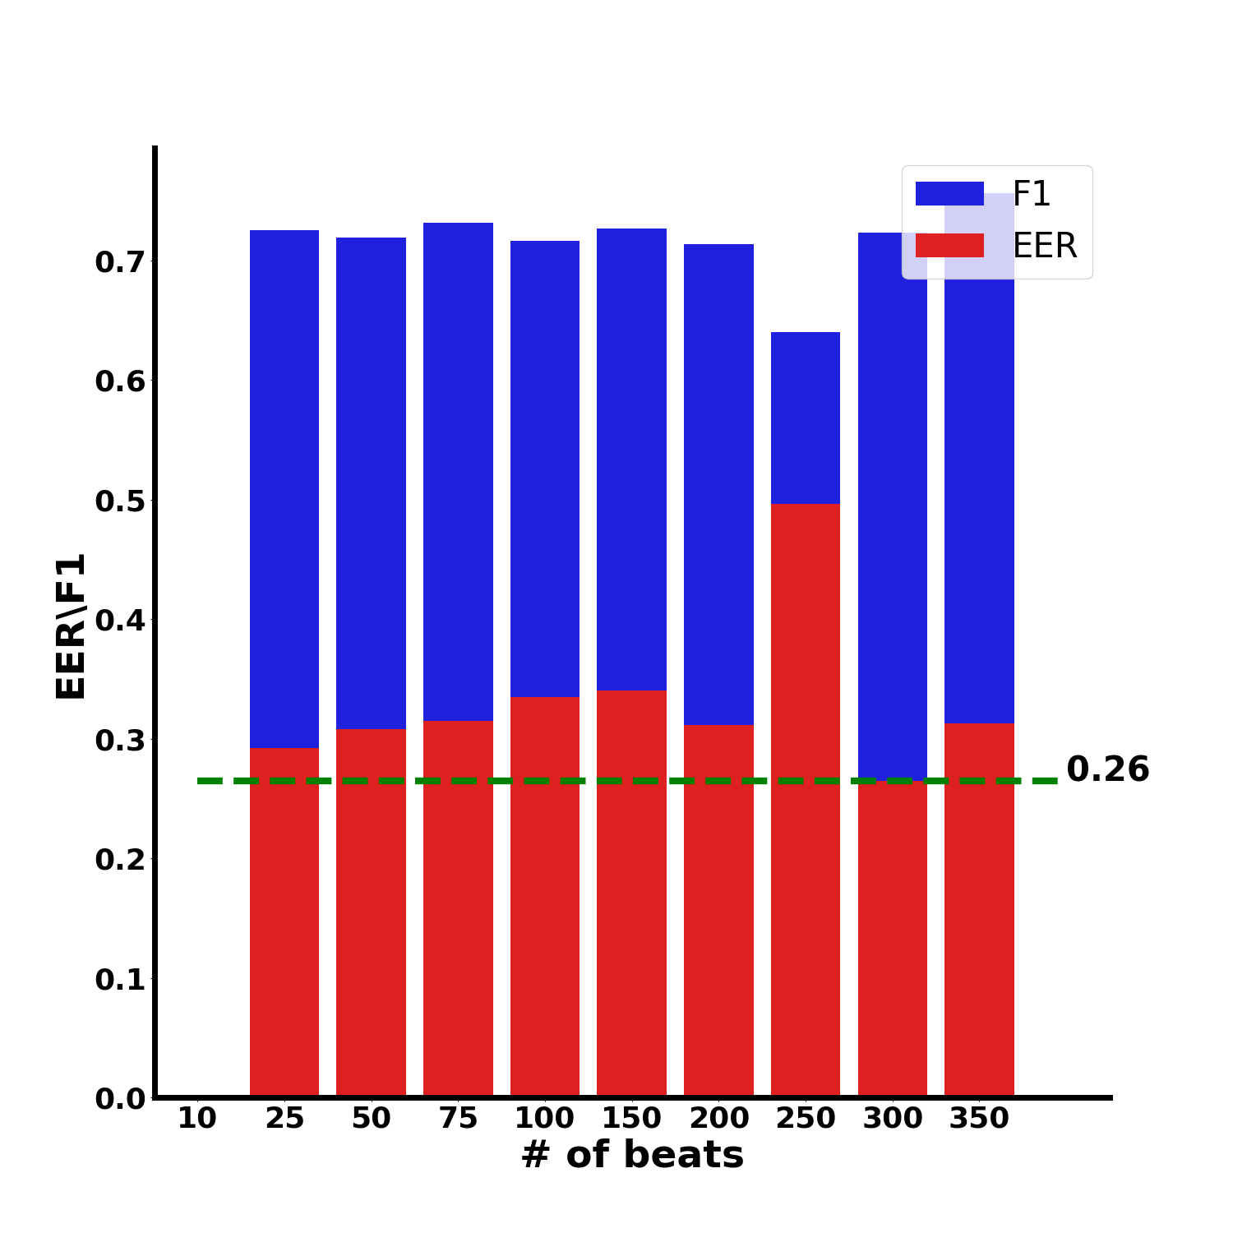
PD: basal,int,comb as function of nbeats
Basal
Intrinsic
Combined

Slide 4
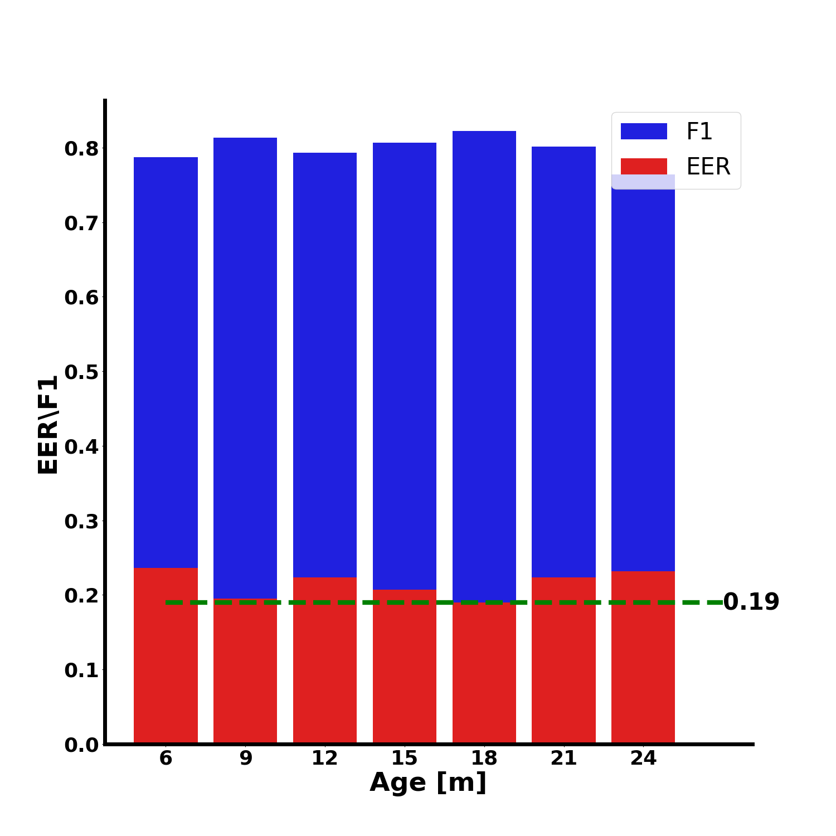
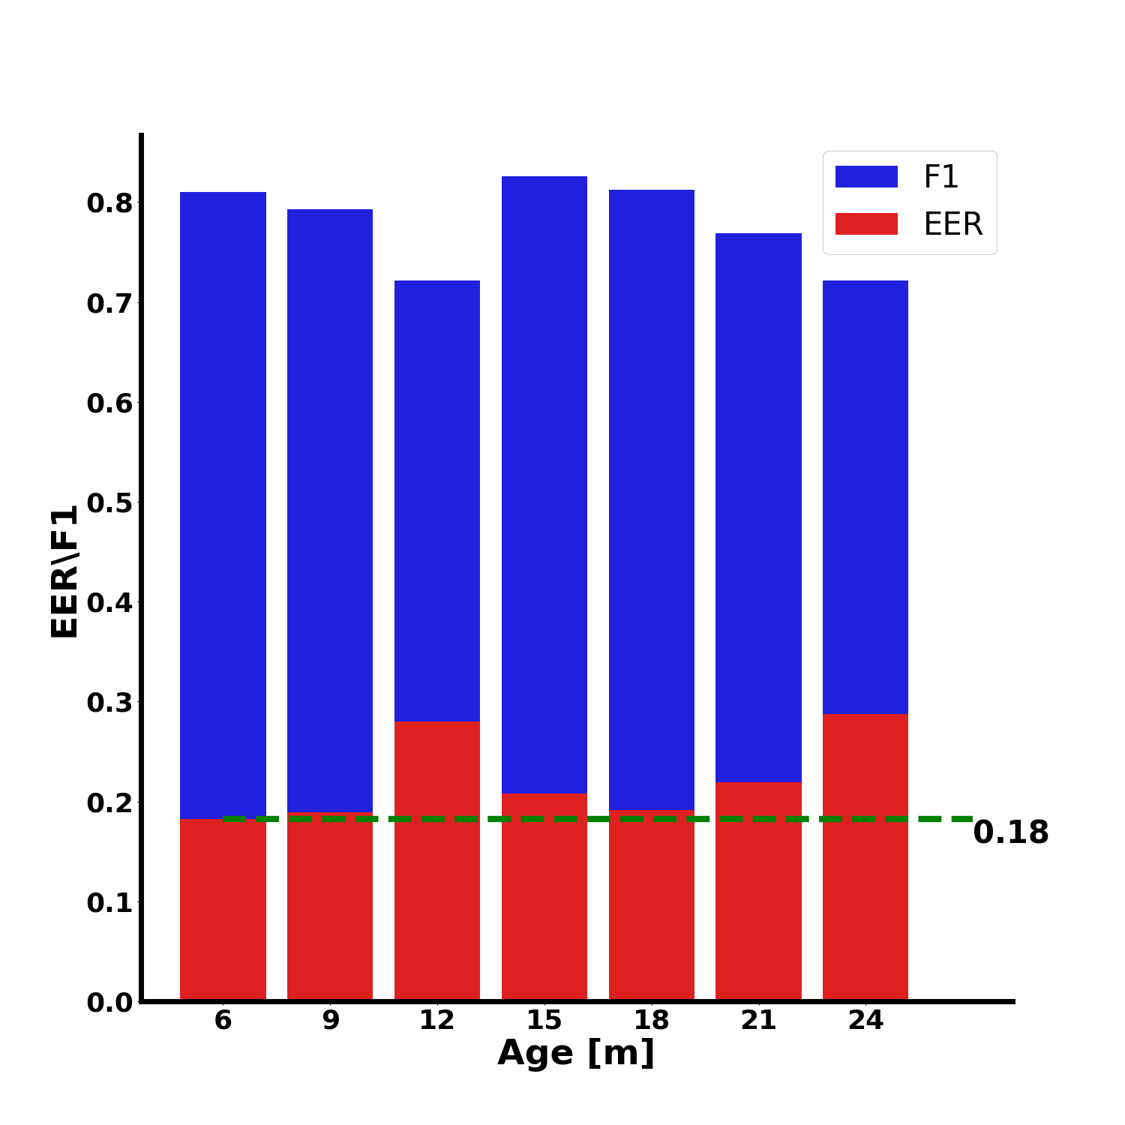
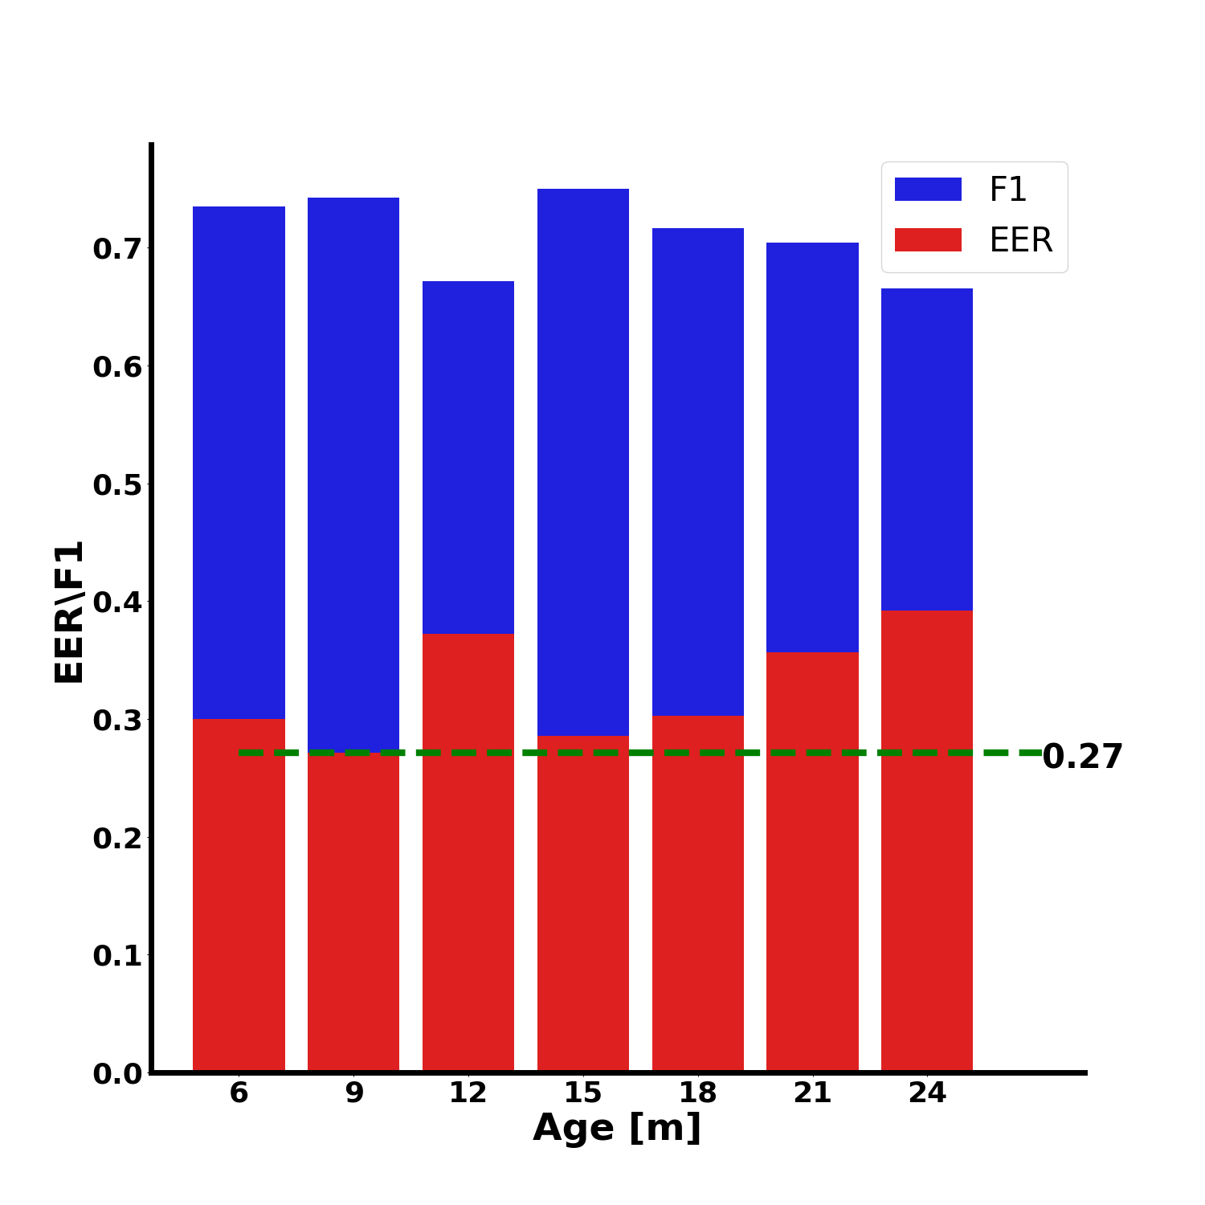
CD: basal,int,comb as function of age (50 beats)
Basal
Intrinsic
Combined

Slide 5
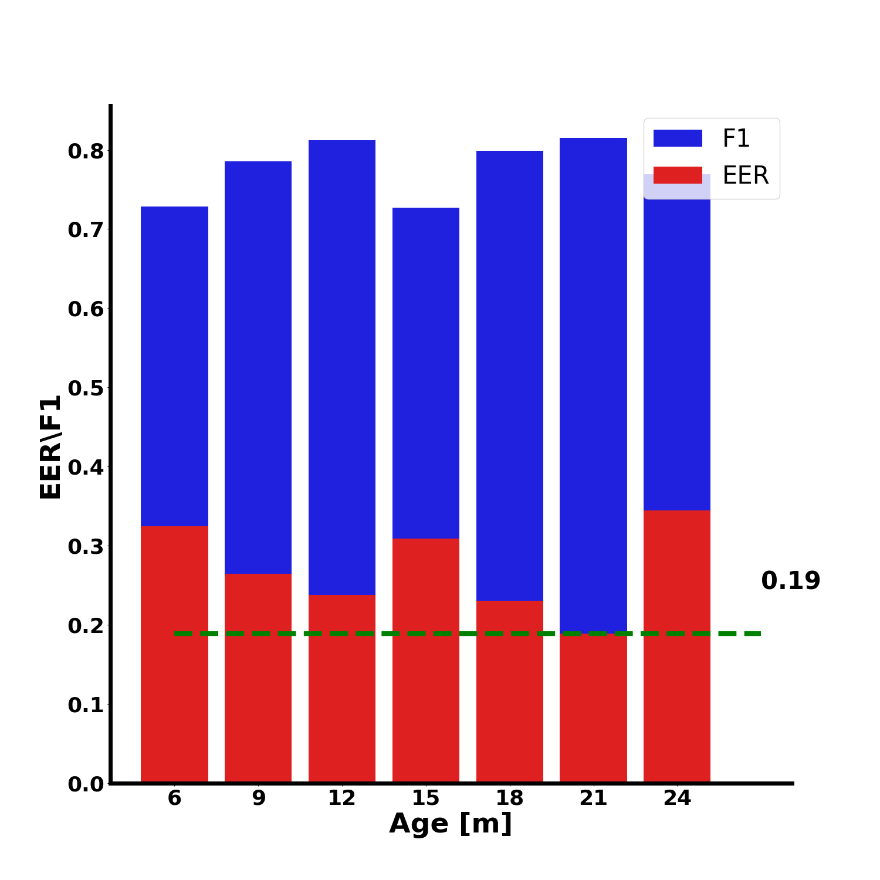
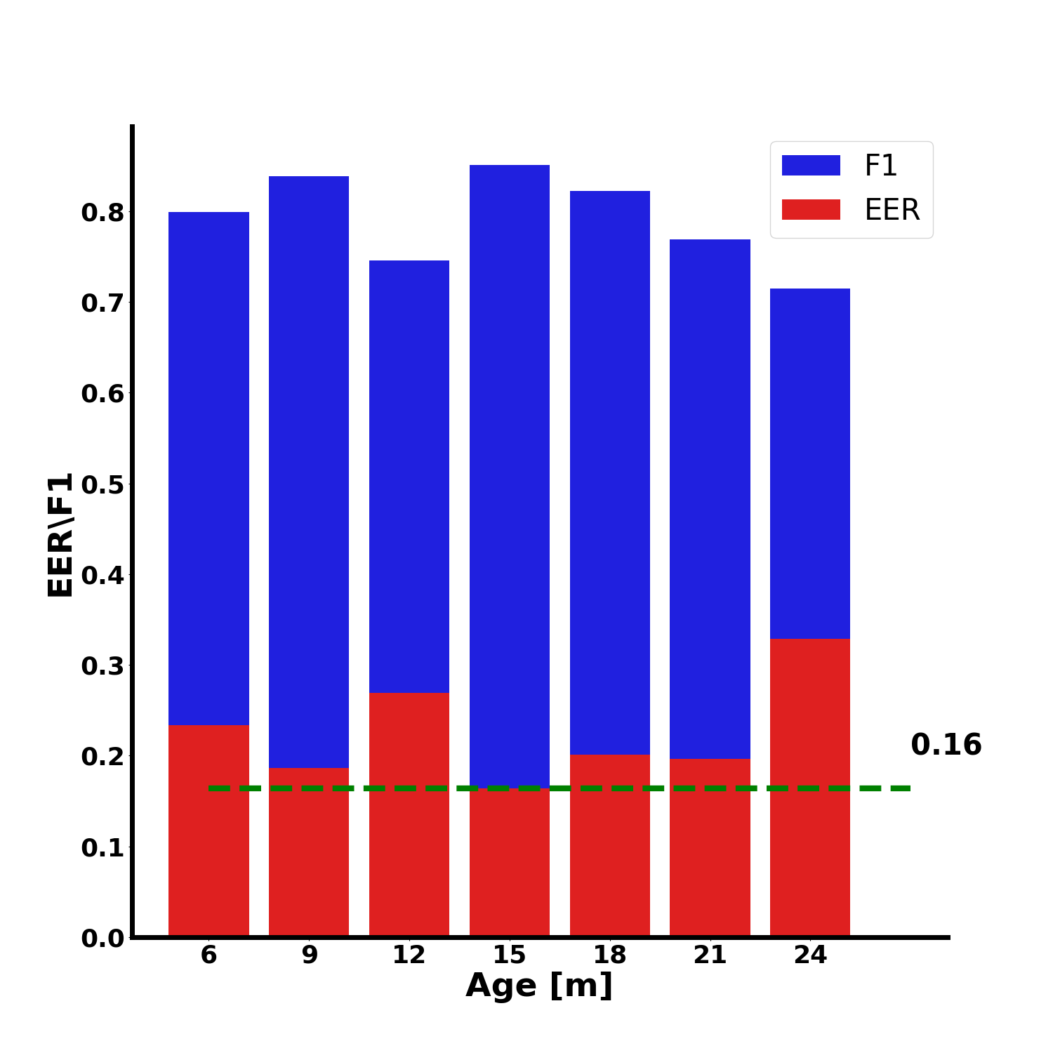
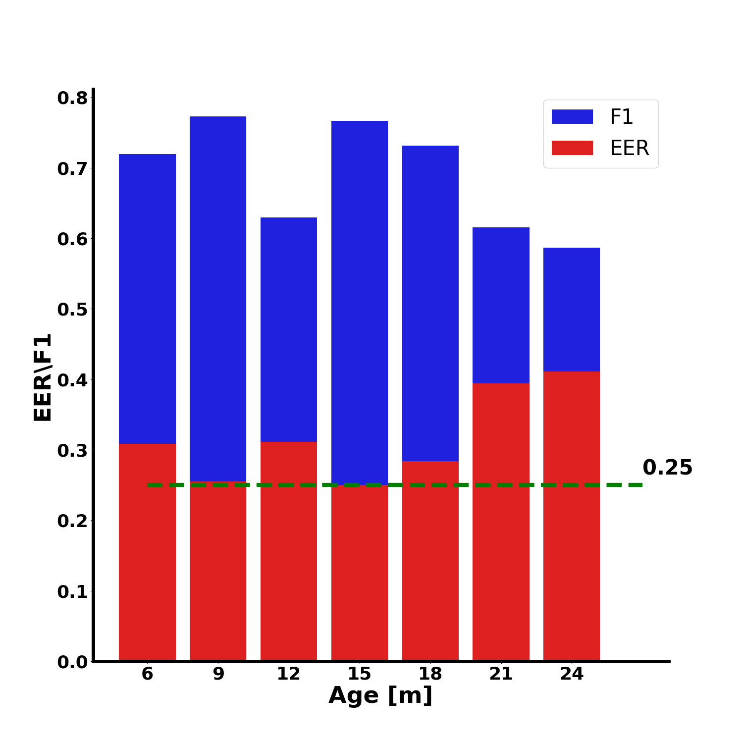
PD: basal,int,comb as function of age (50 beats)
Basal
Intrinsic
Combined

Slide 6
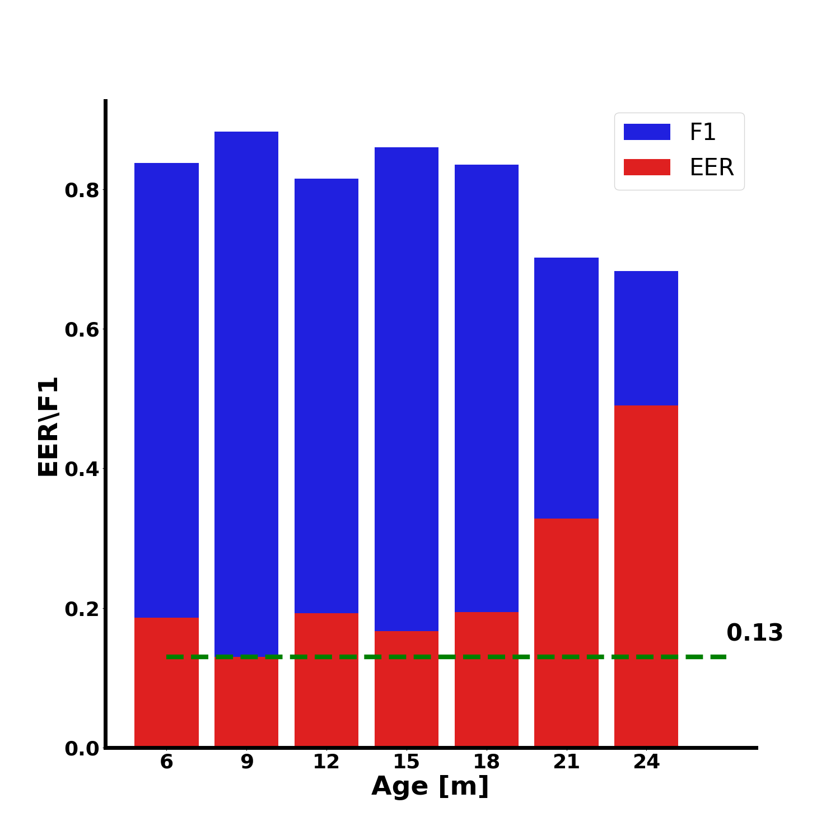
CD: basal and comb tested on int (50 beats)
Basal tested on basal
Basal tested on intrinsic

Slide 7
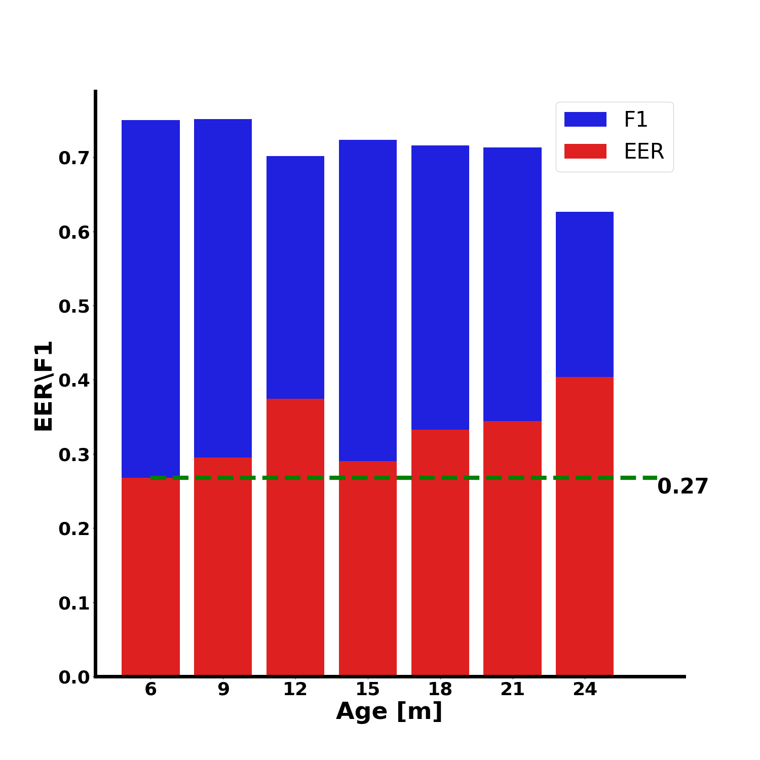
CD: basal and comb tested on int (50 beats)
Combined tested on combined
Combined tested on intrinsic

Slide 8
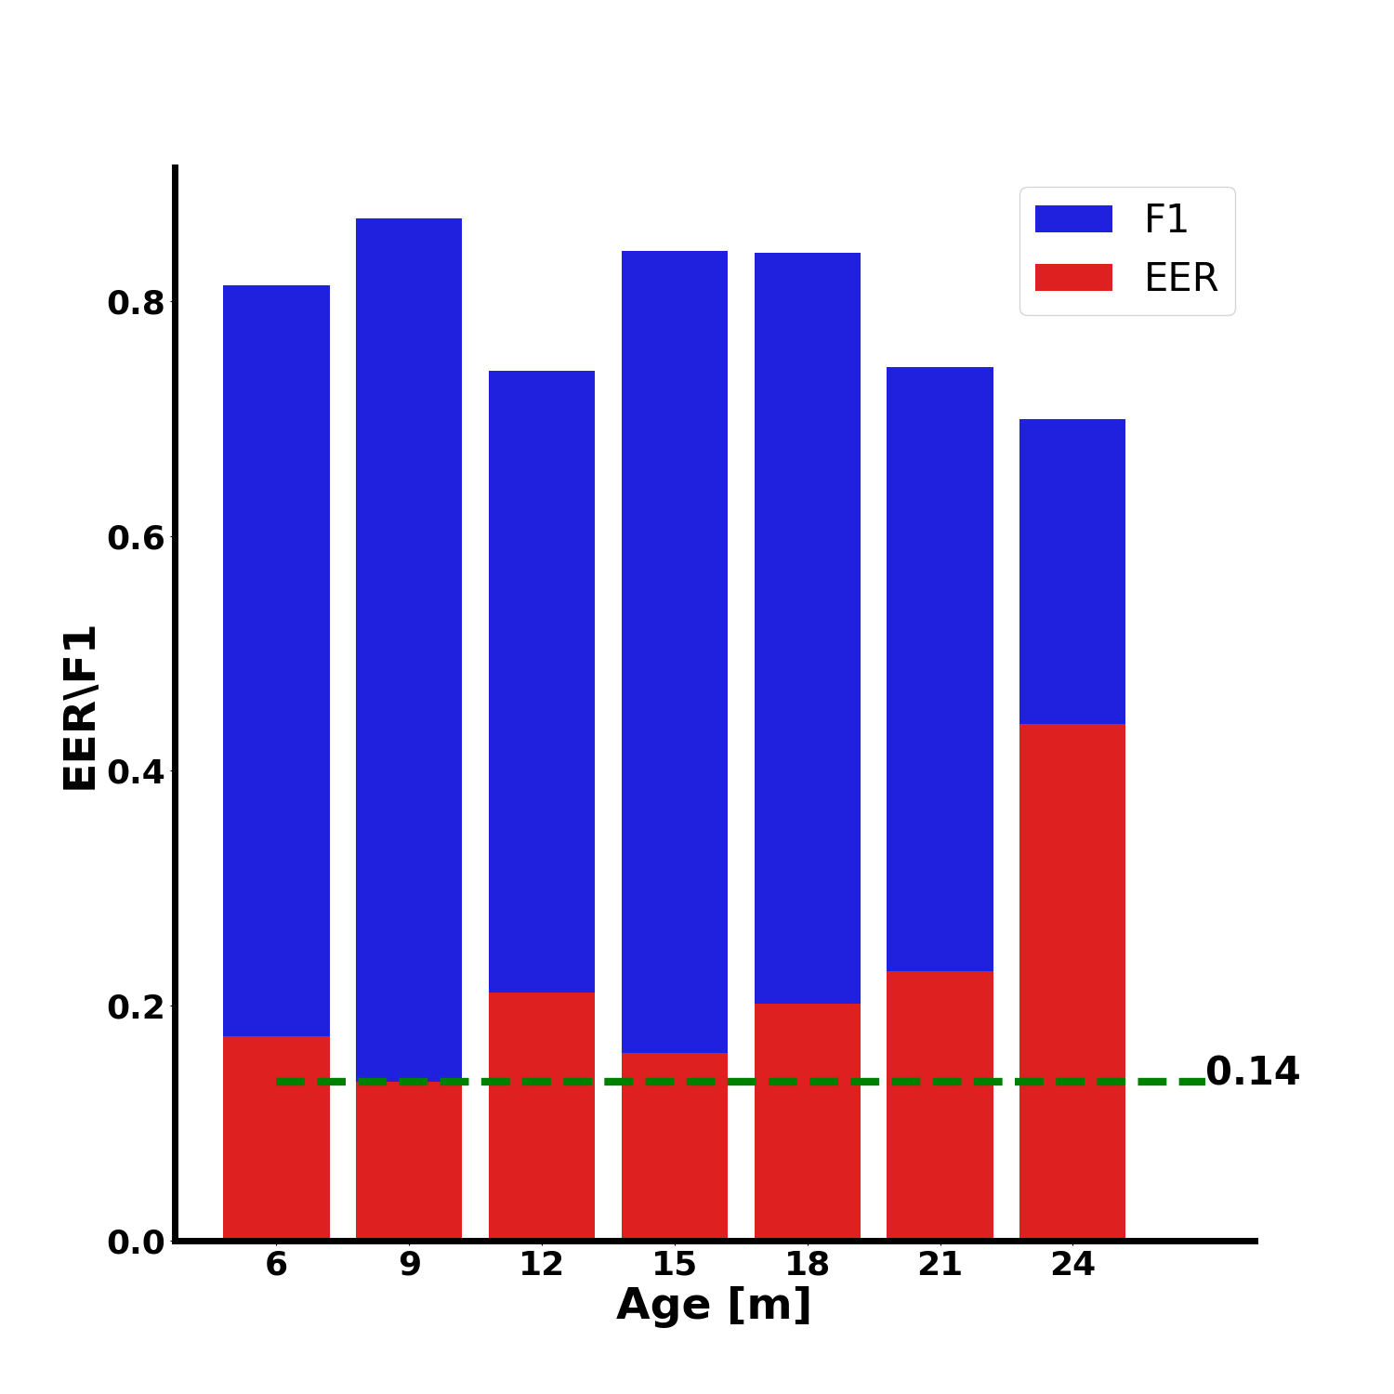
PD: basal and comb tested on int (50 beats)
Basal tested on basal
Basal tested on intrinsic

Slide 9
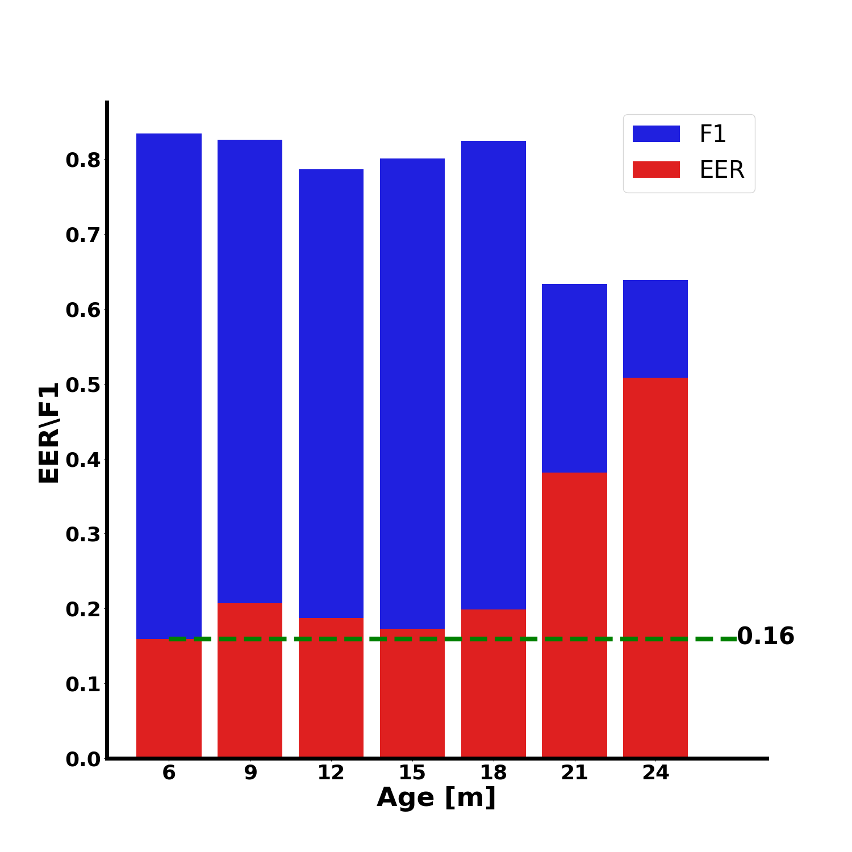
PD: basal and comb tested on int (50 beats)
Combined tested on combined
Combined tested on intrinsic

