Slide 1
Bodybuilding Exercise Recommendation Chatbot
ID:2020984
Name: Ta-Yu Mar

Slide 2
Content
Project Introduction
Rasa Architecture
Project Design Flow
Demo
Summary

Slide 3
Project Introduction
Introduction:
This project is building a Task-Oriented chatbot.
Through the conversation, answer the exercise which users want to know.
Using Telegram be user interface
Motivation:
AI, Big Data and Chatbot
Workout exercise
Aim:
Let any kind of level user can easily find what they need.
Difficulty:
Find the exercise dataset.
What I learn:
Python, web crawler

Slide 4
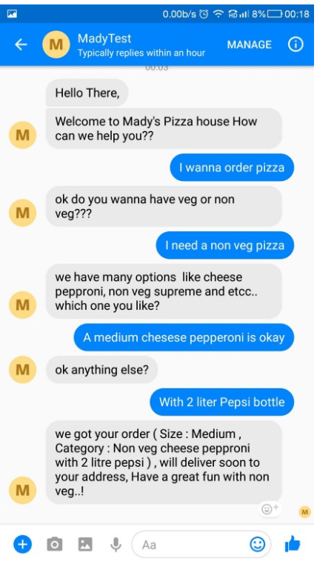
Project Introduction
Chatbot:
A chatbot is a program designed to counterfeit a smart communication on a text or spoken ground.

Slide 5

Project Introduction
NLU:
Natural-language understanding (NLU) is a subtopic of natural-language processing in artificial intelligence that deals with machine reading comprehension.
Rasa:
Rasa is an open-source Machine Learning framework for making chatbots.
Customization
API integration
Connection

Slide 6
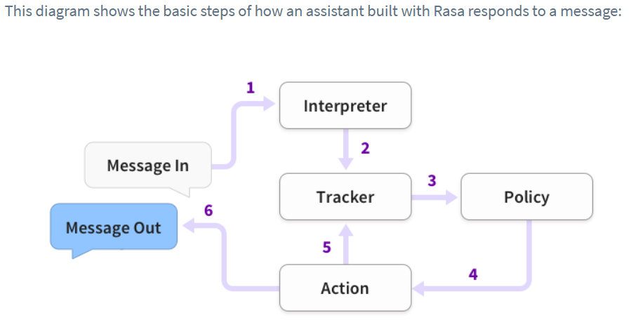
Rasa Architecture
Reference from https://rasa.com/docs/rasa/user-guide/architecture/

Slide 7
Project Design Flow (Part 1)
What part of body would you want to train?
User message
User needs Recommendation
User has question:
Show the detail
Part of body
Result
Which muscle ?

Slide 8
Project Design Flow (Part 2)
Which muscle ?
User message
User needs Suggestion
Muscle
User has question:
Show the detail
Need Equipment?

Slide 9
Project Design Flow (Part 3)
Need Equipment?
User message
User needs Suggestion
Facility
User has question:
Show the detail
Result

Slide 10
Demo

Slide 11
Summary & Reference
Summary:
This project is task-oriented chatbot with NLU and Rasa architecture.
Rasa architecture contains Interpreter, Tracker, Policy and Action.
According to user’s reply to do the corresponding action.
Using python, web crawler to get the dataset.
Reference:
Wikipedia, https://en.wikipedia.org/wiki/Natural-language_understanding
Dahiya, M. & Dahiya, M., 2017. Network Security View project A Tool of Conversation: Chatbot. Article in INTERNATIONAL JOURNAL OF COMPUTER SCIENCES AND ENGINEERING
Madhu Sanjeevi ( Mady ), 2018, Chapter 11: ChatBots to Question & Answer systems, https://medium.com/deep-math-machine-learning-ai/chapter-11-chatbots-to-question-answer-systems-e06c648ac22a
Rasa, https://rasa.com/docs/rasa/user-guide/architecture/

