Slide 1
W02 Assignment MDSC 689.03
Matt Daalder
2020

Slide 2
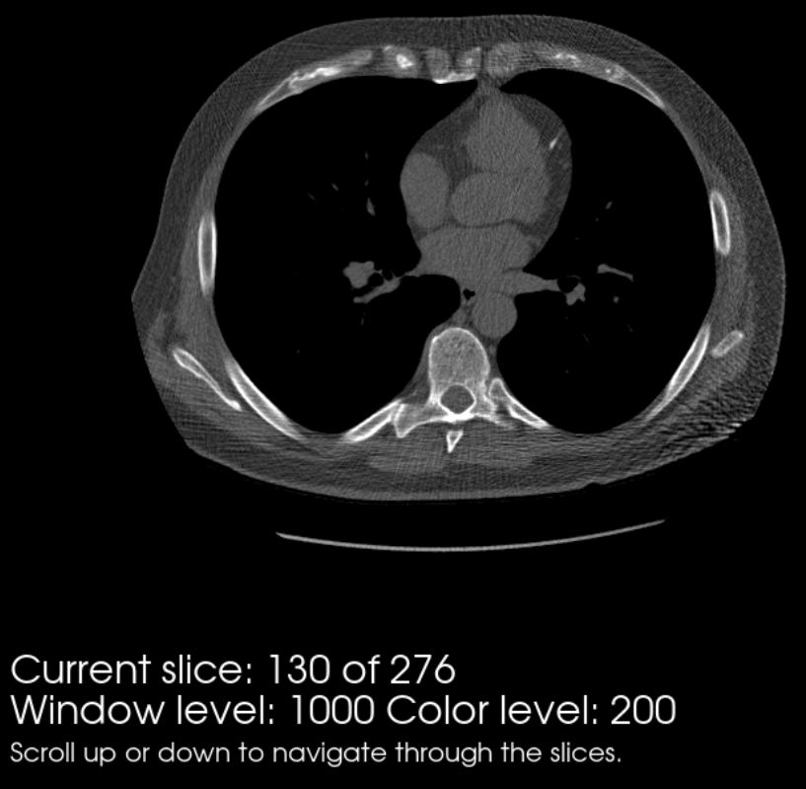
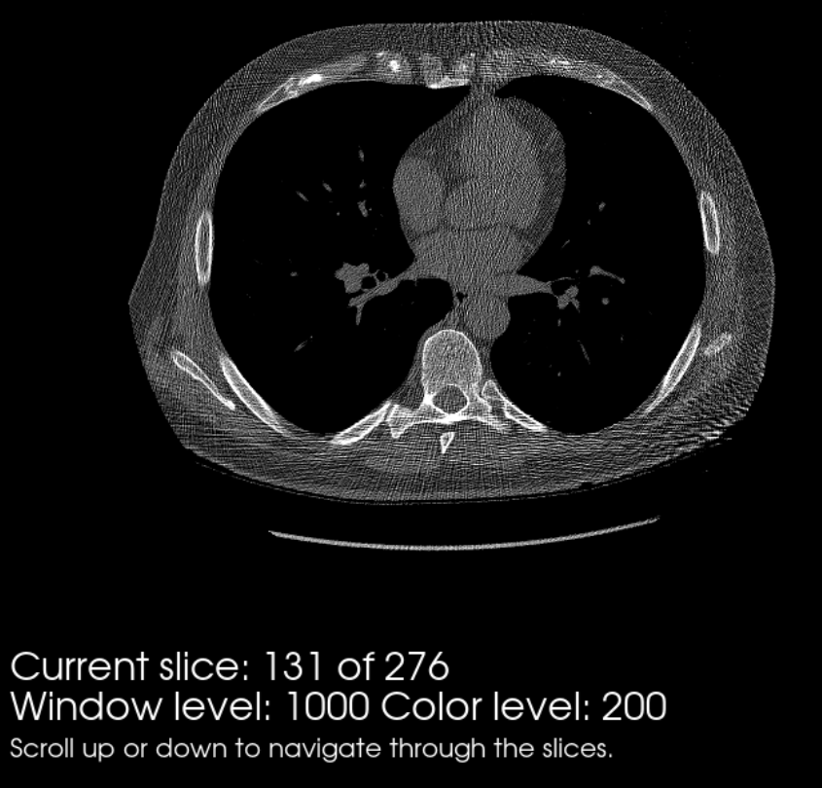
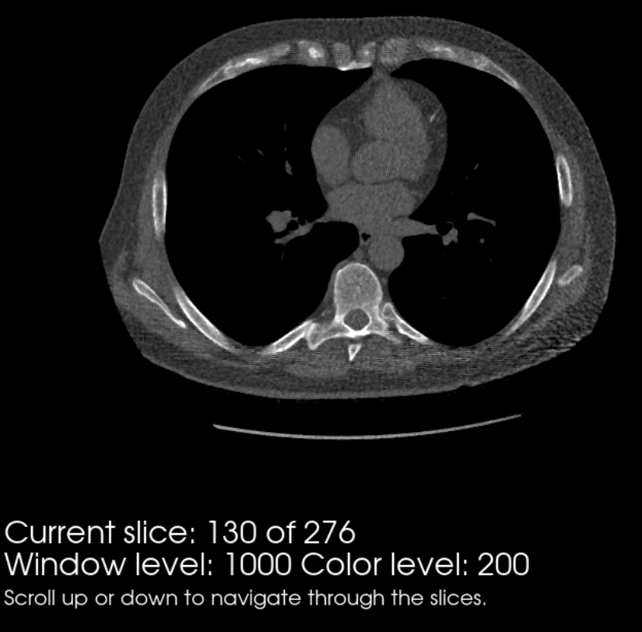
Thorax DICOM
Thorax Gaussian Filtered
Thorax Unfiltered
Thorax Median Filtered
The Gaussian filter seems to be slightly better than the median filter. It does a better job at preserving soft tissue structures,
Edges, and detail. However, the gaussian filter does keep a bit more of the “streaking” artefact than the median filter. Using a
larger Gaussian kernel, or iterating over the image several times might help with the artefact.

Slide 3
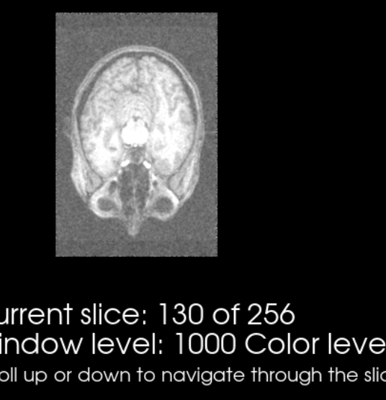
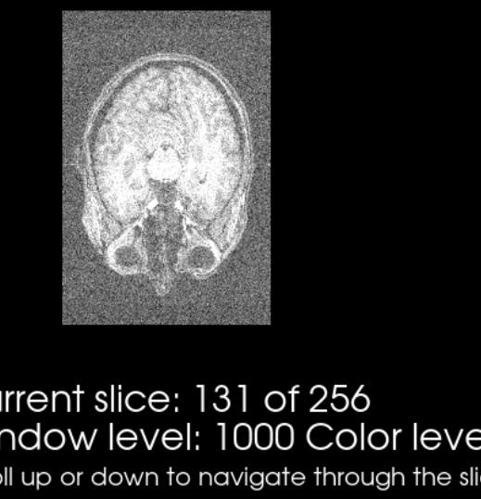
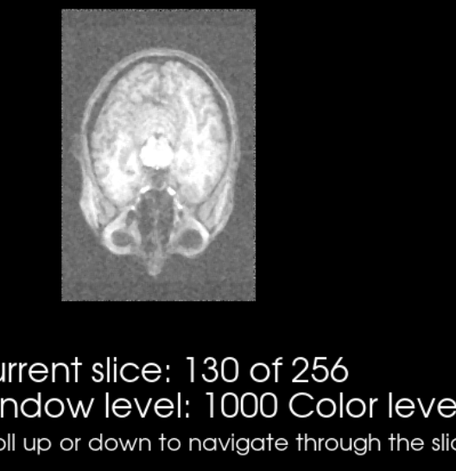
headGaussian Gaussian Filtered
headGaussian Unfiltered
headGaussian Median Filtered
headGaussian.nii
The Gaussian filter looks better than the median filter. It does a better job at preserving structures while the median
filter is more blurry. This makes sense as the median filter would eliminate a lot of the small detail found in the brain tissue.
Notes:
Color level = 600

Slide 4
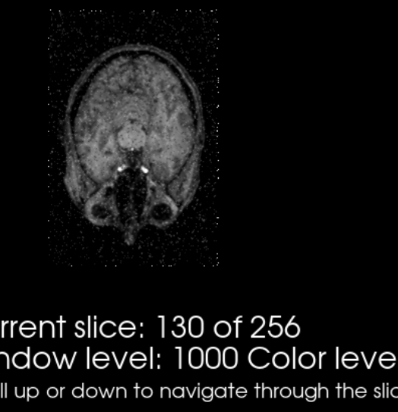
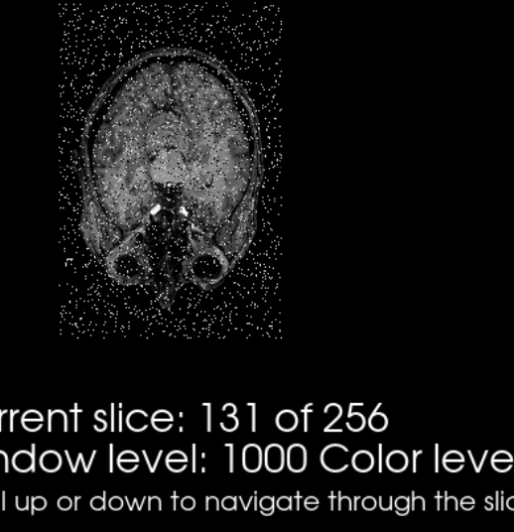
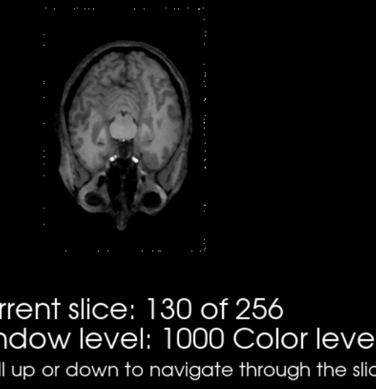
headSaltPepper.nii
headSaltPepper Gaussian Filtered
headSaltPepper Unfiltered
headSaltPepper Median Filtered
The median filter does a much better job at eliminating the salt and pepper noise than the gaussian filter while maintaining
the original structure of the head.
Notes:
Color level = 600

