Slide 1
Social media Influencer anaLYzer - InfluInsights
Dadopoulos Michail

Slide 2
WHAT IS THE PROJECT ABOUT
InfluInsights is a social media influencer analyzer tool that uses the YouTube API to fetch data about influencers performance, including audience demographics and engagement metrics. The tool will offer insights and trends through visualizations and data analysis, and will allow users to sort and display the most popular influencers in a niche. Its goal is to help users make data-driven decisions in their influencer marketing campaigns.

Slide 3
Selected technologIes
Social Media API: Youtube API (
Database: MongoDB Atlas Cloud database
Software language: Python at Google Colab
UI Design: Google Colab Forms and Jupyter Widgets

Slide 4
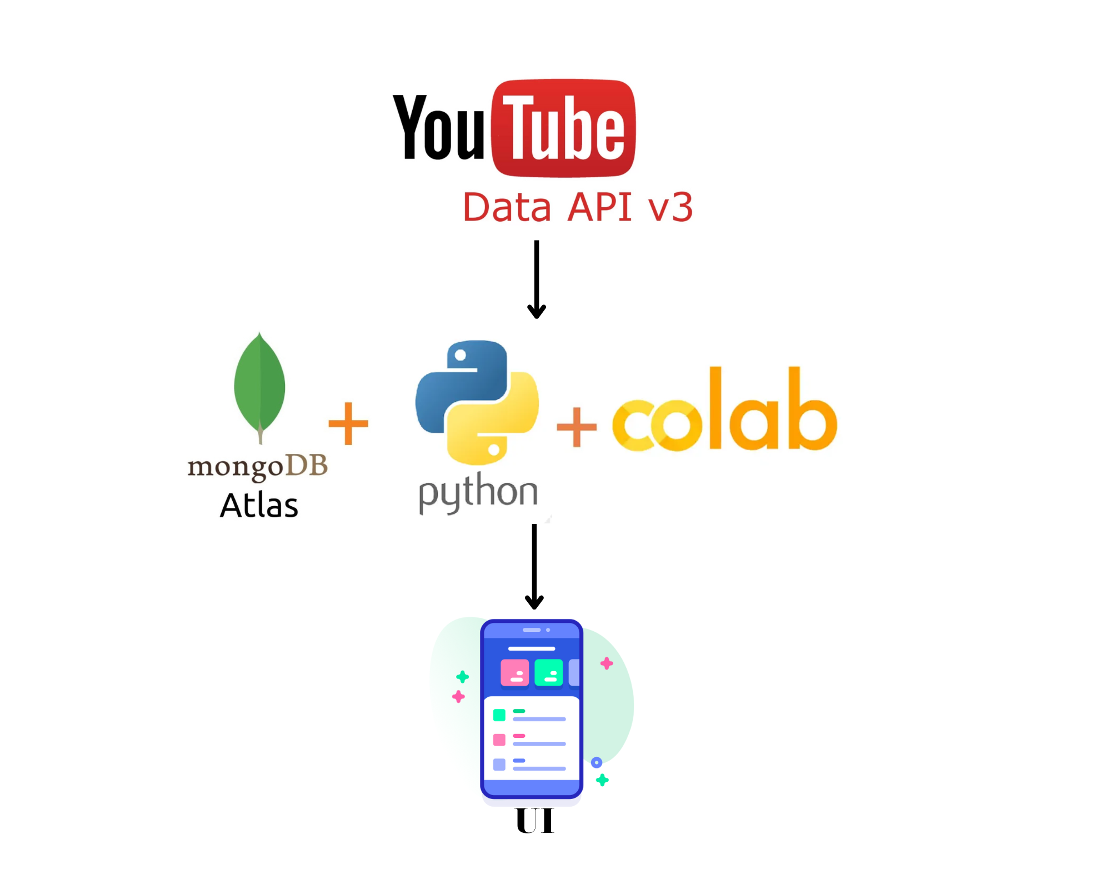

Slide 5


youtube apı
The YouTube API provides developers with programmatic access to YouTube features and data, allowing them to create applications that can interact with the YouTube platform. Some of the features and data that the YouTube API provides access to include:
Videos, channels, playlists, comments, ratings, subscriptions, search.

Slide 6
Steps to USE YOUTUBE API
Create
Create a Google account and a project in the Google Cloud Console.
Enable
Enable the YouTube Data API v3 for your project.
Create
Create credentials (an API key or OAuth 2.0 client ID) for your project.
Use
Use the API key to make requests to the YouTube Data API.
Read
Read documentation about YouTube API .The documentation that exists is really helpful and provides detailed examples of requests and responses to many programming languages.
Parse
Parse the API response to extract the relevant data.

Slide 7
MongoDB Atlas & mongodb compass
MongoDB Atlas is a fully-managed multi-cloud database service by the same people that build MongoDB. Atlas simplifies deploying and managing your databases while offering the versatility you need to build resilient and performant global applications on the cloud providers of your choice(AWS, Azure, and GCP ).
MongoDB Compass is a graphical user interface tool for MongoDB, which allows users to visually explore and interact with their MongoDB data. It provides an intuitive and user-friendly interface for working with MongoDB databases and collections, and includes features such as schema analysis, document validation, and real-time performance metrics.

Slide 8
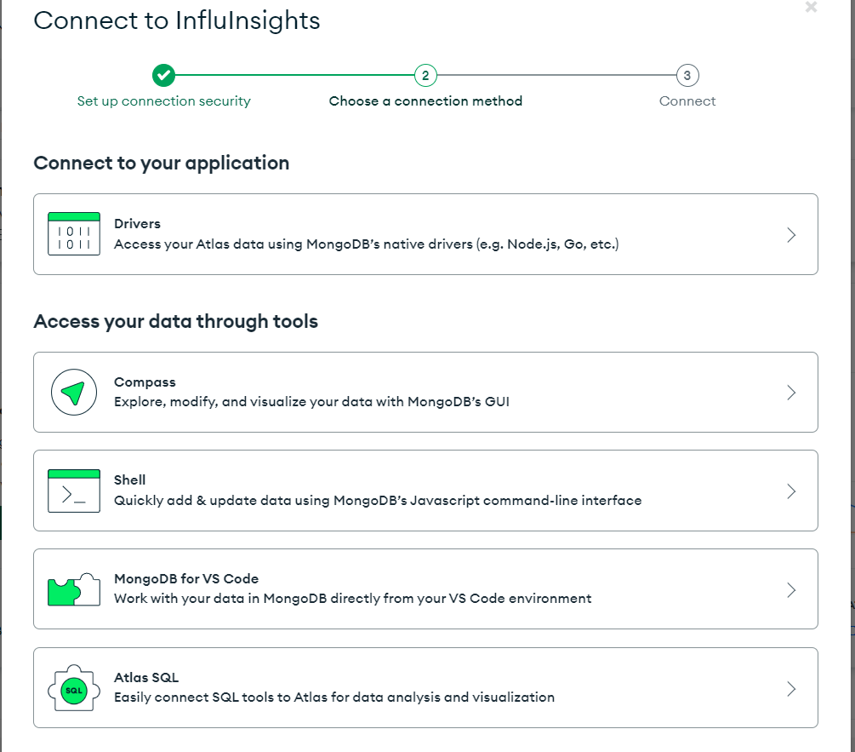
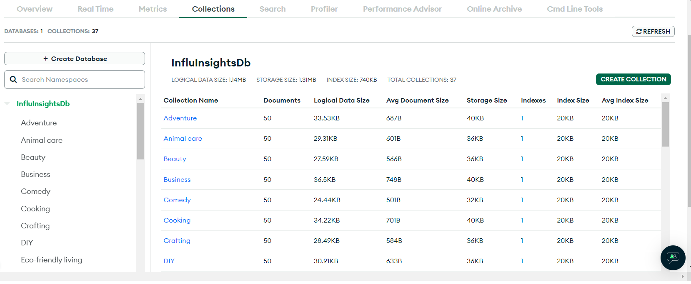
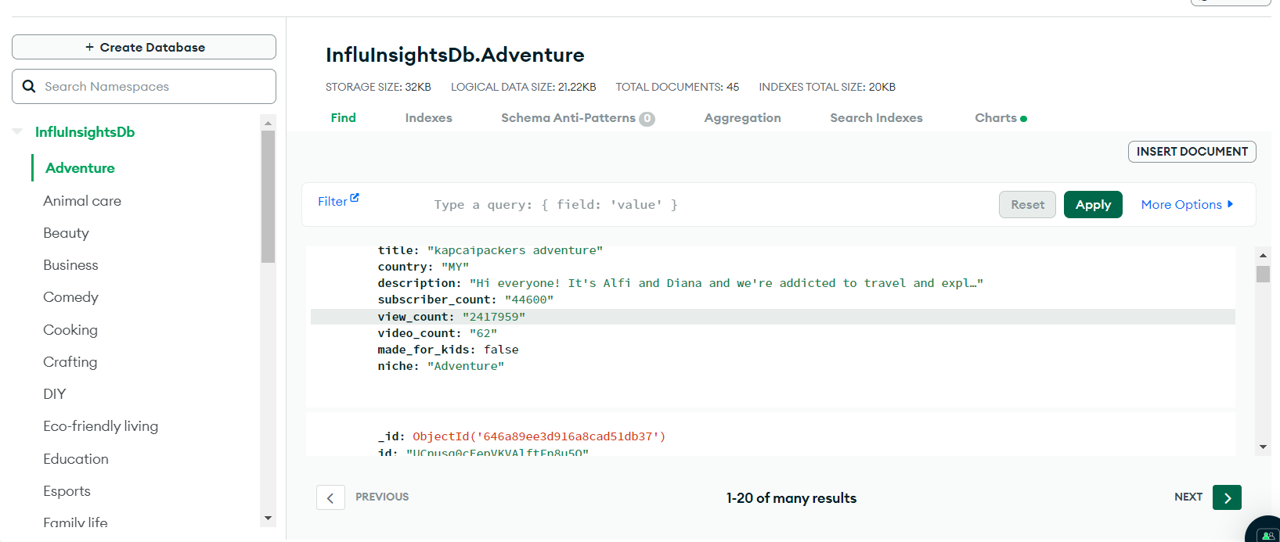
You can connect to your cloud Database and gain access data your data with many different tools such as MongoDB,command shell,etc.
MongoDB Atlas also provides many tools such as visualization of your data,metrics, implementation of trigger events for your database,etc.

Slide 9
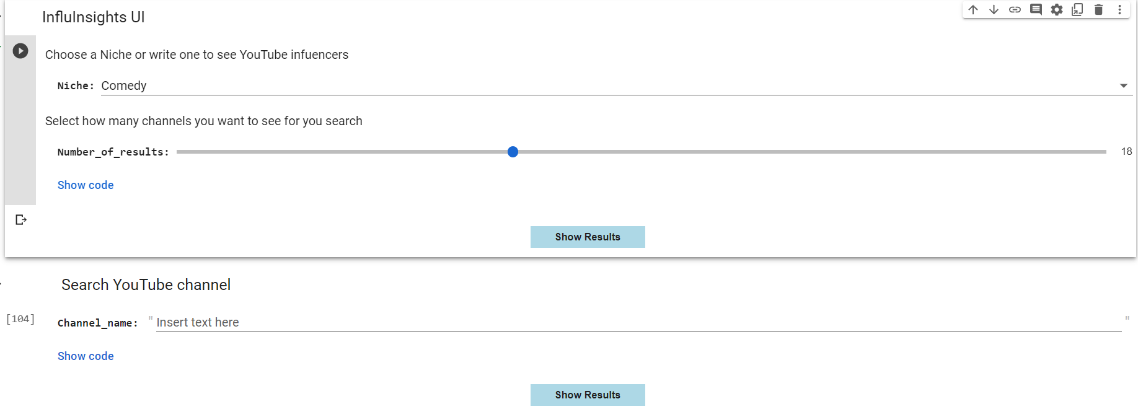
DESIGNING UI WITH GOOGLE COLAB
It is possible to create simple UI designs (for example basic forms) with Google colab.

Slide 10
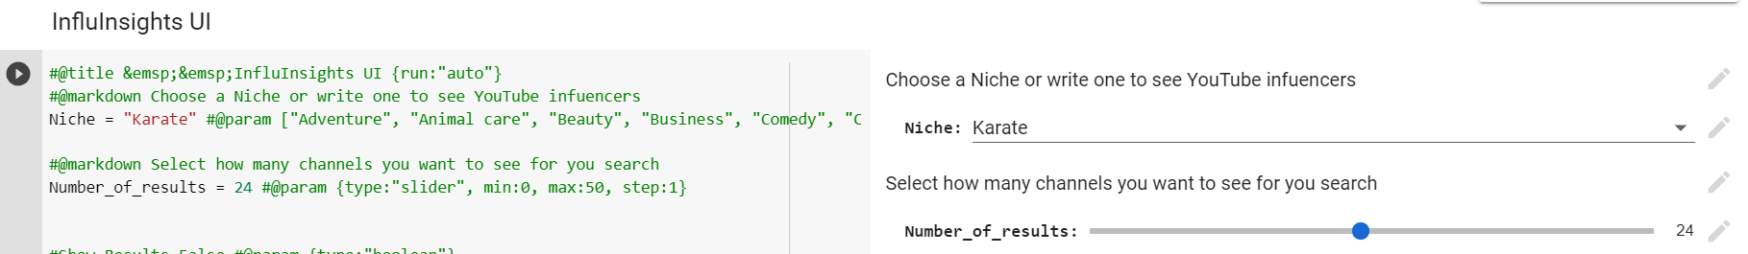
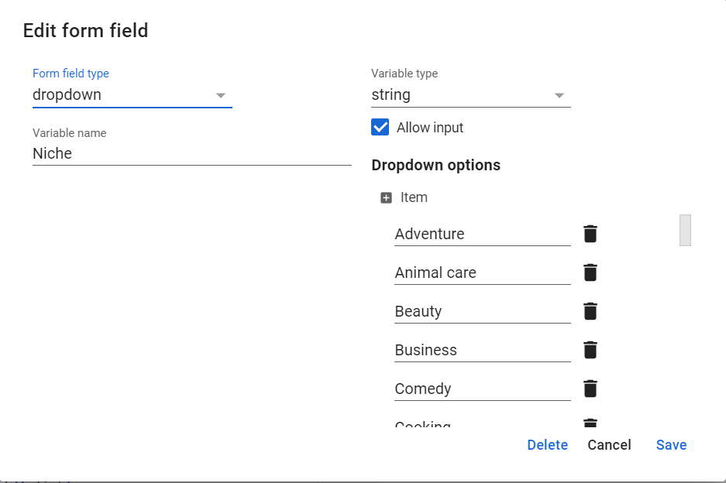
The #@title sets the title of the form and with the option {run:’auto’} our code is executed every time we change the parameters of the form.
We can have simple text with #@markdown
To create a variable for our python code we write its name and an initial value and we comment #@param and we then define the type of it in the UI
To create a dropdown menu we just define a list of items we want to have as options.If we have add in the end of the comment {allow-input: true},this allows us to write new inputs that are not in the dropdown menu.
To create a slider we choose {type:”slider”,min:startValue,max:endValue,step:stepValue}
We can also create a simple input form with {type:”string”} in order for the user to add a string iput.It can also be of type date,Boolean,integer,number and raw ,which is in the form of code inside the variable.
It is possible also to edit the forms manually and without writing code by clicking to the pencil icon next to each form field

Slide 11
Influınsıgths step by step
Fetches Channels data with Youtube API about several niches. (around 37)
Selects the data with the required information from the data returned.
Connects to and stores this data in MondoDB Atlas.
Creates simple UI at Google Colab and use a Jupyter widget button to show the results when is pressed.
Searches Channels Information about several Niches in a dropdown menu or providing the option to search for a new one. Provides the option to select the number of results shown (0-50)
Depending on the inputs in the UI forms, when the button is pressed the app restores data from the database or fetch data from YouTube about the new input niche at real time and shows the results.
The app provides the option to search a YouTube channel by its name and see its information about it. It request and fetch the data from YouTube at the same time and shows it.

Slide 12
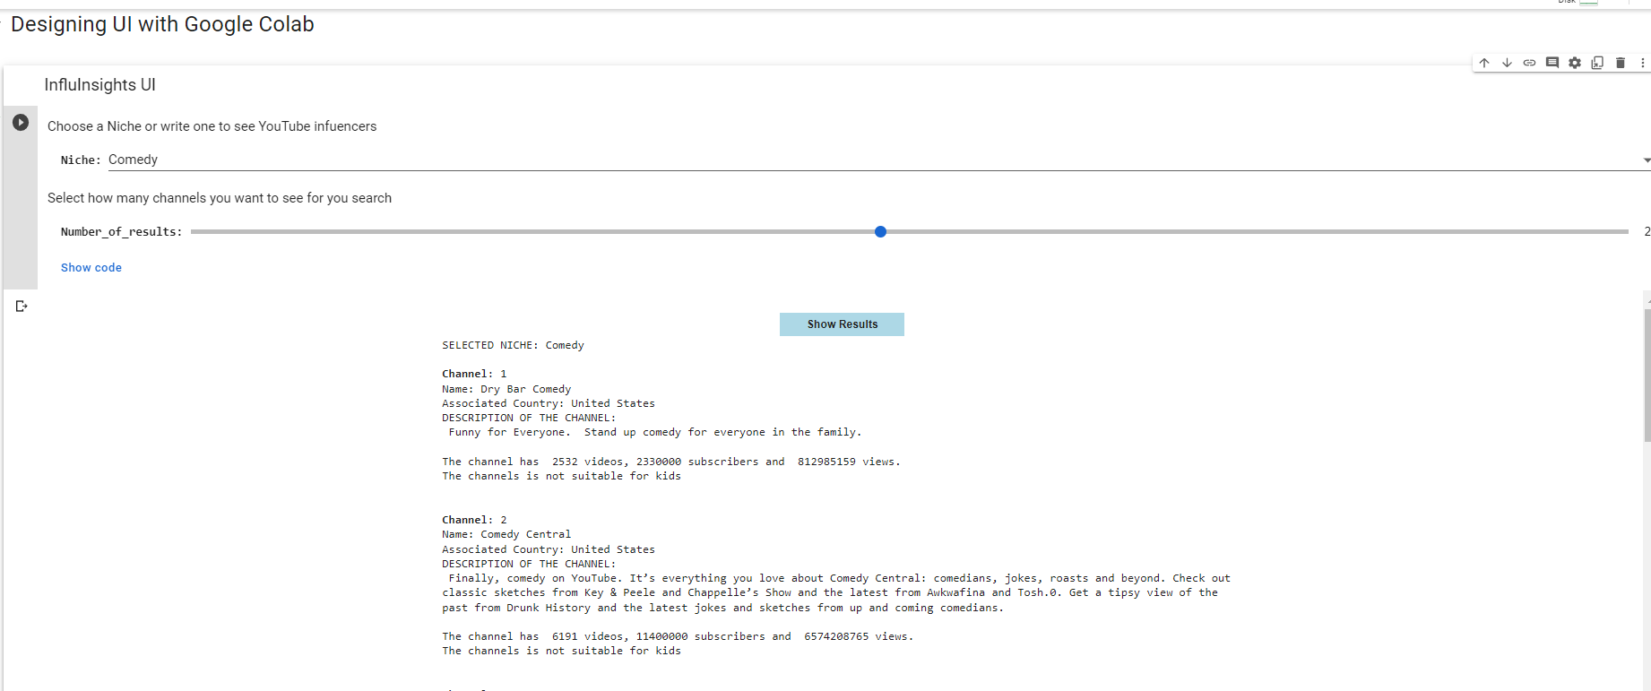
SELECTING ONE EXISTING NICHE

Slide 13
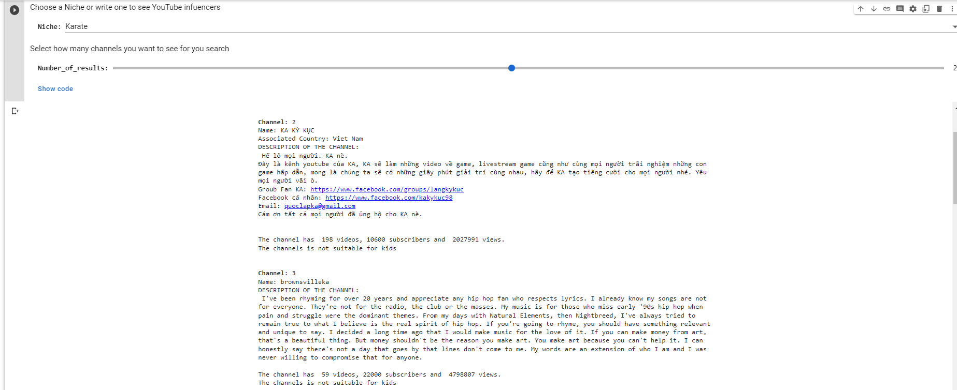
Searching For a new niche

Slide 14
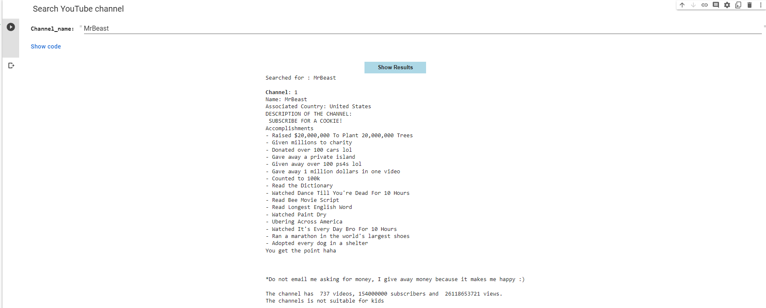
Searching one channel BY ITS NAME

Slide 15

Problems Faced
YouTube API has a request limit of 1000/day.
Solution:
We just created more Projects in the Google Cloud Console and created new credentials (keys) to use in our requests.

Slide 16
References:
Data | Cloud: MongoDB Cloud
Channels: list | YouTube Data API | Google Developers
Sample API Requests | YouTube Data API | Google Developers
Credentials – APIs and services – InfluencerAnalyzer – Google Cloud console
https://www.w3schools.com/python/python_mongodb_limit.asp
https://ipywidgets.readthedocs.io/en/latest/examples/Widget%20Basics.html

Slide 17

THANK YOU!

