Slide 1
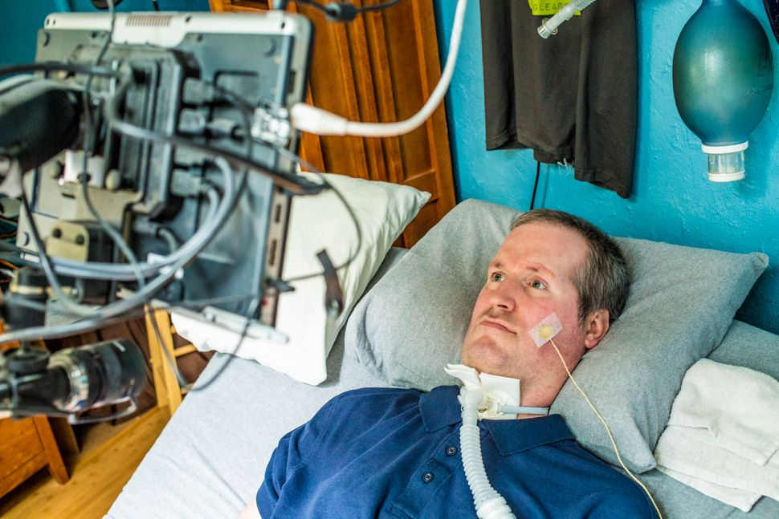
IDEA AND MOTIVATION
The idea came after observing the paralysed patients and realizing their need
We believe to make them independent to perform necessary tasks

Slide 2
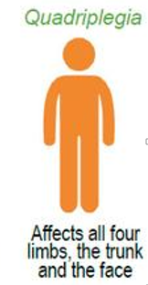
OUR TARGET AUDIENCE
Who can not use their all four limbs
They can think and feel physically and emotionally but can not tell the muscle to move
But they can blink their eyes or can move eye ball
So we have made this blinking ability useful

Slide 3
WHAT PATIENT WOULD BE ABLE TO DO
Communicate by sending messages through GSM
Can describe their feelings and also what he wants
They will be able to control the room appliances such as controlling fans and lights
Their words would be converted into voice through text-to-speech and can be heard through a speaker

Slide 4
Let’s talk about the approach

Slide 5
Process Flow
Camera
Face recognition
Desktop application
GUI for navigation
Arduino
Bridge between hardware and software
SMS sending and appliance control

Slide 6
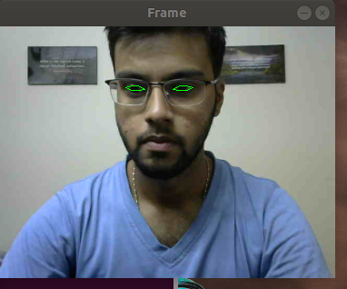
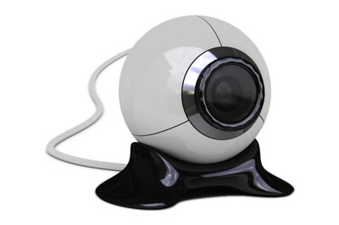

camera
Face and Eye recognition using a webcam and OpenCV

Slide 7
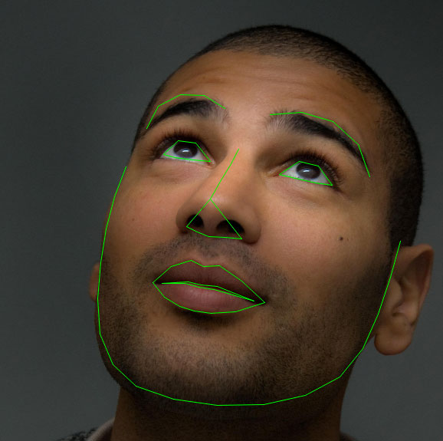
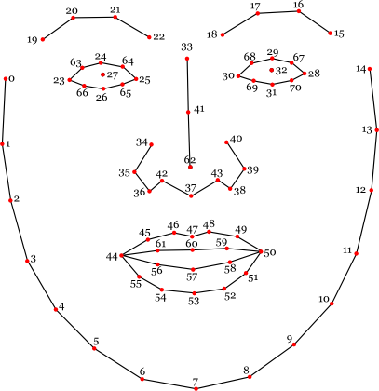
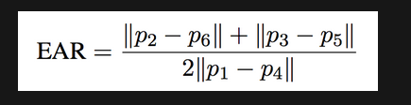
algorithm
Dlib’s facial landmark detector
It is open source and can be used for commercial applications
EAR ( eyes aspect ratio from which we can calculate whether the eye is close or open)
There are in total 68 points on the face
We will extract the points of our interest

Slide 8
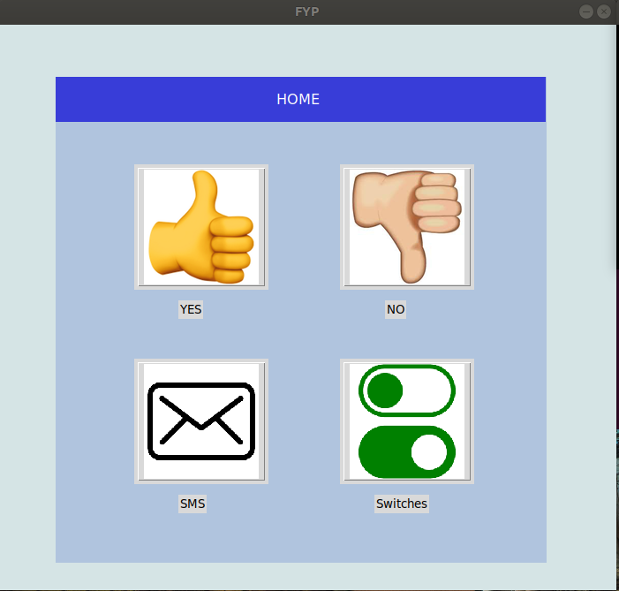
Desktop application
GUI using ‘Tkinter’ Python library
This is the area of navigation
These buttons are connected to some functions
Patient will navigate through short eye blinks
Long blinks would trigger the function

Slide 9
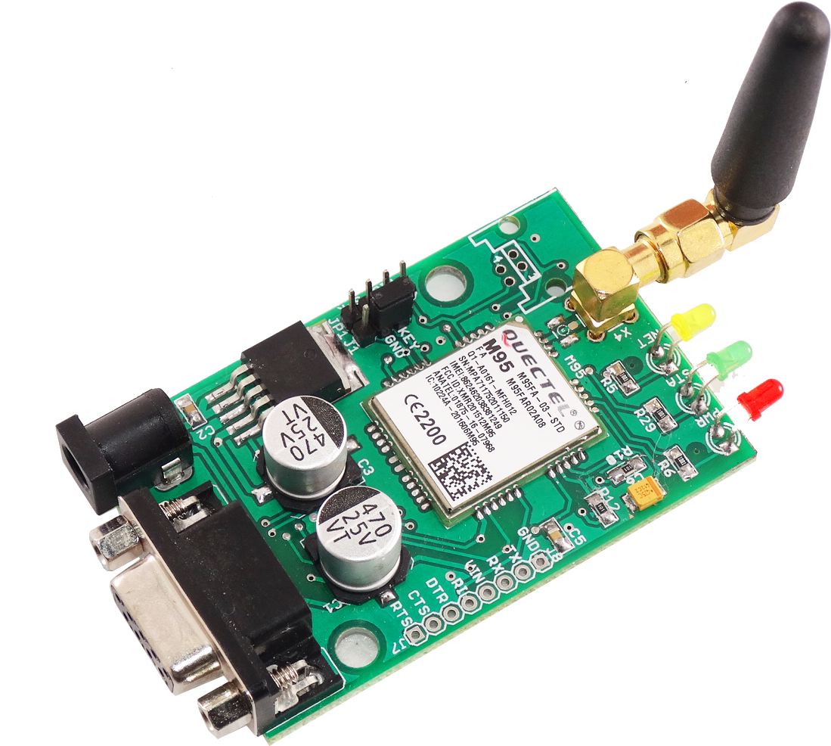
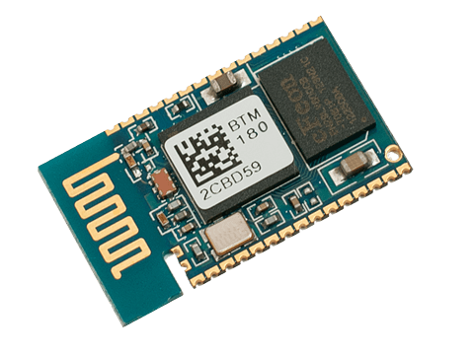
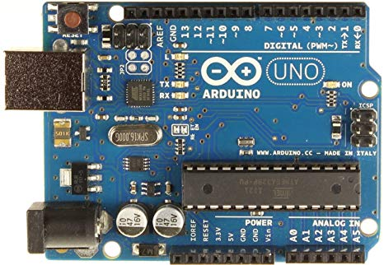
ARDUINO
Arduino is used for the serial communication with python desktop application
GSM module and Bluetooth module are also connected to the Arduino
For room automation we have designed a switch board with relay module and atmega8 IC, receiving signal from Arduino via a Bluetooth module

