Slide 1
EYES GESTURE BASED NAVIGATION FOR PARALYSED PATIENTS
GROUP MEMBERS
Group Leader : Daniyal Hussain ( EL-15044 )
Group Member : Syed Hadi Muteeb ( EL-15048 )
Group Member : Syed Shahzaib Ali ( EL-15068 )
Group Member : Hassan Ali Shah ( EL-15040 )

Slide 2
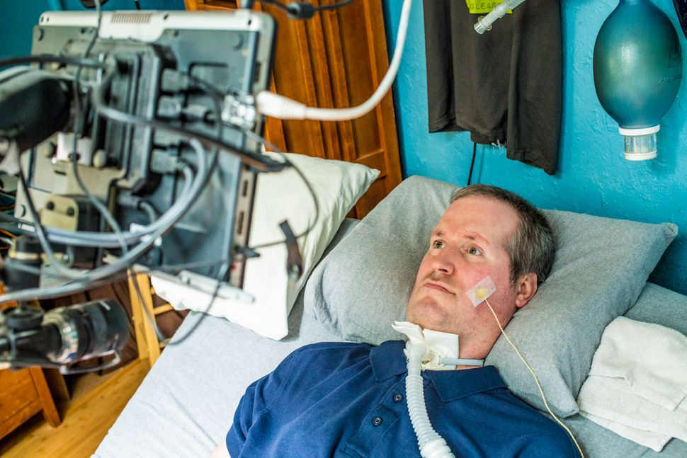
IDEA AND MOTIVATION
The idea came after observing the paralysed patients and realizing their need
We believe to make them independent to perform necessary tasks

Slide 3
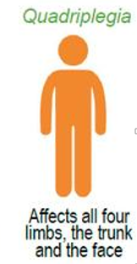
OUR TARGET AUDIENCE
Who can not use their all four limbs
They can think and feel physically and emotionally but can not tell the muscle to move
But they can blink their eyes or can move eye ball
So we have made this blinking ability useful

Slide 4
WHAT PATIENT WOULD BE ABLE TO DO
Communicate by sending messages through GSM
Can describe his feelings and also what he wants
He will be able to control his room appliances such as controlling fans and lights
His words would be converted into voice through text-to-speech and can be heard through a speaker

Slide 5
Let’s talk about the approach

Slide 6
Process Flow
Camera
Face recognition
Desktop application
GUI for navigation
Arduino
Bridge between hardware and software
SMS sending and appliance control

Slide 7
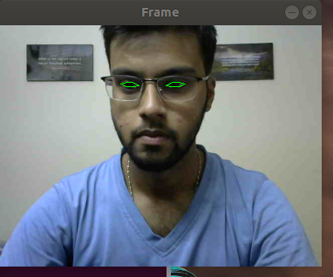
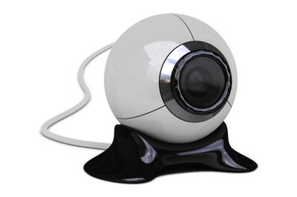

camera
Face and Eye recognition using a webcam and OpenCV

Slide 8
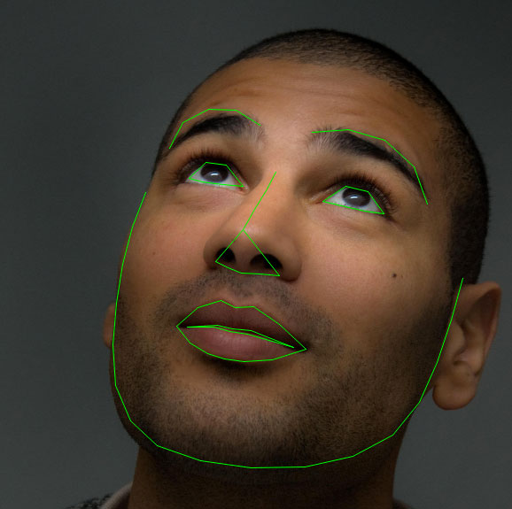
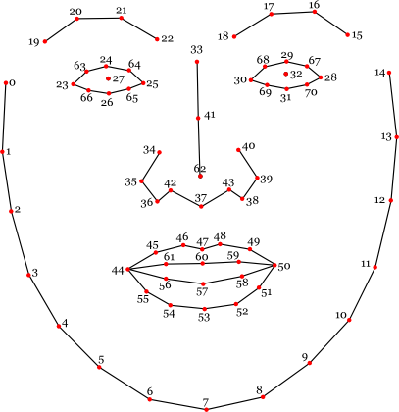
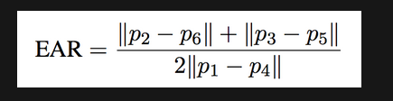
algorithm
Dlib’s facial landmark detector
It is open source and can be used for commercial applications
EAR ( eyes aspect ratio from which we can calculate whether the eye is close or open)
There are in total 68 points on the face
We will extract the points of our interest

Slide 9
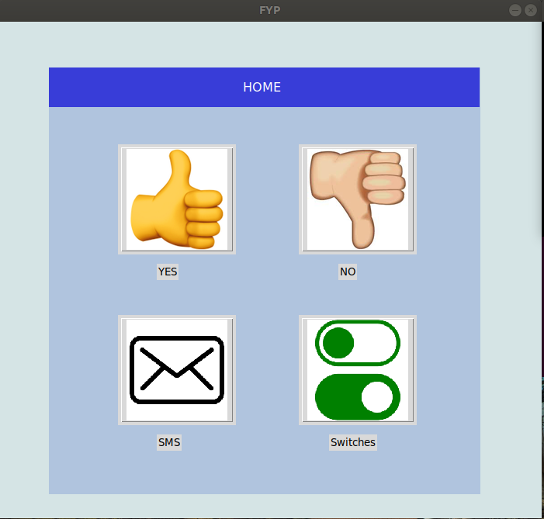
Desktop application
GUI using ‘Tkinter’ Python library
This is the area of navigation
These buttons are connected to some functions
Patient will navigate through short eye blinks
Long blinks would trigger the function

Slide 10
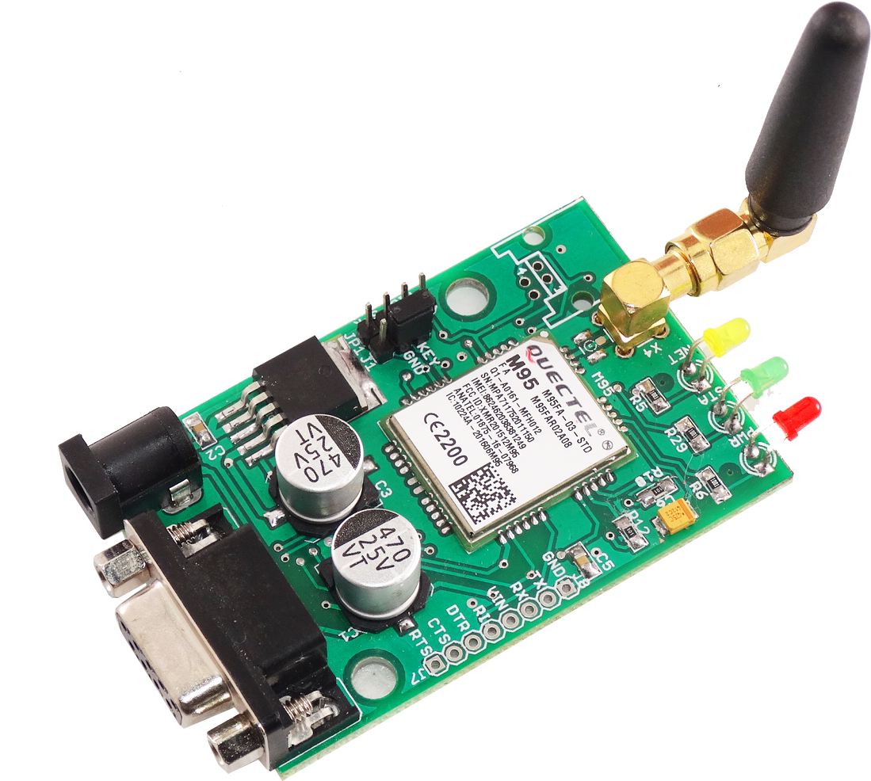
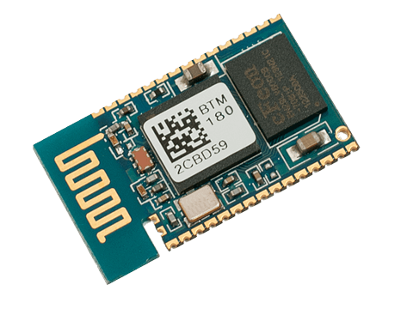
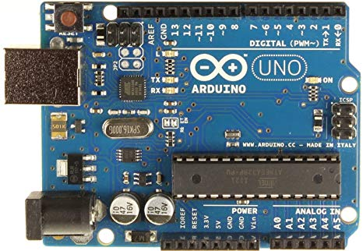
ARDUINO
Arduino is used for the serial communication with python desktop application
GSM module and Bluetooth module are also connected to the Arduino
For room automation we have designed a switch board with relay module and atmega8 IC, receiving signal from Arduino via a Bluetooth module

Slide 11
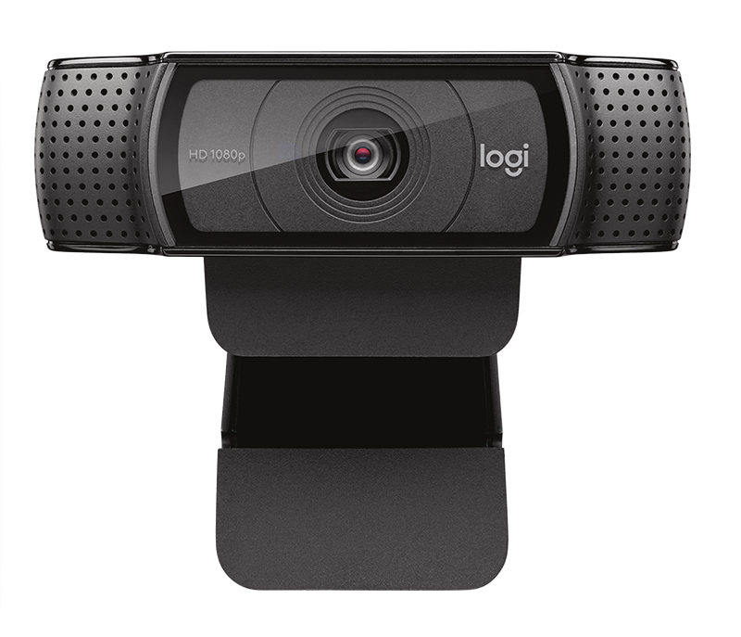
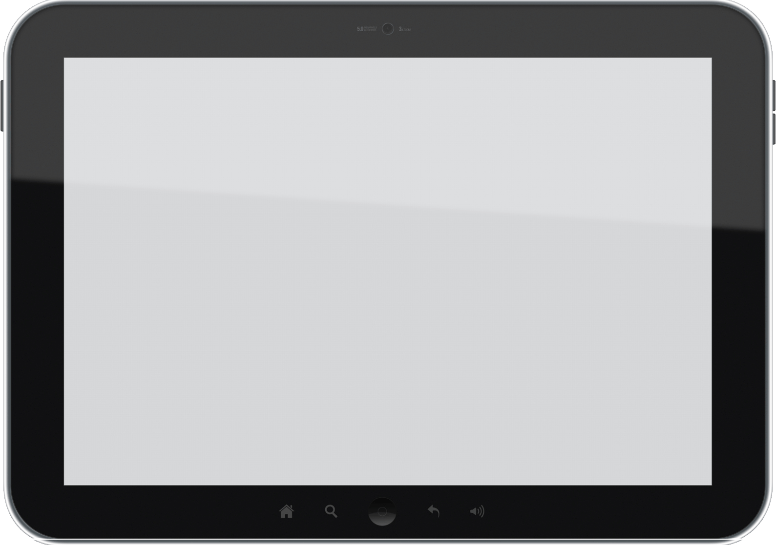
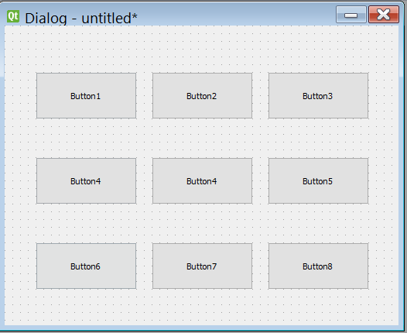

Milestones
Development of an eye gesture controlled software
Interfacing of hardware and software
Development of an integrated system which can make patient independent to some extent
Applying the project on a paralyzed patient

Slide 12
APPLICATION OF THE PROJECT ON A PATIENT

Slide 13
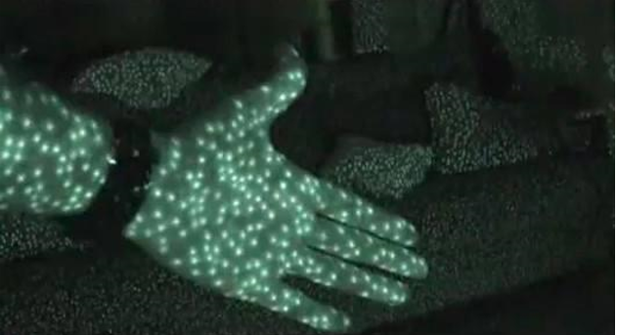
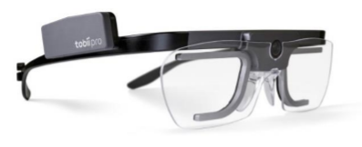
FUTURE SCOPE AND RECOMMENDATION
An addition of an IR led and IR detector will enhance the
accuracy of this device. This would eliminate the requirement of brightness in the room, making the controlling more comfortable. The working principle of IR Led is that it emits infra-red spots in a dispersed manner, those rays then reflect back from any obstacle in front and hence can calculate the depth of the objects as well. This technique can be used to map the image of patient’s eye into 3d space making eye recognition much easier. Moreover we can make glasses with fixed IR camera giving more flexibility.

Slide 14
Conclusion
Tasks | NOV |  | DEC |  | JAN |  | FEB |  | MARCH |  | APRIL |  | MAY |  | JUNE |  | JULY |  | AUG
Literature Review
Software work
Hardware work
Interfacing
Poster designing And finalizing project
Report writing

