Slide 1
Social Media Analysis Presentation

Slide 2
Project analysis slide 2
Project Analysis
PROBLEM STATEMENT
Marketing teams wants to leverage Instagram's user data to develop targeted marketing strategies
Their aim is to increase user engagement, retention, and acquisition to
Increase user activity in meta platform.

Slide 3
Project analysis slide 3
Project Analysis
OBJECTIVE
IDENTIFY
THE TOP USERS WITH HIGHEST USER ENGAGEMENT
RATE
ANALYZING THE
USER ACTIVITY
LEVELS
PROPOSE MEASURES
TO RETAIN INACTIVE USERS

Slide 4
Project analysis slide 4
Project Analysis
Total Users
100
Total Comments
7488
Inactive Users
15
KEY METRICS
Total Likes
8782
Active Users
59
Total Hashtags
501
Total Posts
257

Slide 5
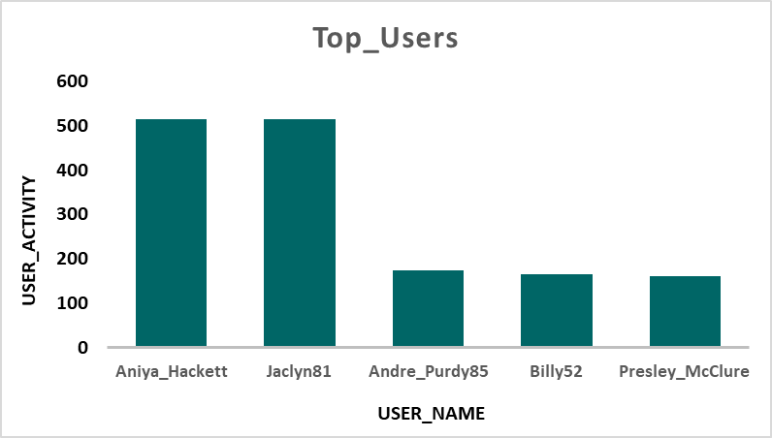
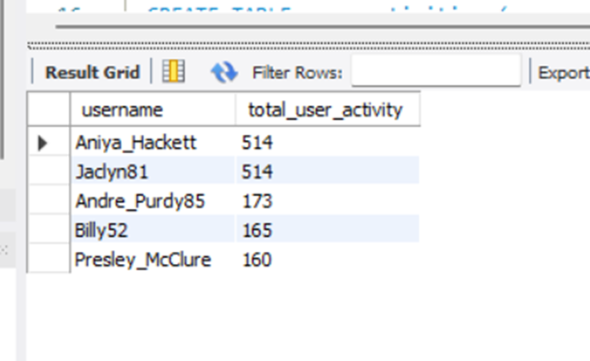
Project analysis slide 5
Project Analysis
Identify the top users with highest user engagement rate
Insights: From the likes, comments, and hashtags dataset, we identified the top 5 users with higher user engagement rates. From the data, Aniya_Hackett and Jaclyn81 have higher user activity."

Slide 6
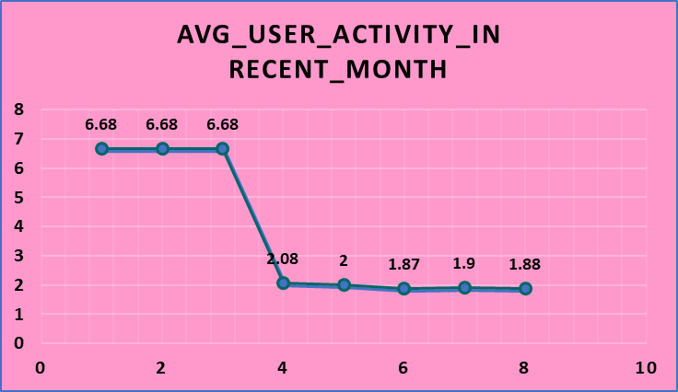
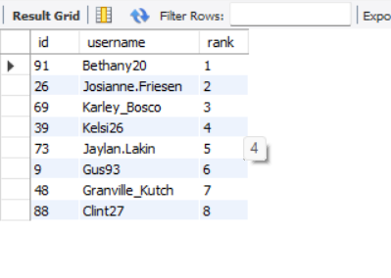
Project analysis slide 5
Project Analysis
Analyzing the user activity
levels
Insights: usernames that have had a high retention rate on the Meta platform over the years and their ranking in user activity in the recent month. This will help identify inactive users and propose strategies to re-engage them while increasing the acquisition of new users.

Slide 7
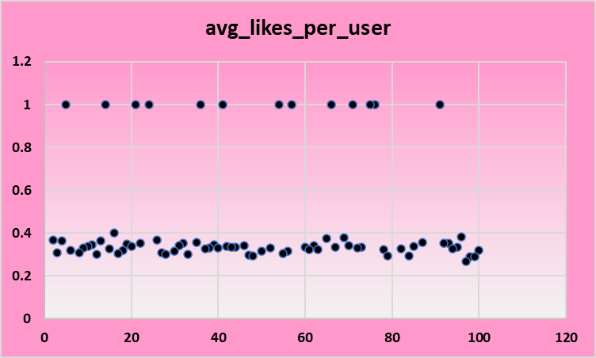
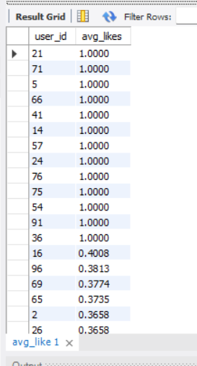
Project analysis slide 5
Project Analysis
Insights: The click rate in the photo-like was 73% which is when good impression and 13 users have a 100% click rate and 190 users shared their impressions on the meta platform. .

Slide 8
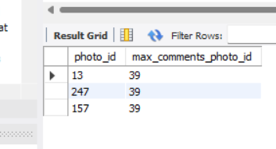
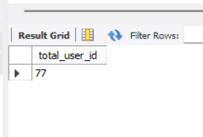
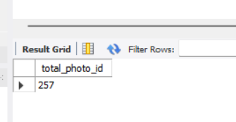
Project analysis slide 5
Project Analysis
Insights:77 users have commented on the posts. Each photo received a minimum of 21 comments, with the maximum being 39 comments. There are 13 inactive users who did not comment on any photo.

Slide 9
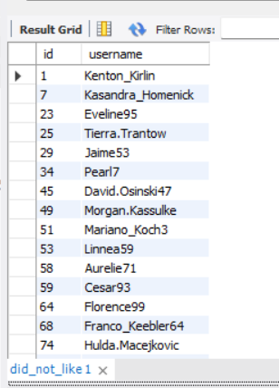
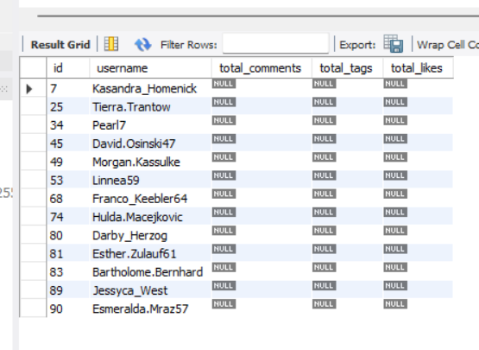
Project analysis slide 5
Project Analysis
Insights: A total of 23 users did not like any photos, and 15 users are completely inactive on the Meta platform. Therefore, 30 user IDs need to be targeted for retention and to increase their activity.
The users did not like any photo
Inactive users

Slide 10
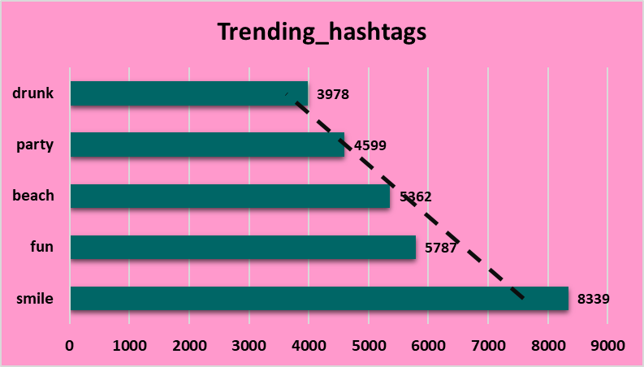
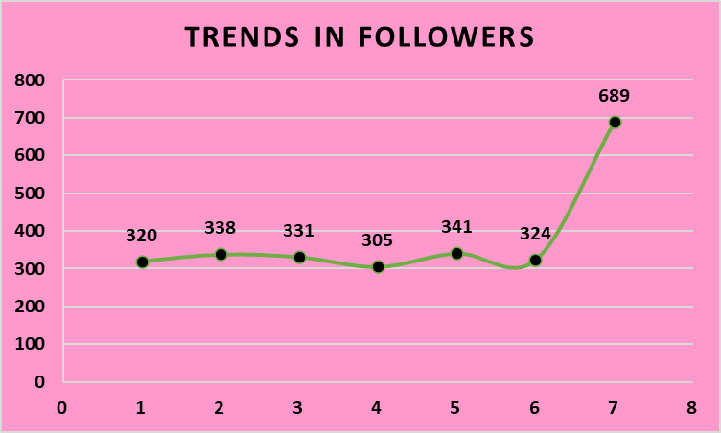
Project analysis slide 5
Project Analysis
PROPOSE MEASURES
TO RETAIN INACTIVE USERS
Insights: Analyzing trendy hashtags and photos on Meta platforms, along with metrics such as followers per user and likes per photo, can help identify strategies to retain inactive users and develop incentives to engage more active users.

Slide 11
Suggestions
More user acquisition is needed, as there are currently only 100 users on the Meta platform.
Rewards and incentives should be given to attract user acquisition. These measures will help increase the number of users.
Out of 100 users, only 30 are inactive on the platform. retain these inactive users with the help of our existing active users. User retention is more important than acquisition, and we should not lose our existing users to another social media platform.
Click-through rate, comment generation, and hashtag usage are key metrics for trend analysis, and these rates should be increased.

Slide 12
Thank You

