Slide 1
Movie Search API Project
Team Members:
Morgan Dehoff
Luke Davis
Trey Rios

Slide 2

Project Overview
Web-based Movie/TV Show Search App
Uses TVMaze API (no local database)
Search, browse, and view details
Built with HTML, CSS, JavaScript

Slide 3
Project Objectives
Practice
Practice APIs & async JavaScript
Build
Build clean responsive UI
Display
Display real‑time data from TVMaze
Create
Create separate details page
Collaborate and divide
Collaborate and divide tasks

Slide 4

Success Criteria
✔ Search works
✔ Accurate API results
✔ Details page loads
✔ Smooth navigation
✔ Responsive layout

Slide 5

Methodology
Light Agile workflow
Each member owned a section
UI wireframing
JavaScript + API integration
Testing + team troubleshooting

Slide 6

Technical Stack
Front‑end:
HTML
CSS
JavaScript
Data Source:
TVMaze Search API
TVMaze Show Details API

Slide 7

Architecture Overview
index.html – Search UI + results grid
main.js – API calls + dynamic rendering
details.html – Loads show details via ID

Slide 8

Team Responsibilities
Luke – index.html + CSS
Morgan – main.js
Trey – details.html

Slide 9

Project Performance
Finished on schedule
All features complete
Smooth API response
UI fallbacks added

Slide 10
Demo Plan
1. Live search
2. Open show details
3. Navigate back

Slide 11
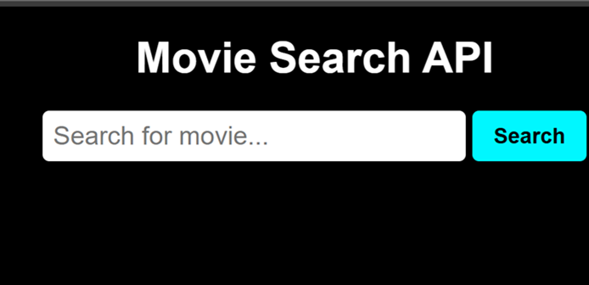
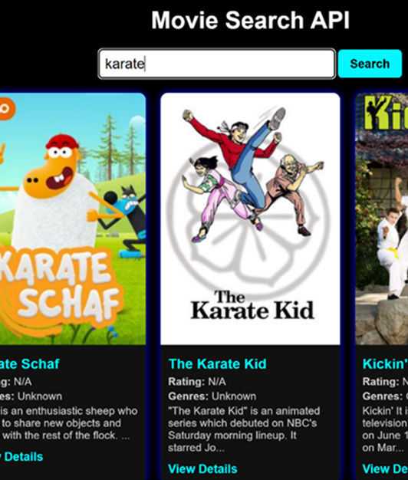
Live Search
This is the search bar for our Movie Search API. You can type in any movie title, and all available versions or related results will be displayed.

Slide 12

Show Details
Within the show details button, you get a full description of the movie including rating, genre, premiere date, and the language of the movie

Slide 13

Navigating back
Our app is user friendly and super easy to navigate through. Once a movie is clicked, after you are done reading the description, you click back to search button to return to the search bar.

