Slide 1
Detecting the presence of Breast Cancer
By Manthan Desai

Slide 2


The Problem
Nearly 12% of women worldwide suffer from breast cancer
Timely diagnosis is critical for positive prognosis
Data from trials presents an opportunity to improve diagnostic accuracy
Based on a patient’s tumor profile, can we accurately predict it to be benign or malignant?
What factors are most useful in distinguishing between the tumors?

Slide 3
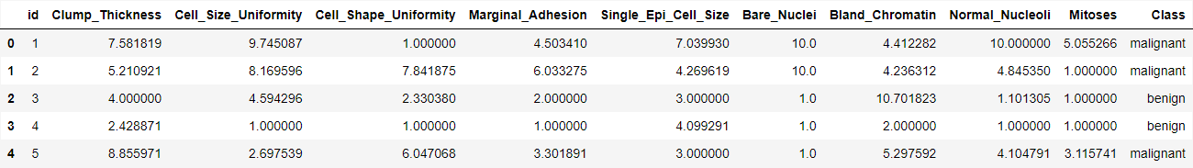
About the Data
Wisconsin Breast Cancer Dataset (1992)
# of records: 39,366, # of fields: 11
Each record signifies trial data for individual patients
Dataset was already polished with no missing values
Invalid data (values < 1) were removed prior to EDA

Slide 4
Exploratory Data Analysis
A look at the dataset, features and their relationship among each other and the target variable

Slide 5
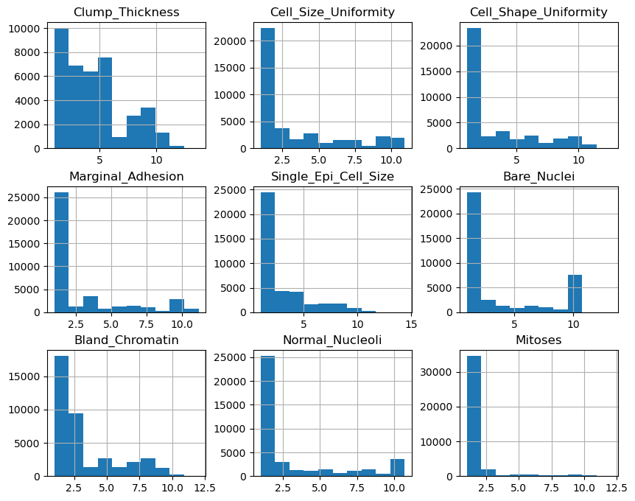
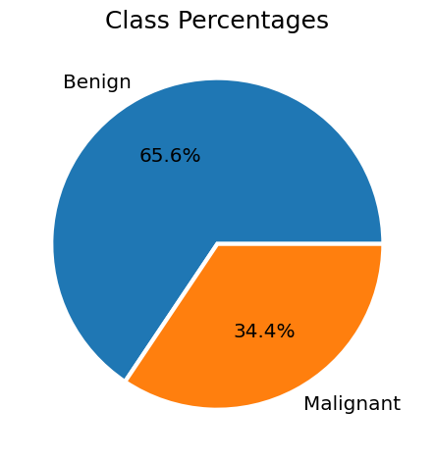
Preliminary observations
The pie chart of class percentages indicates an imbalanced dataset.
All features except ‘Clump_Thickness’ are heavily skewed to the right.
‘Mitoses’ distributions has two significant peaks on either end of the data range.

Slide 6
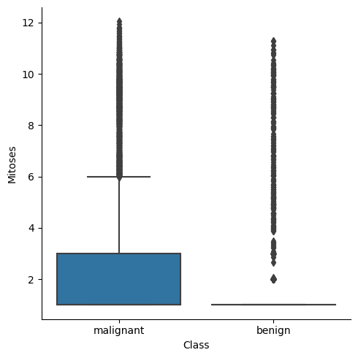
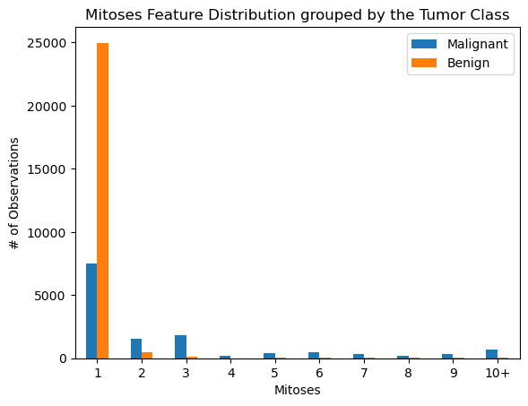
Feature Highlight: ‘Mitoses’
Mitoses: Quantifies the current stage of Mitosis in the cells
Box plot for Mitoses depicts the heavy density of data points with benign label towards 1.
Bar chart confirms most benign data points aggregate at the first bin.
Malignant data points are most prevalent at lower values but have a consistent presence in the other bins.

Slide 7
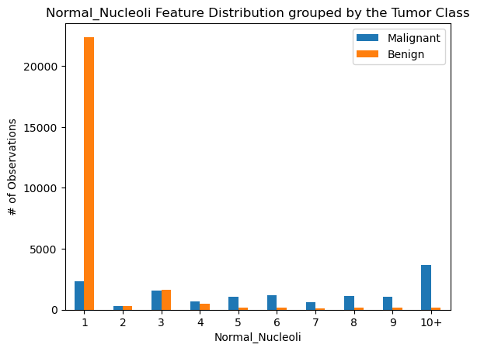
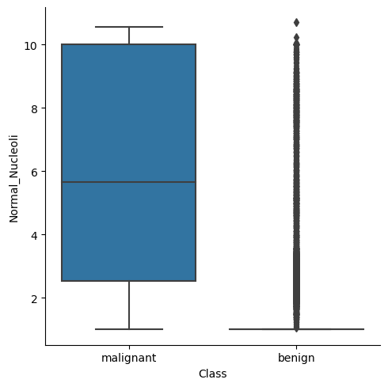
Feature Highlight: ‘Normal_Nucleoli’
Normal_Nucleoli: Count of normal nucleoli in the cell sample
Like Mitoses, the heavy density of benign data points lie near 1 while an even distribution occurs for malignant data points.
Bar chart visually confirms the wildly different data distributions for the two labels
Highest number of malignant data points lie in the ‘10+’ bin while benign points aggregate at ‘1’ bin.

Slide 8
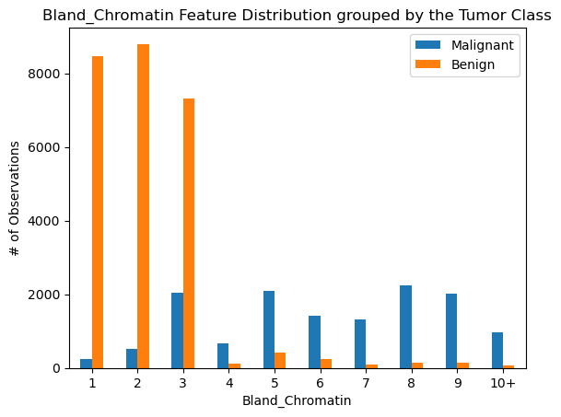
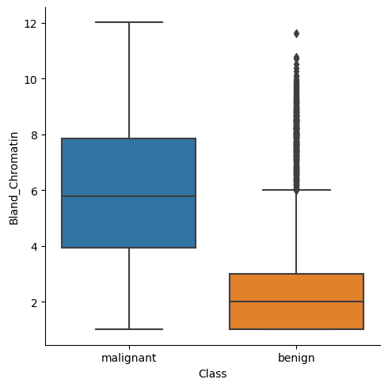
Feature Highlight: ‘Bland_Chromatin’
Bland_Chromatin: Quantifies the presence of bland chromatin in the cell sample
Unlike previous two features, the data points for both labels have a bigger range.
Bar chart shows most benign labels to be falling in the first three bins/
Malignant data points appear in all bins in significant quantity, most at ‘8’

Slide 9
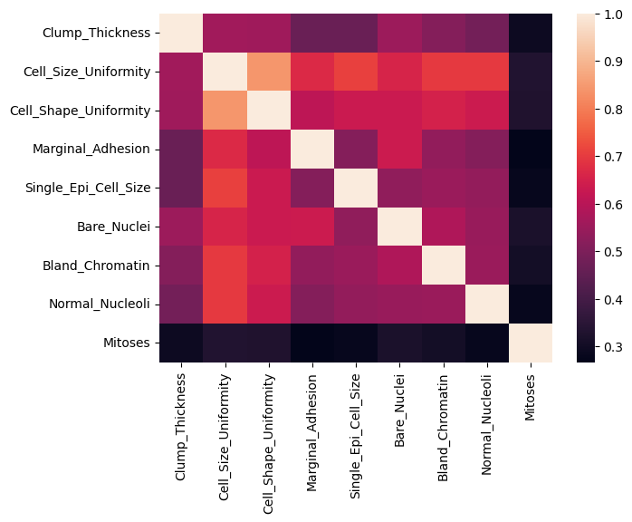

Relationship between the features
Pair plot showcases no visually significant relationships among the features
Heatmap of feature correlation showcases intriguing information
‘Mitoses’ is not strongly correlated with any other feature in the dataset
‘Cell_Size_Uniformity’ has a strong correlation with most of the other features, particularly with ‘Cell_Shape_Uniformity’
Feature correlation important to note for modeling

Slide 10
Modeling
Methodology and Results

Slide 11
Methodology
Preprocessing
Removed the ‘id’ field
Map class labels: Malignant → 1, Benign → 0
Train/Test Split
75% training set, 25% testing set
Classifiers used:
Logistic Regression
Random Forest
XGBoost
Performance metrics:
ROC Curve
Confusion Matrix
R-squared

Slide 12
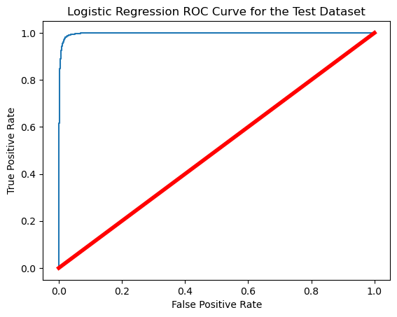
Logistic Regression
Hyperparameters:
penalty = ‘L2’, C = 10
R-squared for the test dataset: 0.979
Confusion Matrix:
True Positives: 6309, True Negatives: 3315
False Positives: 114, False Negatives: 92
ROC curve confirms the exceptional performance of the model

Slide 13

Random Forest
Hyperparameters:
Bootstrapping = true, n_estimators = 100, criterion = ‘entropy’
R-squared for the test dataset: 0.985
Confusion Matrix:
True Positives: 6325, True Negatives: 3354
False Positives: 98, False Negatives: 53
ROC curve looks very similar to the Logistic Regression ROC curve

Slide 14
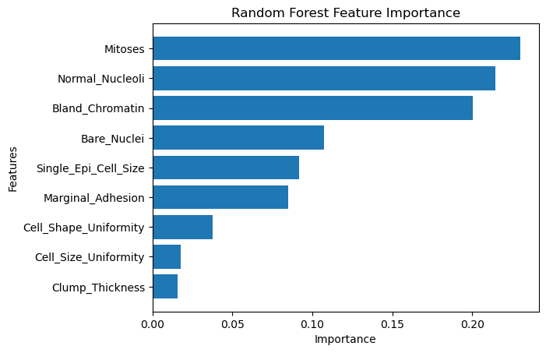
Feature Importance by RF Model
Mitoses, Normal_Nucleoli, and Bland_Chromatin are significantly more important than the rest of the features according to the RF model

Slide 15
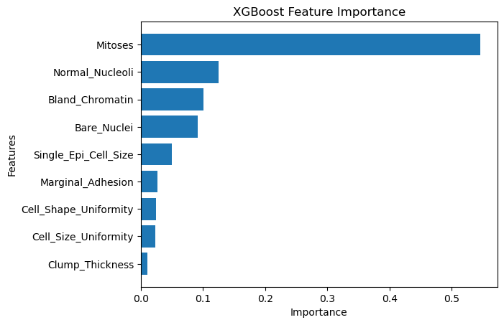
XGBoost
Hyperparameters:
penalty = ‘L2’, C = 10
R-squared for the test dataset: 0.985
Confusion Matrix:
True Positives: 6329, True Negatives: 3358
False Positives: 94, False Negatives: 49
The feature importance plot for XGBoost shows that Mitoses is overwhelmingly the most important feature

Slide 16
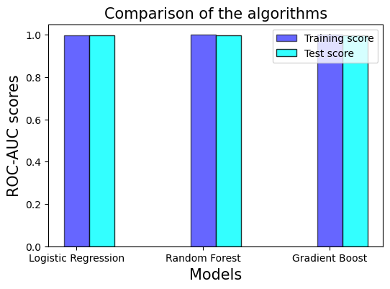
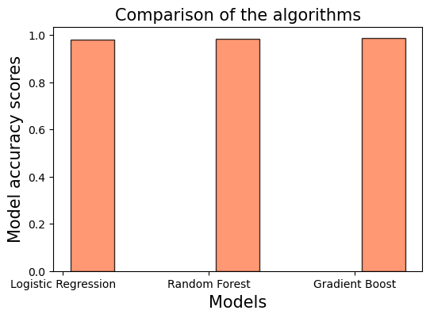
Performance comparison
All three models performed very similarly with exceptionally high scores however the XGBoost performed the best by a slight margin.

Slide 17
Conclusions
XGBoost model produces the least number of false positives and false negatives, albeit by a very small margin
Each model has unrealistically high scores which suggests the presence of data leakage and other fundamental issues with the dataset
Absence of several key features that can directly influence the outcome of the target variable such as the time passed since initial diagnosis, tumor stage.
Data for each patient is a one-time collection as opposed to multiple collections over a period of time
These fundamental issues with the dataset defeat the purpose of machine learning in this instance because the goal is to use ML models as a supplement to real-world situations.
While we can fit models to this dataset and achieve high-accuracy results, the real-world utility is lacking

