Slide 1

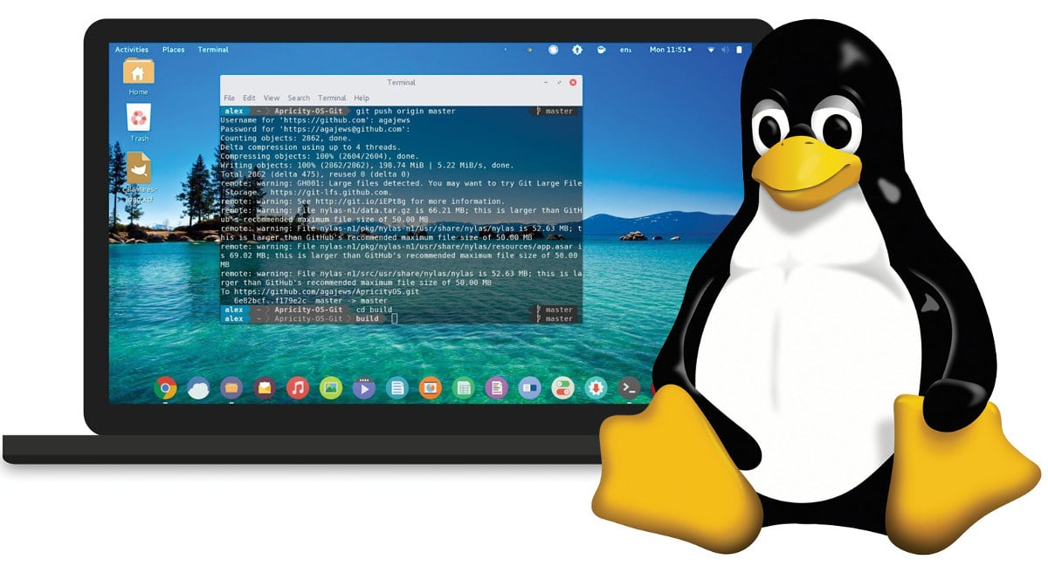
How we can play with Linux system
with zero knowledge?

Slide 2
零基础如何玩转 Linux 操作系统？

Slide 3

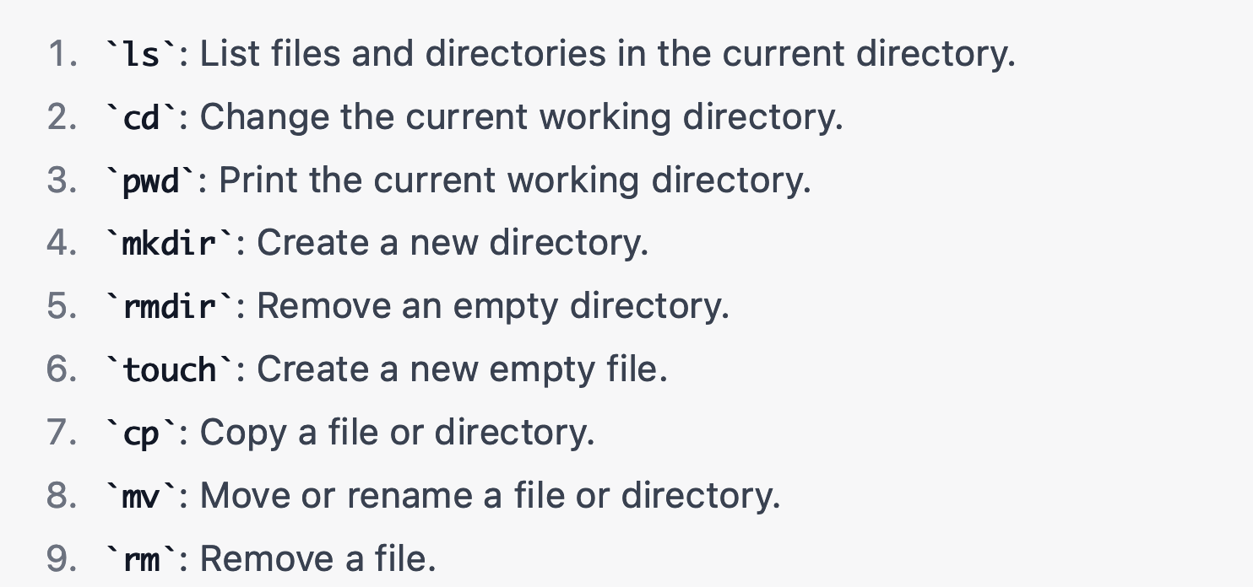
Basic Linux command lines beginners must know

Slide 4
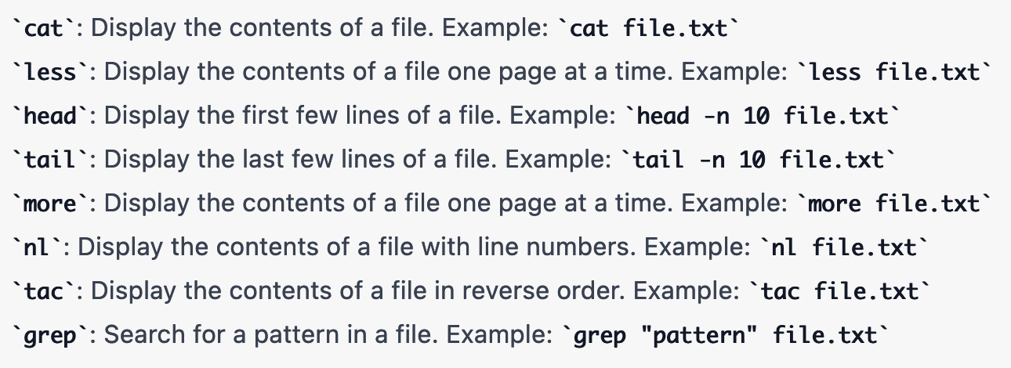
Basic Linux command lines to read files

Slide 5
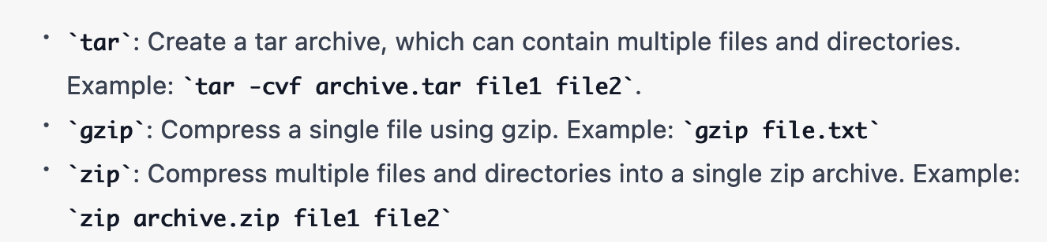
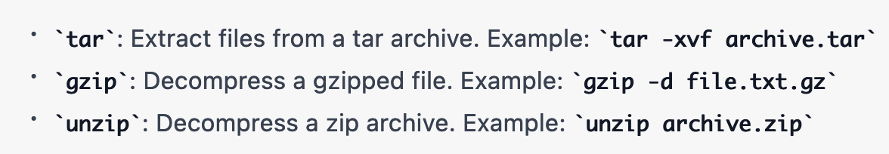
Basic Linux command lines to compress and files
Compress files
Decompress files

Slide 6
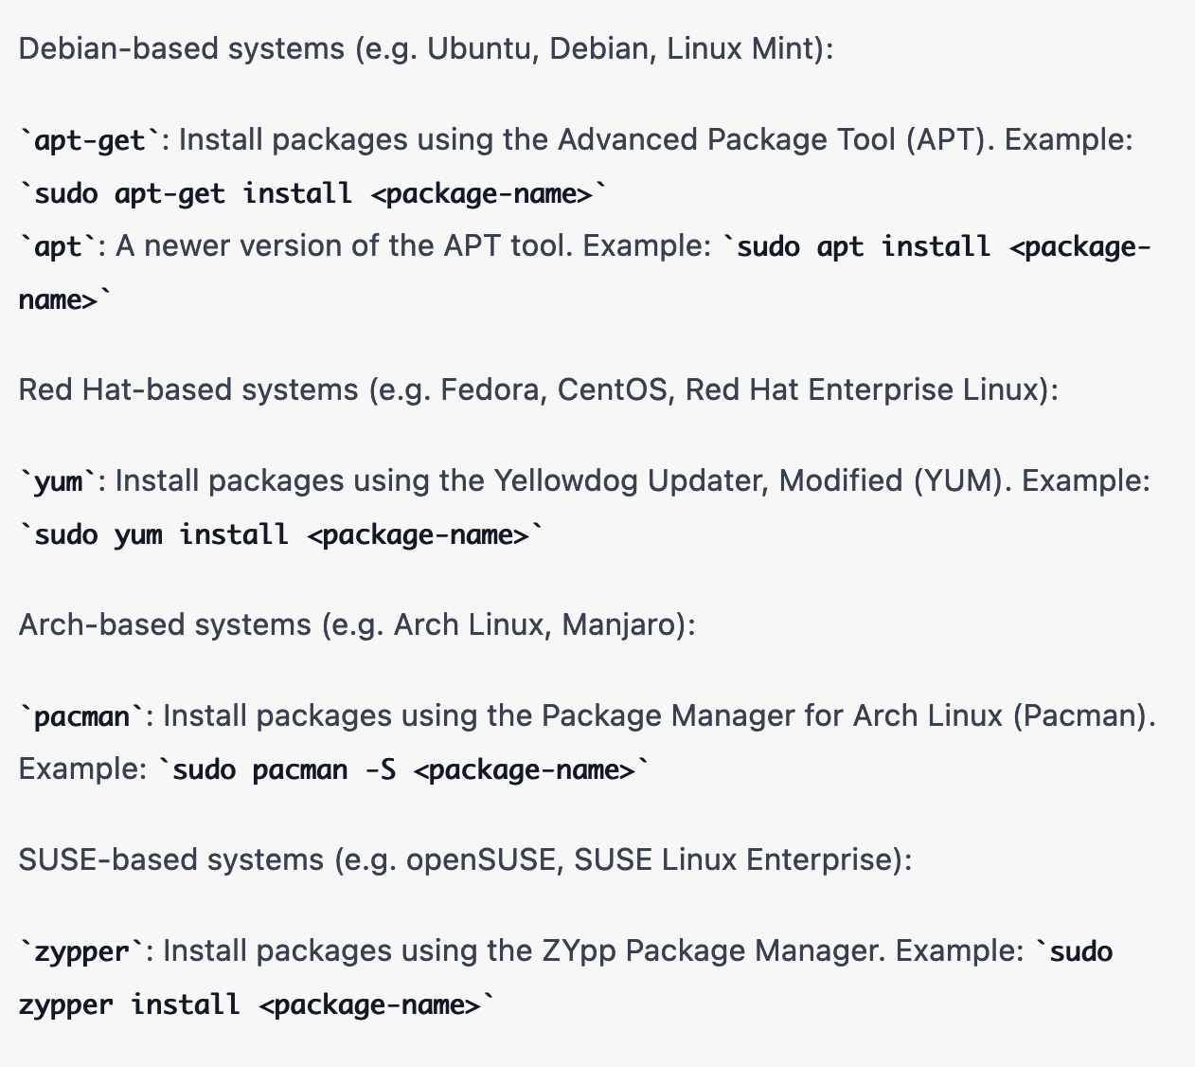
Basic Linux command lines to install packages

Slide 7
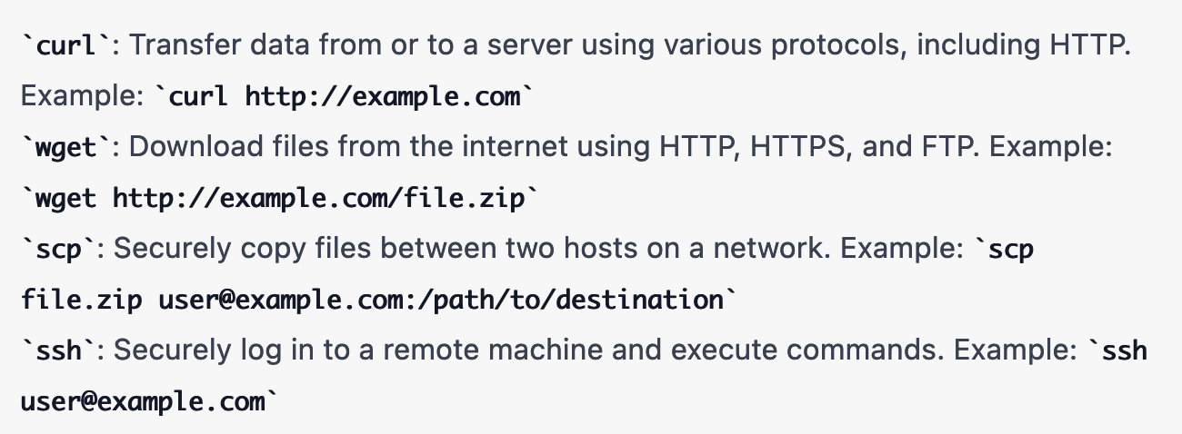
Basic Linux command lines to manage web server

Slide 8
Other command lines you think are important to work with Linux system? Comment below and let me know
If you like what you see, please don’t forget to click “like” and subscribe to start your bioinformatics journey together with me!
Thank you!

