Slide 1
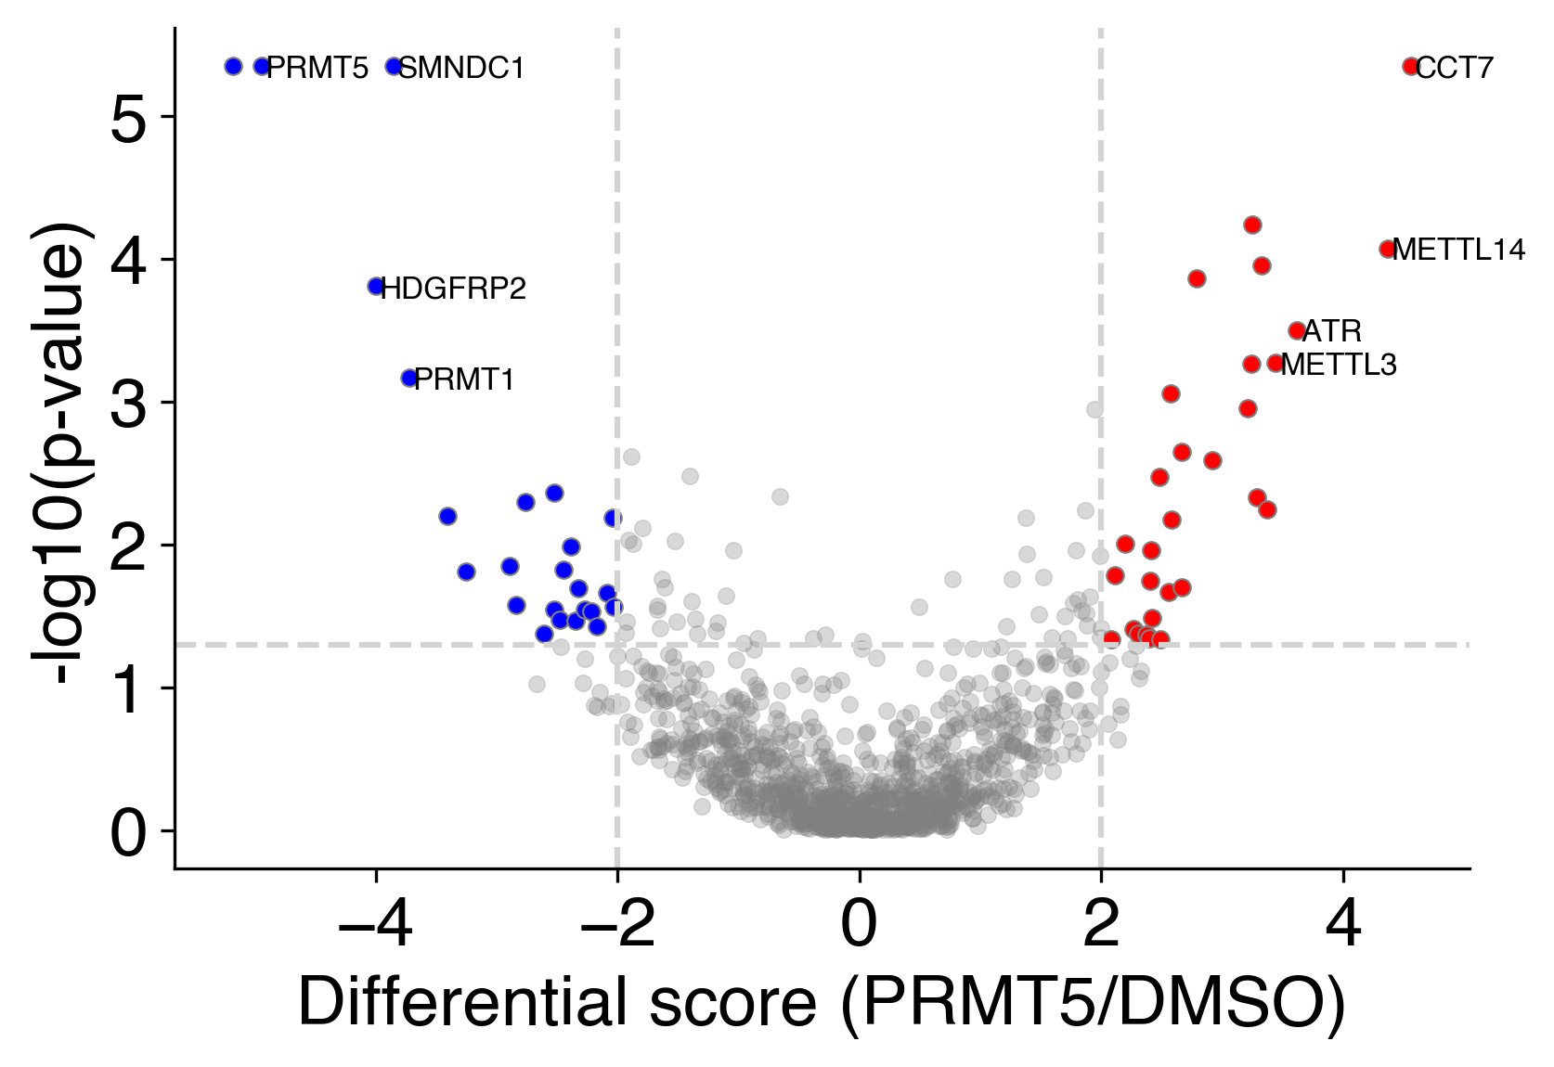
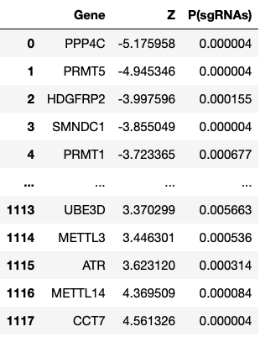


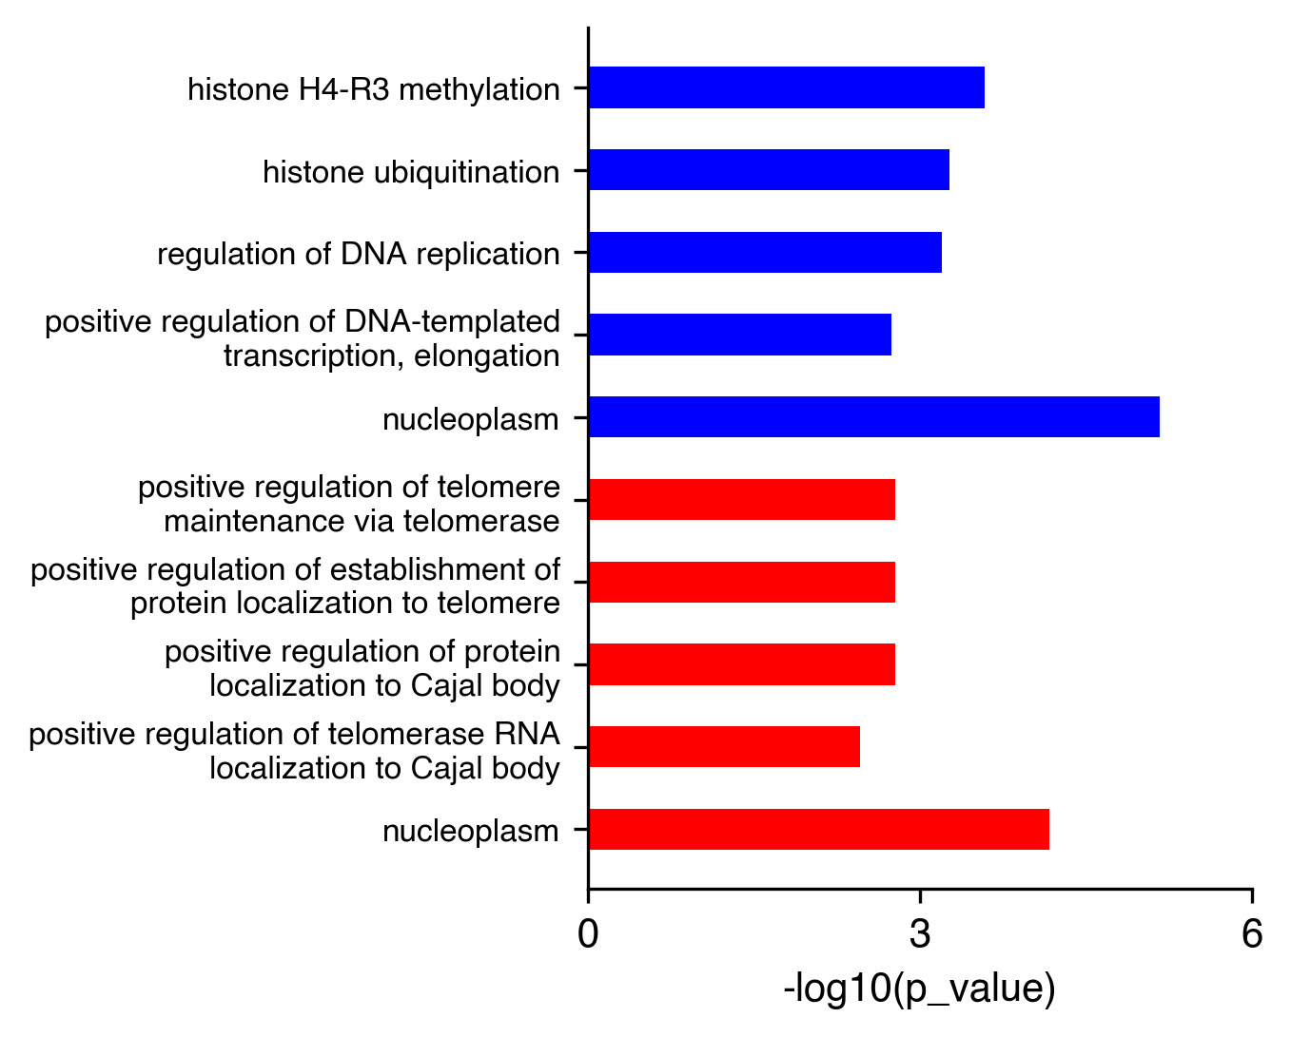
[Skills] How to plot volcano plot and perform Gene Ontology analysis with python？
Volcano plot
goatool

Slide 2
[技能篇] 如何用 python 画火山图并进行基因本体论分析 (Gene Ontology analysis )?
Volcano plot
goatool

