Slide 1

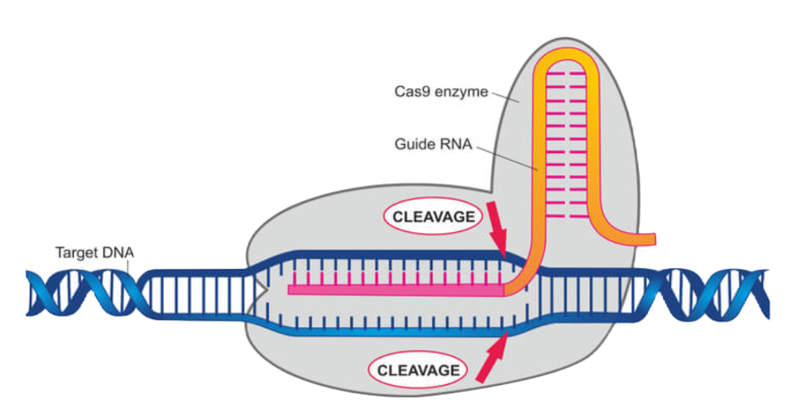
[CRISPR] How to design best sgRNA for protein knockout?

Slide 2
[CRISPR]如何设计用于基因/蛋白质敲除的最优 sgRNA

Slide 3
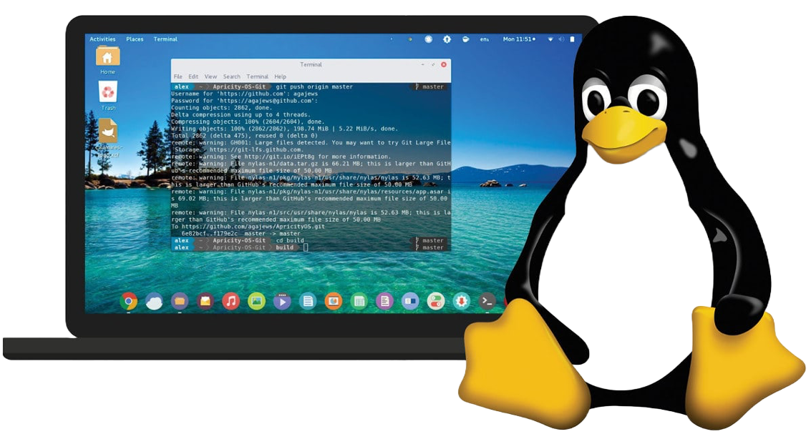
[Linux] How to work on Linux system with zero knowledge?

Slide 4
[Linux] 如何零基础玩转 Linux 操作系统?

Slide 5
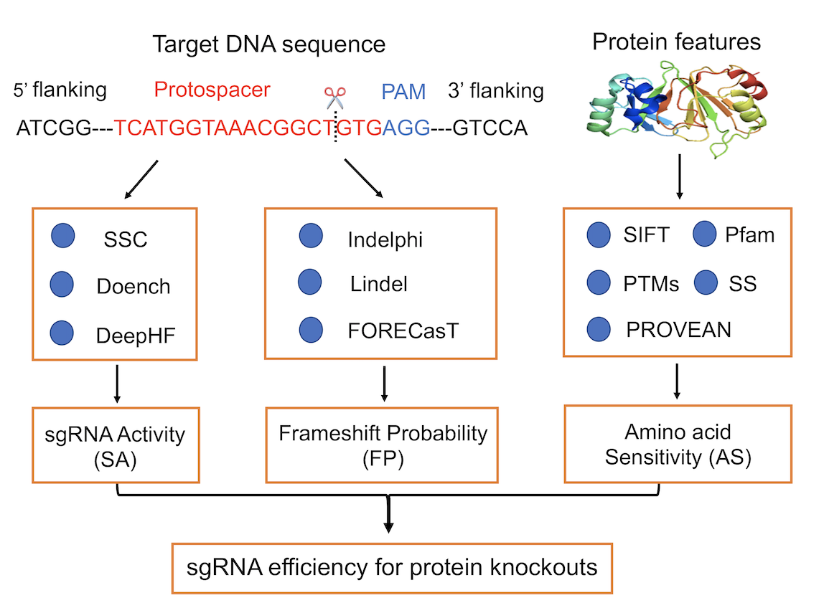
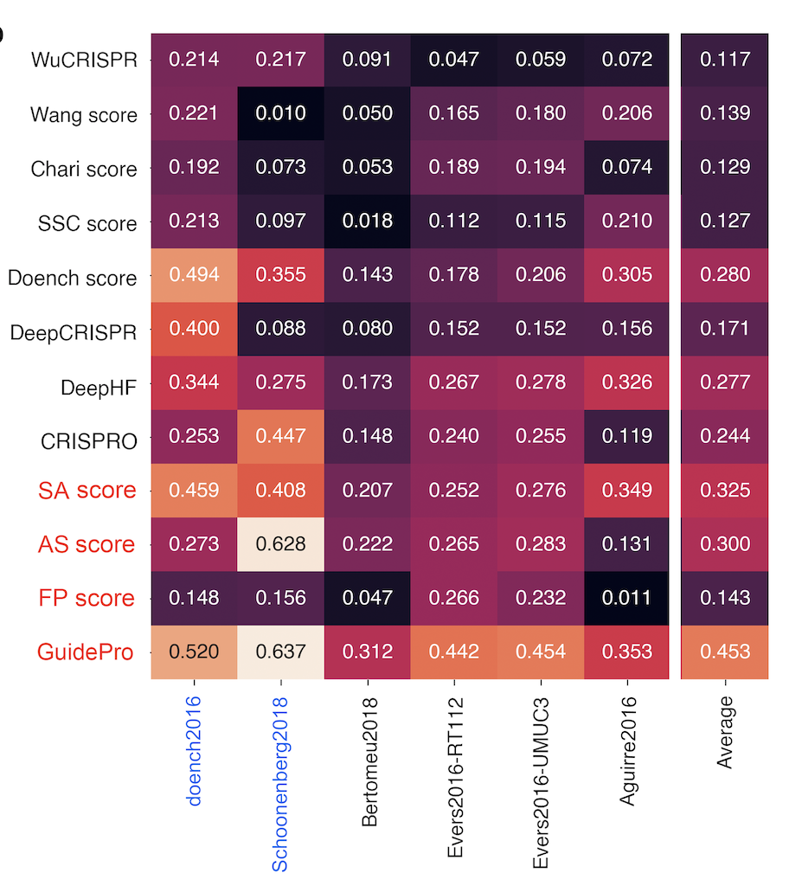
He et al., Bioinformatics, 2021
https://bioinformatics.mdanderson.org/apps/GuidePro/

