Slide 1


How to stay tuned for the significant publications relevant to your study?

Slide 2

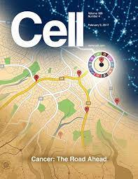
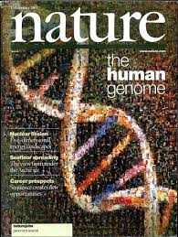
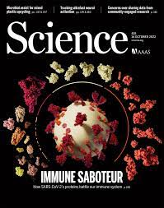
EP1: Amazing tools for paper reading

Slide 3
有什么文献阅读神器？

Slide 4
第一集：文献阅读神器

Slide 5


