Slide 1
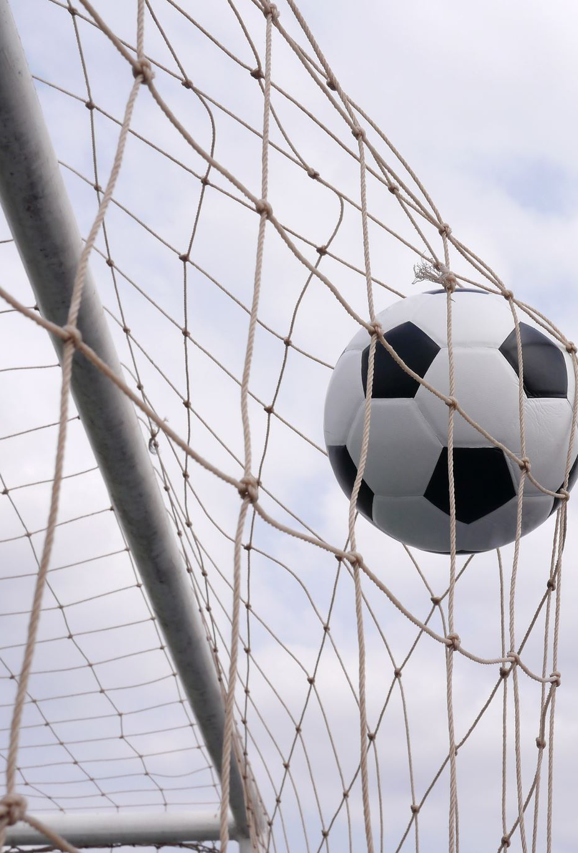
RANKING cOLLEGE SOCCER TEAMS ARRIA-BOOST
MATT DOCKMAN
RASHAAD RATLIFF-BROWN
VICKI NOMWESIGWA

Slide 2
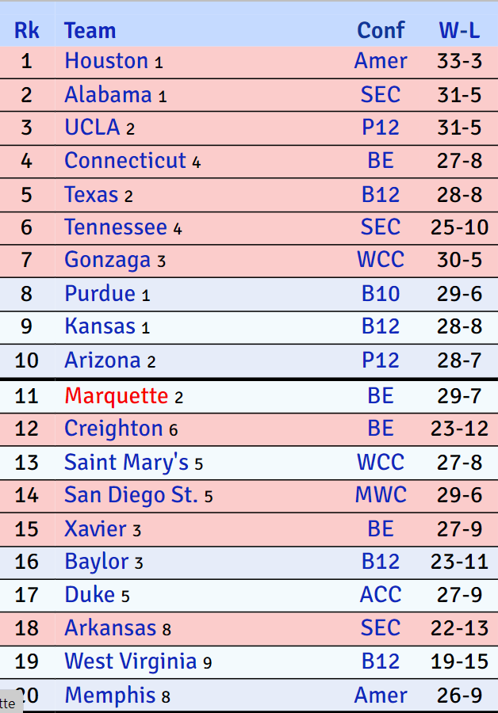
Problem
Numerous methods for ranking college football and basketball teams, but none exist for soccer
Emblematic of a general neglect toward college soccer
Notes:
Our problem is simple and straightforward, current ranking methods exists for college football and basketball but not soccer
This is indicative of a general lack of attention given to college soccer
On the right is an example of a popular ranking methodology used in basketball known as Kanpom
As we can see teams have been ranked according to how best they played in the season. Similarly,

Slide 3
OUR objective
Objective is to build a model that ranks the performance of NCAA D1 men’s and women’s soccer teams
Model should be applicable to match outcome and score prediction as well as tournament projections
Goal is to predict at least 55% of 3-way outcomes (win/loss/draw) and at least 85% of the participants in the NCAA tournament
Notes:
to fulfil our objective, we have created an accurate ranking system for NCAA Division I soccer teams i.e., men's and women's for the 2020-2022 season.
Our approach is quantitative and interpretable, making it helpful in predicting 3-way match outcomes i.e., win, loss, draws and predicting scores like goal differential and tournament projections.
Goal is to predict at least 55% of these 3-way outcomes because previous ML methodologies applied to Premier league where we see more draws predicted at least 50% of outcomes. We, therefore, increase this by 5% bse we see fewer draws in college soccer
Secondly, we want to predict at least 85% of the participants in the NCAA tournament and our model predicted at least 55/64 - teams for women and 35/48 for men's
Moving onto our modeling approach,

Slide 4
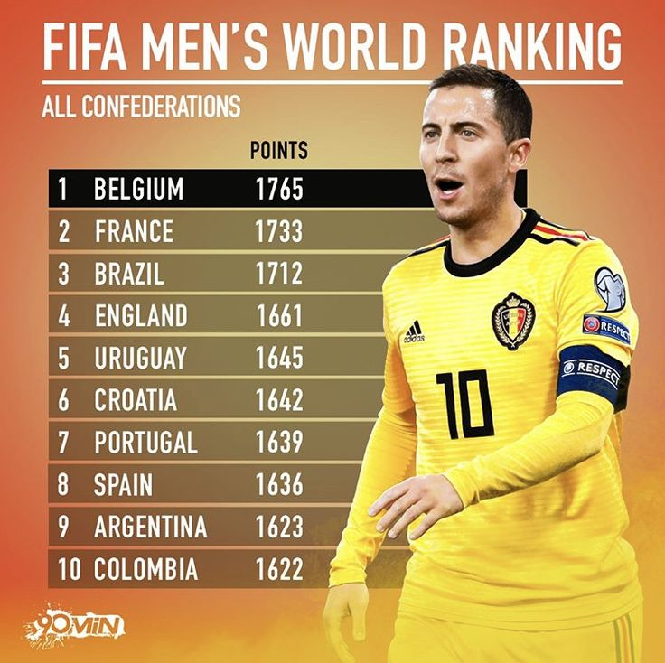
Modeling Approach
The FIFA ranking model is the only existing ranking system of high-level soccer
Ratings do not provide an easy comparison of teams
Ambiguous how often or by how much we would expect one team to beat another
No measure of uncertainty surrounding ratings
Notes:
We consider the FIFA model as a baseline since it is the only existing ranking system of high-level soccer
We could use this model to rank college soccer teams but it has drawbacks for example,
fifa's ratings don't provide an easy comparison of teams,
if we look at belgium and france, belgium is 32 pts ahead of france but it is unclear how or by how much we expect belgium to beat another team like spain.
this level of uncertainty surrounding ratings begs you to ask the question, is belgium's rating the true rating or not? how is the rating derived, is it by team strength or points scored.
with these drawbacks in mind, we build our model with certain improvements

Slide 5
Improving FIFA's Model
Incorporate goal differential and in-game features, such as shots, corners, and offsides
Allow for effect of home-field advantage
Account for autocorrelation of game outcomes
Implement draws directly
Make ratings interpretable as the average number of goals by which a team would beat an average college team
Notes:
-to begin with our model incorporates goal differential as a significant indicator of team strength meaning teams that tend to win more tend to be better. we also include in-game features like shots, corners, location, offsides because we don't want to just consider the outcome but also a team's performance in the game. like how many shots on target did that team have
-our model incorporates the home-field advantage bse teams tend to win more when they play home games
-note that teams that have won the last couple of games or teams that have lost the last couple of couples tend to continue their winning or losing streak, so our model account for autocorrelation of game outcomes
-unlike the fifa model that only considers wins and losses, we implement draw probabilities bse soccer is a 3-way outcome game unlike football and basketball
-lastly, we put ratings on a scale to make them interpretable as the avg no of goals a team needs to beat an ave d1 team e.g if duke has a rating of 2 goals, we say duke on avg needs to score at least 2 goals to beat an avg team.

Slide 6
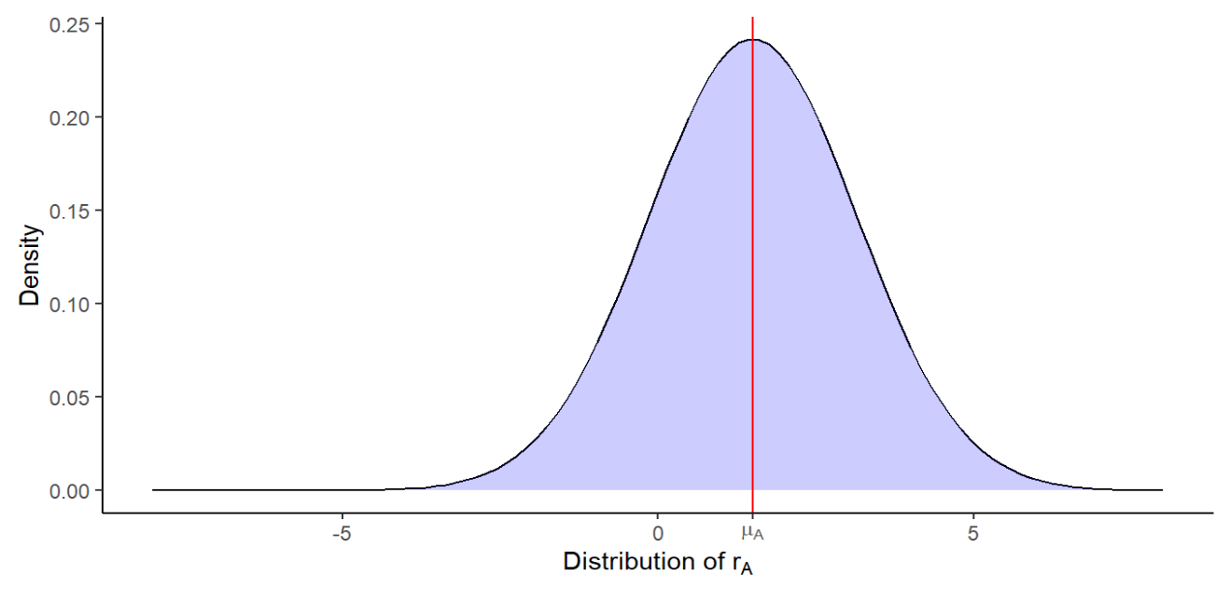
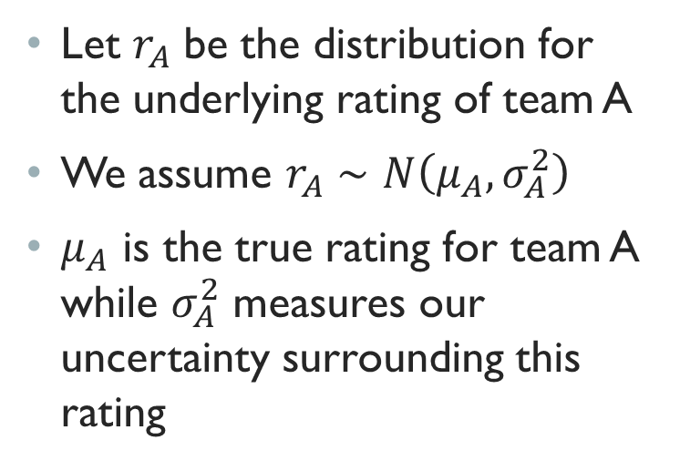
Model Formulation
Let $r_{A}$ be the distribution for the underlying rating of team A
We assume $r_{A}∼N\left(μ_{A},σ_{A}^{2}\right)$
$μ_{A}$ is the true rating for team A while $σ_{A}^{2}$ measures our uncertainty surrounding this rating

Slide 7
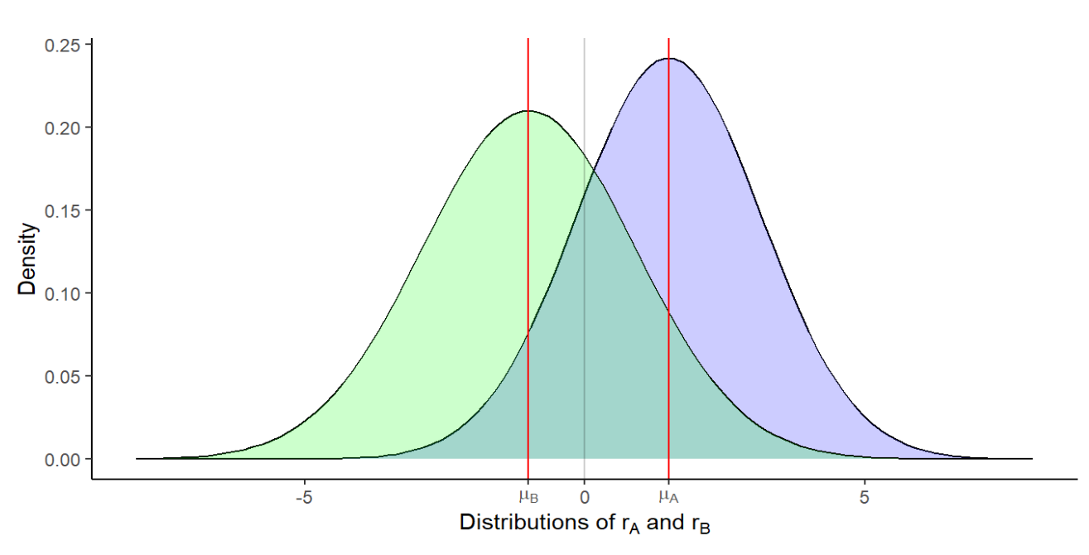
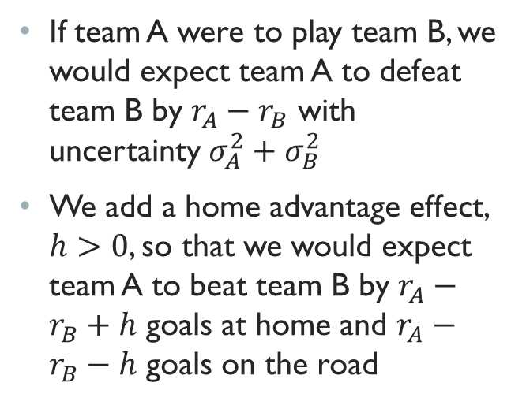
Model Formulation
If team A were to play team B, we would expect team A to defeat team B by $r_{A}−r_{B}$ with uncertainty $σ_{A}^{2}+σ_{B}^{2}$
We add a home advantage effect, $h>0$, so that we would expect team A to beat team B by $r_{A}−r_{B}+h$ goals at home and $r_{A}−r_{B}−h$ goals on the road

Slide 8
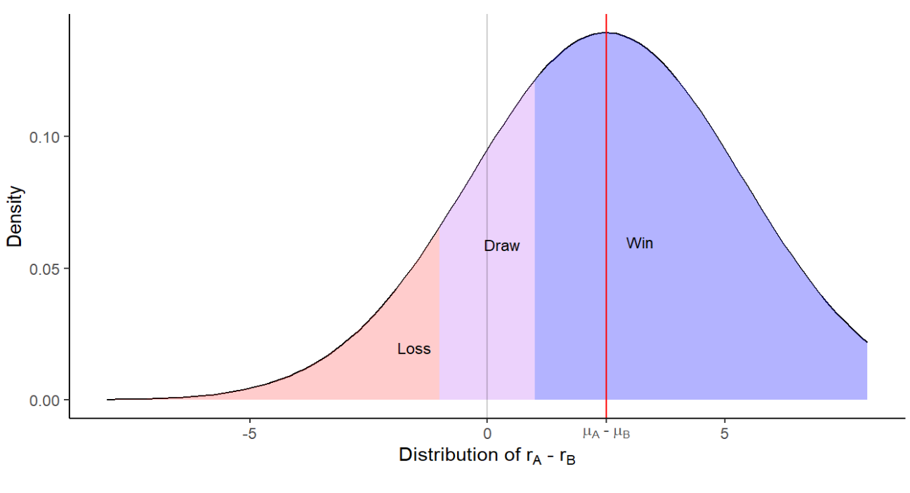
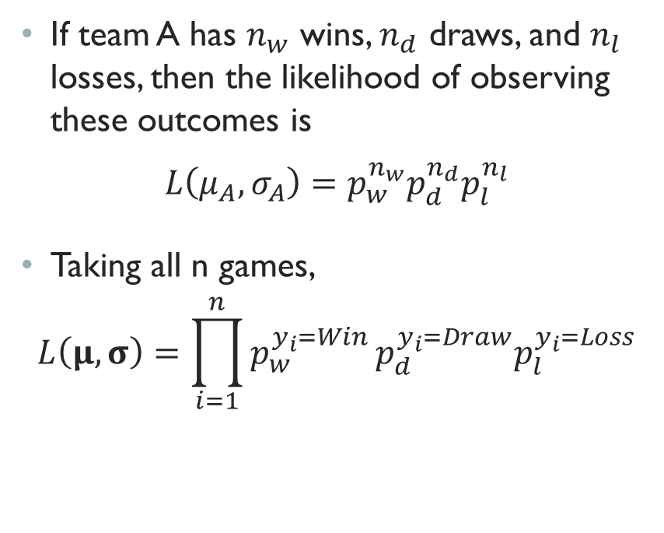
Model Formulation
If team A has $n_{w}$ wins, $n_{d}$ draws, and $n_{l}$ losses, then the likelihood of observing these outcomes is
$$L\left(μ_{A},σ_{A}\right)=p_{w}^{n_{w}}p_{d}^{n_{d}}p_{l}^{n_{l}}$$
Taking all n games,
$$L\left(μ,σ\right)=\prod_{i=1}^{n}{p_{w}^{y_{i}=Win}}p_{d}^{y_{i}=Draw}p_{l}^{y_{i}=Loss}$$

Slide 9
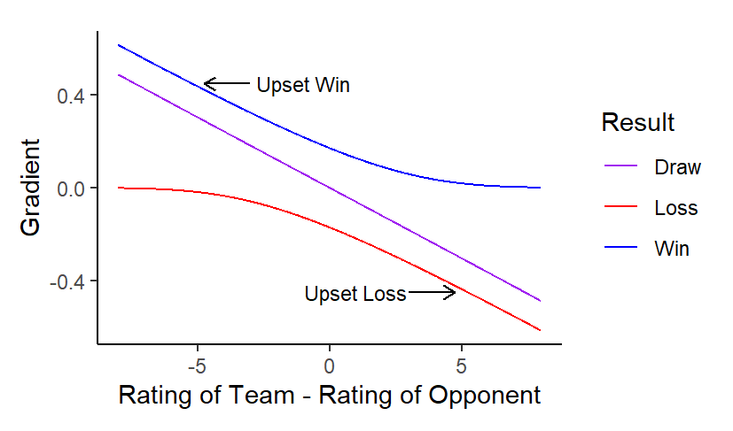
Model Formulation
Use online gradient descent to update each team's rating and its volatility
Gradient depends on strength of opponent and game outcome
Step size is determined by margin of victory
Use momentum to incorporate prior performance

Slide 10
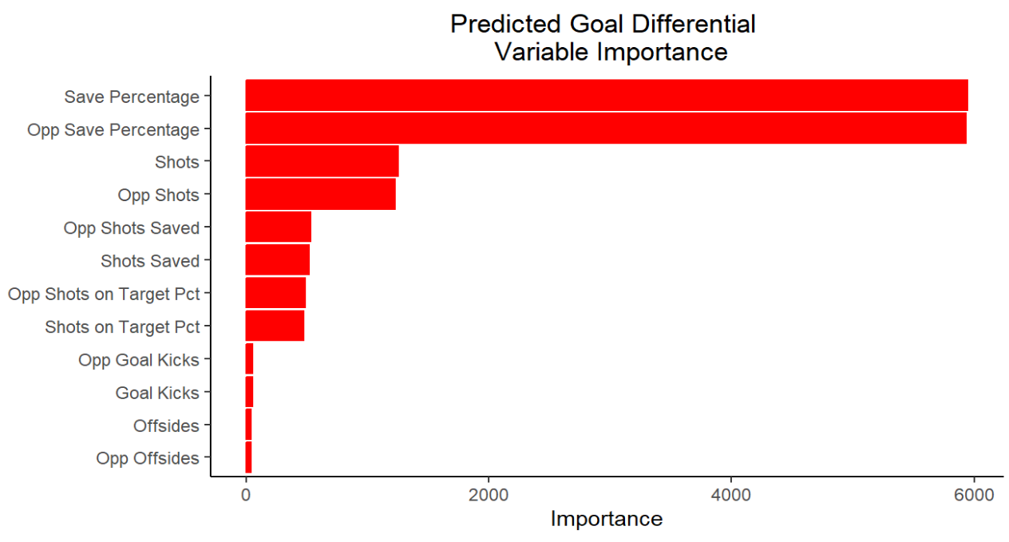
Adjusted goal differential
Build second model to predict goal differential using in-game statistics
Use predicted goal differential rather than true goal differential to update ratings

Slide 11
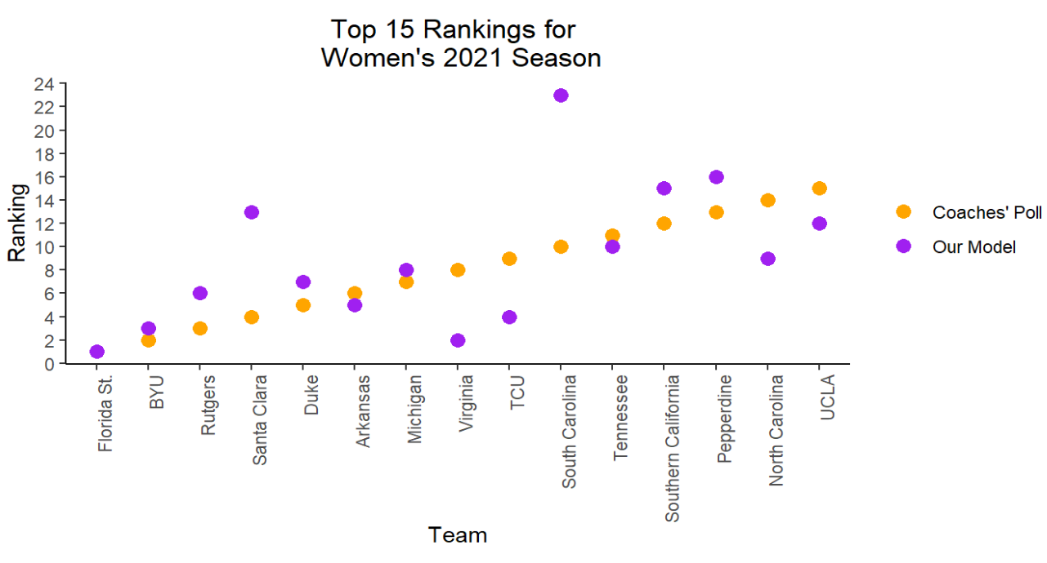
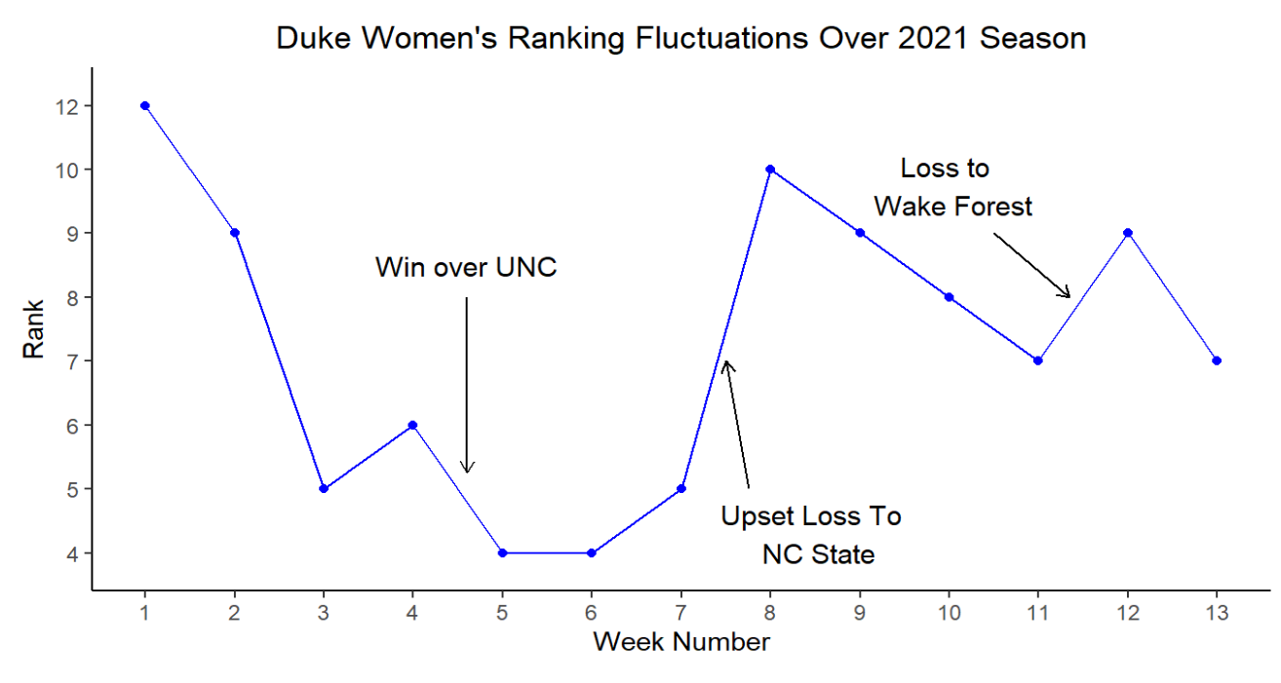
Results

Slide 12
Women’s model Results
Year | FIFA's Model Accuracy | Our Model Accuracy | FIFA’s Model Brier Score | Our Model Brier Score (lower is better)
2020 | 56.9% | 60.7% | 0.600 | 0.565
2021 | 59.9% | 63.0% | 0.577 | 0.523
2022 | 52.1% | 56.6% | 0.676 | 0.560

Slide 13
men’s model Results
Year | FIFA's Model Accuracy | Our Model Accuracy | FIFA’s Model Brier Score | Our Model Brier Score
2020 | 55.7% | 56.1% | 0.613 | 0.591
2021 | 58.3% | 60.7% | 0.580 | 0.540
2022 | 52.8% | 54.1% | 0.680 | 0.573

Slide 14
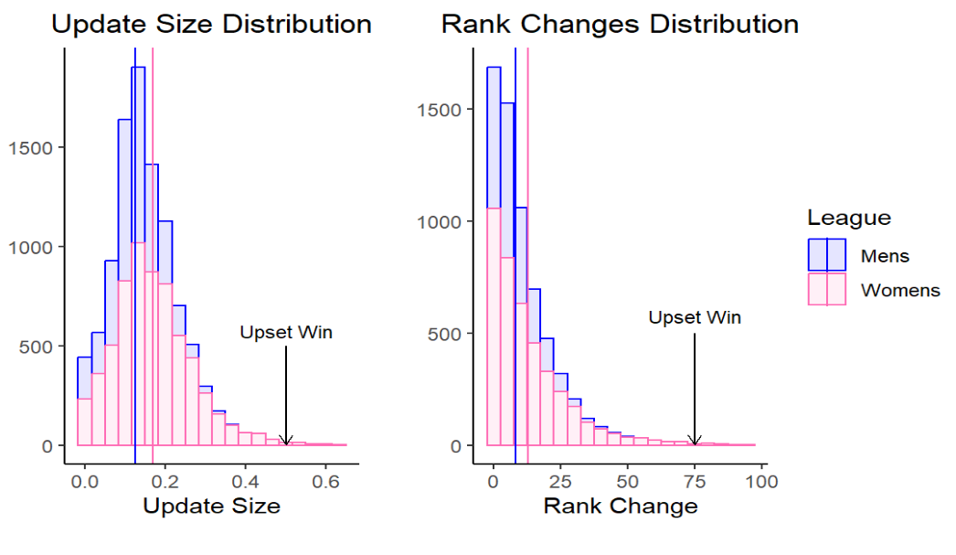
Model Features
Our model is sensitive to unexpected outcomes
Rankings are stable from week to week
Mean change of 8 for men and 13 for women seems reasonable given 200 men’s and 350 women’s teams

Slide 15
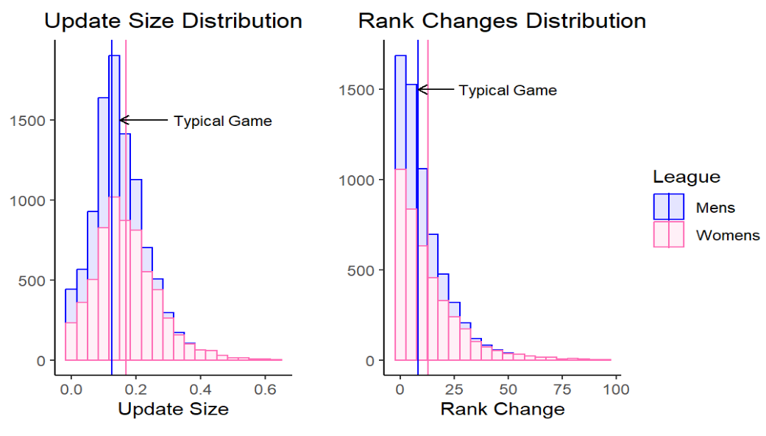
Model Features
Our model is sensitive to unexpected outcomes
Rankings are stable from week to week
Mean change of 8 for men and 13 for women seems reasonable given 200 men’s and 350 women’s teams

Slide 16
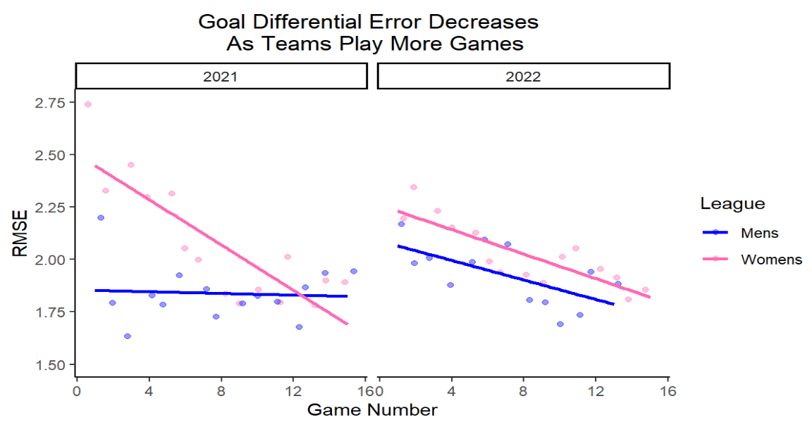
MODEL Concerns
Model does not account for changes across seasons
Implemented momentum to address this
Still need 4-6 games for ratings to accurately represent team strength
Notes:
Incorporate momentum to address this issue
Also initialize new season ratings at final ratings from prior season

Slide 17

Thank you!
QUESTIONS?
Notes:
Inconsistent information such more goals than shots taken in a game

