Slide 1
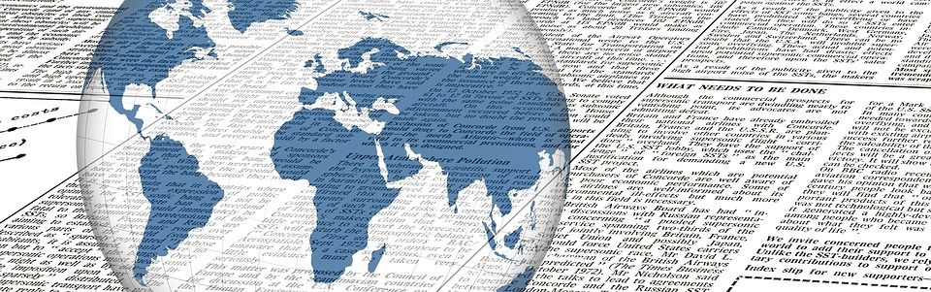
Media Modeling: journalism data collection and analysis
MD Shuey, 2020

Slide 2
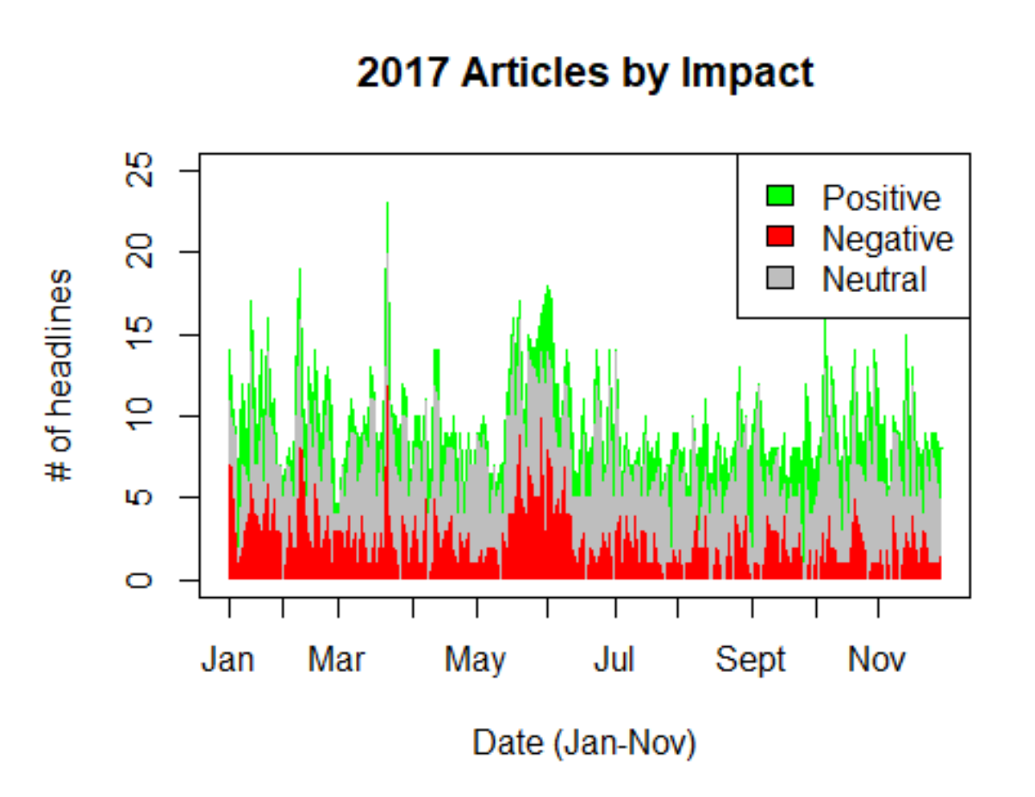
Project inception
Manual Collection
(daily)
Former internship project
E-mail newsletter summarizing relevant news across 7 major English-language sources
Originally a limited Excel analysis
Manual Classification
Few, Select Sources

Slide 3
How to recreate? How to expand?
Manual Collection
(daily)
Automatic API Collection
Automatic headline pulling
Manual classification
Sentiment analysis
Manual Classification
ML Classification text analysis
Few, Select Sources
Any/All Sources!

Slide 4
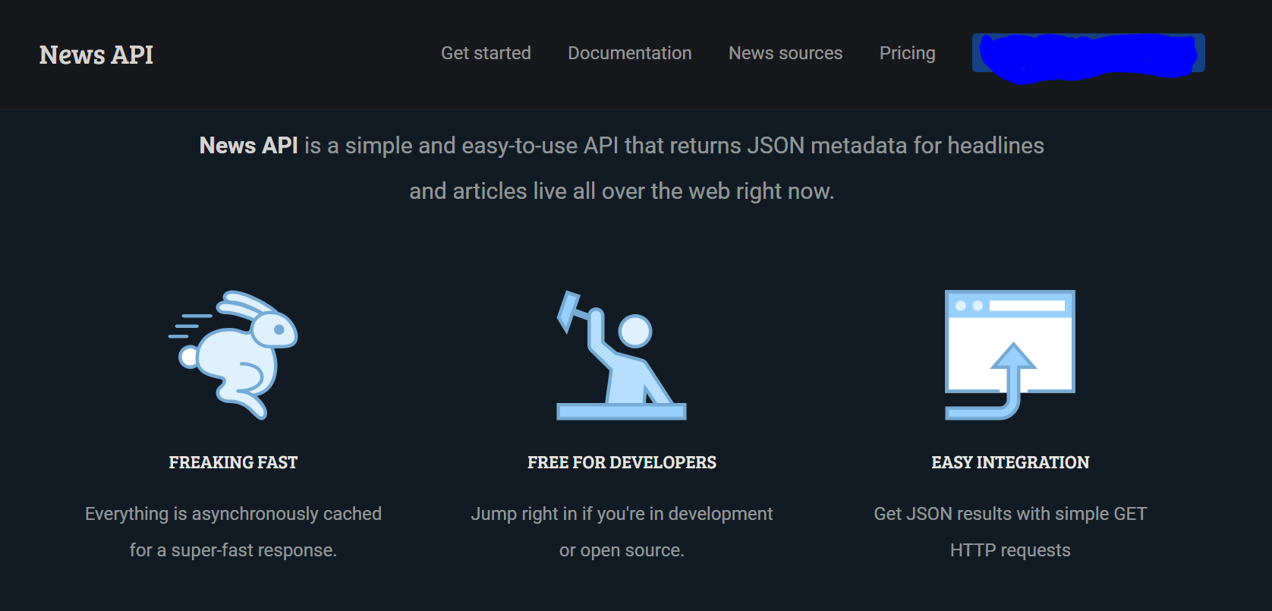
NEwsapi

Slide 5
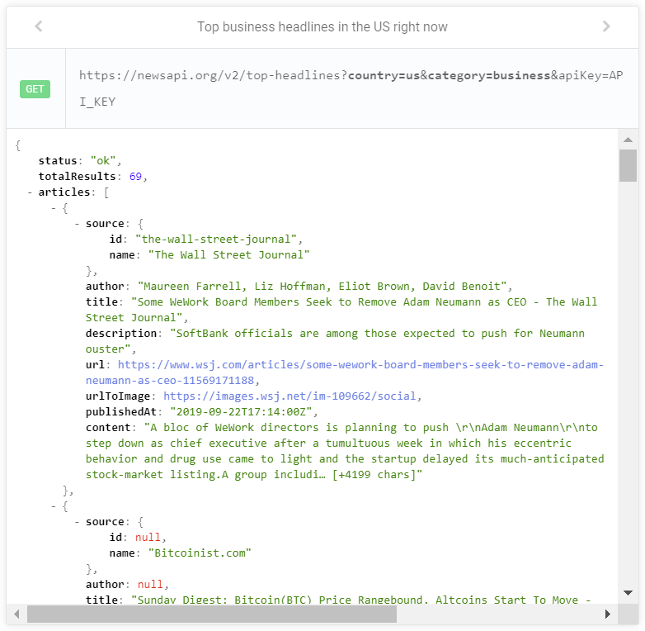

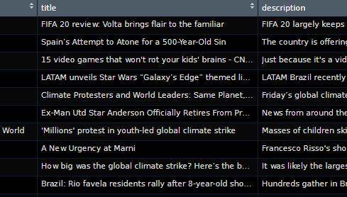
NEWSAPI R wrapper
Github.com/MDshuey/NewsAPI & /newsanchor (CorrelAid)
Credit to mkearney for 1.0
Possible future pull request for 2.0 updates
Using R parameters, creates the HTML API call, and converts from JSON to data frame format
daily_recaps function allows for more efficient pulling (from the last 30 days)
Variables:
Source, author, title, URL, image URL, time published, content (first sentences of article)

Slide 6
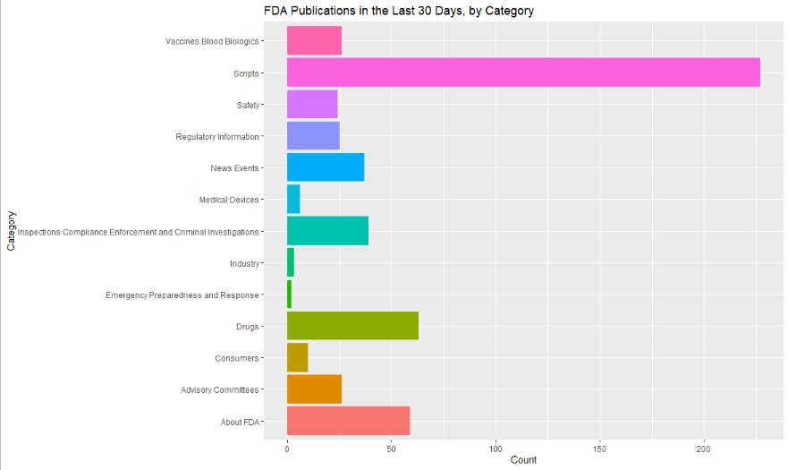
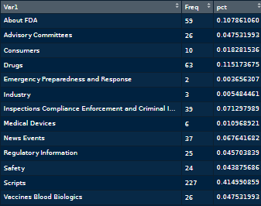
An analysis example
Research question: What has the FDA been publishing, both online and in the Federal Register?
Collection: Query API using sources = “FDA.gov”
Extract category from full HTML URL into new variable
Plot, calculate, and compare

Slide 7
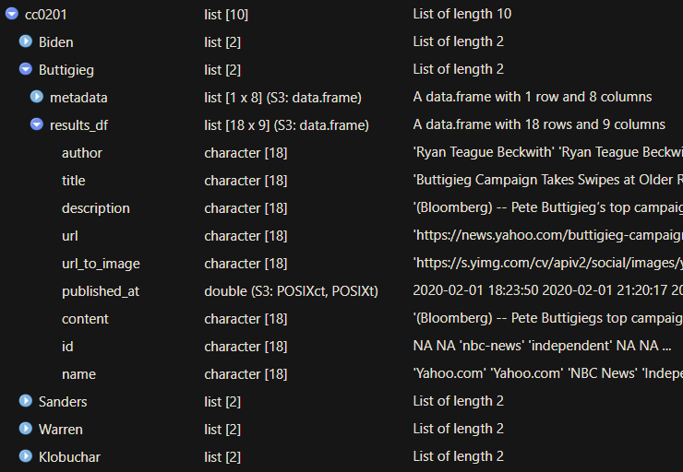
Lists in lists (having fun with s3)

Slide 8
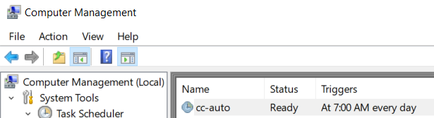
Constructing a data collection methodology
TaskScheduleR (or manually use taskschd.msc)
10 politicians
Last names only
Assumptions
Save previous days’ data in .Rdata format
Capped at 100 articles per pull, sorted via “popularity” of sources

Slide 9
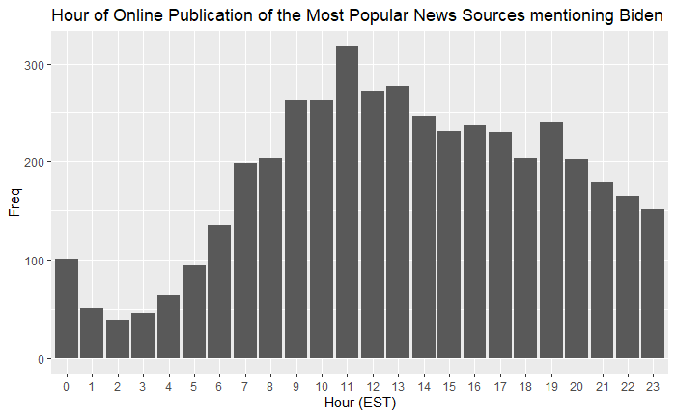
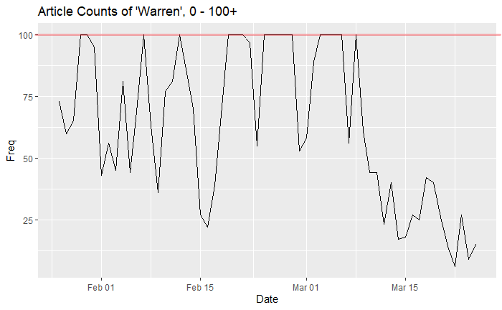
Use cases
Bag-of-words text analysis (trends/news cycle detection)
Aggregate sentiment scoring
International/multilingual
Comparison with external time series data (polls, stock market, etc) and event data (debates)

Slide 10
conclusion
GitHub.com/Mdshuey
LinkedIn: Mitchell D. Shuey
Twitter: @MitchellShuey

