Slide 1
How to incorporate (or replace)
your excel tasks with r
Mitchell D. Shuey

Slide 2

temponomics
Notes:
Temping for about half a year
I’ve finished assignments ahead of time because of my tasks
Ironically, making less money in theory
Code DOESN’T replace thoroughness
<number>

Slide 3
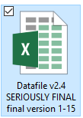
Why bother?
Less folders full of past versions, no reverting to old ones when you catch a mistake
Potential to reduce human error
A weekly task that can even be partially automated, that saves 30 minutes a week, can save over 24 hours of time a year
Ideas are connected! Use your newly tidied data for good

Slide 4
Some helpful things to already know:
Basic programming concepts, for troubleshooting, but most importantly:
  Where your excel sheet came from
  The audience your deliverable is going to
  How scalable (or reusable) your end product may be

Slide 5
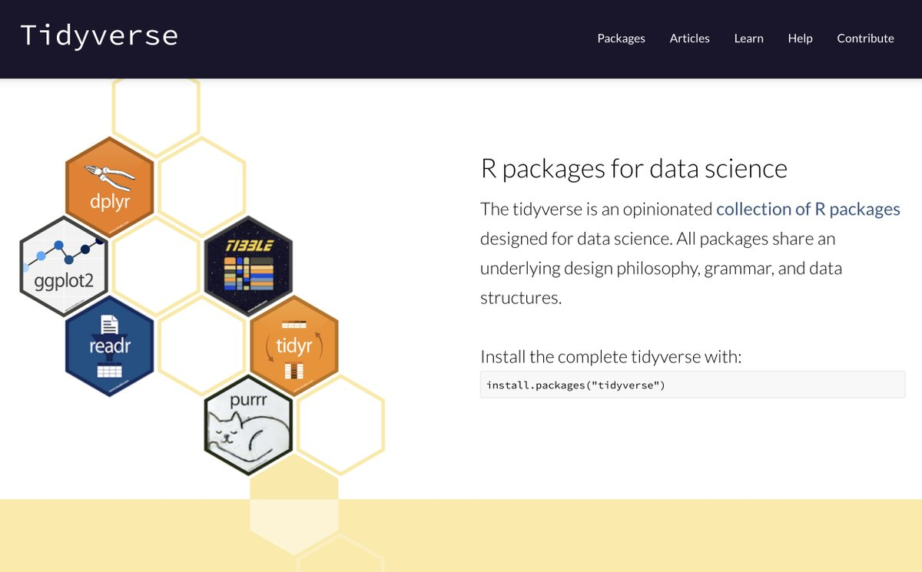

Slide 6
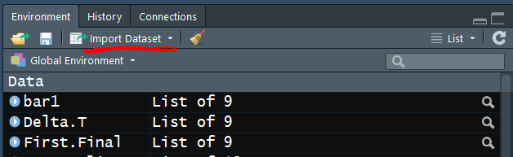
importing and saving
install.packages(readxl), or, via the GUI:
Don’t forget to copy/paste the code into your
R file!
To write a data table into .xlsx format:
install.packages(xlsx)
filepath= paste(getwd(), “file_name.xlsx”, sep=“”)
write_xlsx(dataname, filepath)
This takes a while for big datasets!

Slide 7
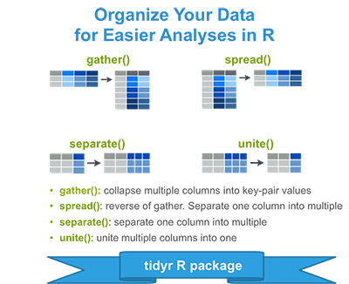
Pivot Tables
install_packages(tidyr)
gather(data, key, value, c(column indices to include/exclude)
spread(data, key, value)

Slide 8
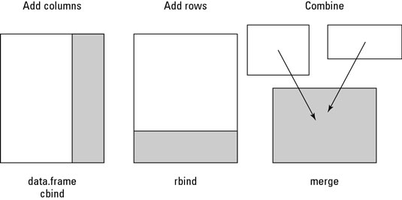
Quick intro to merging

Slide 9
Converting variable types
data$variable= as.factor(data$variable) for categories (State, Industry, etc.)
Other functions to convert:
  as.logical()
  as.data.frame() for your whole data table
Multiple options for converting dates
  as.Date(42705, origin = "1899-12-30") converts to “2016-12-01”
Stack Exchange has you covered!

Slide 10
Cross-checking between two sheets or datasets
install_packages(dplyr)
Left_join(data1, database2, by=“id”)
Inner, Outer, and Anti-joins
Advanced: Business names with slight variations on two different excel sheets?
  Try the package “fuzzymatching” to merge them together from the start and creating an ID# column, instead of creating more human labor in the future
Warning: Can create duplicates with identical “by” variables, so assumptions can be deadly!

Slide 11
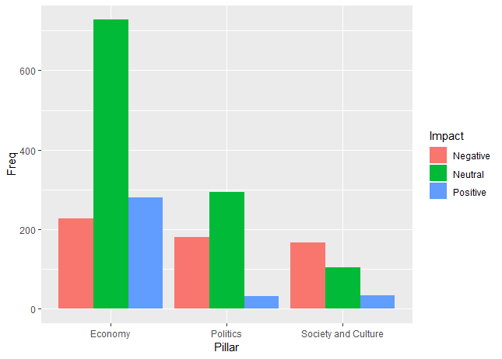
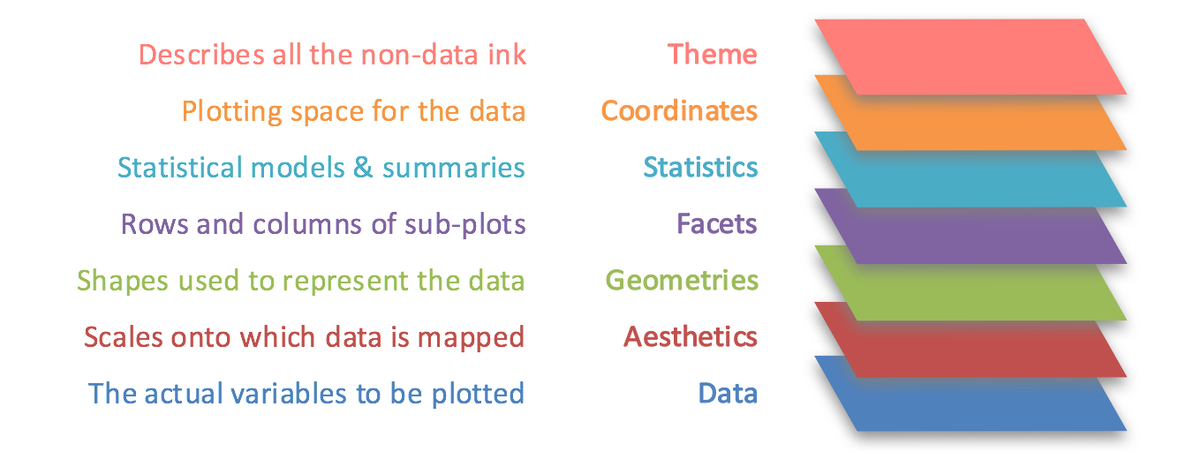
But my graphs!
ggplot(pill.imp, aes(Pillar, Freq, fill=Impact))+geom_bar(stat="identity", position = position_dodge())
From Toward Data Science

Slide 12
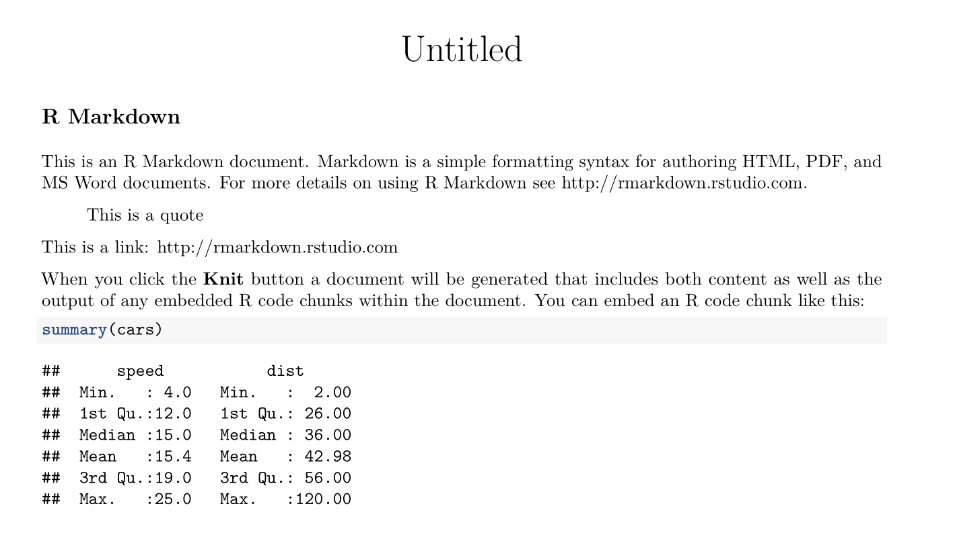
Advanced polish: knittr, markdown, and formatted reports

Slide 13

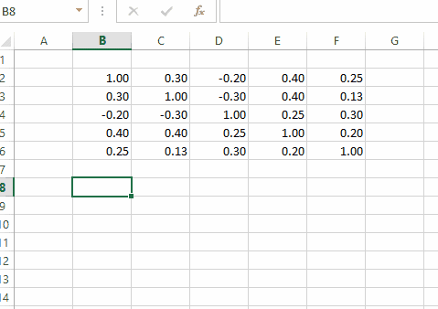
Advanced integration
VBA Integration: It exists!

Slide 14
Thank you

