Slide 1
AI-Powered Collections Strategy
Leveraging Agentic AI for Scalable, Fair, and Effective Debt Management at Geldium

Slide 2
How the System Works
Inputs: Customer Data collection
The system starts by gathering important data such as:
Repayment history
Credit score
Income details
Previous customer interactions
This input helps the system understand customer behavior and financial risk.
Decision Logic: AI risk prediction
1)The AI model analyzes the input data.
2)It predicts which customers are likely to miss payments.
3)Based on this risk, it suggests the best next steps (e.g., reminder or escalation).
Actions: The system sends personalized reminders or repayment plans based on customer risk level. Messages are delivered through SMS, email, or app notifications.
Learning: The system monitors customer responses and updates itself. This helps improve future decisions and makes the model smarter over time.
Notes:
Prompts to try:
Generate a simple outline for an AI collections system workflow, including inputs, decision logic, action triggers, and learning loop.
List 3–5 key customer attributes that would be most predictive for collections decision-making, and explain why each one matters.
Suggest examples of business rules and AI-driven actions the system could use at different risk levels (e.g., low, medium, high risk).
Create a rough sketch or step-by-step description of how customer data flows through the system from intake to action.

Slide 3
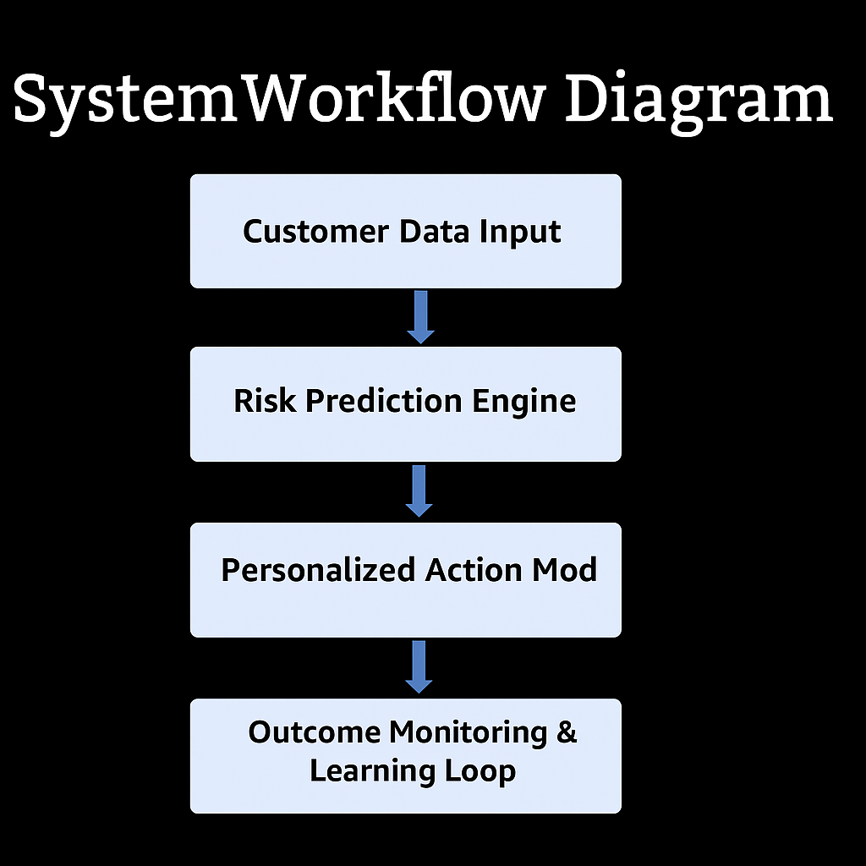
SYSTEM WORK-FLOW DIAGRAM

Slide 4
Role of Agentic AI
Fully Automated Decisions:
The system can automatically send reminder emails, SMS alerts, or payment nudges based on risk level.
Risk scoring and customer segmentation are handled by the AI without human input.
Human-Reviewed Actions:
For high-risk or sensitive customers, humans review the AI’s suggestions.
Personalized plans, escalations, or settlements are finalized with agent approval.
Notes:
Prompts to try:
Explain how agentic AI could automate financial collections while keeping humans in critical decision points.
List 3–5 examples of collection actions, and classify each as best suited for full automation or requiring human oversight, with a brief reason why.

Slide 5
Responsible AI Guardrails
Fairness Checks Ensure the system is free from bias and treats all customer groups equally.
Explainability Make AI decisions simple and easy for users to understand.
Compliance Follow important laws like GDPR and ECOA to protect data and rights.
Human-in-the-Loop Let humans handle sensitive or critical decisions where needed.
Notes:
Prompts to try:
List key fairness, transparency, and compliance practices to build into an AI-powered credit collections system.
Suggest specific ways to monitor and audit the system over time to ensure it stays fair, compliant, and effective.

Slide 6
Expected Business Impact
Business KPIs:
Reduce delinquency by 25% and cut down operational costs.
Improve recovery rates and make collection processes scalable.
Customer Outcomes:
Offer personalized repayment plans that match customer needs.
Build trust with fair, transparent, and stress-free experiences.
Notes:
Prompts to try:
Suggest KPIs for an AI-powered collections strategy that balances business outcomes with customer fairness.
Describe 2–3 ways an AI collections system could improve both operational efficiency and customer experience.

